Slide 1
Gathering the Harvest: Mobilizing Campus Resources to Serve Asian American
& Pacific Islander Students
APIASF Higher Education Summit
Washington, D.C. June 25,2013
Rowena Tomaneng and Aida Cuenza-Uvas

Slide 2
Agenda
Welcome and Introductions
Session Learning Outcomes
Mobilizing awareness and support for AAPI issues
Navigating campus politics
Developing campus and community partnerships
Leveraging other sources of funding beyond AANAPISI
Reflection and Discussion

Slide 3
Welcome and Introductions
Small group work (3-4 people)
Share your name and institution
What motivates/you to do this work—of supporting and advocating for AAPI students?

Slide 4
Session Learning Outcomes
Learn strategies for mobilizing awareness and support for AAPI issues
Develop an understanding of navigating campus politics
Develop an understanding of ways to develop campus and community partnerships
Learn how to leverage other sources of funding beyond AANAPISI federal funding

Slide 5
“Assumptions about AAPIs"?

Slide 6
Mobilizing Awareness and Support of AAPI Issues (Internal)
Conduct student focus groups
Student development workshops
Develop Reports/Data
Create AAPI issues speaker series
Discuss issues with key academic departments
Create Faculty & Staff development workshops
Hold an AAPI issues summit
Host Public forums
Promote inclusion of AAPI voices
Maintain marketing and outreach activities

Slide 7
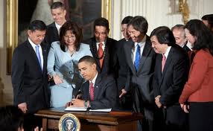
Mobilizing Awareness and Support of AAP Issues (External)
Promote discussions in organizations/conferences where AAPI student issues are a primary focus (e.g., Asian Pacific Americans in Higher Education-APAHE)
Maintain communication networks between AANAPISI grantee institutions (e.g., Western Regional AANAPISI meetings)
Consistently define our issues and needs to key local, regional, state, and federal decision-makers (e.g., WHIAPPI, APIACU, APIASF)

Slide 8
Navigating Campus Politics
How a new grant gets introduced to the campus community
Joint communication/news release
Individual meetings/department meetings
Support from the top (President)
Keeping campus stakeholders informed and involve
Newsletter
Updates/briefings at meeting
Invitation to special program events
Website
Involving key campus leaders in grant project initiatives
Operational Advisory Committee
Membership: key faculty, administrators, students, and community members

Slide 9
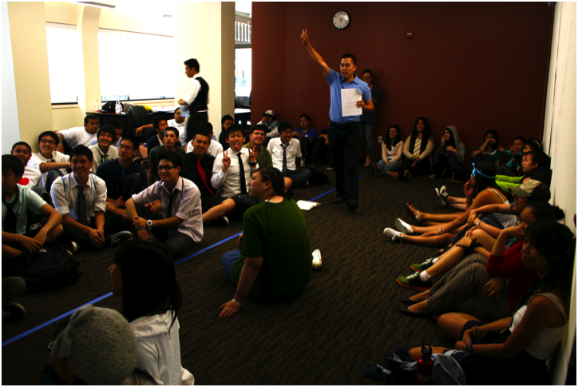
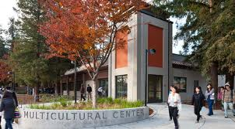
Serving AAPI Students at De Anza College
Founded in 1967 and part of the Foothill-De Anza Community College District
Occupies 112-site in the heart of Silicon Valley, CA
24,000 students with historically under-represented students as majority (AAPI students =42%)
College commitment to equity, social justice, multicultural education, and civic engagement
General education, vocational, and online courses supported by numerous instructional and services programs, including learning communities across the disciplines

Slide 10
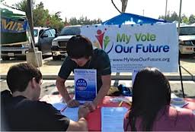
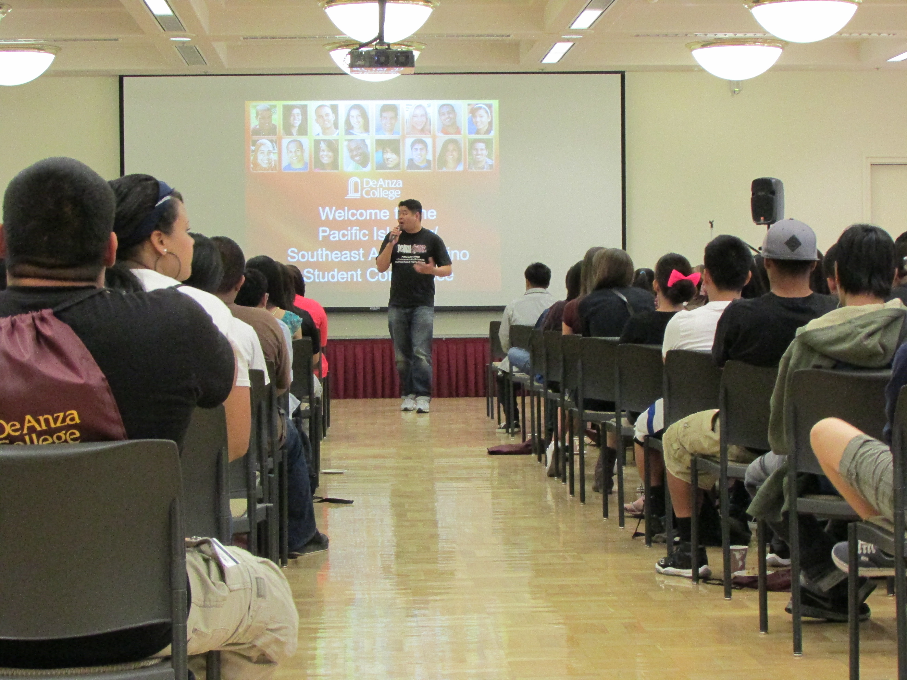
Mobilizing and Maximizing All Resources
Campus Partnerships
Instructional Programs
Student Services
AANAPISI, Title III, and Basic Skills grants
Student Clubs/Organizations
Staff Associations

Slide 11
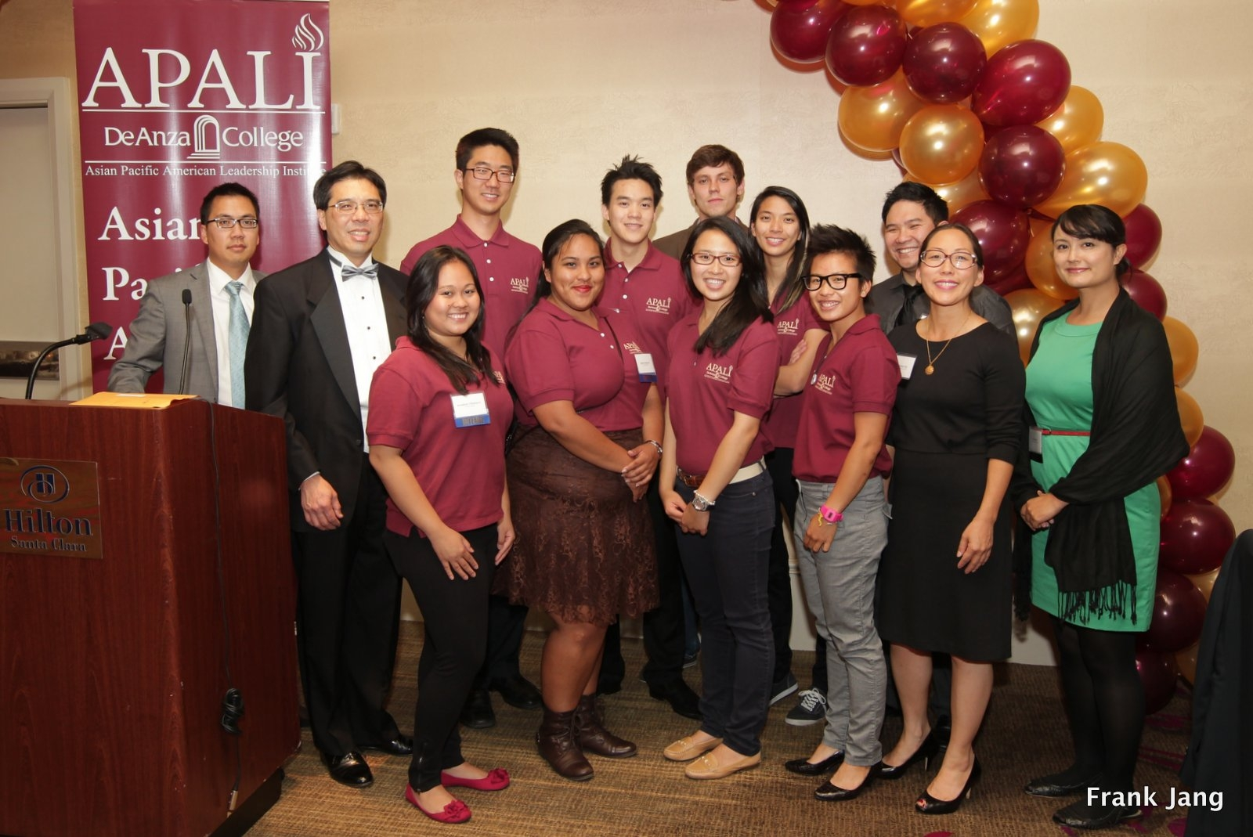
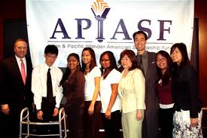
Mobilizing and Maximizing All Resources
Community Partnerships
Community-Based Organizations
Industry Partners
Establishing Advisory Board

Slide 12
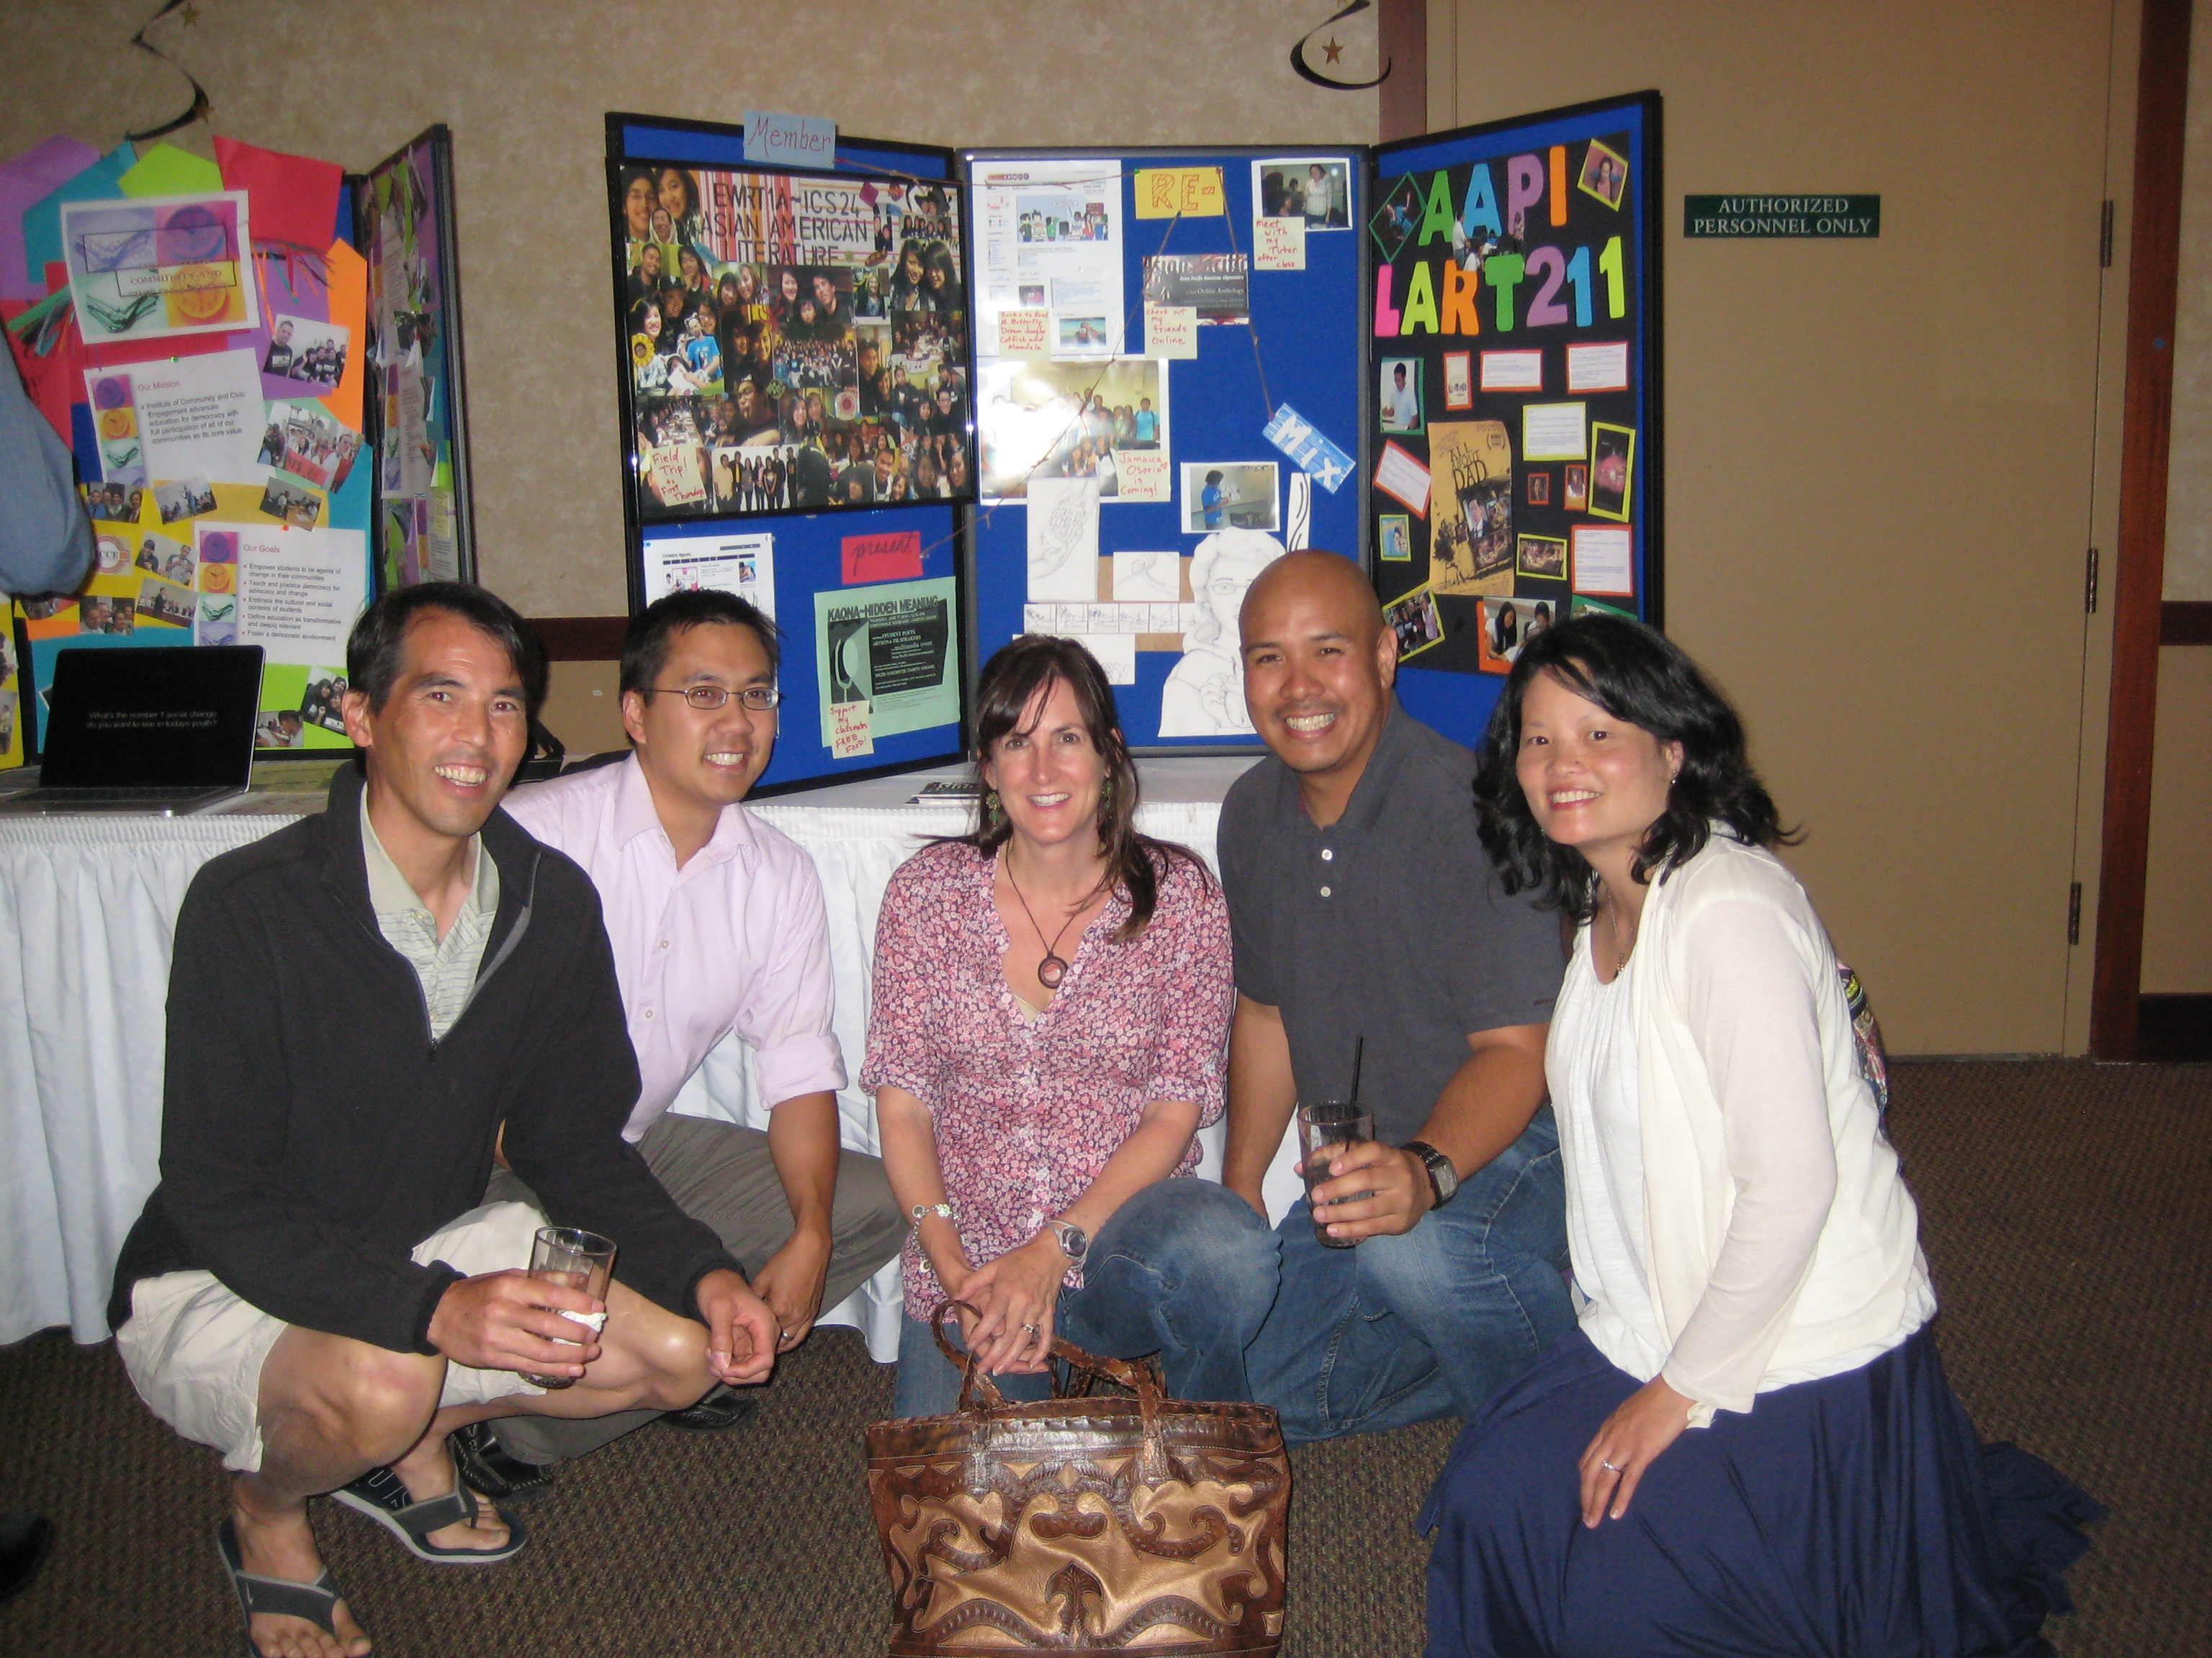
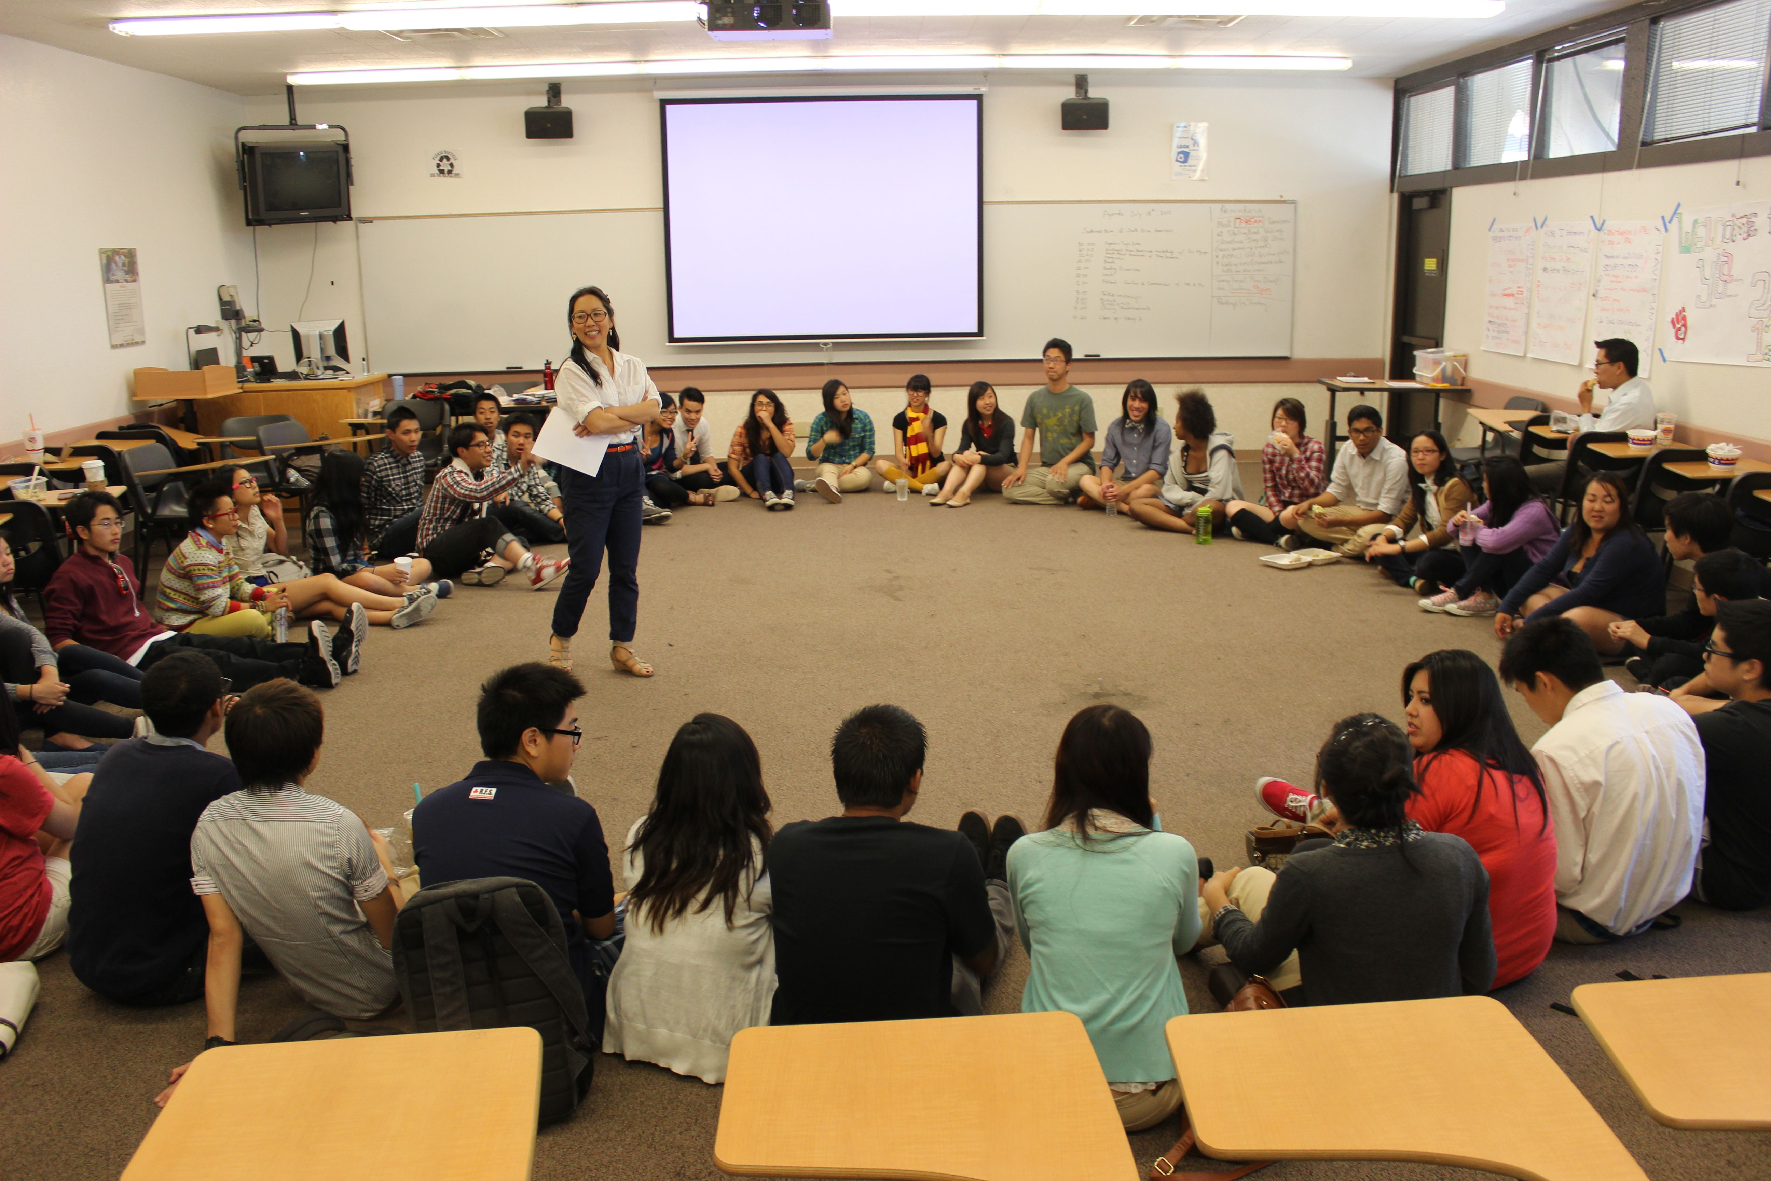
IMPACT AAPI Learning Community
2008 AANAPISI, Part A 1.2 million grant awarded by U.S. Department of Education to improve academic success of Filipinos, Pacific Islanders, and Southeast Asians
Increase student success and close the achievement gap between targeted groups and higher achieving AAPI groups
Curricular pathways that help students meet transfer requirements in English and Math, and generate interest in STEM fields
High impact practices include Learning in Communities team-taught courses, embedded counseling, peer mentoring and tutoring, and faculty development in culturally responsive pedagogy

Slide 13
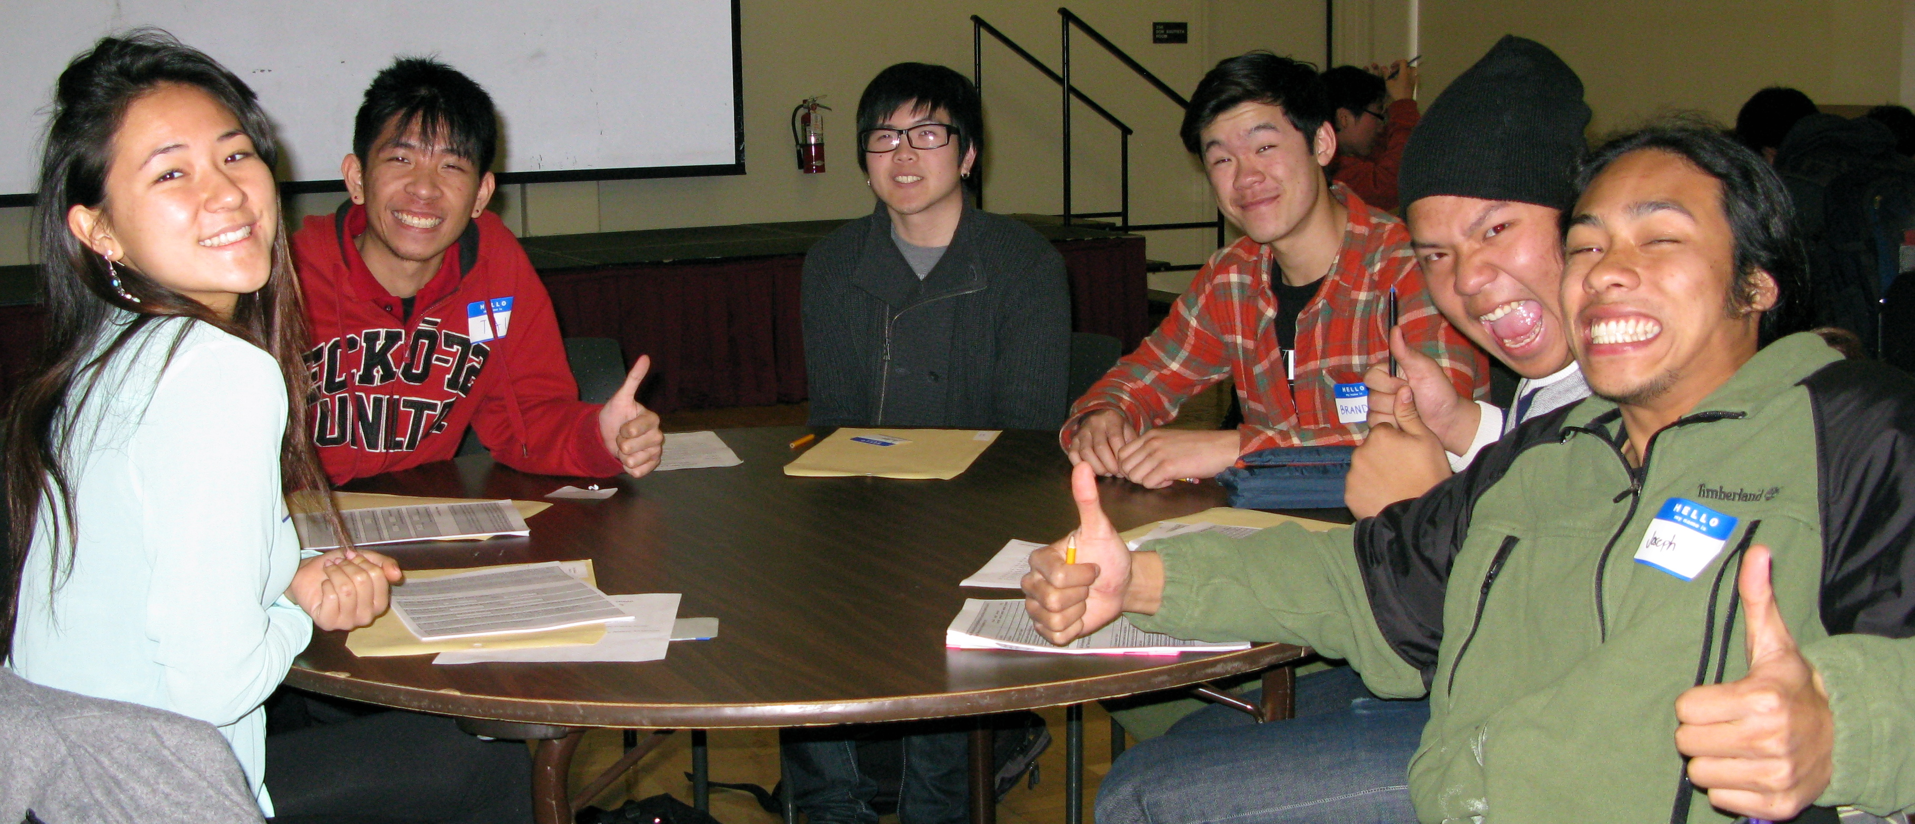
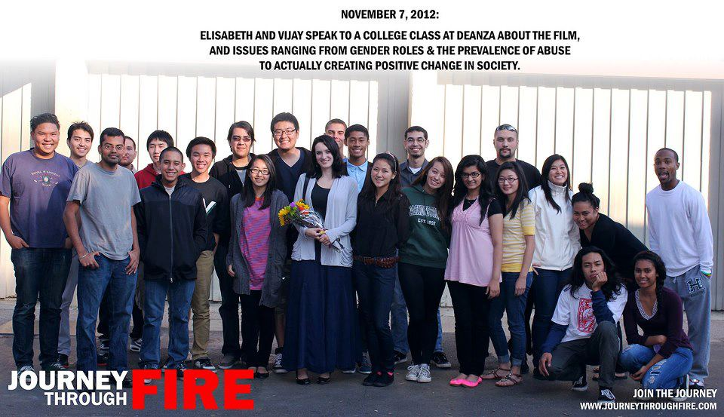
IMPACT AAPI Project Outcomes
Improved course success rates
Improved persistence
Improved college readiness
Successful completion results in 2nd AANAPISI, Part F grant award, 2 million for 5 years (2011-2016) , funding for Resource Development included

Slide 14
Leveraging other Funding Sources beyond AANAPISI

Slide 15
Mt. San Antonio College
AAPI Student Enrollment
2009: Asian Americans and Pacific Islander students comprise 24% of total students enrolled
32% of AAPI students are first-generation college (65% among Vietnamese students; 45.8% of Samoan students; 66.7% of multiple-race Pacific Islander
AAPI Student Issues
English Language Acquisition
Retention/Persistence
Career Counseling
Personal Support
Pacific Islander Student Issues
Cultural misunderstandings
(underrepresented Asian Americans and Pacific Islanders)

Slide 16
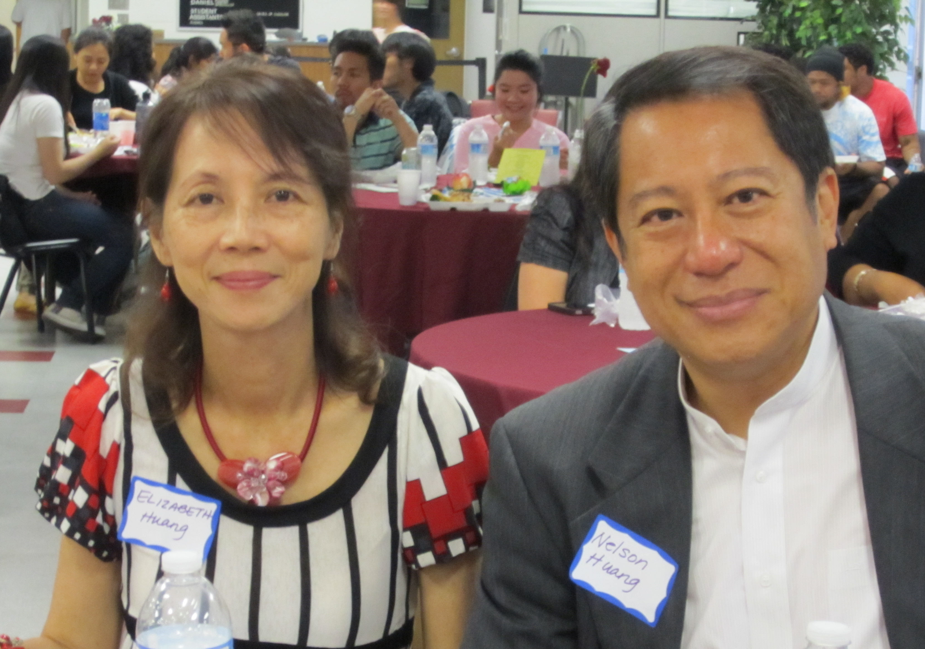
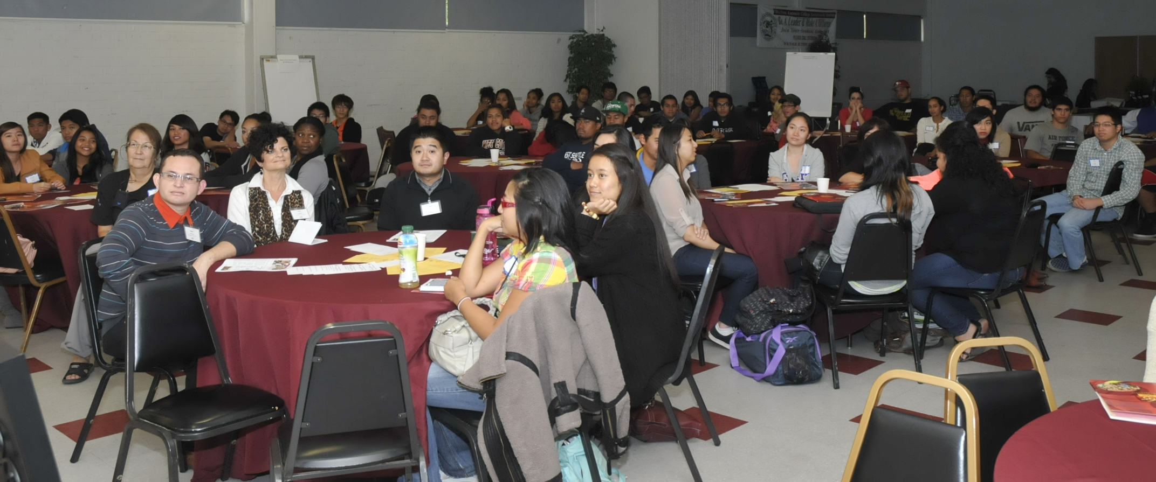
Partnerships
Campus
Collaboration with existing learning communities (Bridge)
Collaboration with like programs (TRIO SSS, Aspire—African Americans)
Collaboration with ESL and Writing Center
Assistance from Counseling, Financial Aid
Student Clubs/Organizations
Community
Community Advisory Committee
Outreach and Support from Asian American Elected Officials
Community Organizations (e.g., APAPA-Asian Pacific Americans in Public Affairs)

Slide 17
The Arise Program
Multiplicity of Student Needs | Program Response
English acquisition; accent reduction | Verbs boot camp; writing workshops designed for non-native English Speakers, faculty tutoring
Basic skills development in English and math; academic tutoring support | Learning Community courses; study hall for English, math
Counseling and Educational Advisement | Staff to provide support services that include development of educational plans, course advisement, consultation/resource referral
Cultural inclusion/recognition | AAPI Heritage Cultural Night Fale Fono (monthly meetings with Pacific Islander students) Cultural fieldtrips: Chinese American Museum, Pacific Islander Ethnic Art Museum, Museum of Tolerance AAPI Conferences
Recognition of Success | Milestones Recognition Ceremony (graduates/transfer students)
Study space and computing resources | In-house: community space for studying, breaks; laptop check-out, printing services
Student and Leadership Development | Leadership Retreat, Summer 2013

Slide 18
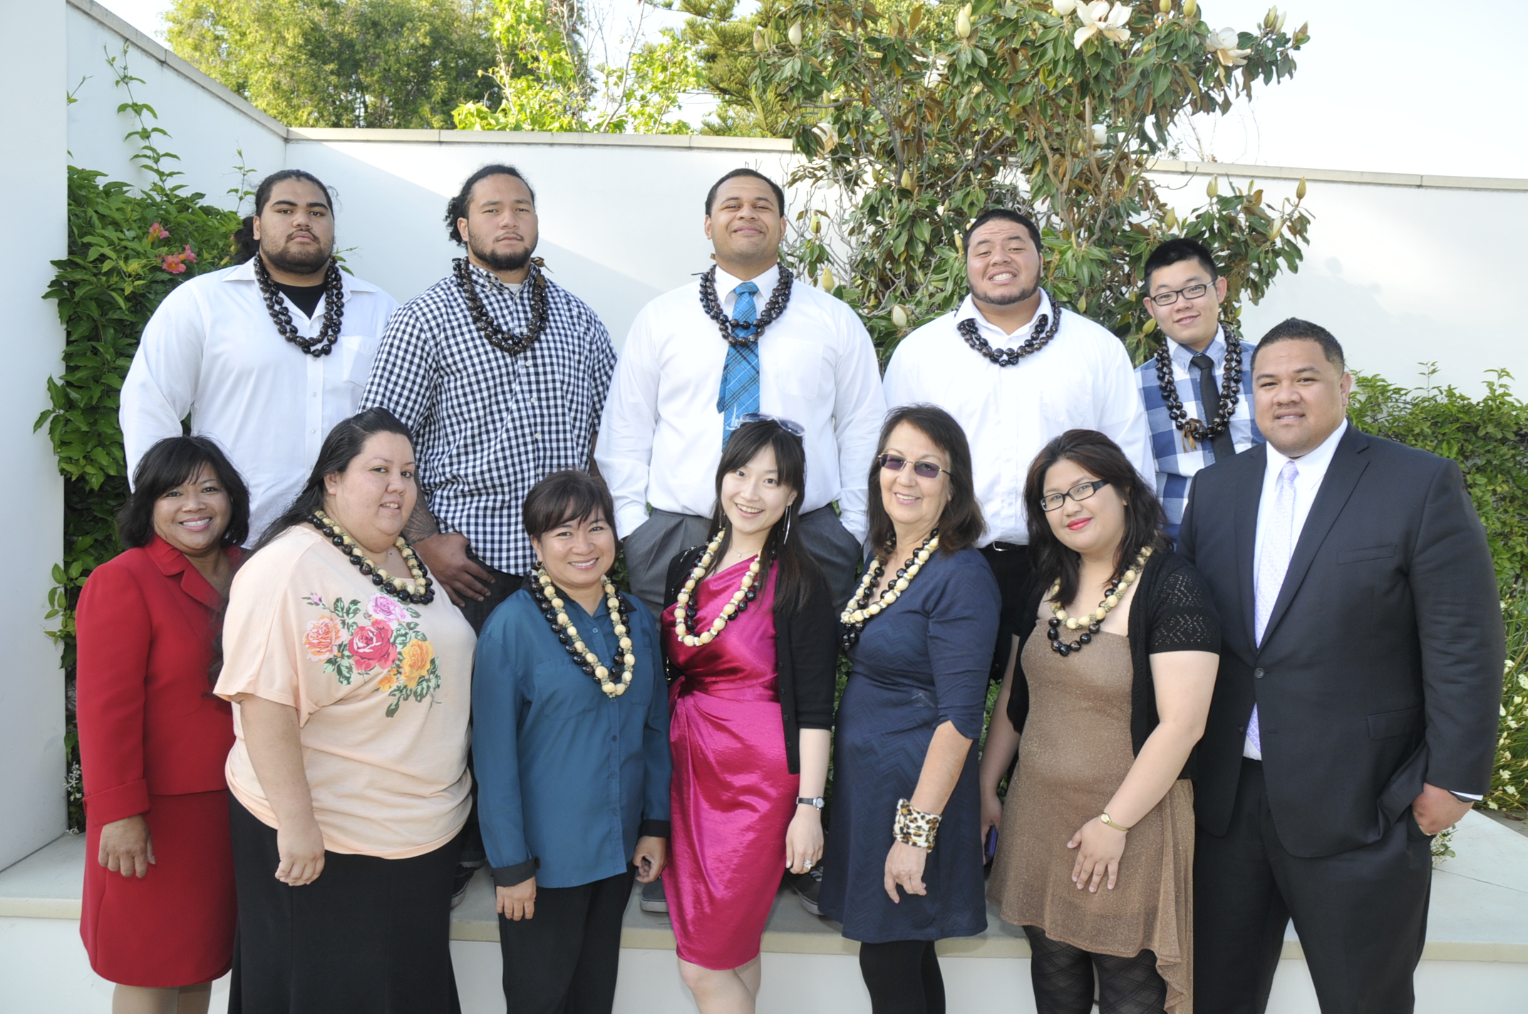
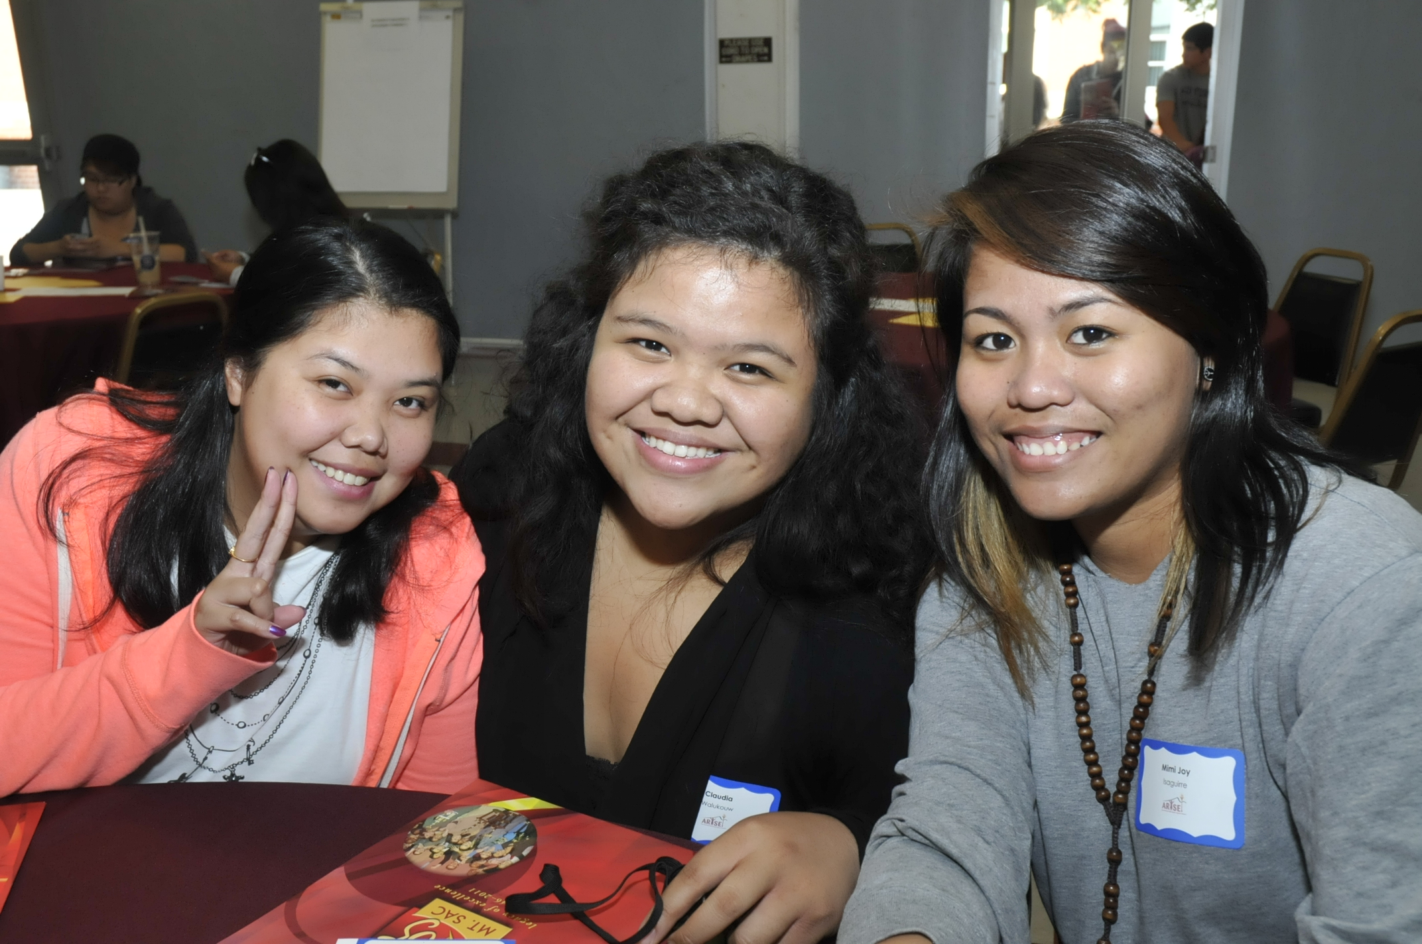
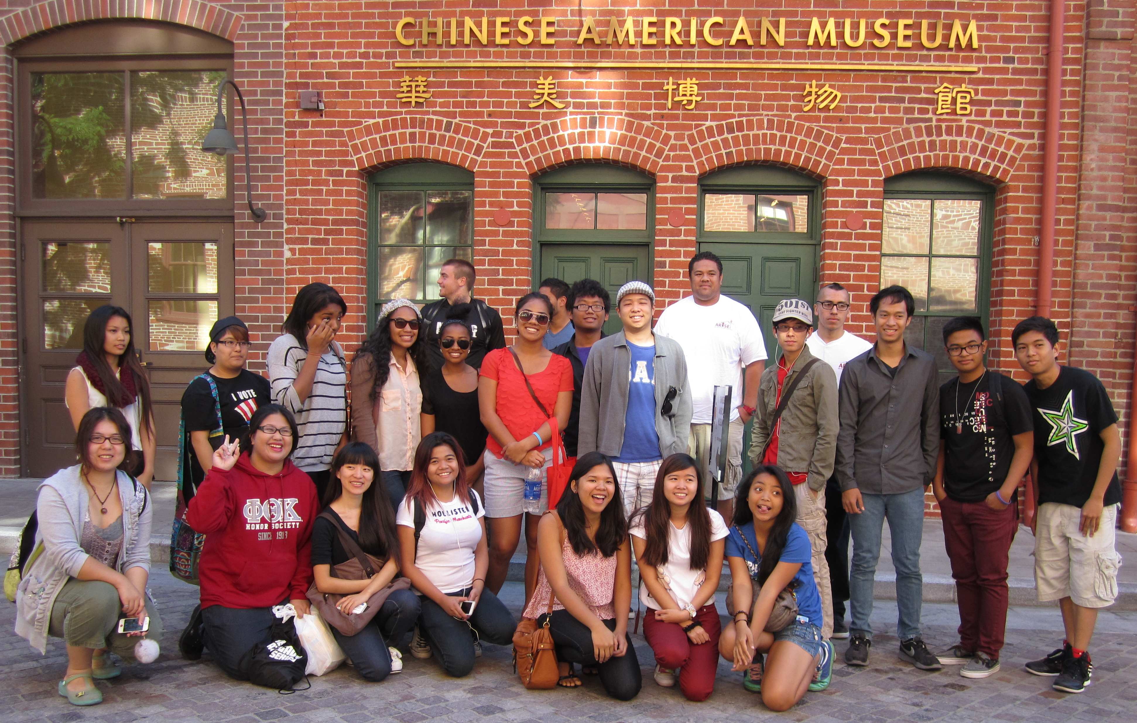
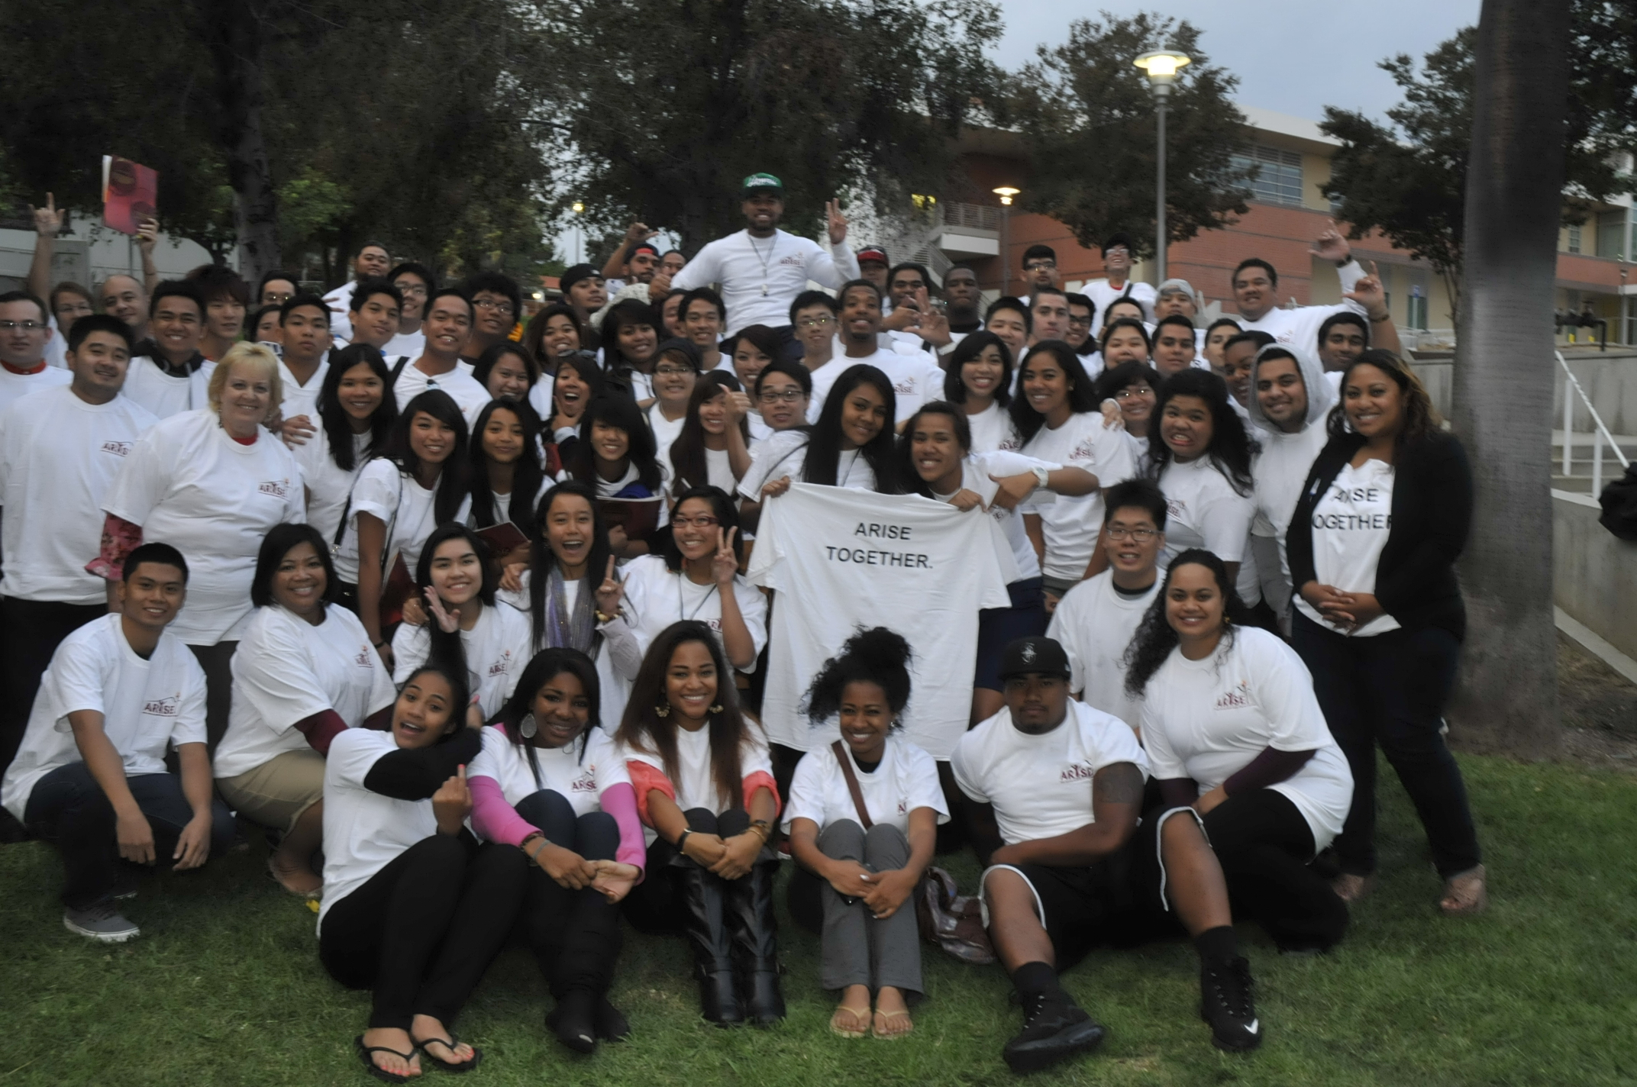
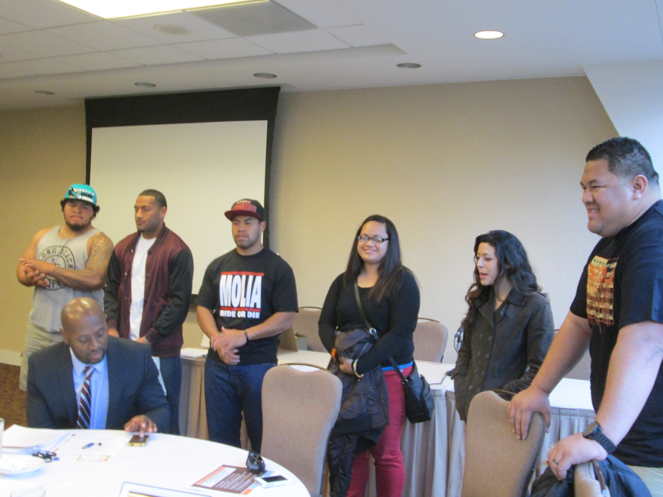
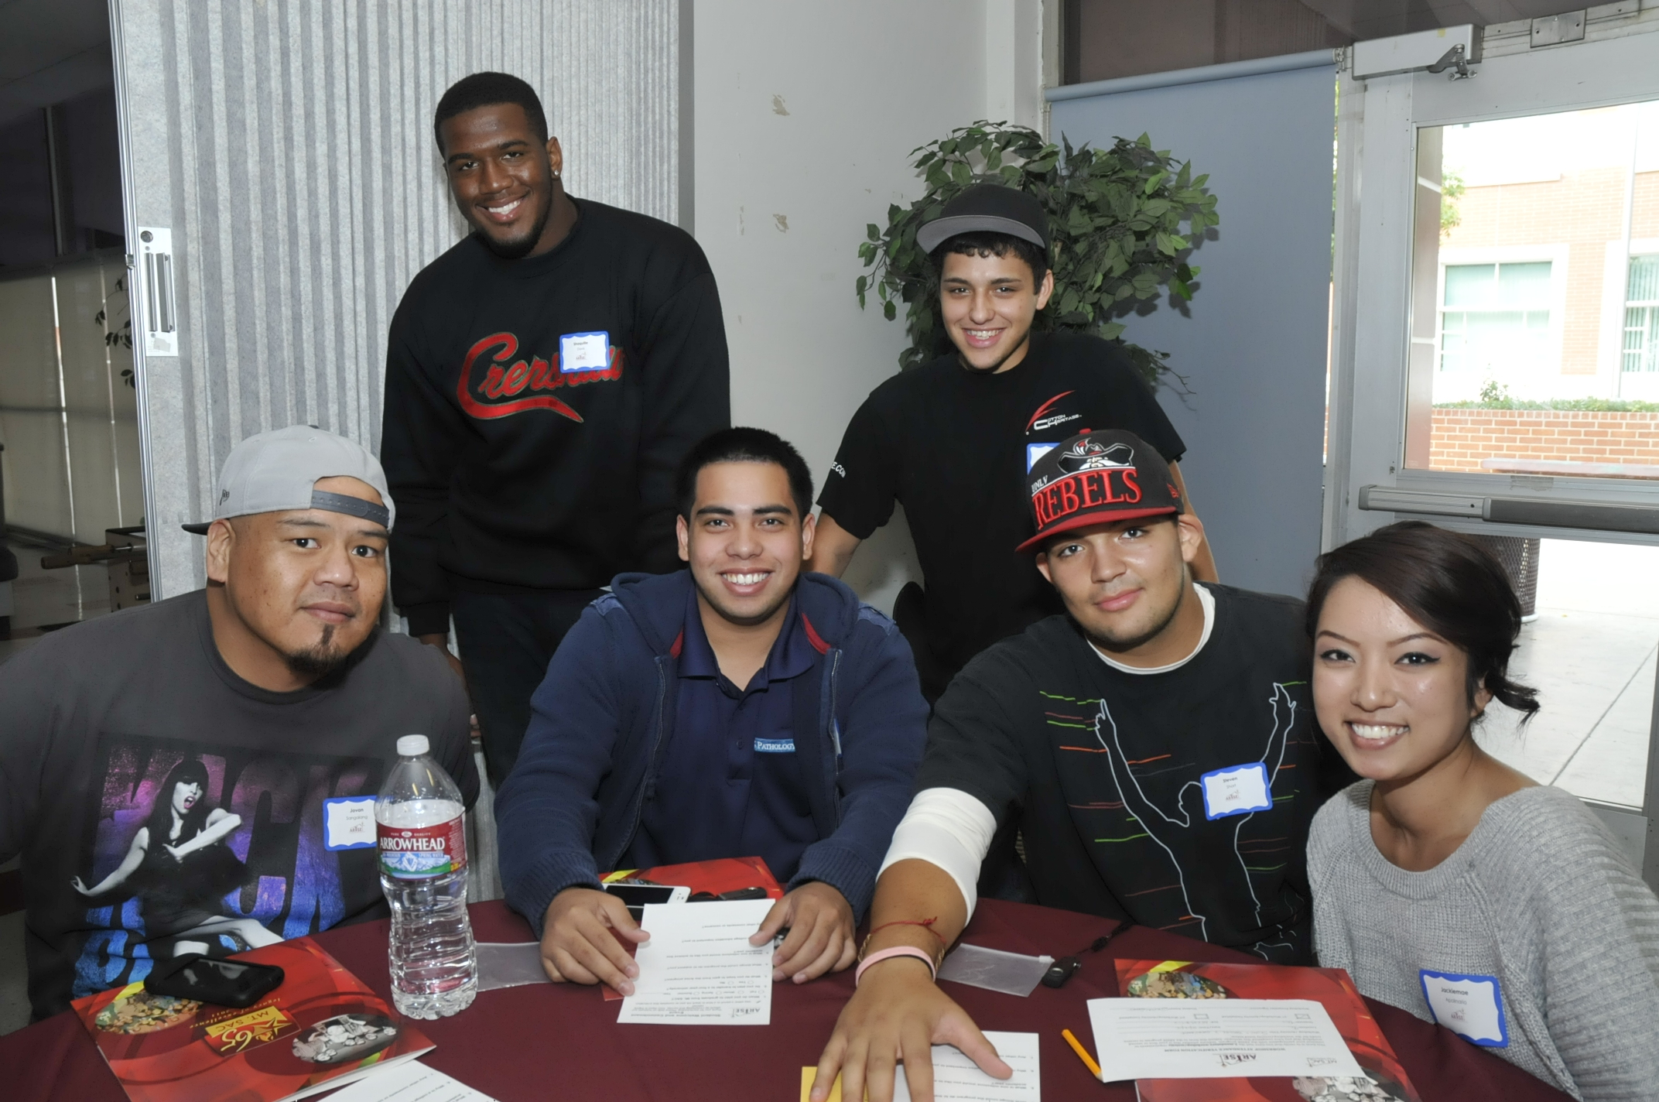
Students in the Arise Program . . .
Build a sense of community with each other
Accept recognition of milestone achievements
Participate in cultural awareness raising fieldtrips
Share their stories at API conferences (e.g., APAHE 2013)
Engage in learning communities

Slide 19
On Campus Support
Fiscal Resources
Facility modification – current and planned
Full incorporation into Student Services
Human Resources Support
Volunteers from other departments
Mentors
Other Forms of Institutional Support
Research
Public Information/Marketing

Slide 20
Reflection & Discussion
Q&A
Small Group Work (5 minutes)
“What are some take aways that you will apply at your institution?”

Slide 21
Contact Info
Rowena Tomaneng
tomanengrowena@deanza.edu
www.deanza.edu/impactaapi
Aida Cuenza-Uvas
acuenza@mtsac.edu
www.mtsac.edu/arise

