Slide 1

Trends in
Emerging Technologies
Sukhjit (Bob) Singh

Slide 2

Agenda
Introduction
Industry Traits
Job Traits
What can you do @ De Anza

Slide 3

Introduction
Technologies continue to evolve over time providing exponential growth in several areas.

Slide 4
Introduction
We experience slow economic growth every few years.

Slide 5
Introduction
This allows us to digest the rights and wrongs.

Slide 6
Introduction
These slow times provide time for thinking and re-tooling.

Slide 7
Industry Traits - Technology Stack - Past
We will look at the history of the elements that have built the infrastructures of our current technologies -
Comparing with Taco Bell Seven
Layer Burrito
Data Presentation –
Window/Browsers/Wireless Devices
Sour Cream (Infancy)
Application Engines –
Defining Business Processes
Cheese (Infancy)
Improved Application Connectivity
Guacamole (Infancy)
Databases – Data Banks
Tomatoes (Matured)
Storage Area Networks – Data Bank Managers
Lettuce (Infancy)
Computer Networks – Data Plumbing
Wired and Wireless
Seasoned Rice (Matured)
Operating Systems and improved Providing
horsepower for data processing.
Refried Beans (Matured)

Slide 8
Industry Trends – Current and Future
Social
Mobile
Modern Applications
Cloud
Big Data

Slide 9
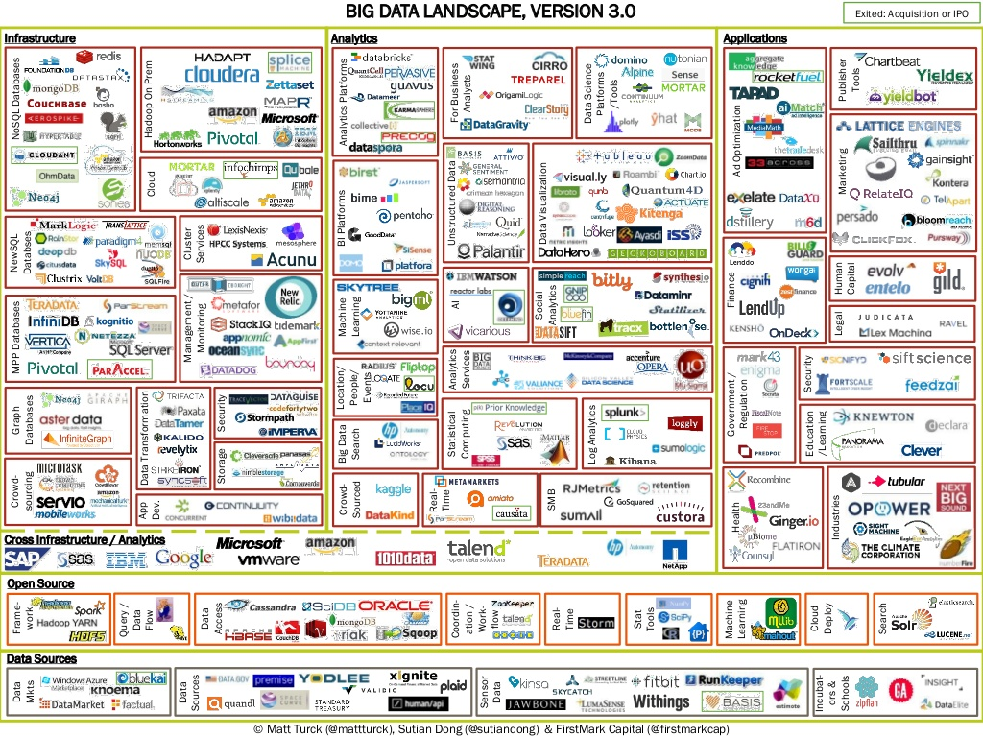
Industry Traits - Big Data

Slide 10
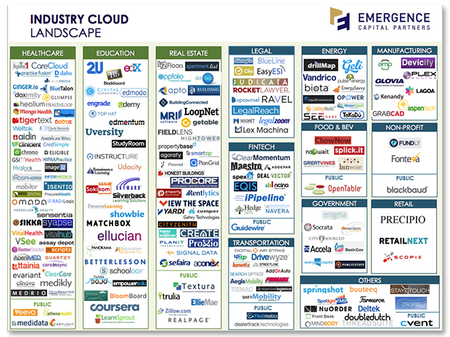
Industry Traits - Cloud

Slide 11
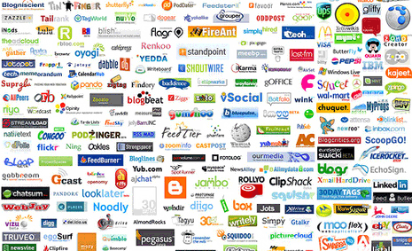
Industry Traits - Social

Slide 12

Industry Traits - Mobile

Slide 13
Industry Traits - Future Markets
Application Connectivity and Integration***
Wireless – (Application, Infrastructure and Deployment)
Emerging language platforms
Programs for small and embedded devices - Connected
Security – at all layers in TACO BELL Burrito
Big-Data
Social-Cloud-Data-Mobile (Convergence)***
Nanotech

Slide 14
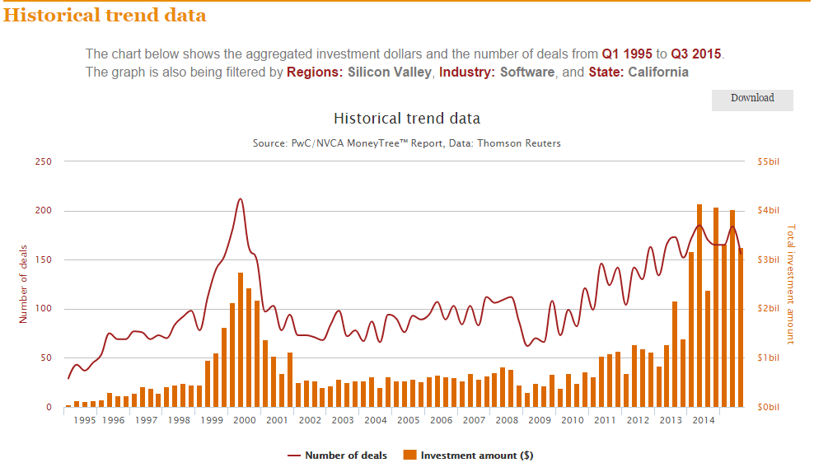
Industry Traits - Investment Trends - Software

Slide 15
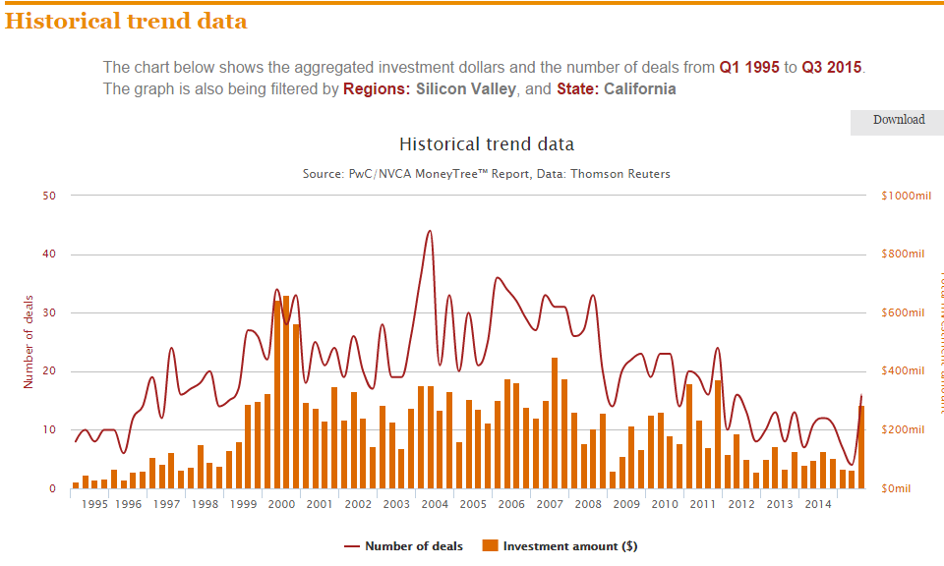
Industry Traits - Investment Trends - Semiconductors

Slide 16
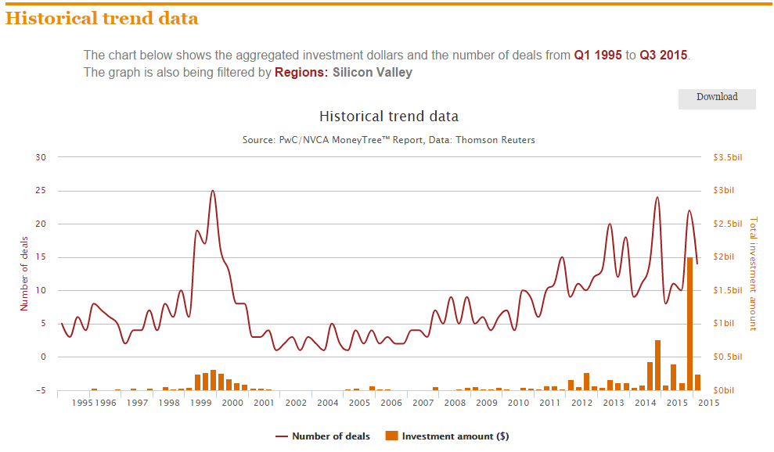
Industry Traits - Investment Trends – Consumer Product and Services

Slide 17
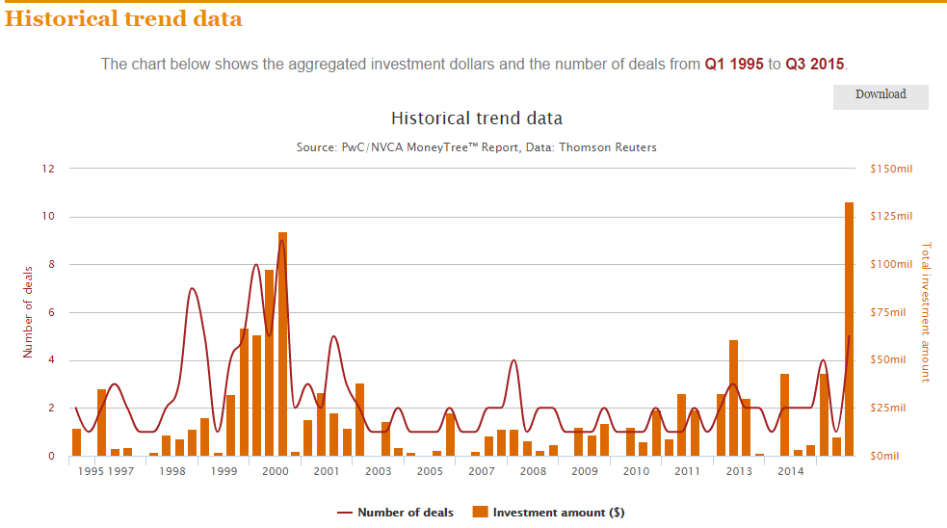
Industry Traits - Investment Trends – Health Care Services

Slide 18
Job Traits – Information Week
1 – Data Scientist
2 – Solutions Architect
3 – Mobile Developer
4 – Project Manager
5 – Software Engineer
6 – Analytics Manager
7 – Software Dev Manager
8 – QA Managers
9 – UX Designers
10 – Software Architects

Slide 19

Job Traits – Courses at De Anza providing some subject area training
1 – Data Scientist
2 – Solutions Architect
3 – Mobile Developer
4 – Project Manager
5 – Software Engineer
6 – Analytics Manager
7 – Software Dev Manager
8 – QA Managers
9 – UX Designers
10 – Software Architects
95F
95G
55
53
79
95A
95B
95C
95D
95E
95F
95G
C++
Python
Perl
Web
DB
Perl
Java
.Net
DB Certificate
95G
28
35B
22C
95G

Slide 20
The future of Software Engineering
Analytics convergence.
Will build tools to process data with easy to use interfaces that can deliver “smart to the point information”, anytime, anywhere.
We will end up developing applications that will provide automation in different spheres of our lives.

Slide 21
Your Questions

