Slide 1
Using XCode
© 2013 Surajit A Bose
De Anza College

Slide 2
What is XCode?
Apple’s free, full-featured IDE for Mac OS X
Supports development in many languages: C, C++, Objective C, Java, Python, Ruby ...
As with all IDEs, includes a text editor, a debugger, and a compiler

Slide 3
Why XCode? (1 / 2)
Extremely modern: current versions use the LLVM compiler with Clang, providing support for the C11 standard
Clean interface, very little overhead, launches and runs fast
Good for coding apps for the iPhone

Slide 4
Why XCode? (2 / 2)
Less buggy and more professional than CodeBlocks
Less bloated than Eclipse
... and, of course, if you have a Mac, you can’t use Microsoft Visual Studio

Slide 5
How to get XCode
Free with Mac OS X 10.7 Lion or above
Under the Apple menu, launch App Store
Then search for XCode and download it

Slide 7
How to get XCode
No Developer Connection account needed
was needed for earlier versions of the OS
Current version is 4.5.2 (as of Nov 2012)

Slide 8
Creating a Project
Launch XCode
Under File, choose New => Project
In the template window that opens, click Application under OS X in the left-hand bar

Slide 9
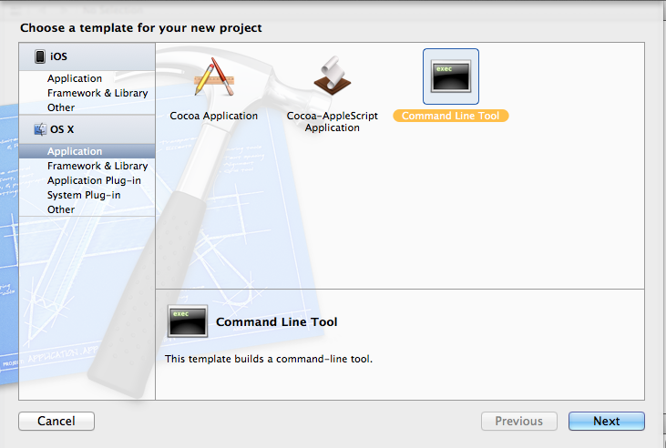
Creating a Project

Slide 10
Creating a Project
Then click Command Line Tool

Slide 11
Creating a Project

Slide 12
Creating a Project
The next window asks for the name and type
Give the project a name and make sure the correct type is selected (usually C or C++ for De Anza CIS classes)

Slide 13
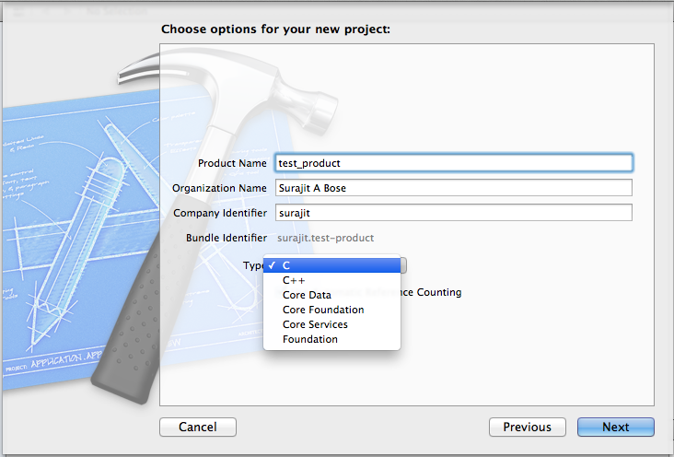
Creating a Project

Slide 14
Creating a Project
The next window asks you where you want the project to be saved
Navigate to the appropriate directory, create a folder if desired, and save the project
Voilà. A big, scary project window opens

Slide 15
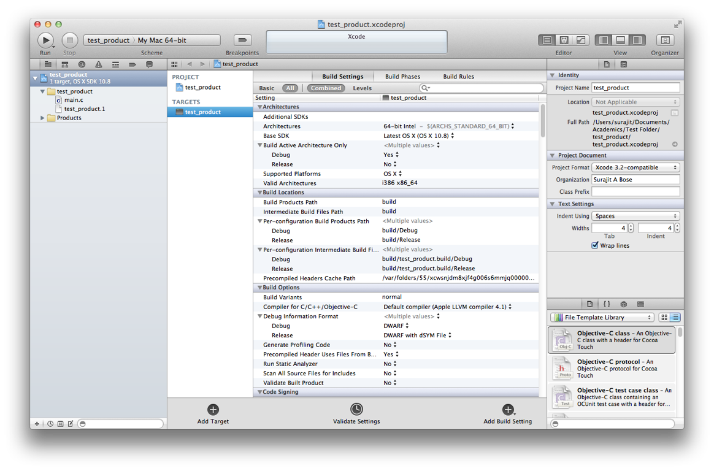
Creating a Project

Slide 16
Creating a Project
Don’t worry. Just click on main.c / main.cpp

Slide 17
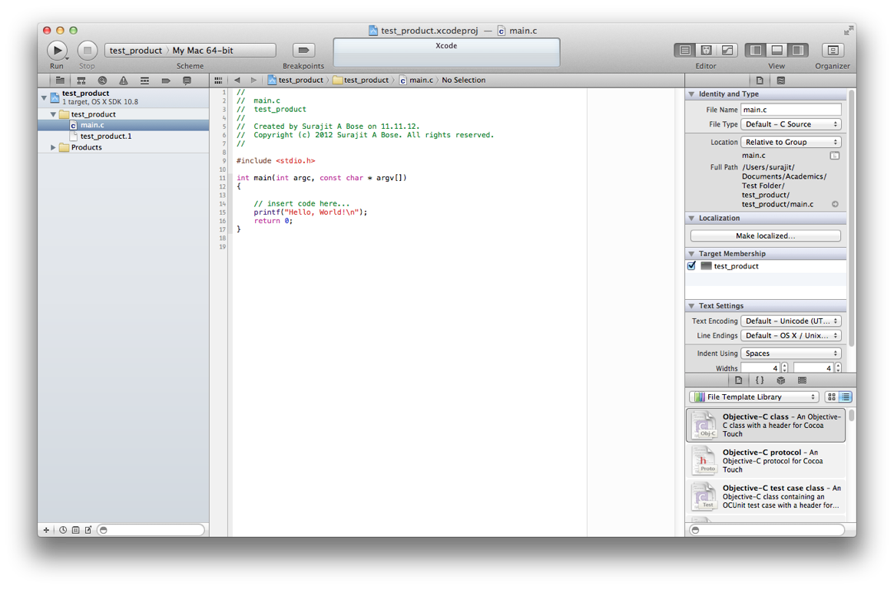
Creating a Project

Slide 18
Creating a Project
Neat. XCode gives you the entire hello world program with nice syntax highlighting
There is a guide to 81 characters so you can ensure that long lines of code wrap properly when you need to print

Slide 19
Creating a Project

Slide 20
Creating a Project
Change Line Endings for compatibility with Windows
Otherwise professors or teammates will complain that your code is all one long line

Slide 21
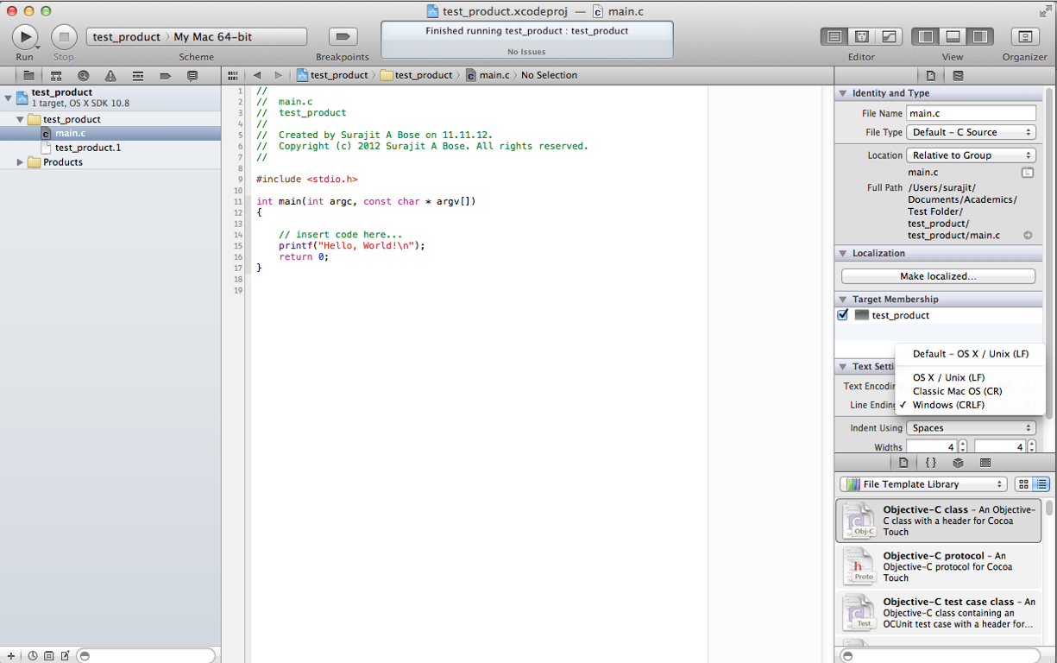
Creating a Project

Slide 22
Creating a Project
Then free up valuable real estate by closing the Utilities bar. To do this, click on the leftmost of the three View icons on the top right of the menu bar

Slide 23
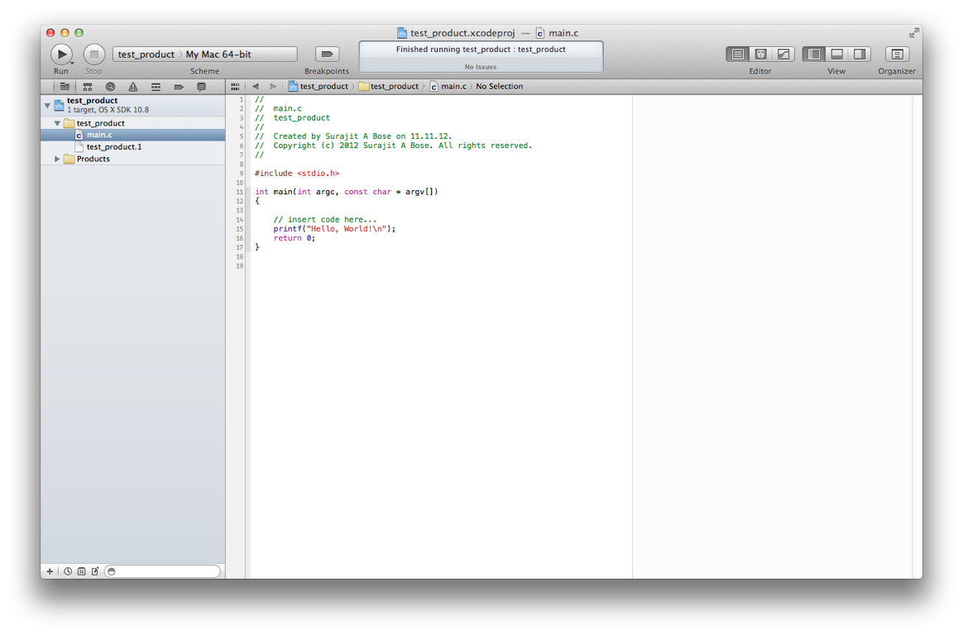
Creating a Project

Slide 24
Creating a Project
Run the program by clicking on the Run button in the top left of the menu bar
The output window opens up below the code editing area

Slide 25
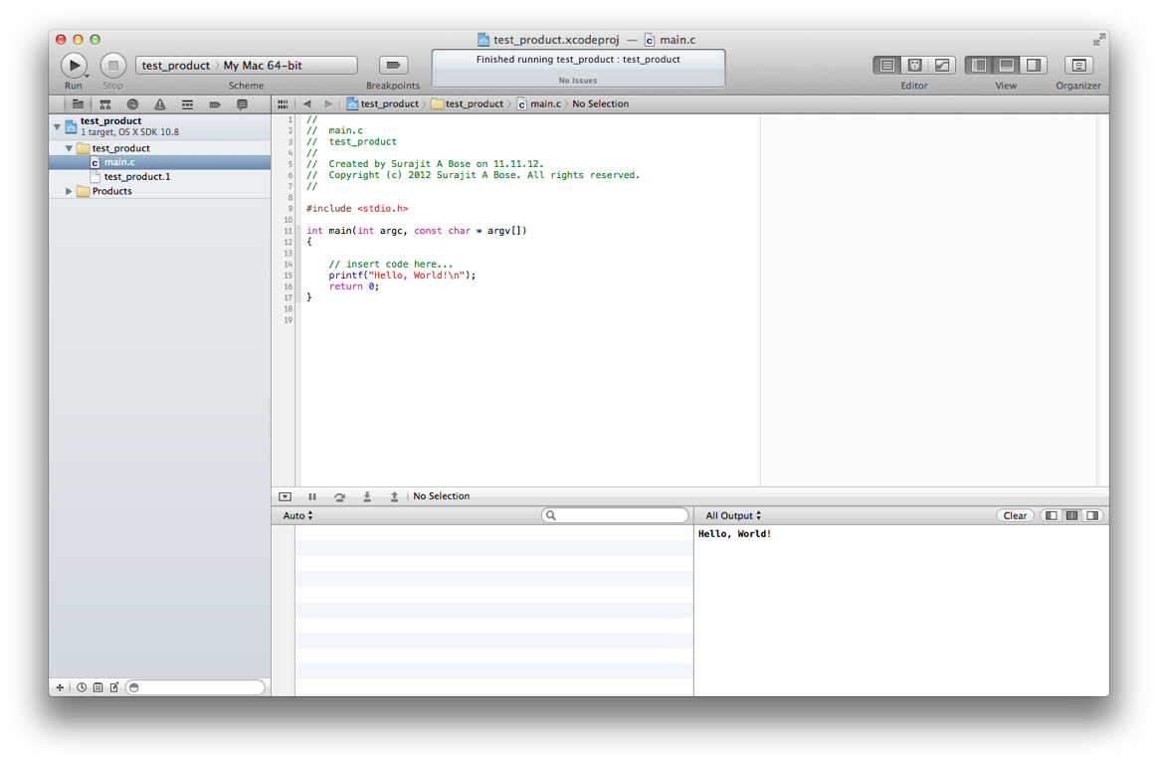
Creating a Project

Slide 26
Creating a Project
You can also see the last output by clicking on the middle of the three View icons on the top right of the menu bar

Slide 27
Creating a Project

Slide 28
Creating a Project
Replace the “hello world” program’s text in main with your own text to create your program (in case you were wondering)
That’s it! That’s how to create a new project in XCode
To continue work on an existing project, double-click its .xcodeproj file or choose File => Open or File => Open Recent

Slide 29
Compile Errors
XCode highlights compile errors with a red circle in the left margin of the code editing window
Here is what happens if I leave out a required semi-colon in the Hello World program

Slide 30
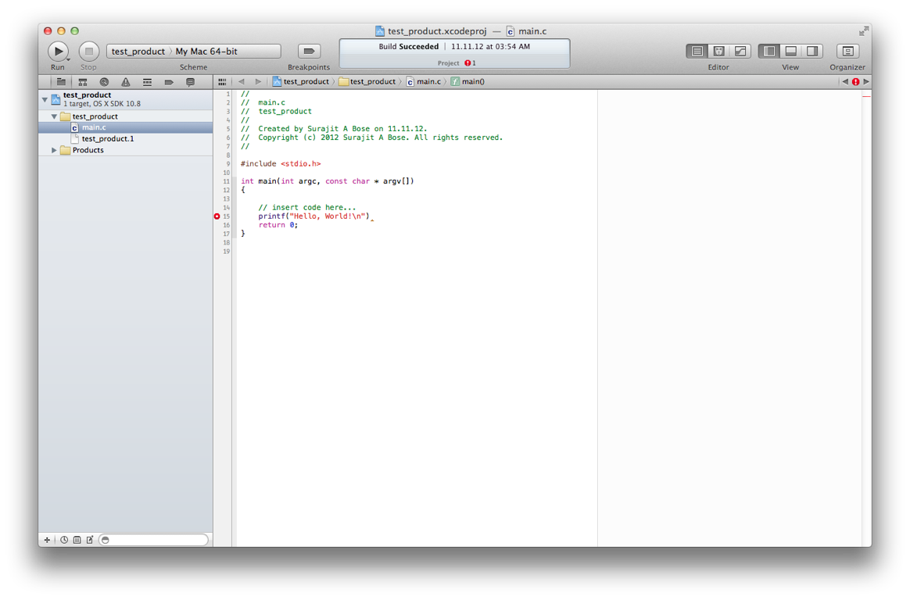
Compile Errors

Slide 31
Compile Errors
You can click on the red circle with the mouse pointer to see details

Slide 32
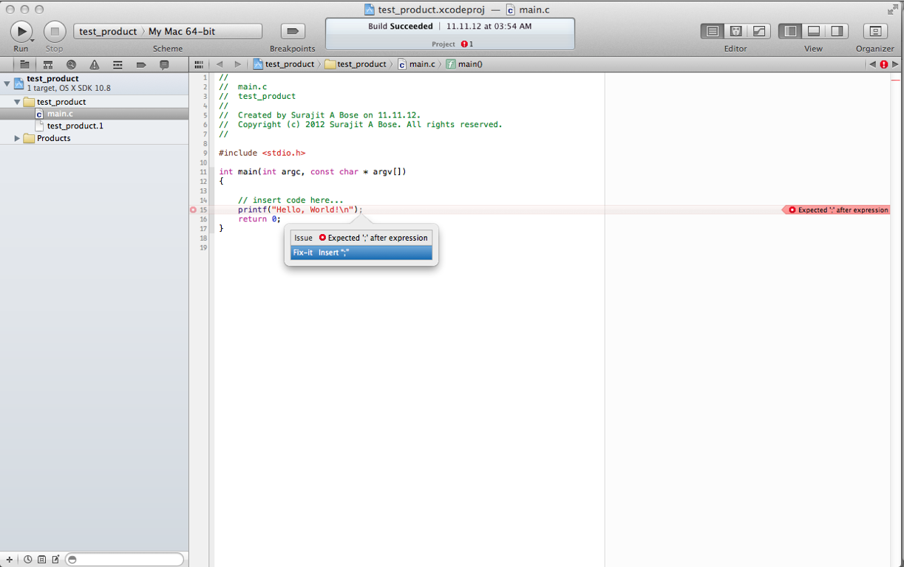
Compile Errors

Slide 33
Warnings
XCode indicates warnings with a yellow triangle in the left margin of the code
Again, you can click on the triangle for details
Here is what happens if I declare an unused variable

Slide 34
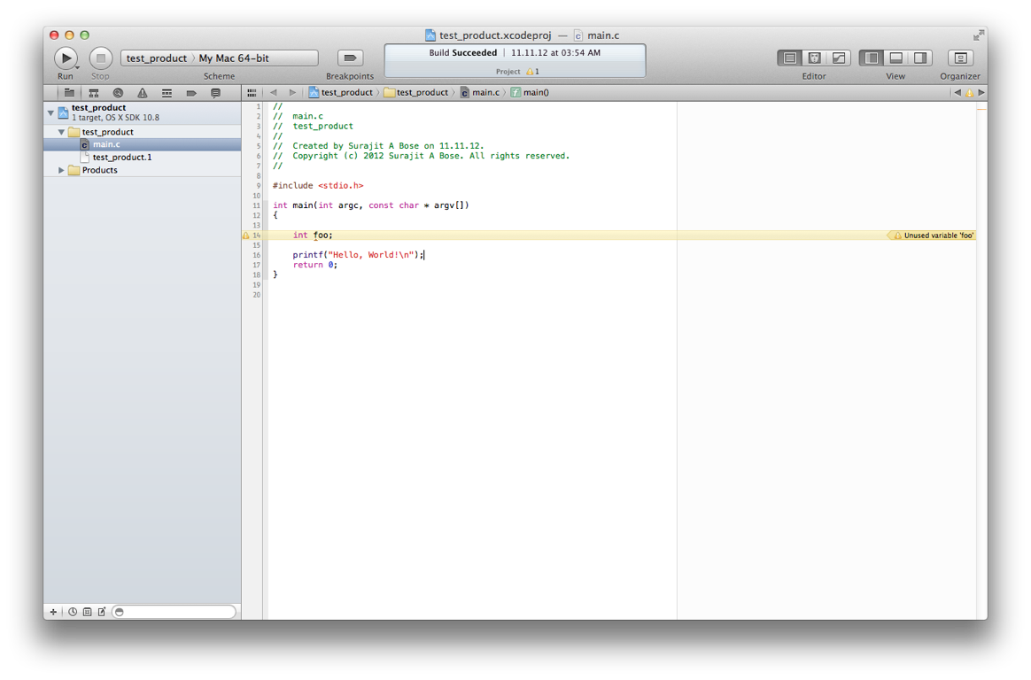
Warnings

Slide 35
Debugging
XCode offers all necessary debugging features
For the purposes of demonstration, let us look at a simple swap program
Note: The lack of comments is deplorable (and you will lose points for it), but I wanted the program to fit on one screen

Slide 36
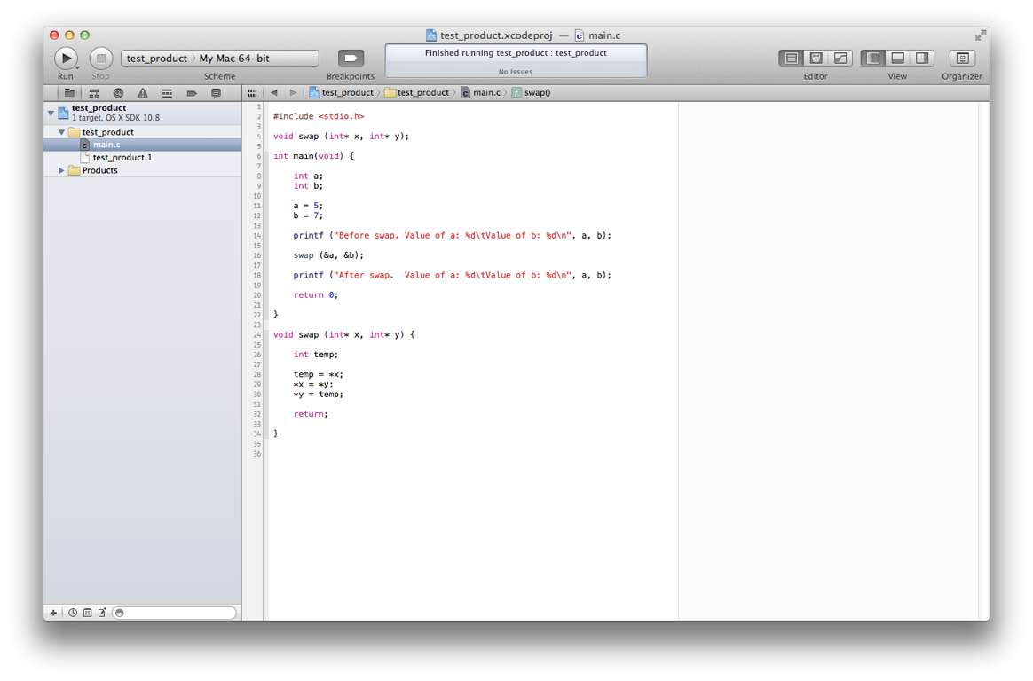
Debugging

Slide 37
Debugging
Set a breakpoint anywhere by clicking on a line number. Breakpoints are indicated by a blue symbol that appears on the line number
When the program runs and stops at the breakpoint, the current instruction (not yet executed) is highlighted in grey
You can see what the values of various variables are

Slide 38
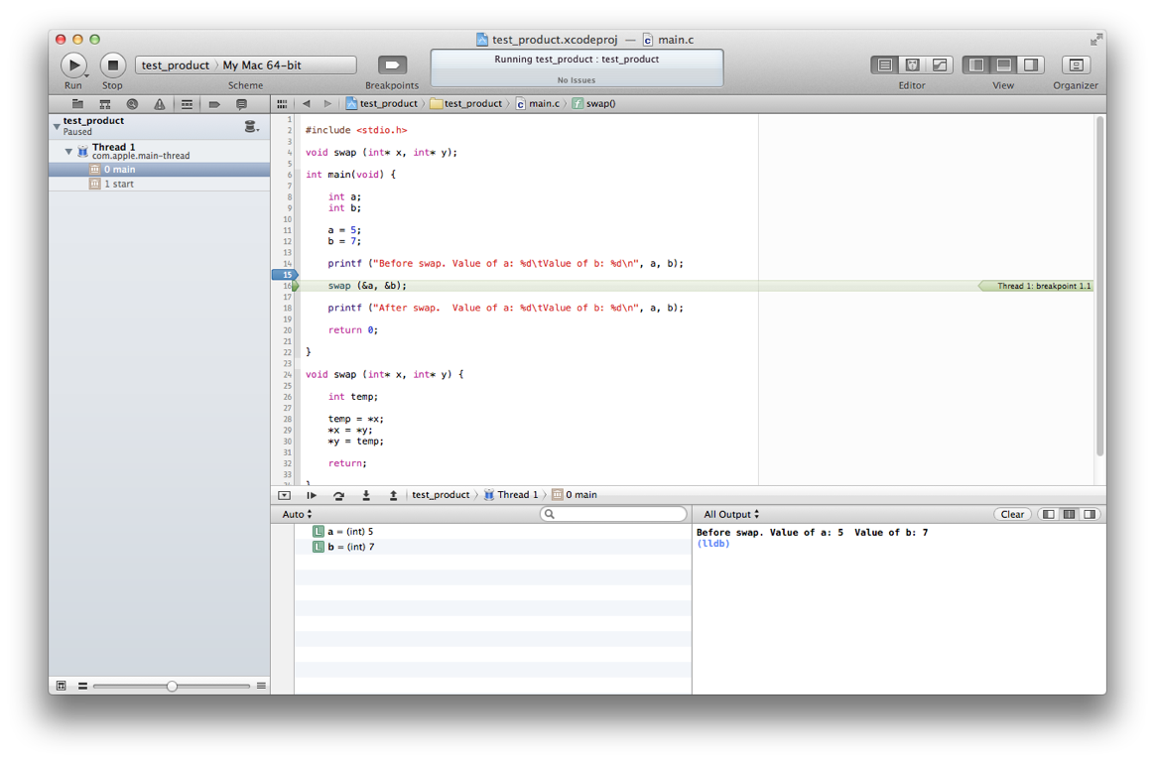
Debugging
breakpoint
variable values

Slide 39
Debugging
You can then continue (step into, step over, etc) by clicking on the symbols

Slide 40
Debugging
From left to right: Continue
Step over
Step into
Step out

Slide 41
Debugging
As you “step into” the next instruction, you can see the values of the variables update
Note that with pointers you can click on the triangle to see the dereferenced values

Slide 42
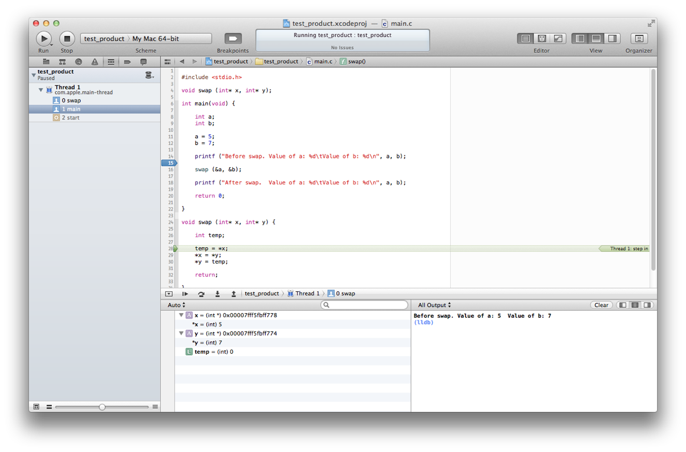
Debugging

Slide 43
Debugging
This is very useful to see what is going on with your code

Slide 44
File I/O
Apple’s philosophy is that the user doesn’t need to know where actual files are (cf. iTunes, iPhoto, iMovie, etc)
This is very irritating in XCode. I/O files need to be in the same directory as the executable, but where’s the @#$%^&! executable?
Here is how to find it

Slide 45
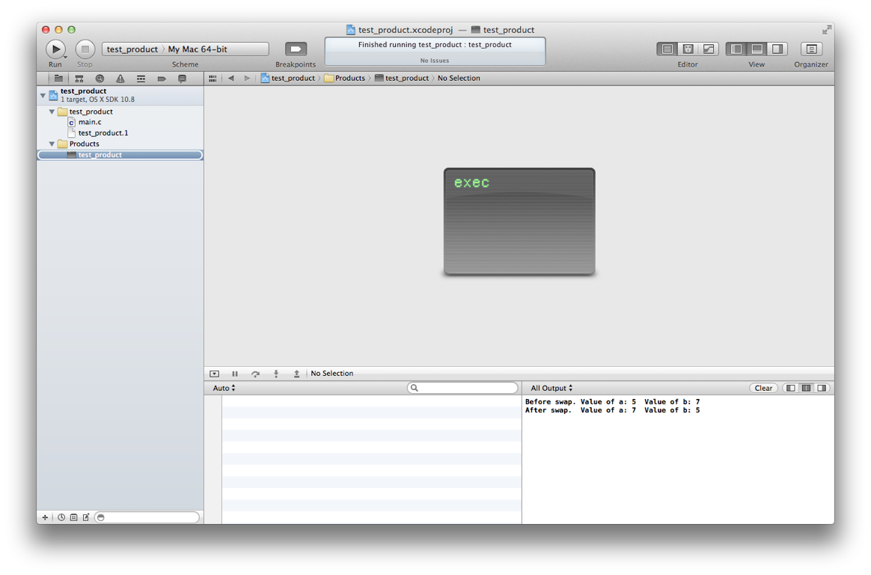
2. Click on the Folder icon
1. Make sure the Navigator is showing
3. Click on the Products folder to see the executable

Slide 46
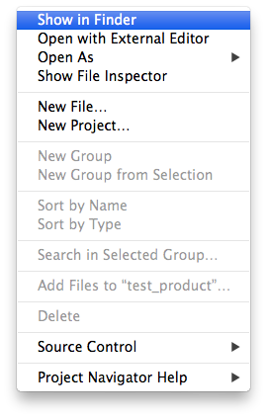
4. Control-Click on the executable and choose “Show in Finder”

Slide 47
File I/O
After all this rigmarole, the folder that has the executable will open in the Finder
This is where the swap program was on my computer: /Users/surajit/Library/Developer/Xcode/DerivedData/test_product-adzjubnqtxjalfcrtlxcqusmphix/Build/Products/Debug/test_product. Note that Library is an invisible folder
Way to go, Apple

Slide 48
File I/O
Anyway, after this Sherlock Holmes feat of detection, you can finally put the input files where they need to be for the program to access them
Output files are in this directory by default

Slide 49
Conclusion
Barring the really stupid, opaque handling of build and debug directories, XCode is an excellent IDE
It is far superior to Visual Studio in terms of compliance to standards (plus, it shows line numbers by default—imagine that)
Use it especially if you plan to develop apps for the iPhone

