Slide 1
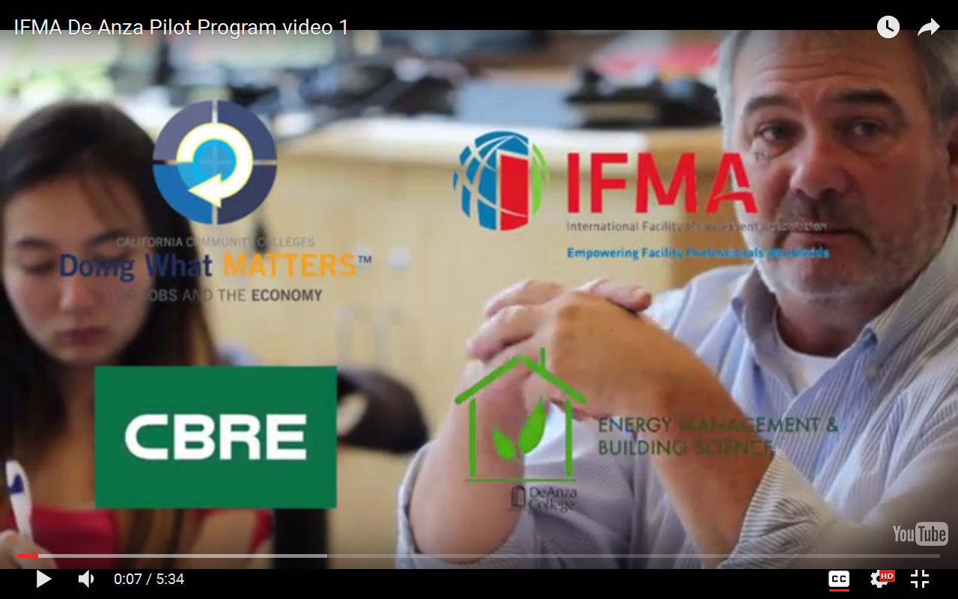
CLICK HERE TO SEE HOW AN EXCITING CAREER IN FACILITY MANAGEMENT MAY BE FOR YOU

