Slide 1
FLUID POWER

Slide 3
What is Atmospheric Pressure?
=14.7 PSI @ 32* F at Sea Level
The weight of the atmosphere above us.
Varies with altitude, temperature, & weather.
1 Atmos = 760 mm Hg = 29.2 in Hg = 14.7 psia =
101.3 Kpa = 1 Bar or Baro

Slide 4
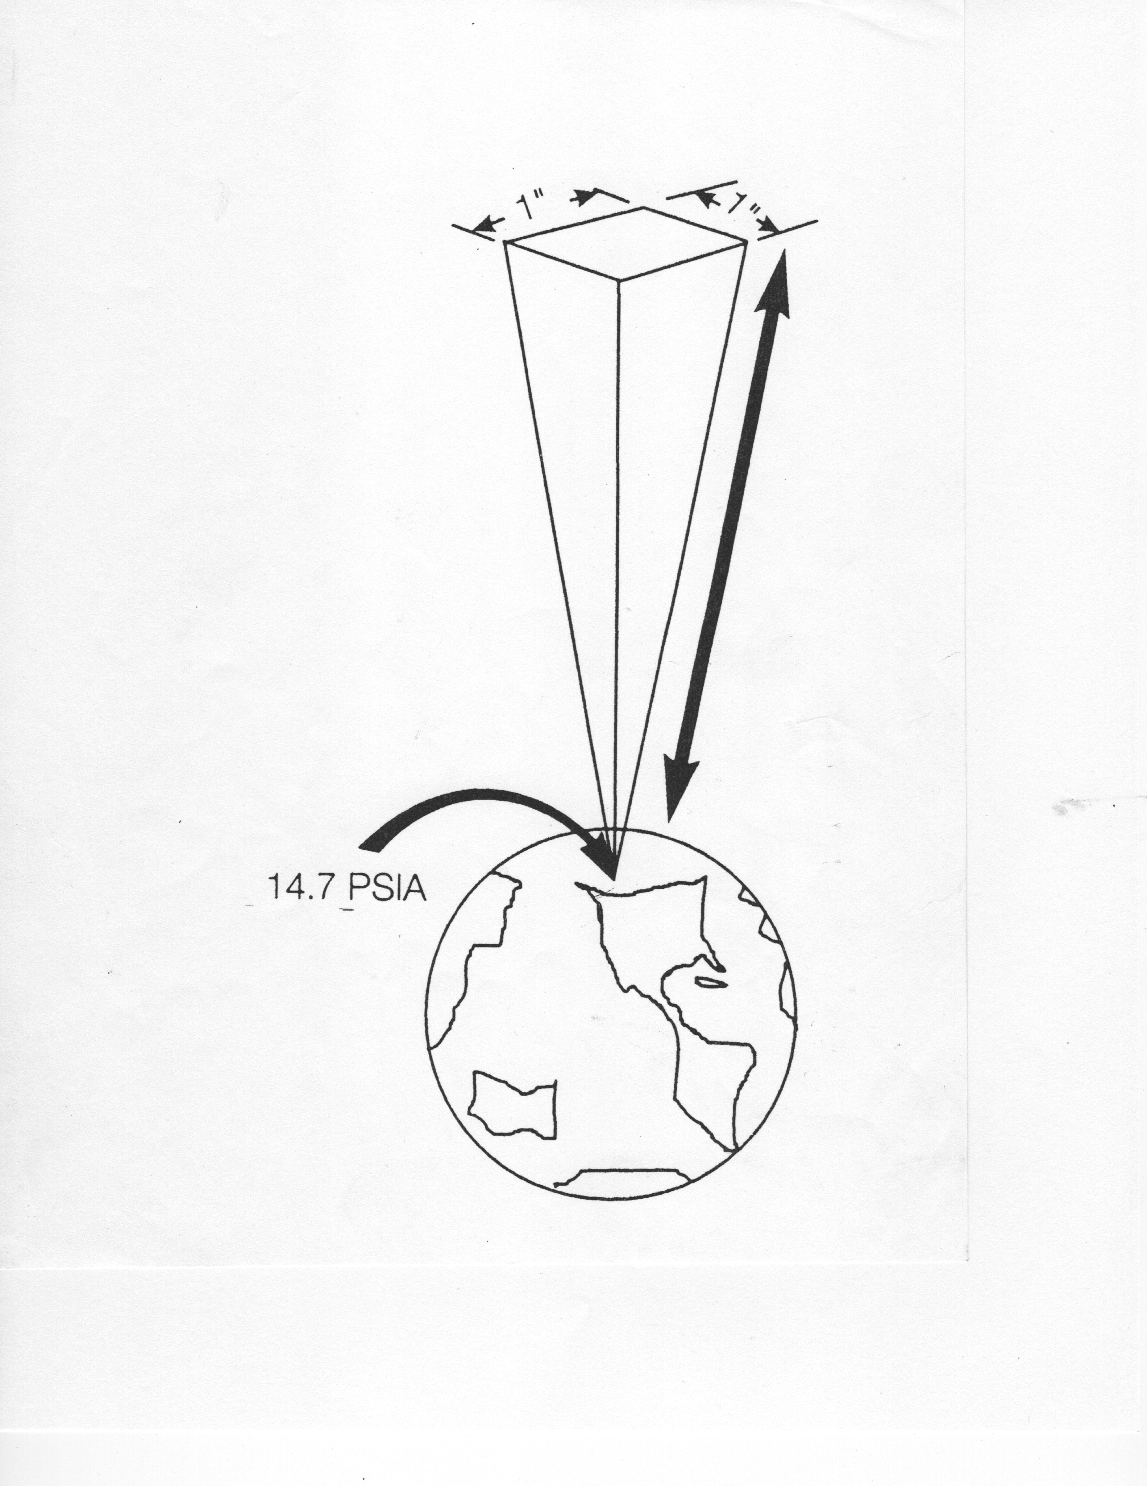
ATMOSPHERIC PRESSURE
50 MILES

Slide 5
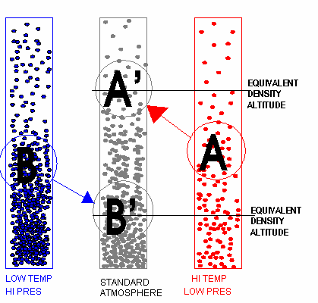

Slide 7
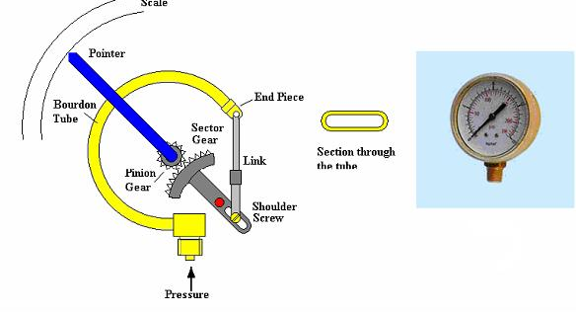
BOURDON TUBE GAGE

Slide 8
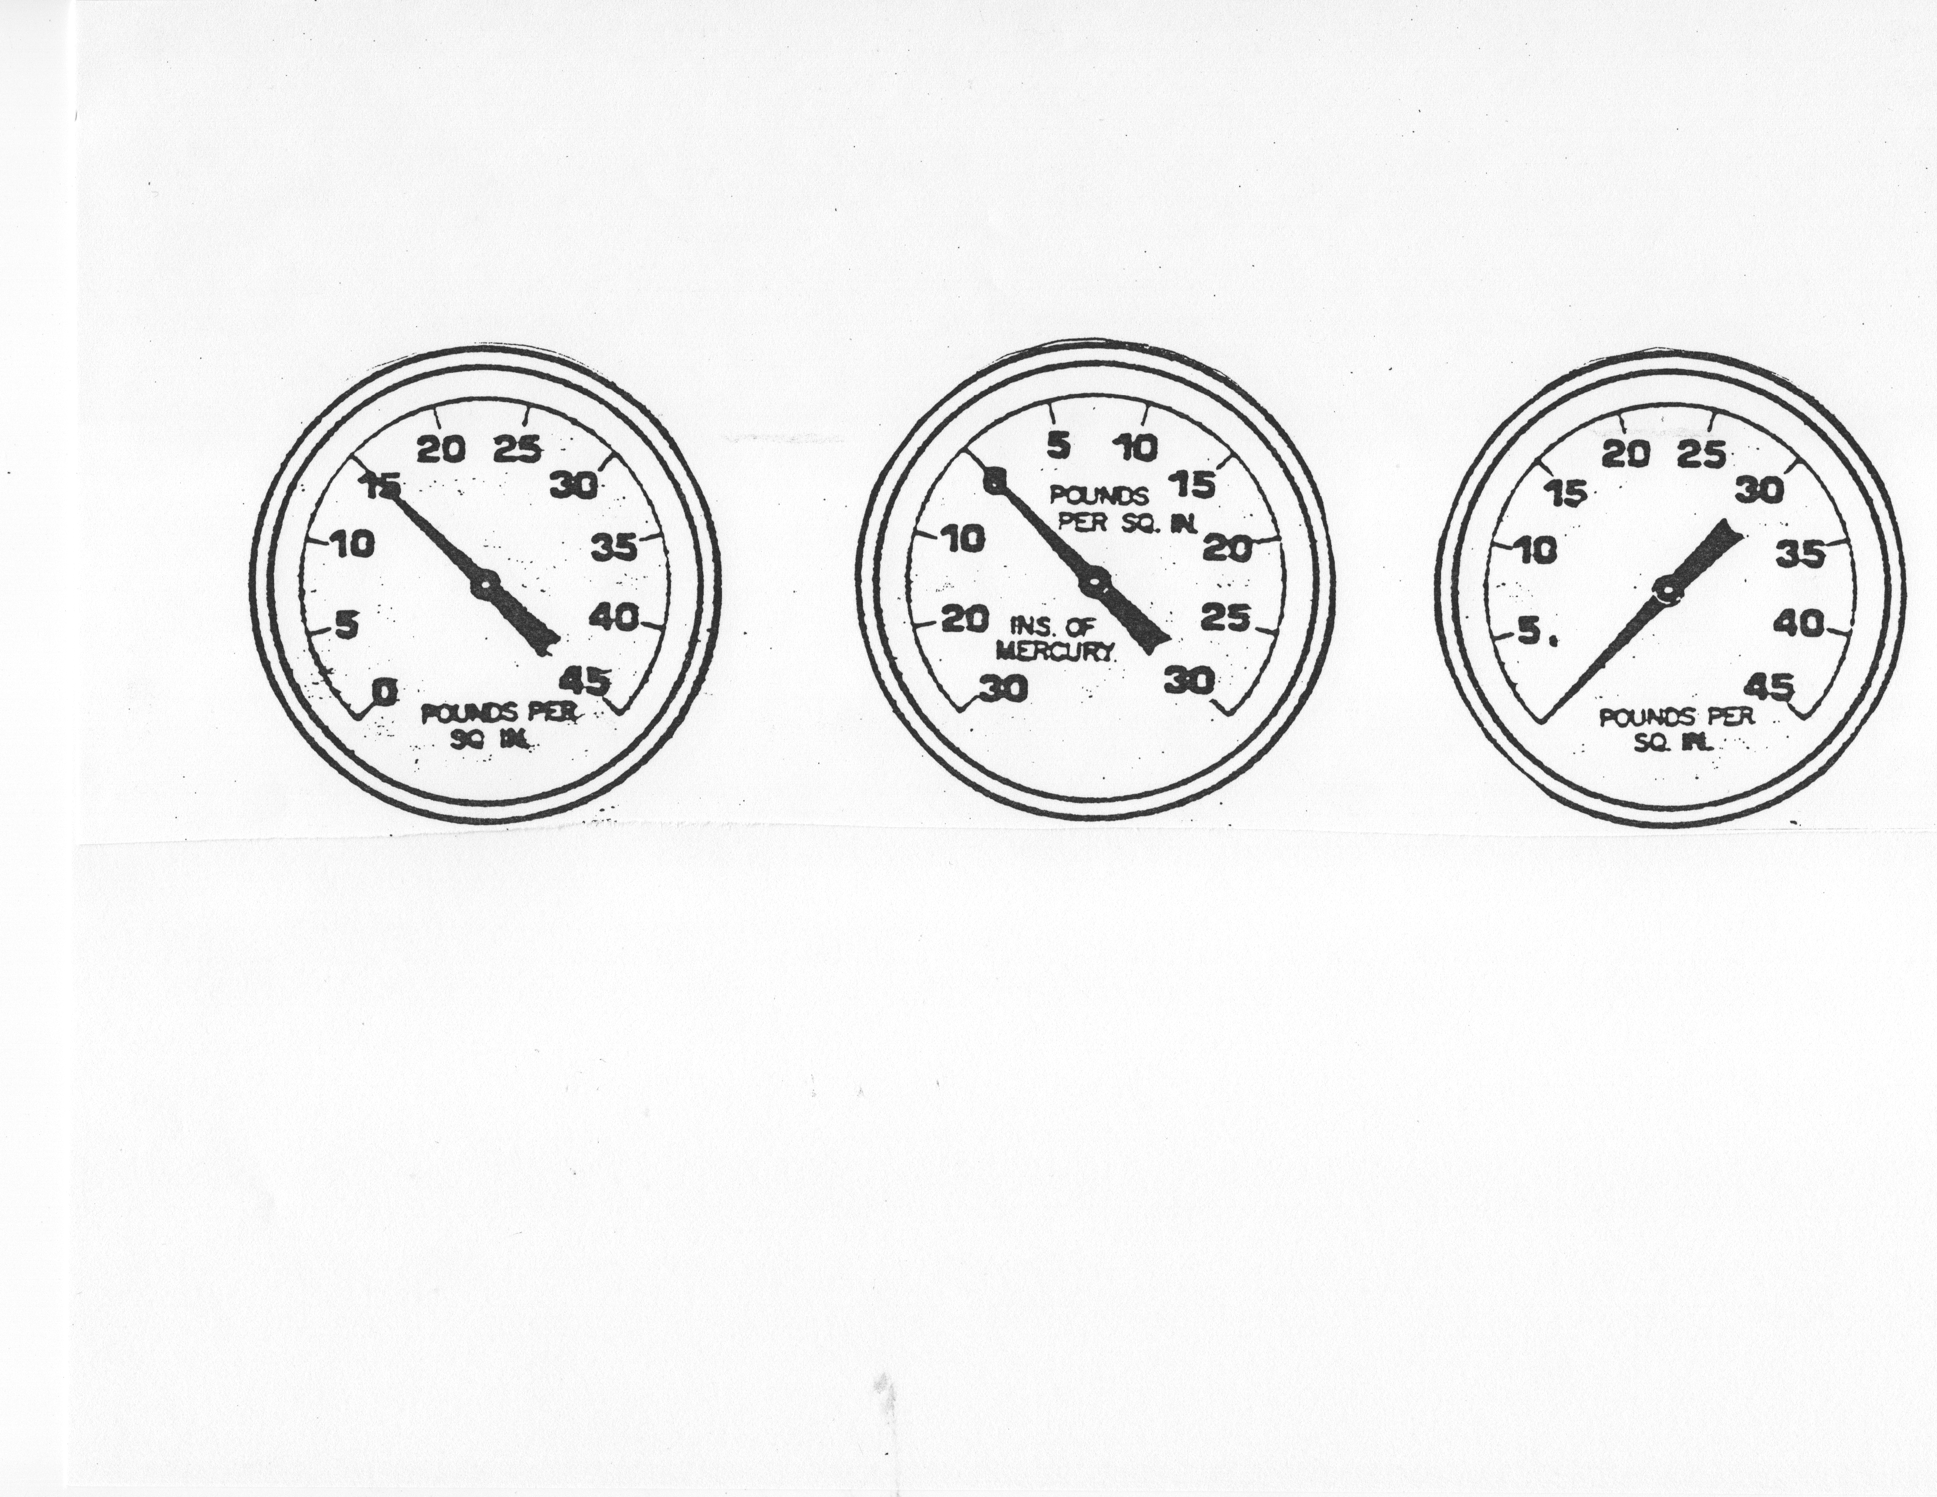
ABSOLUTE GAGE COMPOUND GAGE REGULAR GAGE

Slide 9
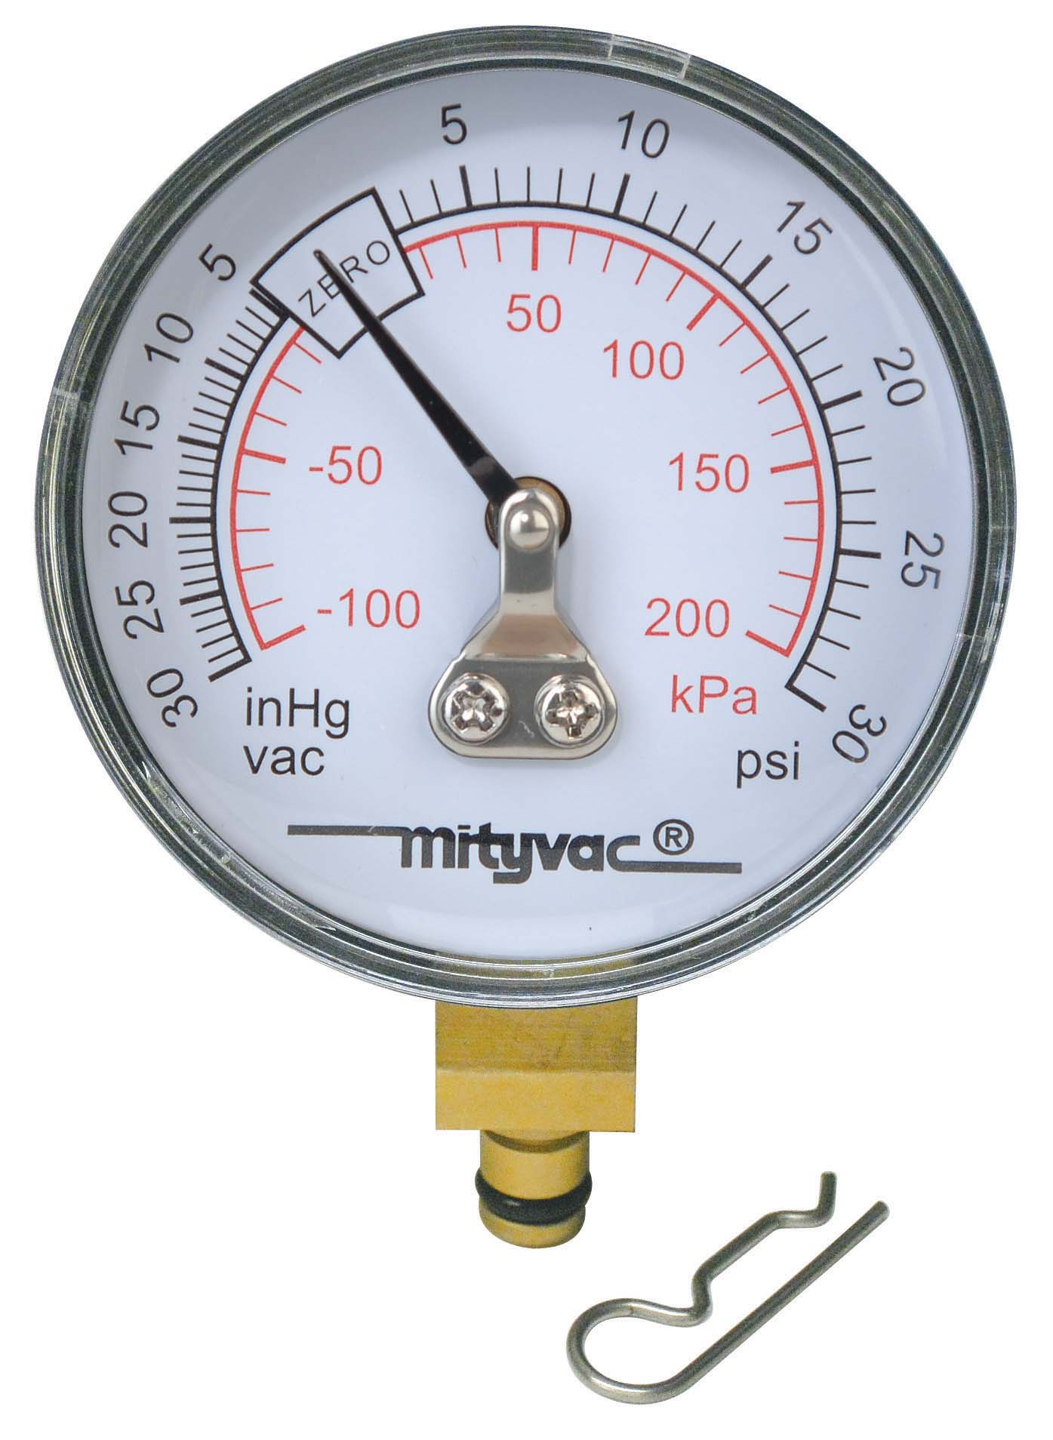
COMPOUND GAGE
Measures pressures both above & below atmospheric pressure, but on different scales

