Slide 1
KBMA End User Module
Cathy Patton, MA, RN
Chris Tarver, MS, RN, CNS
Elizabeth Yang, IT
October 2012

Slide 2
What is KBMA?
Knowledge Based Medication Administration (KBMA) is a software product:
  embedded in ECHO
  allows nurses and RTs to scan meds prior to administration.
When you scan the barcode on a patient’s wristband and the medication to be administered, KBMA compares the scanned data to medication orders and eMAR data. KBMA is accessed through an icon on your ECHO eMAR.

Slide 3
KBMA is Being Implemented in the Inpatient Areas
All Inpatient Units and PACU in MV and LG
The Infusion Center
The PILOT unit: 4B (training 10/16-10/18)
Go Live for 4B : October 23
Rest of implementation will begin in January 2013 with 1-2 units going live every other week thru April 2013
LG Go Live will be May 2013

Slide 4
Who is NOT implementing KBMA?
Emergency Departments
Dialysis
Cath Lab/Interventional Services
Radiation Oncology
Endoscopy

Slide 5
Five Rights of Medication Administration and KBMA
Right Patient – Verified by scanning patient’s wristband barcode
Right Medication – Verified by scanning the barcode on the medication
Right Dose – Verified by scanning the medication. KBMA compares to the ECHO order

Slide 6
Five Rights of Medication Administration and KBMA (cont.)
Right Time – Verified by scanning the medication. KBMA compares to the ordered frequency, when the medication was last administered and when it is scheduled to be administered again
Right Route – Certain High Risk Medications will be configured for KBMA to prompt you to validate the route on administration. Otherwise, right route is verified by the RN/RT as you always have.

Slide 7
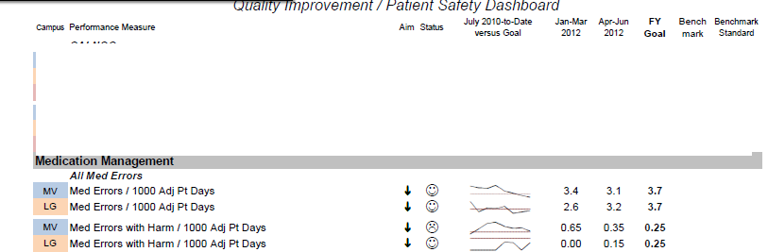
Our Medication Errors
We believe that bar coding medication administration will decrease our error rate!

Slide 8
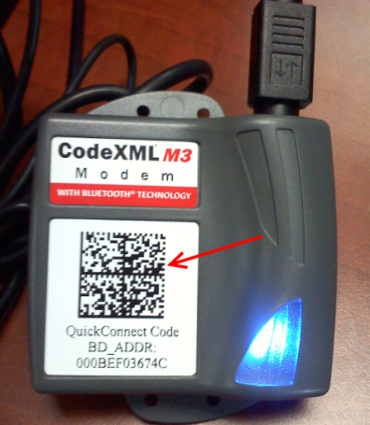
KBMA General Workflow
Obtain meds as you normally do from PYXIS or med room bins & proceed to the patient’s room.
At the bedside, scan “sync square”
Log into ECHO
Select patient
Open eMAR
Click the KBMA icon
Scan the patient’s wristband.
Scan the drug(s) to be administered to the patient.

Slide 9
KBMA General Workflow
Review detailed information about the scanned med and the associated task
Acknowledge any required alerts or warnings.
Click Scan Complete
Make a final review of scanned medications.
Administer medications to patient.
Click Administration Complete to record medication administration
Close KBMA

Slide 10
Next slide shows the layout of the KBMA Screen
The HEADER
Includes information about the patient whose armband you have scanned
The WORKLIST
Includes medications available to administer
KBMA displays a rolling 2 hours worth of meds due or PRNs available
The MATCH RESULTS
Populates as meds you scan match the orders

Slide 11
KBMA Layout
KBMA Header Area
KBMA Worklist Area
KBMA Match Result Area

Slide 12
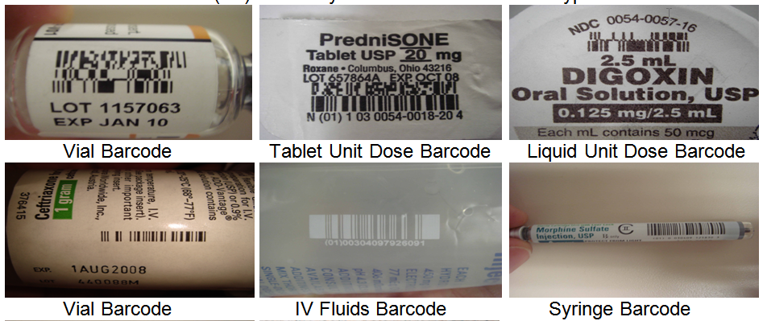
Examples of Medication Bar Codes

Slide 13
PROTECT THE BARCODE!
When opening medication packaging, use scissors when necessary to protect the barcode from damage!
Prepping meds in the med room?
Be sure to take the barcode to the bedside!

Slide 14
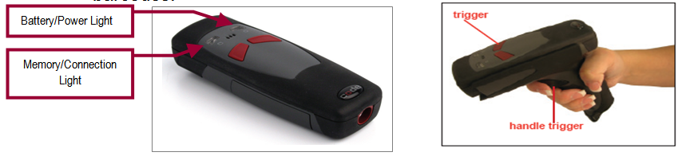
Bar Code Scanners
Manufacturer: “Code”
4B will pilot “palm” style and “handle” style

Slide 15
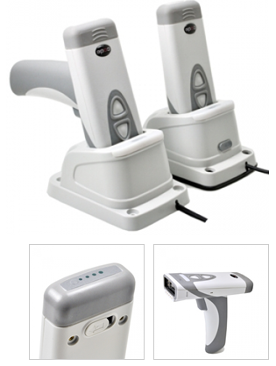
Brand New on the Market
“Code” – the company that makes our bar code scanners has just introduced a new model
We have ordered two of these Scanners to test

Slide 16
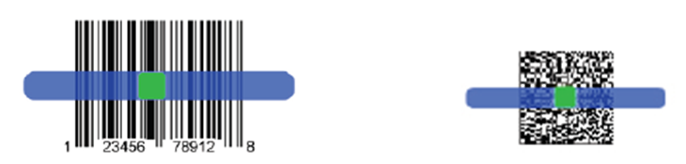
Barcode Reading Techniques
Hold the scanner steady and center the barcode in the light. Press the trigger until scanner beeps/vibrates, indicating the code has been successfully read.
*It can be helpful to hold scanner close to barcode, then press & hold trigger as you slowly pull scanner straight back, away from barcode.

Slide 17
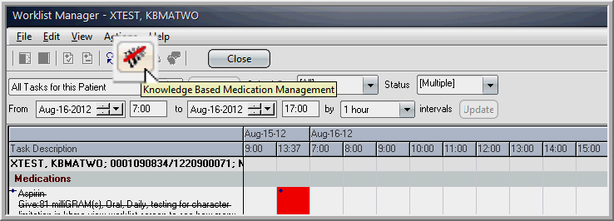
The KBMA Icon on the eMAR/WLM

Slide 18
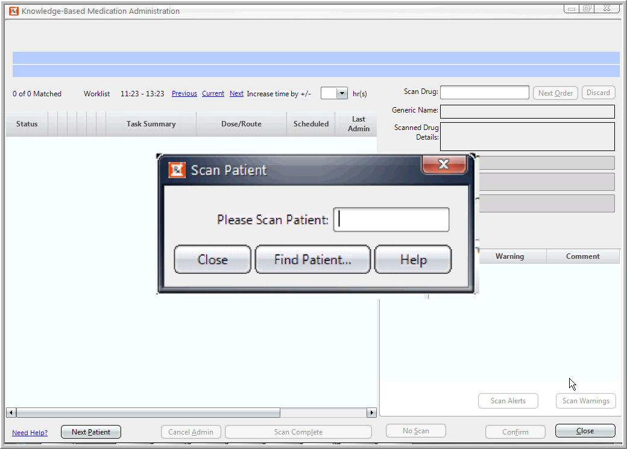
KBMA – Scan Patient (After clicking the KBMA Icon)
Cursor MUST be in field before scanning patient

Slide 19
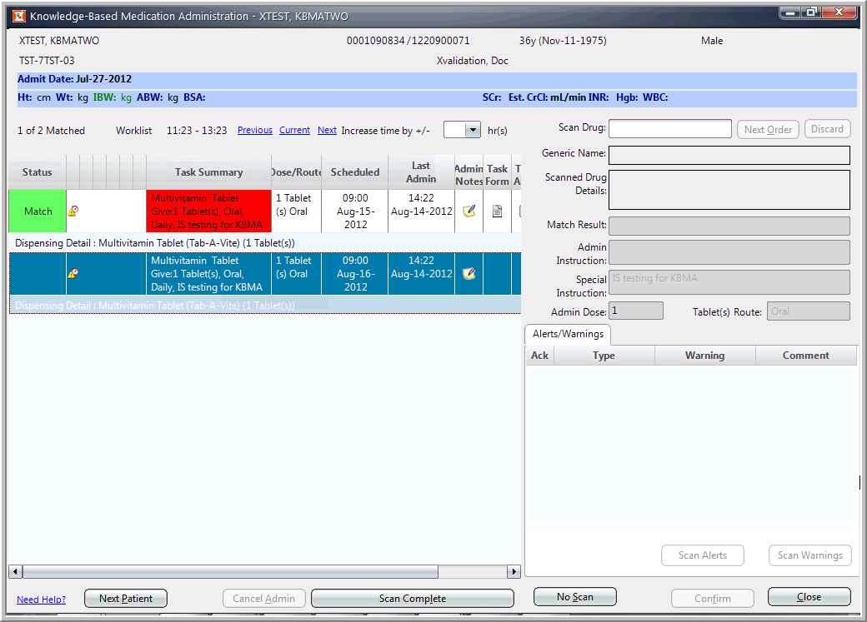
KBMA displays a 2-hour window of time
Cursor MUST be in field before scanning medication
Scan Complete
No Scan

Slide 20
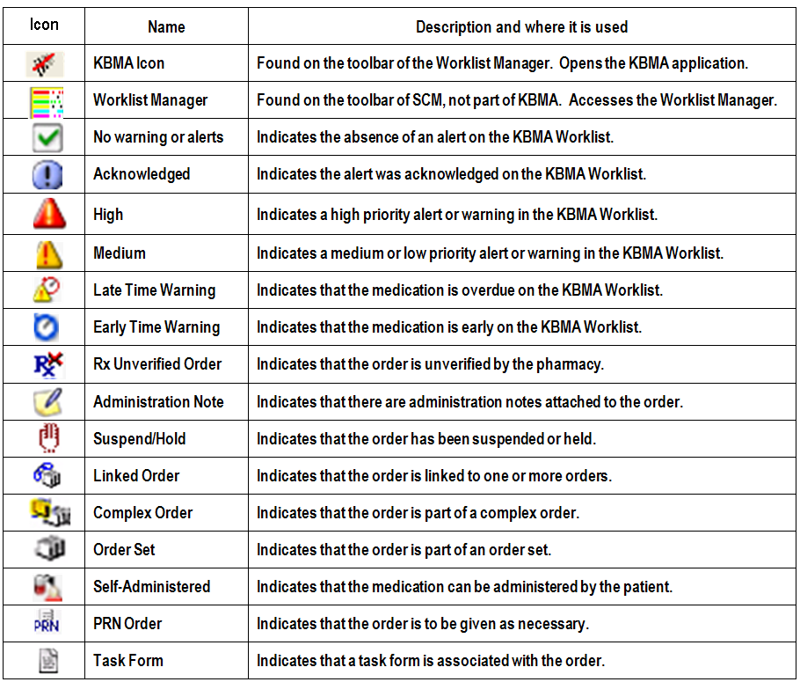
KBMA Icons

Slide 21
KBMA Glossary
MATCH – Medication scancode matches medication task in KBMA
NO MATCH – Medication scancode is valid but does not match a medication task in KBMA. Enduser can usually find task by changing time view.
MULTIPLE MATCH – Medication scancode matches more than one medication task in KBMA as there may be bioequivalent medications, or multiple task occurrences like Q1hr.
PRODUCT NOT FOUND – Medication scancode is not a valid code. The scan is recognized but the drug information is not in the system. Please report as directed.
MANUAL MATCH – Occurs when there are no task occurrences from verified orders that can be matched to the scanned drugs in the time displayed. Enduser must choose appropriate task from list of drugs.

Slide 22
KBMA Glossary Continued
MULTI-TAB MED (Partial Dose) – These are medications that require multiple components to be dispensed and requiring more than one scanned dose .
MULTI-DOSE MED – These are medications that require multiple doses to be given from the same container like an ointment tube or bottle of eye-drops.
VARIABLE-DOSE MED – These are medications that require a variable dose to be given to the patient like insulin.
NO SCAN -- The process by which a medication can still be administered despite a damaged barcode or no barcode.
FIND PATIENT – If the patient’s wristband barcode won’t scan or if it is missing, the enduser can still find the patient to use in KBMA.

Slide 23
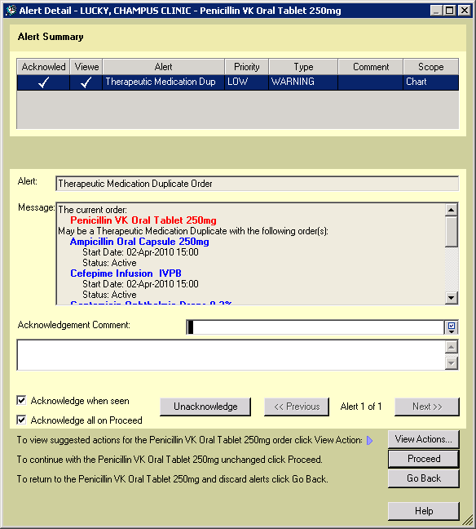
Alerts Workflow
If there are alerts in the Alerts/Warnings List in the “Match Result” Panel, the Scan Alerts button will become enabled.
  Select the “Scan Alerts” to view all the alerts associated with the currently selected matched task
  Acknowledge the alerts at each scan as needed.
If there are pre-existing unacknowledged task alerts:
  these alerts will also appear in the Alerts/Warnings List
  may be presented in the Alert Detail dialog box
  Acknowledge as needed

Slide 24
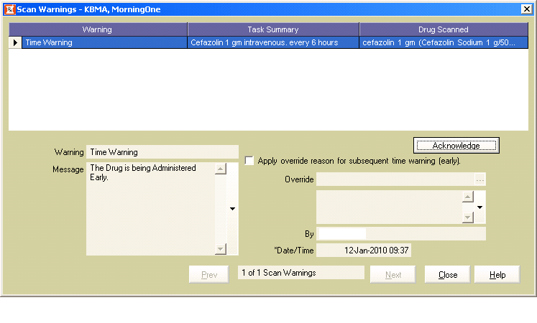
Scan Warnings Workflow
If there are Scan Warnings in the Alerts/Warnings List, the Scan Warnings button will become enabled.
  Select “Scan Warnings” to view all the scan warnings associated with the currently selected matched task
  Acknowledge the warnings at each scan as needed.
If the scan warning is of type “Time Warning (Early)” or “Time Warning (Late) for early or late administration, or “Drug Not Scanned Warning”:
“Apply override reason for subsequent <warning type>” checkbox becomes available
Allows user to select or clear such that the override reason may be carried forward to the next scan warning of the same warning type.

Slide 25
Alerts and Scan Warnings
For both Alerts and Scan Warnings:
user does not need to acknowledge these alerts/warnings immediately
May be deferred until the scans of all required medications to administer are completed.
If user has acknowledged any of the alerts/warnings after a match is made, user will be able to un-acknowledge any time before finishing all scans.

Slide 26
If you need help, use your Vocera to: “Call Bar Code Help”

Slide 27
Thank you!!
Contact your manager if you have not already signed up for a scenario-based training session!!
All training sessions will be held in the OLD MAIN HOSPITAL, OLD RADIATION ONCOLOGY IN THE BASEMENT – FOLLOW THE SIGNS!
Any persons who are more than 5 minutes late to the training session will not be allowed to enter!

