Slide 1
The Development of a Profession Chapter One
Catherine Hrycyk, MScN
Nursing 50

Slide 2
Topics for today:
-Professionalism terminology
-Nursing as a profession
-Members of the healthcare team
-Power & empowerment of nurses

Slide 3
Professionalism Terminology
Position: a group of tasks assigned to one individual
Job: a group of positions that are similar in type and level of work
Occupation: a group of jobs that are similar in type of work and are found throughout an industry

Slide 4
Professionalism Terminology
Profession: a type of occupation that meets certain criteria that raise it to a level above an occupation
Professional: a person who belongs to and practices a profession
Professionalism: the demonstration of high-level personal, ethical and skill characteristics of a member of a profession

Slide 5
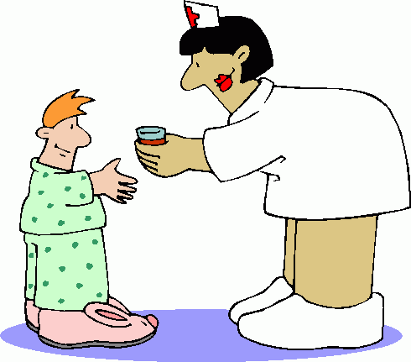
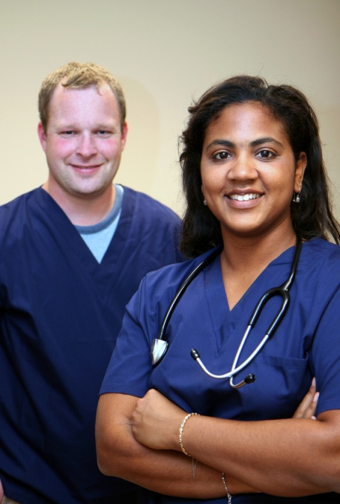
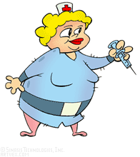
What is nursing’s public image when it comes to being viewed as a profession?

Slide 6
Nursing as a Profession when measured against ‘Professional Traits’….
High intellectual level of functioning
-nurses use assessment skills, critical thinking, make judgments, use of advanced technology
High level of individual responsibility and accountability
-nurses accept and must demonstrate high levels of individual responsibility for the care and services they provide

Slide 7
Nursing as a Profession when measured against ‘Professional Traits’….
Specialized body of knowledge
-compiled through the research efforts of nurses that hold advanced degrees
Evidence-based practice
-interventions based on data from research that demonstrates that they are appropriate and successful
Public service/ altruistic activities
-nurses working in remote areas, care for sick and dying, working shifts and weekends

Slide 8
Nursing as a Profession when measured against ‘Professional Traits’….
Well Organized and Strong Representation
-NLN, ANA. Organized, but not strongest
Have a Code of Ethics
-published 1st in 1971, but updated to reflect current healthcare and nsg. practice
Competency and Professional Licensure
-national licensing exam to demonstrate qualification. Legal activity regulated by state practice act and governing boards

Slide 9
Nursing as a Profession when measured against ‘Professional Traits’….
Entry Level of Education for Practice
-nursing only major discipline that does not require a baccalaureate degree in order to obtain licensure
Autonomy and Independence of Practice
-nursing is independent and interdependent. Some advanced practice nurses establish their own practices. Other professions need to recognize nursing as having practitioners who practice independently to be considered a ‘true profession’.

Slide 10
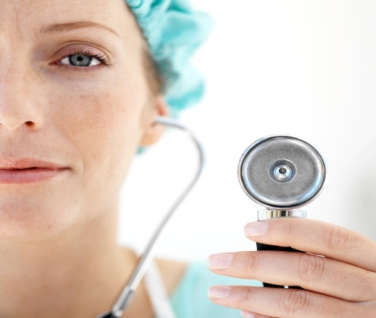
Nursing as a Profession when measured against ‘Professional Traits’….
Professional Identity and Development
-many nurses still view nursing as a job rather than as their life’s work (probably because it is not recognized as a true profession!)

Slide 11
So, is nursing a profession?
It’s pretty close but still lacking in a few areas
Main area is education
It will be hard to claim that nursing is a full profession until the entry level is a BS degree
Public still does not see nursing as a profession

Slide 12
Members of the Healthcare Team
Table 1.1 (on page 11) reviews the non-nursing members. Please review.
UAP- unlicensed assistive personnel (CNA)
LPNs- licensed practical nurse
RNs- registered nurse
-LPN & RNs (ADN grads)- technical nurses
BSN, MSN and DNS/PhD- professional
Advanced Practice Nurses- CNSs, NPs
Case Managers- high-risk, LT health problem coordinators

Slide 13
Empowerment in Nursing
What is power?
The capacity to exert influence
The ability to influence other people to do things that they may or may not want to do

Slide 14
Origins of Power
Referent: depends on establishing and maintaining a close personal relationship with someone. (nurses therapeutic relationship with clients)
Expert: derived from knowledge, skill or expertise. (nurse’s education & experience ↑ their expert power)
Coercive: the ability to punish, withhold rewards & threaten punishment

Slide 15
Origins of Power
Reward: ability of one person to grant another some type of reward for specific behaviors/ changes in behavior (praise)
Legitimate: legislative or legal act that gives an individual or organization a right to make decisions that they might not otherwise have authority to make (license of nurse)
Collective: professional organization is focal point for this source of power

Slide 16
How to Increase Power in Nursing
Professional unity! (ANA= 2.7 million)
Political activities! (related to practice issues. We are the experts)
Accountability and professionalism! (establish standards & evaluation)
Networking! (support system. “Old boy”)

Slide 17
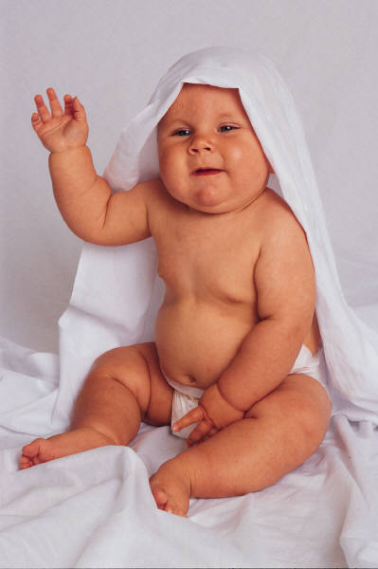
See you next class……
Please do your readings & bring thoughtful questions!

