Slide 1
Reality Shock in the Workplace Chapter Ten
Catherine Hrycyk, MScN
Nursing 50

Slide 2
Topics for today:
-Nursing Shortage
-Transition from student to nurse
-Issues after employment

Slide 3
Nursing Shortage
The demand increases and decreases with changes in the health-care system
The demand for nurses is to some extent regional
Strong economies tend to be reflected in drops in enrollment in nursing because there are more opportunities in areas outside of the traditional female role

Slide 4
Reasons for ↓in nursing positions?
-↑ concern for cost reduction in the health-care system
-use of unlicensed personnel
-high burn out

Slide 5
Transitioning from student to nurse
Problems integrating the ‘ideal image’, the ‘perceived image’ and the ‘performed role image’
ideal: what is expected
Perceived: individual’s own definition
Performed: what the practitioner actually does
Reality shock occurs when the ideal/perceived conflict with the performed role!

Slide 7
Transitioning from student to nurse
So what do we do about it??
Preceptorships: in the final quarter/semester, students function as a real RN with a real workload. It is actually as close to the performed role as possible while still a student….allows for ‘adjusting’ the perceived role.
Internships: some opportunities in hospitals between school years with some participation in nursing tasks

Slide 8
Issues after employment
Burnout Syndrome- a state of emotional exhaustion that results from the accumulative stress of an individual’s life, including work, personal and family responsibilities
results mainly from personal/ professional dissatisfaction
usually more intelligent, idealistic , perfectionist, hard-working types
signs & symptoms?

Slide 9
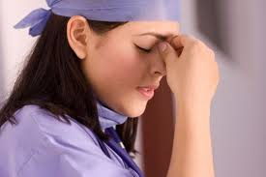
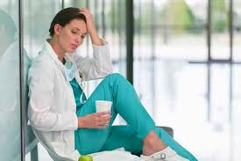
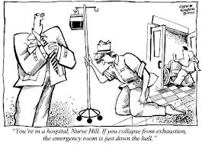
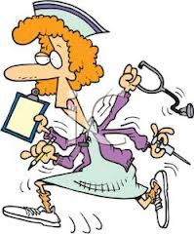
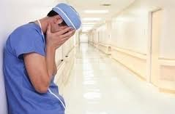

Slide 10
Treatment:
-recognize the signs
-manage the stress & time management
-delegate those things that you can
-overcome procrastination
-prioritize tasks
-take care of own health: eat well, sleep, exercise, no drinking in excess
-set a daily decompression routine
-share your feelings (work mates?)

Slide 11
See you next class…… Please do your readings & bring thoughtful questions!

