Slide 1
Health-Care Delivery Systems Chapter Fourteen
Catherine Hrycyk, MScN
Nursing 50

Slide 2
Topics for today:
-Demographics affecting delivery
-Health-care plans and models
-Levels of service
-Health-care settings

Slide 3
Demographics affecting delivery
Age- ‘greying’ of America
Chronicity- LT care
Population- who are the poor?
-city dwellers, healthcare needs,
Healthcare costs- where are the big expenses?
-LT care, cost of technology, not preventative
Need to refocus to health promotion- physical fitness, healthy diets, ↓ tobacco / substance, mental health support, family planning, etc

Slide 4
Health-care plans and models
Managed Care Organizations- comprehensive, preventive and treatment services to a specific group of voluntarily enrolled persons
Preferred Provider Organizations- limits choice to list of ‘preferred’ hospitals, physicians and providers (pay more if not on list)
Medicare- federally funded for persons > 65 yrs and permanently disabled workers of any age
Medicade- federally funded, state operated for people of low incomes
Private Insurance- fee-for-service plan, usually have deductibles client pays before insurance pays

Slide 5
Quality Assurance/ Quality Improvement

Slide 6
Levels of service
Primary Care- focuses on health promotion, illness prevention, early diagnosis and treatment of common health problems and education (MD office, clinic, community setting)
Secondary Care- emergency and acute care designed to diagnose and treat complex disorders (hospital setting)
Tertiary Care- provision of rehab care, LT care and care of the dying (in hospital and community setting)

Slide 7
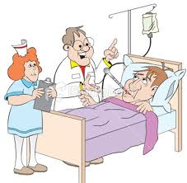
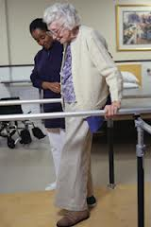

Slide 8
Health-care settings
Outpatient care- treatment, injections, infusions, medical exams
Public health- disease control and prevention, as well as child health, OB health, TB, STDs
Home health- assuming responsibilities of public health (by family members or others)
School-based services- screenings, health promotion and illness prevention, minor trt
Community health- team approach that provide diagnostic and treatment (MD, RN, lab, radiology)
Physician offices/ general clinics- screening, dx, treatment, minor surgery

Slide 9
Health-care settings
Occupational health clinics- workplace health promotion, illness prevention & safety programs
Long-term care facilities- rehab, ADL/ skilled nursing care
Retirement and Assisted Living centers- maintain as much independence but service available
Day care centers- not just for kids!
Parish nursing centers- PT or volunteer
Voluntary health agencies- Am. Heart, Easter Seals, March of Dimes
Rural health centers- ↓ numbers or MDs and RNs
Independent nurse-run centers-health promotion and illness prevention

Slide 10
Primary Nursing: focuses on the whole person & gives nurses responsibility for ALL of the client’s needs

Slide 11
See you next class…… Please do your readings & bring thoughtful questions!

