Slide 1
Cultural Diversity Chapter Twenty-Two
Catherine Hrycyk, MScN
Nursing 50

Slide 2
Topics for today:
*Culture terminology
*Melting Pot vs Salad Bowl
*Developing cultural awareness
*Assessing culture
*Transcultural communication
*Cultural conflict/ synergy

Slide 3
Culture
Def’n: a group’s acceptance of a set of attitudes, ideologies, values, beliefs and behaviors that influence the way that the members of the group express themselves
Cultural orientation- result of a learning process that starts at birth and continues through the lifespan (from one generation to the next)
Expression of culture- language, spirituality, works of art, groups customs and traditions, food preferences, response to illness, bereavement, decision-making and world philosophy. Primarily unconscious

Slide 4
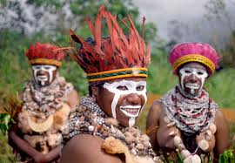
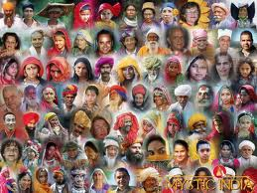
Culture

Slide 5
Culture -Individuals belong to several subcultures within their major culture -Culture is a powerful influence on how clients and nurses interpret and respond to health care (don’t forget the culture of the healthcare world!)

Slide 6
Culture
Cultural diversity- explains the differences between cultures:
>primary characteristics- race, color,
gender, age and religious beliefs
>secondary characteristics socioeconomics status, education, occupation, time away from country of origin, gender issues, sexual orientation
Stereotyping- oversimplified belief, opinion, or conception about another person (or group) based on a limited amount of exposure or information

Slide 7
Melting Pot vs Salad Bowl Melting pot- acculturating (‘fitting in’) Salad bowl- multiculturalism

Slide 8
Culture
US population trends:
-in year 2000, 30% of the US pop. was composed of minority groups, but only 10% of nurses in the US are composed of minority groups
How would this help/hinder nursing care?

Slide 9
Cultural awareness:
-understanding the client’s perspective of what is happening in the healthcare setting
-as nurses develops this awareness, they are better able to recognize and value all aspects of a client’s culture
-begins with an understanding of one’s own cultural healthcare beliefs and cultural values (ID similarities and differences from those of the client, and appreciate both)

Slide 10
Assessing Culture
-most important is to establish a warm and trusting relationship (to compensate for asking questions that might be considered revealing and personal!)

Slide 11
Cultural Competence:
-provision of care for others based on nursing knowledge and understanding of values, customs, beliefs & practices of the culture, requiring comm. skills, understanding and sensitivity
Transcultural Communication:
-both verbal and nonverbal communication, tone, acceptable greetings, etc

Slide 12
Culture
Careful of the differences:
*don’t interpret nodding as agreement
*diff. cultures hold the role of women or healthcare personnel in varying esteem
*communication between upper & lower classes may be affected (castes)
*certain groups less willing to disclose
*touching varies between cultures
*personal space differences
*eye contact

Slide 13
Cultural Conflicts
-noncompliance on the part of the client can be caused by:
*nurse’s incomplete understanding of culture or unrealistic expectations
*lack of external symptoms of disease
* inconvenient or painful treatments
* lack of external support from family members

Slide 14
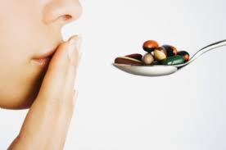
Culture Facts Passive Obedience -what is it? Patient Compliance -what would affect this?

Slide 15
Cultural Synergy
Healthcare workers need to learn about other cultures and also, to immerse themselves in those cultures. This helps the nurse selectively include values, customs and beliefs of other cultures into their own

Slide 16
See you next class…… Please do your readings & bring thoughtful questions!

