Slide 1
Theories and Models of Nursing
Chapter Three
Catherine Hrycyk, MScN
Nursing 50

Slide 2
Topics for today:
-Differences between theory & model
-Common concepts to nursing models
-General systems theory
-Orem’s self-care model

Slide 3
Differences Between Theory and Model
Theory:
a speculative statement involving some element of reality that has not been proven
Nursing theory:
explains apparent relationships b/w observed behaviors & effect on client’s health
Goal of theory:
describe & explain a particular nursing action in order to make a hypothesis (or predict its outcome)

Slide 4
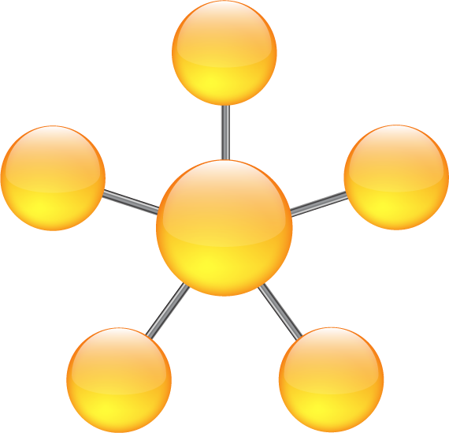
Differences Between Theory and Model
Model:
hypothetical representation of something that exists in reality
Purpose of a model:
to attempt to explain a complex reality in a systematic and organized manner

Slide 5

Concepts Common to Nursing Models
Four key concepts common to all
1. Patient (client)
-a small group or a large collective of individuals (community)
-complex entities affected
by factors as mind, body and
environment
-need not have an illness

Slide 6

Concepts Common to Nursing Models
2. Health
-not an absence of disease, but seen as a continuum (moving depending on circumstances and health status)
-perception of health varies radically
depending on age & culture
-health includes:
*cultural perception
*historical perception
*continuum of range of
health states

Slide 7

Concepts Common to Nursing Models
3. Environment
-includes ‘simple’ physical environs to ‘larger picture’ (public sanitation, air & water quality)
-also, interpersonal & social interactions
-also, ‘internal environs’

Slide 8

Concepts Common to Nursing Models
4. Nursing
-delineates the function and role that nurses have in their relationship with clients
-historically, nursing provided all basic care, psychological support and relief of discomfort. It is different now

Slide 9
General Systems Theory
System acts as a whole because of the interdependence of its parts
When a part fails, the whole system suffers
(Example- 9/11: economic system failure with repercussions to airline, hotels, home buying)
Elements of many nursing models are found in general systems theory
Parts have common function: make system work well to achieve its overall purpose

Slide 10
General Systems Theory
Key Parts of Systems Theory
1.System:
-Open: relatively free movement of info, matter, and energy into & out of the system
: most living organisms are ‘open’
-Closed: prevents any movement into & out of the system.
: totally static and unchanging
: rocks!

Slide 11
General Systems Theory
Open system:
Throughput
Input
Output

Slide 12
General Systems Theory
2. Input and Output:
-Input: any type of info, energy or material that enters the system from the environment through its boundaries. Human input?
-Output: any info, energy or material that leaves the system and enters the environment through its boundaries. Human output?
-End product: a type of output that is not reusable as input

Slide 13
General Systems Theory
3. Throughput:
-a process that allows the input to be changed so that it is useful to the system
(example in text- gas in car is changed to a useful form of energy. Similarly, food to a human)
4. Feedback Loop:
-allows the system to monitor internal functioning so it can ↑ or ↓ the input or output and maintain the highest level of functioning
(‘quality control’)

Slide 14
General Systems Theory
Feedback Loop:
-Positive Feedback: leads to change within the system, with the goal of improving the system (positive comments to students)
-Negative Feedback: maintains stability, therefore does not produce change. Only good if system is at peak level of functioning.
(athlete trying to ‘maintain’)

Slide 15
General Systems Theory
Open system:
Throughput
Input
Output

Slide 16
Nursing Theories/ Models
Help describe, explain, predict and control nursing activities to achieve the goals of client care
By using theories, nurses will be better able to use theoretical info in their practice to provide new ways of approaching nursing care and improving practice!
Many nursing theories and theorists. We will focus on Orem’s Self-Care Model only, as it is what we follow here at De Anza. (Cheer here!)

Slide 17



Orem’s Self-Care Model
Aimed at helping clients direct and carry out activities that either help maintain or improve their health
Health is the responsibility of each individual!

Slide 18
Orem’s Self-Care Model
Client:
-the biologic, psychological and social being with the capacity for self-care
-’self-care’: practice of activities that individuals initiate and perform on their own behalf to maintain life, health and well-being
Health:
-the person’s ability to live fully within a particular physical, biologic and social environment, achieving a higher level of fcning
-’healthy’: living life to the fullest with the capacity to maintain life through self-care

Slide 19
Orem’s Self-Care Model
Environment:
-the medium through which clients move as they conduct their daily activities
-generally viewed as a negative factor on a person’s health status because they may detract from the ability to provide self-care
Nursing:
-goal- help client conduct self-care activities in order to reach optimum level of functioning
-methods: wholly compensatory -ICU
partially compensatory- post op
supportive/ educative- new dx

Slide 20
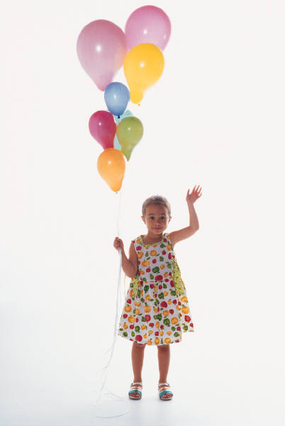
See you next class……
Please do your readings & bring thoughtful questions!

