Slide 1
Bioethical Issues
Chapter Seven
Catherine Hrycyk, MScN
Nursing 50

Slide 2
Topics for today:
-Common ‘medical’ ethical issues
-Advanced directives
-Euthanasia
-Right to self-determination
-Ethical issues for children

Slide 3

Bioethical Issues
*Earliest code of ethics had nurses’ prime responsibility to be obedient to physicians
*Present codes of ethics have nurses’ prime responsibility to client well-being’
*Change is due to ↑ self-awareness, independence and a growing accountability

Slide 4
Common Ethical Situations
1. Abortion
-religious, ethical, social and legal implications. Still a political issue.
*matter of convenience
*conflict of rights
*nurse’s values- as client advocate, can the
nurse be for or against abortion
2. Use of Fetal Tissue
-stem cell research- hot topic, especially here in California (data recently on the use of stem cells from mice)
Notes:
Abortion- Roe v. Wade- did NOT deal with ethical or moral basis of the act, but of self-determination
Conflict- when life begins vs freedom of choice Stem Cell- since the umbilical cord and placenta are discarded after birth, ok? Who owns that material?

Slide 5
Common Ethical Situations
3. Genetics and Genetic Research
-mandatory screening? (detecting genetic health patterns in newborns can be a positive thing, but what about insurance companies)
-informed consent (parents vs insurance co.)
-confidentiality
-emotional impact
-self-determination
4. Organ Transplant
-when the donor is a child-when can they have a say in the decision (can they be forced to donate?)
-when does death occur- brain death
-selection of recipient- who gets what?
Notes:
Insurance Companies- if call….no info
Self-determination- nurses should refuse to participate in mandatory, involuntary screening of clients)

Slide 6
Common Ethical Situations
5. Use of Scarce Resources in Prolonging Life
-preserve life at any cost?
-ethics of tube-feeding (Sciavo, 19 years coma)
-should care be restricted? (equal access!)
6. Right to Die
-‘euthanasia’ and ‘assisted suicide’
-no extraordinary measures- CPR? Ventilation?
Notes:
Equal access- regardless of income, race sex, religious beliefs or diagnosis (universal healthcare)

Slide 7
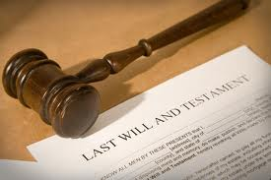
Advanced Directives
-are the client’s wishes about future health care, in a documented format
-should include a designated decision-maker (moral surrogate), if client becomes unable to make own decisions
-in form of a living will or durable power of attorney
-specifies what procedures, surgeries, meds or treatments can be used
Notes:
Needs to be witnessed by 2 people unrelated to client
Now a required part of the health care of all clients (Omnibus Budget Reconciliation Act of 1990)

Slide 8
Advanced Directives
Problems with Living Wills
-what exactly did the person know about the disease state and treatments that might later affect care?
-beneficence and nonmaleficence- is difficult to determine whether the primary duty of health-care provider is to produce benefit or prevent harm
-lack of clarity- language is broad and vague (not specific enough to include all forms of treatment)
-legality of living will if travelling to another state

Slide 9

Euthanasia
-a ‘good or peaceful death’
-passive- allowing to die without any extraordinary interventions
-active- practice of hastening a death thru some act or procedure (‘mercy killing’) such as pain meds, poison, gun, knife, etc
Notes:
Passive- DNR, living wills, and withdrawal of ventilators or life support. If DNR: who writes the order? If competent, only the patient. Still must be written by MD
Is assisted suicide (Dr. Kevorkian) an homicide?

Slide 10
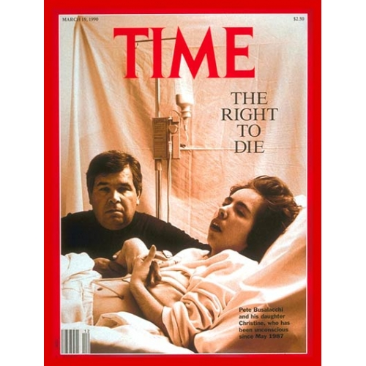

Slide 11
Right to Self-Determination
-can a client who is mentally competent MAKE these decisions? What about the right to self-determination?
-opposed- legally, ethically and morally wrong. Can a patient really think clearly about these issues if they are in pain, on medications or are depressed? What about nonmaleficence?

Slide 12

Common Ethical Situations
7. HIV and AIDS Issues
-right to privacy- confidential diagnosis (what is the big deal?)
-right to care- can a nurse refuse to care for an AIDS patient?

Slide 13
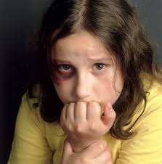
Ethical Issues for Children
Child Abuse
-must be reported by anyone who suspects abuse
-neglect harder to pinpoint because of lack of/ ‘fuzzy’ evidence
-conflicting ethical principle is right to family privacy and self-determination

Slide 14

Ethical Issues for Children
Informed consent and children
- as dependents, not usually attributed the right to self-determination
-a three-way relationship is the best option ( healthcare professional, parent and child)

Slide 15

See you next class……
Please do your readings & bring thoughtful questions!

