Slide 1
Nursing Law and Liability
Chapter Eight
Catherine Hrycyk, MScN
Nursing 50

Slide 2
Topics for today:
-Sources of Law
-Divisions of Law
-Good Samaritan Act
-Issues in Health-Care Litigation
-Preventing Lawsuits

Slide 3
Sources of Law
Statutory Law:
-written and enacted by the US Congress, state legislatures & other government entities
-laws that govern the profession of nursing are mostly written at the state level, because licensure is a state issue
-include the Nurse Practice Act- it enables the state boards of nursing, individual licensure procedures and schedule of fees for the state

Slide 4
Sources of Law
Common Law:
-evolved from decisions of previous legal cases that form a precedent
(to precede = to come before)
Include laws involving negligence or malpractice for nurses

Slide 5
Divisions of Law- Criminal
Criminal Law:
-concerned with providing protection for all members of society
-punishment is to fit the crime
-nurses: failing to renew license
: illegal diversion of drugs
: assisted suicide
: intentional/ unintentional
deaths

Slide 6
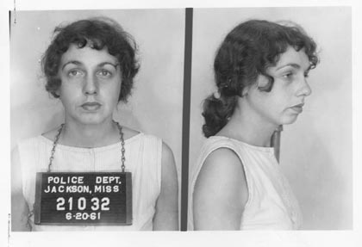
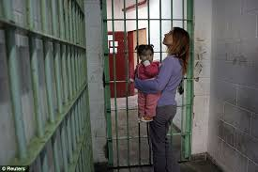

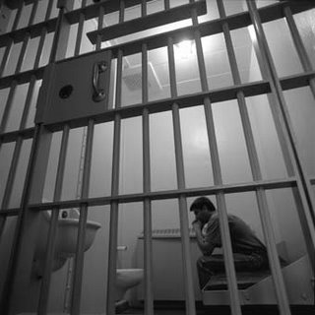

Slide 7
Divisions of Law- Civil
Civil Law:
-violation of one individual’s rights by another individual
-tort law: branch involving most nurses
-tort: wrongful act committed against a person or his/ her property independent of a contract

Slide 8
Unintentional Tort
-negligence: omission of something a reasonable and prudent person would do in a similar situation
(“Prudence, be reasonable!”)
or
commission of something a reasonable person would not do in a similar situation
(“What were you thinking?”)
-malpractice is the type of negligence for which professionals can be sued. It indicates professional misconduct or unreasonable lack of skill in performing professional duties.

Slide 9
Intentional Tort
-a willful act that violates another’s rights or property. Has three requirements:
*the person intended to bring about the consequences,
*intended to interfere with someone’s property
*was a substantial factor in bringing about the injury or consequence)

Slide 10
Intentional Tort
Assault- unjustifiable attempt to touch another or the threat of doing so
Battery- harmful or unwarranted contact with another without consent
False Imprisonment- a competent pt is confined/ restrained with the intent of preventing him from leaving the hospital (or use of threats or medications that interfere with ability to leave the facility)
Abandonment of clients- breach of contract, can cause injury
Intentional infliction of emotional distress

Slide 11
Quasi-Intentional Tort
-mix of unintentional and intentional
-a voluntary act that causes injury or distress without intent to injure or cause distress
-usually involve situations of communication with violate a person’s reputation, personal privacy or civil rights

Slide 12
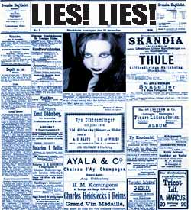

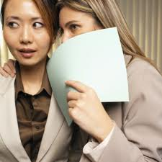
-Defamation of Character
*libel- written
*Slander- spoken

Slide 13

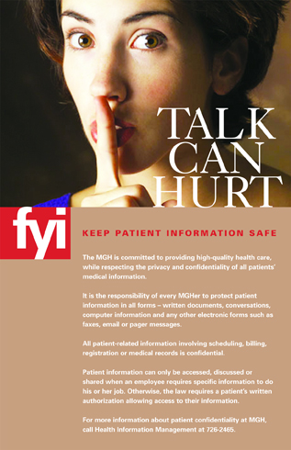
-Invasion of Privacy-
violation of right to protect against unreasonable & unwarranted interference with one’s personal life
-Breach of Confidentiality
trust and confidence are violated by public revelation of confidential communication without client consent

Slide 14
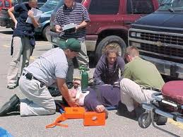
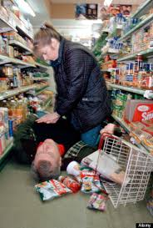
Good Samaritan
Good Samaritan Act
-protects healthcare
providers in emergency
situations within the
scope of their
professional education!
-what if you had to perform a tracheostomy? What would Prudence B. Reasonable do?

Slide 15
Dispute Forums:
Lawsuits:
-please read over facing a lawsuit on your own.
Mediation:
-trying to find common ground
Arbitration:
-neutral third party makes the decision

Slide 16
Issues in Health-Care Litigation
Informed consent- person performing the procedure is the one to get the consent. Informed means informed!
Patient Self-Determination Act- all federally-funded institutions must inform clients of their right to prepare advanced directives (living will, medical durable power of attorney)
DNR orders- needs a written order in the medical record

Slide 17
Issues in Health-Care Litigation
Standards of Care- what would a reasonable and prudent nurse do in the same situation
The Nurse Practice Act- defines nursing and sets standards in each state
-defines scope of practice, license requirements, IDs grounds for disciplinary actions, oversees the practice of nursing

Slide 18
Preventing Lawsuits
Medical documentation- complete, accurate, legible (thanks computers), no opinions, in chronological order, signed
Establish rapport with clients
Keep current on your nursing skills
Have some knowledge of the client
(be direct, problem-solving with the client, have client involved in own care, careful documentation if client is lawsuit prone)

Slide 19

And don’t forget to get professional liability insurance!

Slide 20

See you next class……
Please do our readings & bring thoughtful questions!

