Slide 1
Professionalism and Education / Conceptual and Philosophical Basis of Nursing
Catherine Hrycyk, MScN, RN

Slide 2
Work with the colleague sitting next to you to discuss and answer the following questions (write the answers):
What are the differences between a profession and ‘occupation’?
3. Define the following terms:
1. Value
2. Belief
3. Health

Slide 3
Occupation vs. Profession
OCCUPATION | PROFESSION
Training may occur on the job. | Education takes place in a college or university.
Length of training varies. | Education is prolonged.
Work is largely manual. | Work involves mental creativity.
Decision making is guided largely by experience or by trial and error. | Decision making is based largely on science or theoretical constructs (evidence-based practice).
Values, beliefs, and ethics are not prominent features of preparation. | Values, beliefs, and ethics are an integral part of preparation.
Commitment and personal identification vary. | Commitment and personal identification are strong.
Workers are supervised. | Workers are autonomous.
People often change jobs. | People are unlikely to change professions.
Material reward is main motivation. | Commitment transcends material reward.
Accountability rests primarily with employer. | Accountability rests with individual.

Slide 4
Eight Characteristics of a Profession (Kelly, 1981)
1. The services provided are vital to humanity and the welfare of society.
Why do students want to become a nurse? “To help people”
Caring is the core of professional nursing through which nurses intervene for their patients
Caring in highly technologically advance healthcare environment:
Nurses MUST focus on maintaining human aspects of caring
How do nurses demonstrate caring?

Slide 5
Eight Characteristics of a Profession
2. There is a special body of knowledge that is continually enlarged through research.
Research nursing degrees
Nursing relies on theory and research as a basis for practice.
Example: Evidence-based practice

Slide 6
Eight Characteristics of a Profession
3. The services involve intellectual activities; individual responsibility (accountability) is a strong feature.
Critical and creative thinking serves as basis for providing nursing care. Example: Nursing process
ANA defines accountability
Accountability is firmly rooted in the ethical principles of “fidelity (faithfulness), loyalty, veracity, beneficence, and respect for the dignity, worth, and self-determination of patients.”

Slide 7
Eight Characteristics of a Profession
4.Practitioners are educated in institutions of higher learning.
1909: University of Minnesota – first university-based nursing
1923: Yale – first university based School of Nursing
1965: ANA Position Paper – All nursing education should take place in institutions of higher education.
Debate: Entry level into Practice

Slide 8
Eight Characteristics of a Profession
5. Practitioners are relatively independent and control their own policies and activities (autonomy).
Autonomy – control over one’s practice.
Licensure and autonomous practice
“Dotor’s orders” connotation
Groups that control nursing practice
Organized nursing
Organized medicine
Health service administration
Magnet Recognition program and survey of nurses

Slide 9
Eight Characteristics of a Profession
6. Practitioners are motivated by service (altruism) and consider their work an important component of their lives.
Altruism – ideal of service to others
Nurses’ altruism is sometimes questioned when they demand higher compensation and better working conditions.
Collective bargaining

Slide 10
Eight Characteristics of a Profession
7. There is a code of ethics to guide the decisions and conduct of practitioners.
1893: Nightingale Pledge
ICN and ANA established a Code of Ethics

Slide 11
Eight Characteristics of a Profession
8.There is an organization (association) that encourages and supports high standards of practice.
American Nurses Association (ANA) – official voice of nursing
Purposes
Relatively low percentage of nurses who belong to ANA and the constituent state nurses association
A significant political influence is unrealized for the profession.

Slide 12
Barriers to Professionalism in Nursing
Varying levels of education for entry into practice
Lack of a standardized requirement for a minimum of a BSN, and preferably MSN (David, 2000)
Gender issues
Historic influences
Religious and military background and obedience
External conflicts
Tension between medicine and nursing
Internal conflicts
Fragmented power and influence in professional nursing

Slide 13
Types of RN Education Programs
Pre-licensure programs (entry to practice):
Diploma
AND
BSN
Graduate pre-licensure programs (ELMS, ELDNP)
Post-licensure programs:
RN to BAN
Advance practice programs:
MSN
DNP
Research degrees (doctoral degrees such as PhD, DSc)

Slide 14
Diploma Nursing Programs
Peak: 1920–1930 – ~200 programs in almost any state
Mid 20th century – dramatic decline caused by transfer of nursing education to the institutes of higher education
Reasons for decline:
Increasing complexity of healthcare environment
Most colleges and universities did not recognize diploma programs.
Current practice: Diploma programs establish agreements with colleges and universities.
Hospital misused the programs to turn students into free labor

Slide 15
Baccalaureate Programs
Required to qualify nursing as a recognized profession and to provide leadership in administration, teaching, and public health.
1909: First BSN program in University of Minnesota
4- 5 years programs including general education reqs + nursing courses.
BSN graduates are eligible to take licensure exams, prepared to move into graduate programs and advanced practice certification programs.
2008 AACN. The Essentials of Baccalaureate Education for Professional Nursing Practice.

Slide 16
Associate Degree Programs
Begun 1952, based on a model developed by Mildred Montag.
Mildred Montag’s ADN program:
Short duration to prepare nurse technicians
Nurse technicians function under supervision of professional nurses
Routine care in acute and long-term settings
Intended for end-point degree and not an incremental step to BSN
Contrary to the original intent of ADN, the graduates received the right to sit for NCLEX-RN

Slide 17
Articulated Programs
Definition: Mobility between programs
Purpose: Facilitate opportunities to move up the educational ladder.
Multiple-entry and multiple exit programs
Articulation agreements facilitate student movement between programs and accept transfer credit between institutions. These result in acceleration or advanced placement.

Slide 18
RN to BSN and Graduate Entry Programs
RN to BSN:
Diploma and ADN nurses are given credits to meet certain BSN requirements.
Transfer of general education courses
Options for advanced placement
Graduate entry programs:
Accelerated or fast-track sequence to award a second bachelor’s degree, MSN (ELMS), DNP

Slide 19
Accreditation: Ensuring Quality Education
Accreditation – voluntary review process of educational programs by a professional organization
The accrediting agency compares the educational quality of the program with established standards and criteria.
It derives authority from the US Department of Education.
Two agencies:
Accreditation Commission for Education in Nursing (ACEN)
Accredits ALL nursing programs, not just RN programs
Commission on Collegiate Nursing Education (CCNE)
Baccalaureate and higher

Slide 20
Advance Practice Degrees: MSN
Admission requirements:
Active and unrestricted license
BSN or equivalent AND
Work experience
2 to 4 years, depending on focus
Major areas of role preparation:
Administration, case management, informatics, health policy/health care systems, teacher education, clinical nurse specialist, NP, nurse-midwifery, nurse anesthesia, and other clinical and nonclinical areas of study

Slide 21
Advance Practice Degrees: Doctorate
Doctoral programs prepare nurses to become faculty members in universities, administrators in schools of nursing or large medical centers, researchers, theorists, and advanced practitioners.
Research-focused degree—doctor of philosophy (PhD) or doctor of science (DSc)
Practice-focused degree—doctor of nursing practice (DNP)
DNP to become minimum requirement for advance practice

Slide 22
Conceptual and Philosophical Basis of Nursing
Peter Miskin, DHSc, MScN, RN, PHN

Slide 23
Systems Theory
Ludwig von Bertalanffy (1936): General Systems Theory
Components of systems:
Input,
Throughput,
Output,
Evaluation,
Feedback

Slide 24
Types of Systems
Open system:
An open system promotes the exchange of matter, energy, and information with other systems and the environment.
Closed system:
A closed system does not interact with other systems or with the surrounding environment.
Sub-system:
System that is a part of a large system
Supra-system:
The larger environment outside the system

Slide 25
Characteristics of Systems
The whole is different from and greater than the sum of its parts (its subsystems).
Synergy occurs when all the various subsystems work together to create a result that is not independently achievable.
A change in one part of the system creates change in other parts.
There is continuous exchange of energy and information
WITHIN open systems
BETWEEN open systems
Supra-systems
Dynamic balance within and between subsystems, systems, and supra-systems helps create and maintain homeostasis.

Slide 26
Key Concepts about Systems
A system is a set of interrelated parts.
The parts form a meaningful whole.
The whole is different from and greater than the sum of its parts.
Systems may be open or closed.
All living systems are open systems.
Systems strive for homeostasis (internal stability).
Systems are part of supra-systems.
Systems have subsystems.
A change in one part of a system creates change in other parts.

Slide 27
Fundamental Nursing Concepts
CONCEPT 1: Person: An open system with human needs
An individual
Each individual is an open system with numerous subsystems.
Each person is unique – determined genetically, environmentally, and experientially.
Human needs – required for a person’s well-being
Maslow (1954) Motivation and Personality: Human behavior is motivated by intrinsic needs. He identified five level of needs.

Slide 28
Maslow’s Hierarchy of Needs
Physiologic needs – food, oxygen, rest, activity, shelter, and sexual expression
Physical and psychological safety and security – reasonably predictable environment with which one has some familiarity and relative freedom from fear and chaos
Love and belonging – close intimate relations, social relations, a place in the social structure
Self-esteem – need to feel self-worth, self-respect, and self-reliance
Self actualization – realized maximum potential

Slide 29
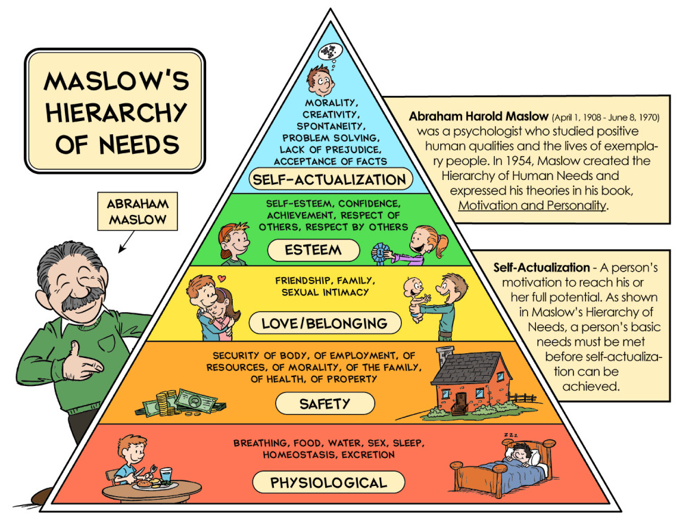

Slide 30
Assumptions About Maslow’s Hierarchy
Basic needs must be at least partially satisfied before higher-order needs can become relevant to the individual.
Individuals meet their needs in different ways.
The manner the needs are met and the extent by which these are considered needs vary according to each individual.
Individualized nursing care

Slide 31
Adaptation and Human Needs
Carl Rogers (1961) On becoming a Person
A person’s needs change as the person changes.
Concept of adaptation
People admitted in hospitals and removed from their usual environments commonly become anxious.

Slide 32
Homeostasis
Homeostasis is a dynamic balance achieved by effectively functioning open systems.
Homeostasis is attained by coordinated responses of organ systems that automatically compensate for environmental changes.
Individuals, as open systems, also endeavor to maintain balance between external and internal forces.
When balance is achieved, the person is healthy or is resistant to illness.
If adaptation is unsuccessful, disequilibrium may occur, setting the stage for the development of illness or disease.

Slide 33
Fundamental Nursing Concepts
CONCEPT 2: Environment: The supra-system in which a person lives in.
The environment can either promote or interfere with homeostasis and well-being of individuals.
In Maslow’s hierarchy of needs, there is a dynamic interaction between a person’s needs (internal) and the satisfaction of those needs (often environmentally determined).

Slide 34
Environmental Systems
Family system
Family defined
Nuclear and extended family
Cultural systems
Social systems:
Communities
States
Nations
Supra-national
International

Slide 35
Environmental Systems
Nurses’ potential impact on the environment/supra-system
Ecological health
Healthy work environments
WHO training modules including mercury poisoning
Health Care Without Harm to reduce hazardous waste
Luminary Project

Slide 36
Fundamental Nursing Concepts
CONCEPT 3: Health as a continuum
Definition vary
Health beliefs models:
Rosenstock’s Health Beliefs Model
Bandura’s Theory of Self-efficacy
Locus of control :
Internal locus of control
External locus of control

Slide 37
Health as a Continuum

Slide 38
Nursing: Forming the Meaningful Whole
Holistic nursing care nourishes the whole person – the body, mind, and spirit.
Eight factors contribute to holistic approach to nursing
Nursing is an open system
Nursing is the provision of health care services
Nursing involves collaborating with patients and their families
Nursing is integrally involved with people
Nursing care is provided regardless of diagnosis, individual differences, age, beliefs, gender, sexual orientation, or other factors.
Nurses require advanced knowledge and skills
Nursing requires concern, compassion, respect, and warmth, as well as comprehensive, individualized planning of care, to facilitate patients’ growth toward wellness.
Nursing links theory and research

Slide 39
Beliefs Guiding Nursing Behaviors
Beliefs:
What are beliefs?
Attitudes and behaviors
Belief systems – serve to guide thinking and decision-making
Types:
Descriptive or existential beliefs
Evaluative beliefs
Prescriptive (encouraged) and proscriptive (prohibited) beliefs

Slide 40
Values
Freely chosen principles, ideals, or standards held by an individual, class, or group that give meaning and direction to life.
Abstract representation of what is right, worthwhile, or desirable.
Relatively stable and resistant to change.
Three Steps in Valuing
Choosing is the cognitive (intellectual) aspect of valuing.
Prizing is the affective (emotional) aspect of valuing.
Acting is the kinesthetic (behavioral) aspect of valuing.
All three steps must be taken or the process of valuing is incomplete.

Slide 41
Values Clarification
Identify some of your nursing values based on reactions to these statements.
Patients should always be told the truth about their diagnoses.
Nurses, if asked, should assist terminally ill patients to die.
Severely impaired infants should be kept alive, regardless of their future quality of life.
Nurses should never accept gifts from patients.
A college professor should receive a heart transplant before a homeless person does.
Nurses should be role models of healthy behavior.

