Slide 1
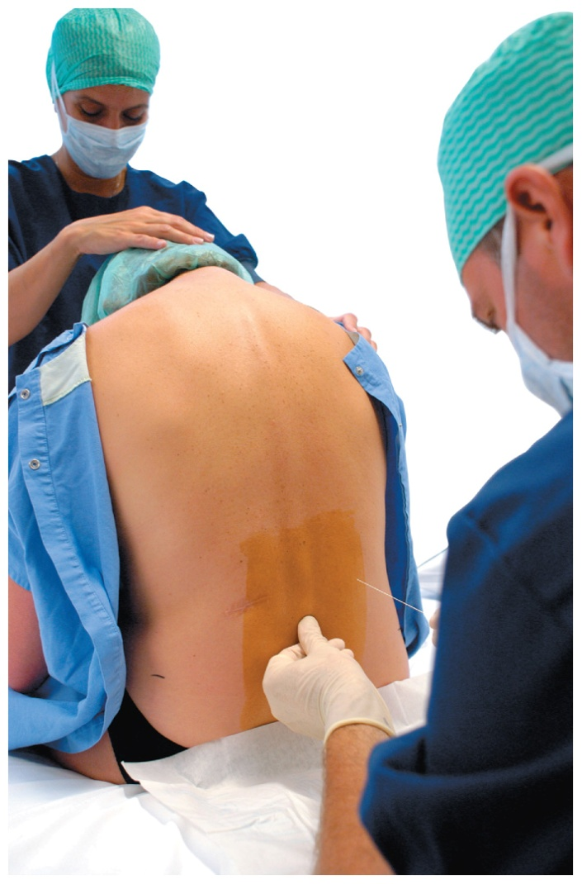
Chapter 12 Alcohols, Thiols, Ethers, Aldehydes, and Ketones
Anesthesia is typically administered by a nurse anesthetist who provides care before, during, and after a medical procedure. A nurse anesthetist gives medications to keep a patient asleep and pain-free while monitoring the patient’s vital signs.

Slide 2
Chapter 12 Readiness
Core Chemistry Skills
Naming and Drawing Alkanes (11.2)

Slide 3
12.1 Alcohols, Phenols, Thiols, and Ethers
Functional groups such as
an alcohol contain a hydroxyl group (—OH)
a phenol contain a hydroxyl group (—OH) bonded to a benzene ring
a thiol contain an —SH group
an ether contain a C—O—C group
Learning Goal Give the IUPAC and common names for alcohols and phenols; give the common names for thiols and ethers. Draw their condensed structural formulas or skeletal formulas.

Slide 4
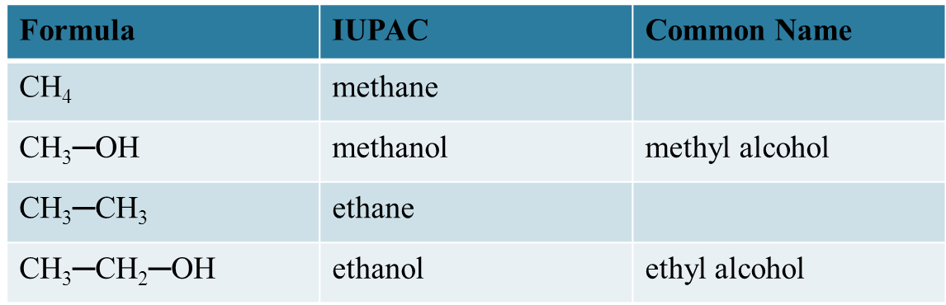
Naming Alcohols
The names of alcohols
in the IUPAC system replace the e with ol
with common names use the name of the alkyl group
followed by alcohol
Core Chemistry Skill Naming Alcohols and Phenols

Slide 5
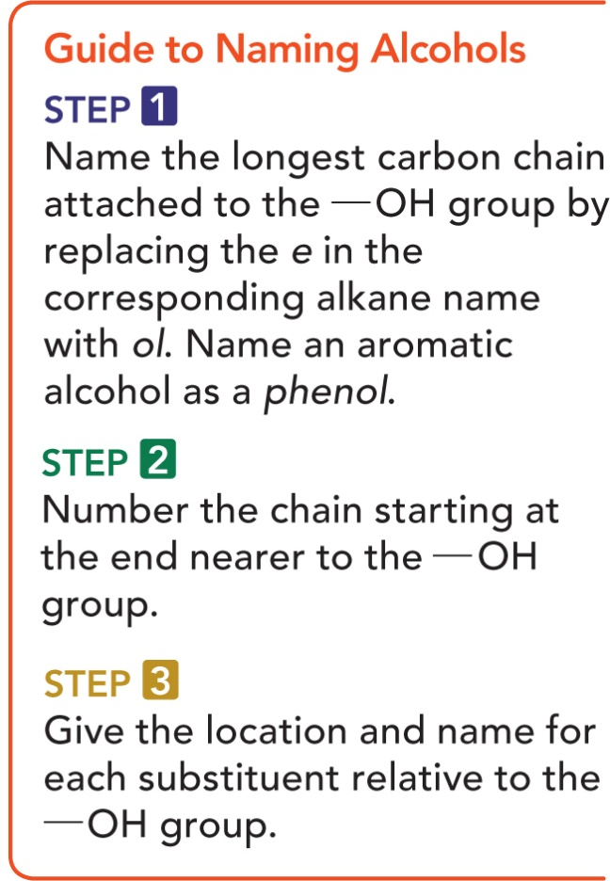
Guide to Naming Alcohols

Slide 6
Naming of Alcohols
Give the IUPAC name for the following compound:

Slide 7
Naming of Alcohols
Give the IUPAC name for the following compound:
SOLUTION:
ANALYZE Functional Family IUPAC
THE Group Naming
PROBLEM hydroxyl group alcohol replace the e in
alkane name with ol

Slide 8
Naming of Alcohols
Give the IUPAC name for the following compound:
STEP 1 Name the longest carbon chain attached to
the —OH group by replacing the e in the
corresponding alkane name with ol.
hexanol

Slide 9
Naming of Alcohols
Give the IUPAC name for the following compound:
STEP 2 Number the chain starting at the end nearer to the
—OH group.
2-hexanol
6 5 4 3 2 1

Slide 10
Naming of Alcohols
Give the IUPAC name for the following compound:
STEP 3 Give the location and name for each substituent relative to the —OH group.
5-methyl-2-hexanol
6 5 4 3 2 1

Slide 11
Study Check
Give the IUPAC name for the following compounds:
A.
B.

Slide 12
Solution
Give the IUPAC name for the following compounds:
A.
ANALYZE Functional Family IUPAC
THE Group Naming
PROBLEM
hydroxyl group alcohol
replace the e in
alkane with ol

Slide 13
Solution
Give the IUPAC name for the following compounds:
B.
ANALYZE Functional Family IUPAC
THE Group Naming
PROBLEM
hydroxyl group phenol
benzene ring
phenol with substituent,
number ring to give
substituent lower number

Slide 14
Solution
STEP 1 Name the longest carbon chain attached to
the —OH group by replacing the e in the
corresponding alkane name with ol. Name
an aromatic alcohol as a phenol.
A. pentanol
B. phenol

Slide 15
Solution
STEP 2 Number the chain starting at the end closer to the
—OH. The compound is a phenol because it consists
of an —OH group attached to a benzene ring.
A. 2-pentanol
B. phenol
5
4
3
2
1
2
3
1

Slide 16
Solution
STEP 3 Give the location and name for each substituent relative to the —OH group.
A. 4-methyl-2-pentanol
B. 3-bromophenol
5
4
3
2
1
2
3
1

Slide 17
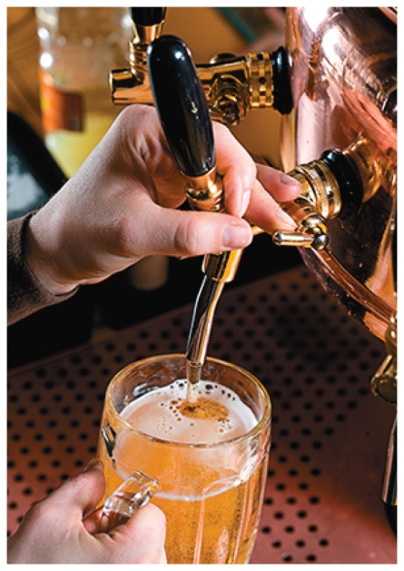
Chemistry Link to Health:
Alcohols and Phenols
Ethanol (ethyl alcohol)
has been known since prehistoric times as
an intoxicating product
is formed by the fermentation of grains,
sugars, and starches
C₆H₁₂O₆ 2CH₃—CH₂—OH + 2 CO₂
Fermentation

Slide 18
Chemistry Link to Health:
Alcohols and Phenols
Ethanol (ethyl alcohol)
is produced by reacting ethene and water at high temperatures and pressures for commercial use
is used as a solvent for perfumes, varnishes, and some medicines, such as tincture of iodine
H₂C CH₂ + H₂O CH₃—CH₂—OH
Ethene Alcohol

Slide 19
Chemistry Link to Health:
Alcohols and Phenols
1,2,3-propanetriol (glycerol)
is a trihydroxy alcohol
is a viscous liquid obtained from
oils and fats during the production
of soaps
has three polar —OH groups that account for its strong attraction to water molecules
is used as a skin softener in products such as skin lotions, cosmetics, shaving creams, and liquid soaps

Slide 20
Chemistry Link to Health:
Alcohols and Phenols
Ethylene glycol is used
as an antifreeze in heating and
cooling systems
as a solvent for paints, inks, and plastics
in the production of synthetic fibers such as Dacron
Because its sweet taste is attractive to pets and children, ethylene glycol must be carefully stored. If ingested, it is oxidized to oxalic acid and forms insoluble salts in the kidneys that cause renal damage. It is therefore considered to be extremely toxic.

Slide 21
Chemistry Link to Health:
Alcohols and Phenols
Bisphenol A (BPA) is used to make polycarbonate, a clear plastic that is used to manufacture beverage bottles, including baby bottles.
Washing polycarbonate bottles with certain detergents or at high temperatures disrupts the polymer, causing small amounts of BPA to leach from the bottles.

Slide 22
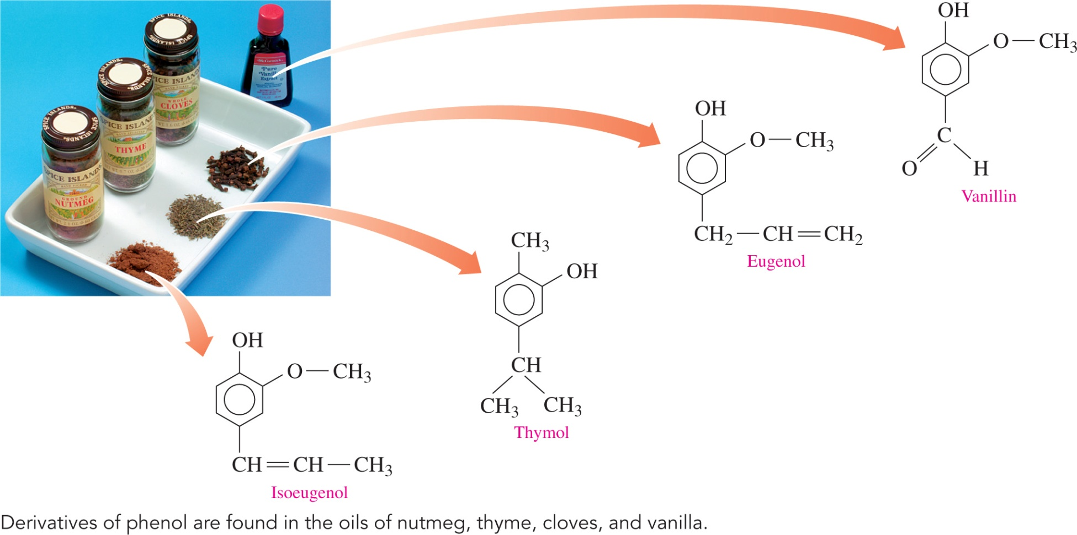
Chemistry Link to Health:
Alcohols and Phenols

Slide 23
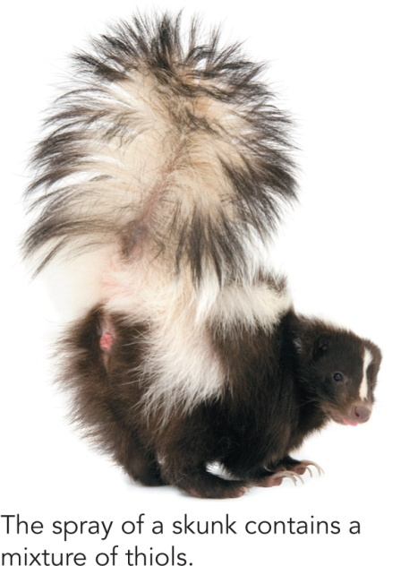
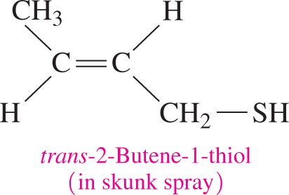
Thiols
Thiols
contain sulfur
contain a thiol (—SH) group
often have strong and sometimes disagreeable odors
are found in cheese, onions, garlic, and oysters
are used to detect gas leaks

Slide 24
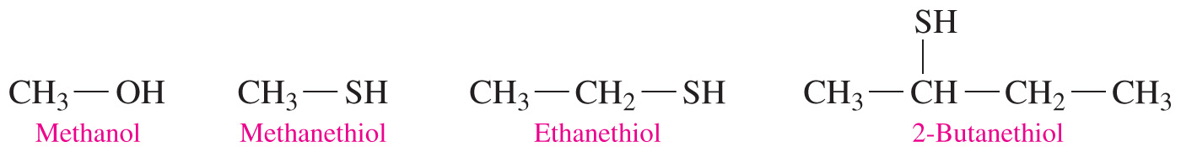
Naming Thiols
In the IUPAC system, thiols are named by adding thiol to the alkane name of the longest carbon chain and numbering the carbon chain from the end nearer the —SH group.

Slide 25
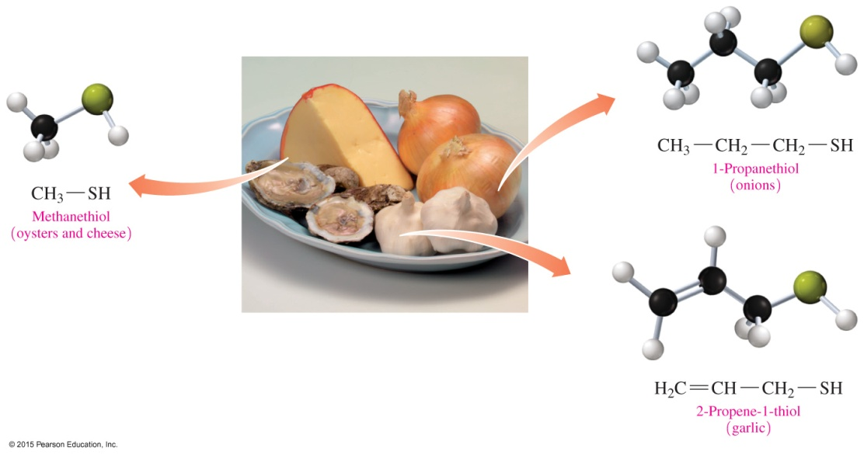
Naming Thiols
Thiols are a family of sulfur-containing organic compounds that have a thiol group (—SH).

Slide 26
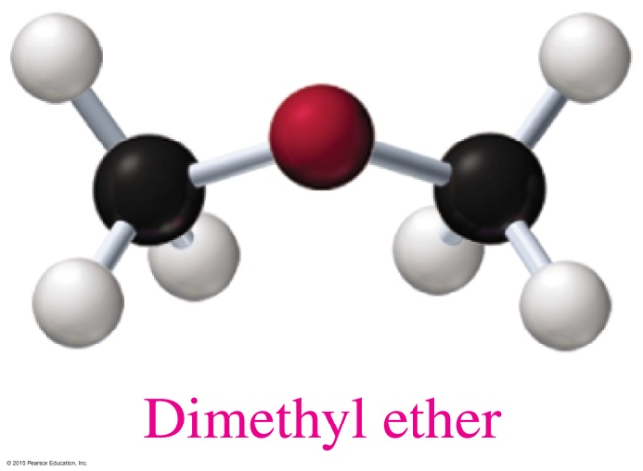
Ethers
An ether
contains an —O— between two carbon groups that are alkyls or aromatic rings
has a bent structure, like water and alcohols do
has a common name that gives the alkyl names of the attached groups, followed by ether
CH₃—O—CH₃
Dimethyl ether

Slide 27
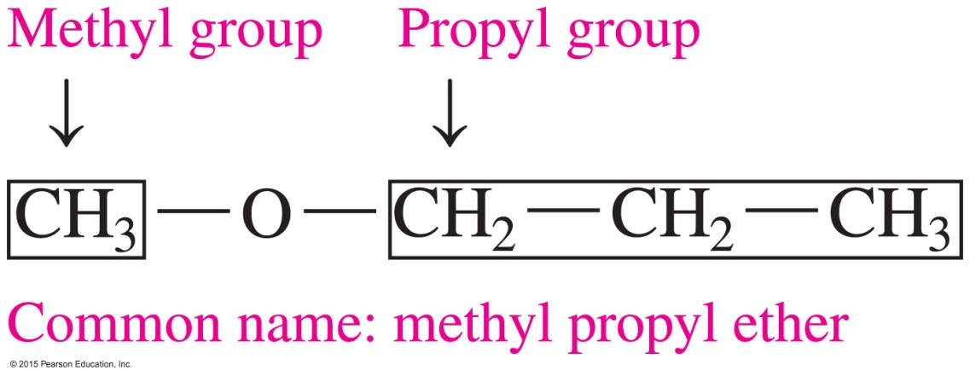
Naming Ethers
Most ethers have common names. The names
of each alkyl or aromatic group attached to the oxygen atom are written in alphabetical order
of the alkyl groups are followed by the word ether
In this text, we will use only the common names of ethers.

Slide 28
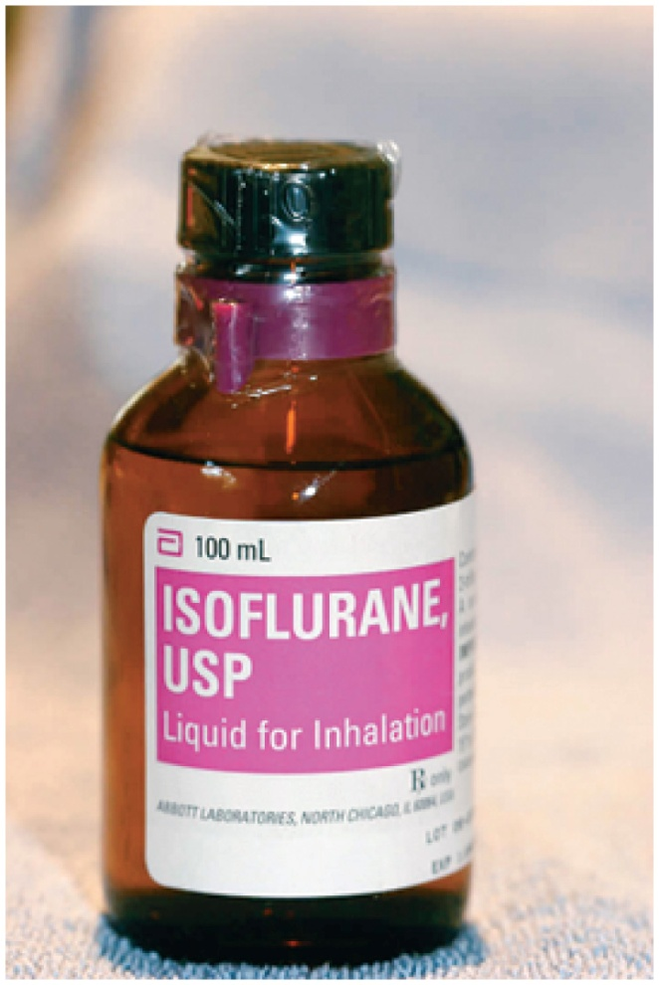
Chemistry Link to Health:
Ethers as Anesthetics
Anesthesia is the loss of sensation and consciousness. A general anesthetic is a substance that
blocks signals to the awareness centers in the brain
gives the patient a loss of memory,
a loss of feeling pain, and an
artificial sleep

Slide 29
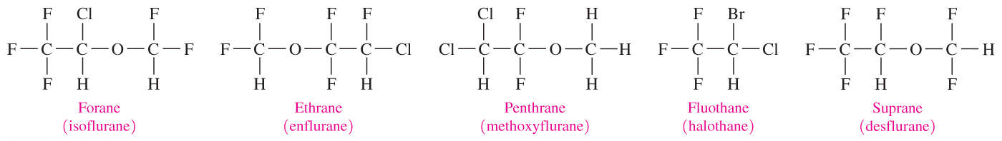
Chemistry Link to Health:
Ethers as Anesthetics
Ether was used in anesthetics for hundreds of years until the 1950s, when a new group of anesthetics were developed that
retain the ether group
replace hydrogen atoms on the carbon with halogen atoms to reduce the volatility and flammability of the ethers

Slide 30
Study Check
Write the structures of the following:
A. 3-Pentanol
Ethanol
C. Diethyl ether

Slide 31
Solution
Write the structures of the following:
A. 3-Pentanol
B. Ethanol
C. Diethyl ether

