Slide 1
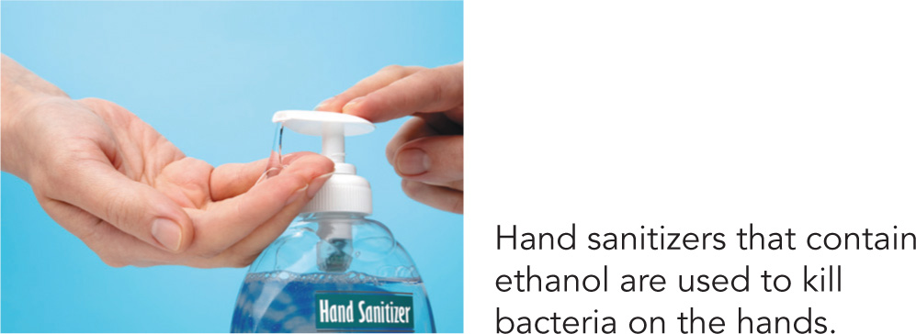
12.2 Properties of Alcohols
In an alcohol-containing sanitizer, the amount of ethanol is typically 60% (v/v) but can be as high as 85% (v/v). Because alcohols are flammable, hand sanitizers are a fire hazard in the home.
Learning Goal Describe the classification of alcohols; describe the solubility of alcohols in water.

Slide 2
Classification of Alcohols
Alcohols are classified
by the number of alkyl groups attached to the carbon bonded to the hydroxyl
as primary (1°), secondary (2°), or tertiary (3°)

Slide 3
Study Check
Classify each alcohol as primary, secondary, or tertiary.
A.
B. CH₃—CH₂—CH₂—OH
C.

Slide 4
Solution
Classify each alcohol as primary, secondary, or tertiary.
A. secondary
B. CH₃—CH₂—CH₂—OH primary
C. tertiary

Slide 5
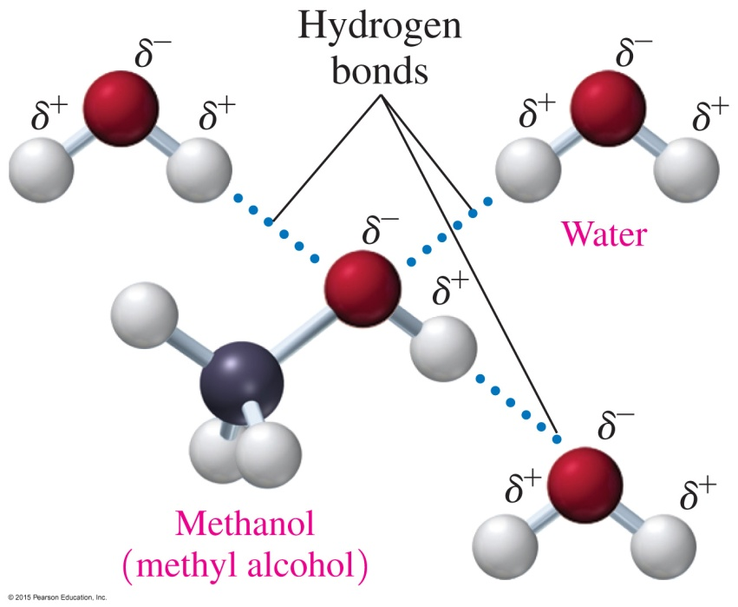
Solubility of Alcohols in Water
Alcohols
contain polar —OH groups and form hydrogen bonds with other alcohol molecules and with water
that have one to three carbons are soluble in water; the solubility of alcohols in water decreases with increasing number of carbons

Slide 6
Solubility of Alcohols and Ethers in Water

Slide 7
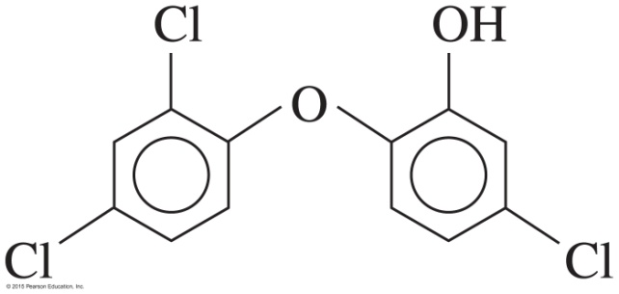
Chemistry Link to Health: Hand Sanitizers
Hand sanitizers containing ethanol as their active ingredient
are used as an alternative to washing hands
kill most bacteria and viruses that spread colds and flu
are approximately 60% (v/v) but can be as high as 85% (v/v)
are highly flammable and produce a transparent blue flame
may also contain triclosan, which can accumulate in the environment, promoting growth of antibiotic-resistant bacteria

Slide 8
Solubility of Phenols
Phenols
are slightly soluble in water
have an —OH group that can form hydrogen bonds with water
can react with water to produce phenoxide ions
were once used as antiseptics
–
+ H₂O + H₃O⁺

Slide 9
Study Check
Indicate whether each of the following is soluble in water
and explain why:
A. CH₃—CH₂—CH₂—CH₂—CH₂—CH₂—OH
B. CH₃—CH₂—OH

Slide 10
Solution
Indicate whether each of the following is soluble in water and explain why:
A. CH₃—CH₂—CH₂—CH₂—CH₂—CH₂—OH
not soluble
Alcohols with long carbon chains (nonpolar) are not soluble.
CH₃—CH₂—OH
soluble
Short-chain alcohols form hydrogen bonds with water.

