Slide 1
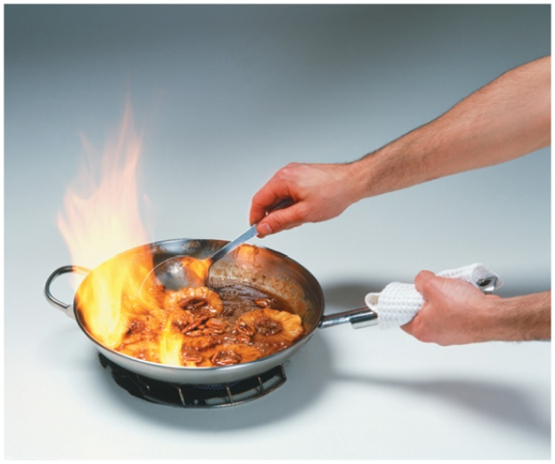
12.4 Reactions of Alcohols, Thiols, Aldehydes, and Ketones
A flaming dessert is
prepared using heat
from the combustion
of an alcohol:
2CH₃—CH₂—OH(g) + 6O₂(g) → 4CO₂(g) + 6H₂O(g) + energy
Learning Goal Write balanced chemical equations for the combustion, dehydration, and oxidation of alcohols. Write
balanced chemical equations for the oxidation and reduction of thiols, aldehydes, and ketones.

Slide 2
Dehydration of Alcohols
Alcohols undergo
dehydration when heated with an acid catalyst
the loss of —H and —OH from adjacent carbon atoms, producing an alkene and water
H⁺, heat
+ H₂O
alcohol alkene

Slide 3
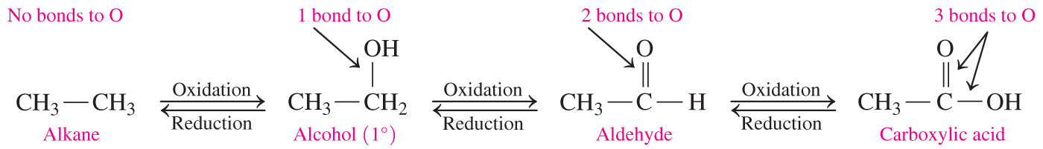
Oxidation and Reduction
In organic chemistry,
oxidation reactions increase the number of carbon–oxygen bonds by the addition of oxygen or a loss of hydrogen atoms
reduction reactions reduce the number of bonds between carbon and oxygen atoms

Slide 4
Oxidation of 1° Alcohols
Alcohols undergo oxidation, which increases the number of carbon and oxygen bonds.
Primary alcohols are oxidized to produce an aldehyde.
1 bond to O 2 bonds to O
oxidation
1° alcohol aldehyde

Slide 5
Oxidation of 1° Alcohols
Aldehydes can further oxidize to produce a carboxylic acid.
2 bonds to O 3 bonds to O
oxidation
aldehyde carboxylic acid

Slide 6
Oxidation of 2° Alcohols
Secondary alcohols are oxidized to produce a ketone.
To indicate the process of oxidation, [O] is placed over the reaction arrow.
1 bond to O 2 bonds to O
[O]
2° alcohol ketone

Slide 7
Oxidation of 3° Alcohols
Tertiary (3°) alcohols do not readily oxidize because there is no hydrogen atom on the carbon bonded to the —OH group.
[O]
no product
no H to oxidize
3° alcohol

Slide 8
Chemistry Link to Health:
Methanol Poisoning
Methanol is
also known as methyl alcohol
highly toxic and found in windshield washer fluid, Sterno, and paint strippers
rapidly absorbed and oxidized to formaldehyde and then formic acid
[O] [O]
methyl alcohol formaldehyde formic acid

Slide 9
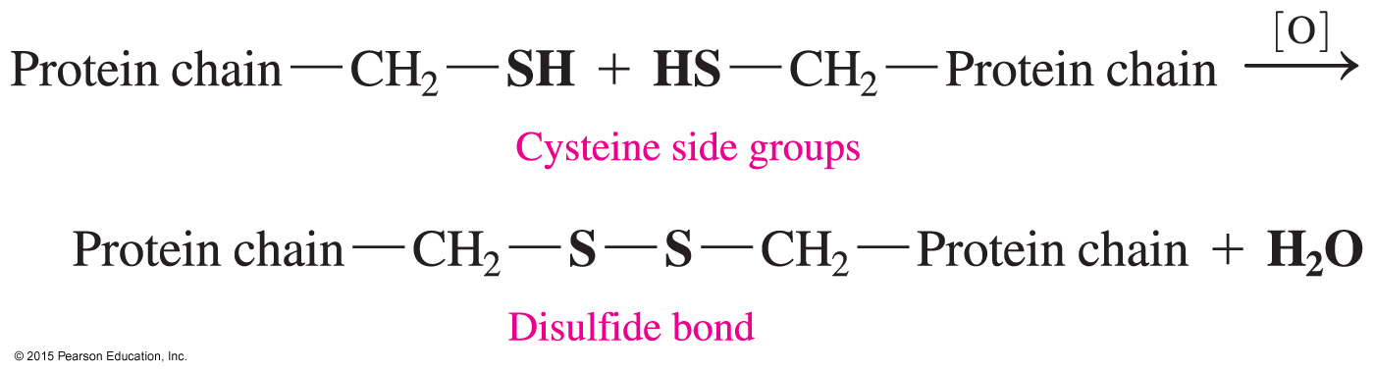
Oxidation of Thiols
When thiols undergo oxidation,
an H atom is lost from each of two —SH groups
the product is a disulfide
protein in hair is cross-linked by disulfide bonds found in the amino acid cysteine

Slide 10
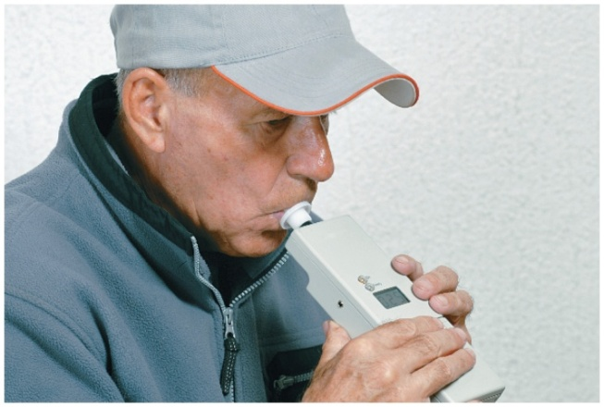
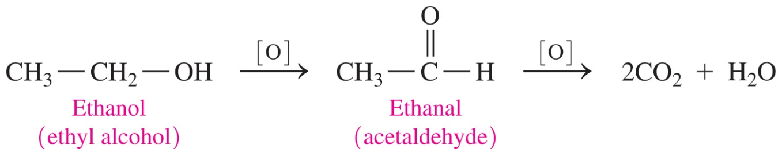
Ethanol, CH₃CH₂OH
Ethanol
acts as a depressant and kills or disables more people than any other drug
consumption can be analyzed by
using a breathalyzer
is metabolized by a social drinker at a
rate of 12–15 mg/dL per hour
is metabolized by an alcoholic at a rate of 30 mg/dL per hour

Slide 11
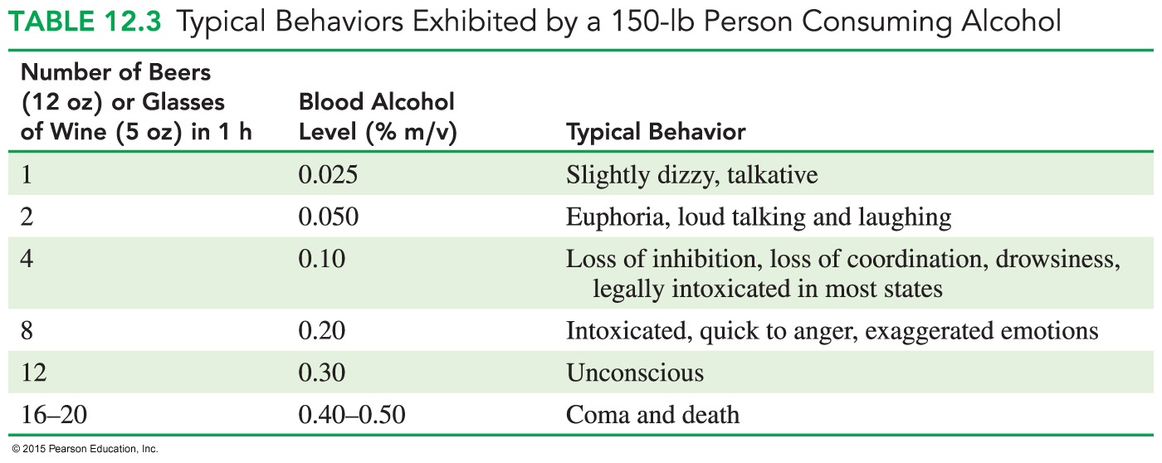
Effect of Alcohol on the Body

Slide 12
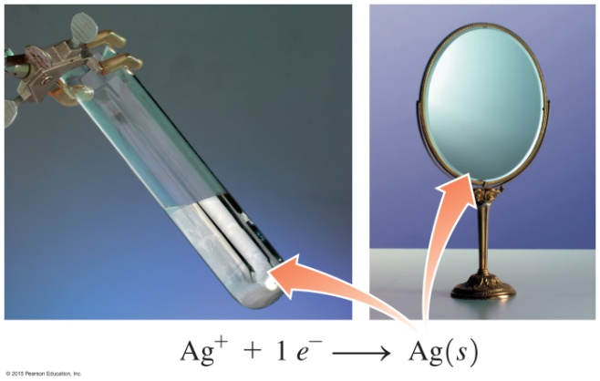
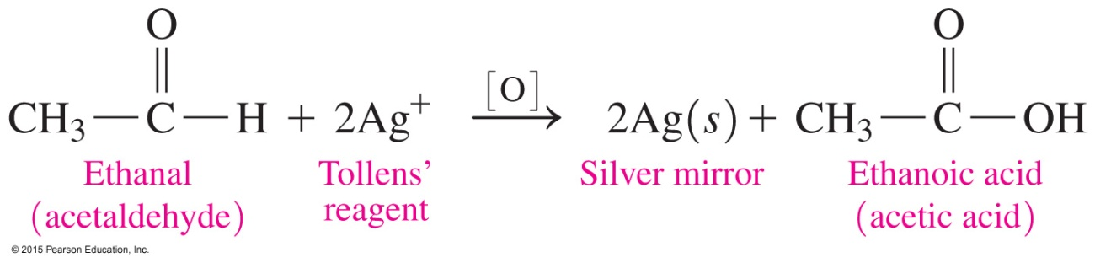
Tollens’ Test
In Tollens’ test,
Tollens’ reagent, which contains Ag⁺, oxidizes aldehydes but not ketones
Ag⁺ is reduced to metallic Ag, which looks like a mirror in
the test tube

Slide 13
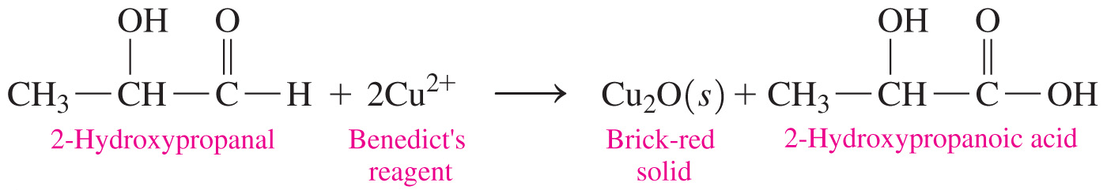
Benedict’s Test
In Benedict’s test, Benedict’s reagent, which contains Cu²⁺, reacts with aldehydes that have an adjacent —OH group.
When Benedict’s solution containing Cu²⁺ (CuSO₄) ions is added to this type of aldehyde and heated, a brick-red solid of Cu₂O forms from the aldehyde.
The test is negative with simple aldehydes and ketones.

Slide 14
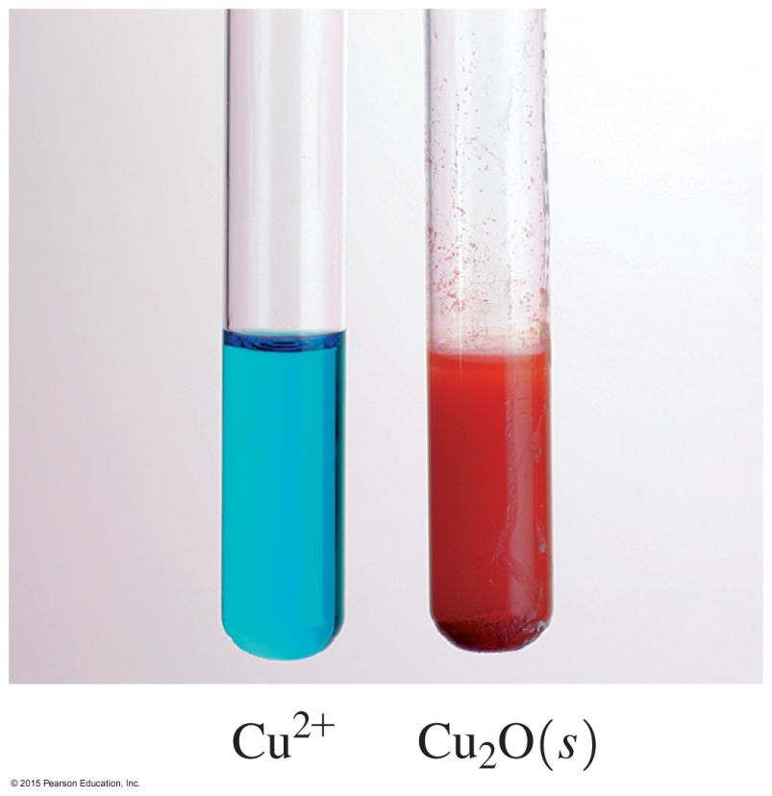
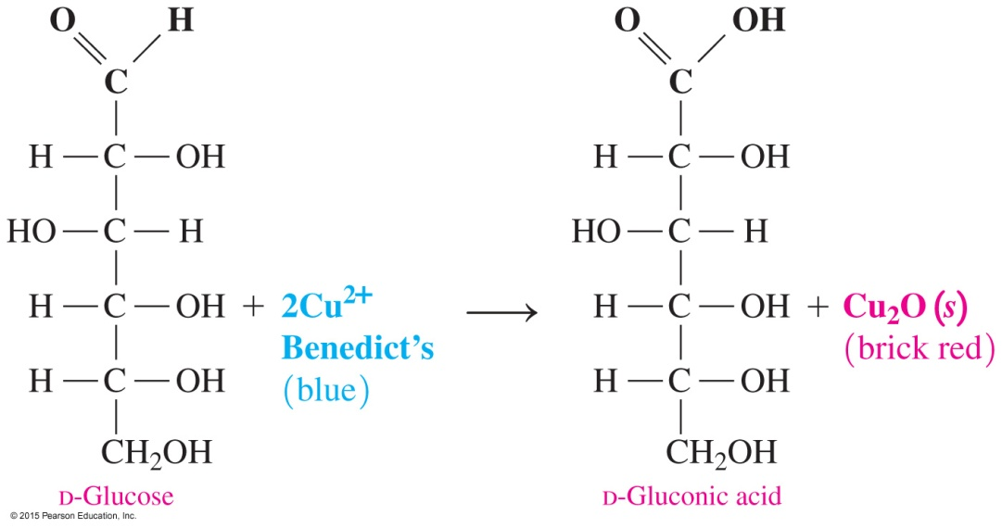
Benedict’s Test
In Benedict’s test, the blue Cu²⁺ in Benedict’s solution forms a brick-red solid of Cu₂O in a positive test for many sugars and aldehydes with adjacent hydroxyl groups.

Slide 15
Reduction of Aldehydes and Ketones
In the reduction of organic compounds,
aldehydes and ketones are reduced by sodium borohydride (NaBH₄) or hydrogen (H₂)
the number of carbon–oxygen bonds is reduced by the addition of hydrogen or the loss of oxygen
a catalyst such as nickel, platinum, or palladium is needed for the addition of hydrogen to the carbonyl group

Slide 16
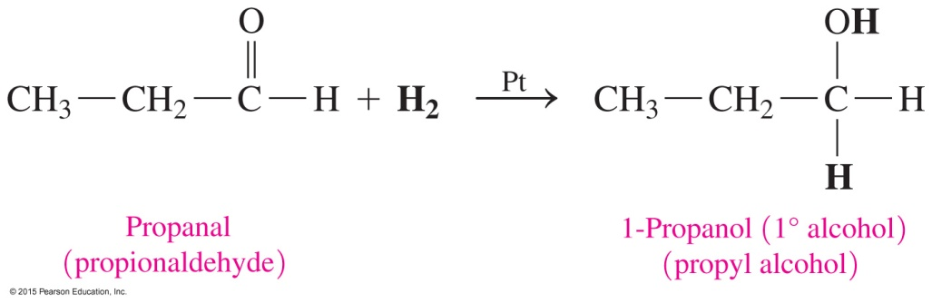
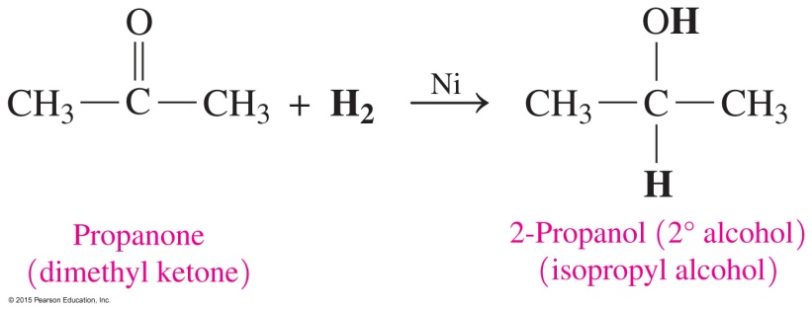
Reduction of Aldehydes and Ketones
Aldehydes reduce to form primary alcohols, and ketones reduce to form secondary alcohols.
A catalyst such as nickel, platinum, or palladium is needed for the addition of hydrogen to the carbonyl group.

Slide 17
Study Check
Select the product for the oxidation of the following:
[O]
A. B.
C. CO₂ + H₂O D.

Slide 18
Solution
Select the product for the oxidation of the following:
[O]
The correct answer is B.

Slide 19
Study Check
Select the product when CH₃—CH₂—CH₂—OH undergoes each of the following reactions:
[O] [O]
B. C.
1)
2) CO₂ + H₂O
3)
4)

Slide 20
Solution
Select the product when CH₃—CH₂—CH₂—OH undergoes each of the following reactions:
[O] [O]
B. C.
B. 3)
C. 4)

Slide 21
Study Check
Give the primary product for the reaction of 2-propanol when it undergoes
A. oxidation
B. dehydration

Slide 22
Solution
= 2-propanol = C₃H₈O
A. oxidation
[O]
2
B. dehydration
H⁺, heat
+ H₂O

Slide 23
Study Check
Write the structure and name of the organic product when each is mixed with Tollens’ reagent.
A. butanal
B. acetaldehyde
C. ethyl methyl ketone

Slide 24
Solution
A.
Tollens’
butanal butanoic acid
B.
Tollens’
    acetaldehyde acetic acid
ethyl methyl ketone + Tollens’ = no reaction
    Ketones are not oxidized by Tollens’ reagent.

Slide 25
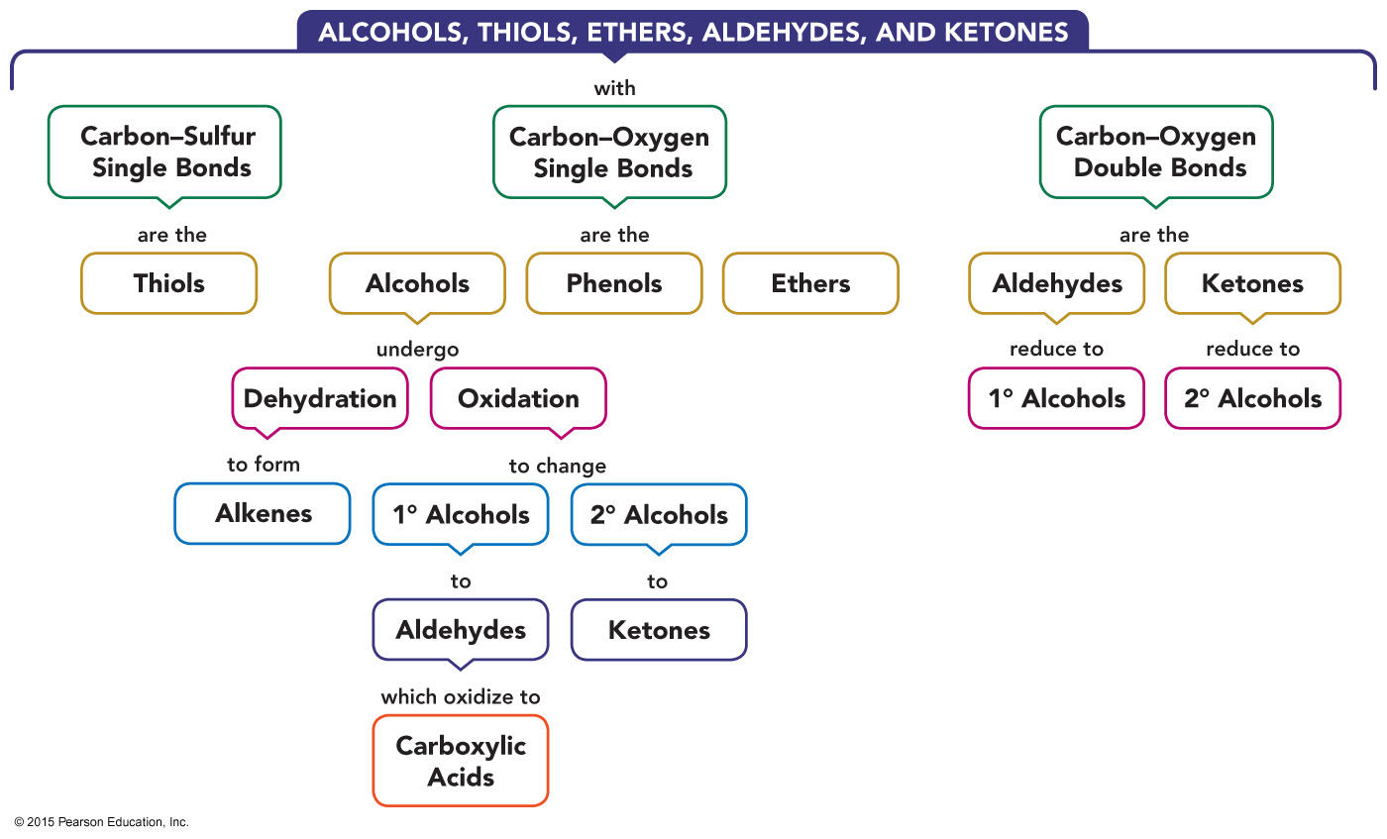
Concept Map

