Slide 1
Chapter 13 Carbohydrates
Paula, a diabetes nurse, teaches Kate to test her blood glucose levels before and after a meal.
Paula explains to her that her pre-meal number should be 110 mg/dL or less, and if it increases by more than 50 mg/dL, she needs to lower the amount of carbohydrates she consumes.

Slide 2
Chapter 13 Readiness
Core Chemistry Skills
Identifying Functional Groups (12.1)
Naming Alcohols and Phenols (12.1)
Naming Aldehydes and Ketones (12.3)
Writing Equations for the Dehydration and Oxidation of Alcohols (12.4)

Slide 3
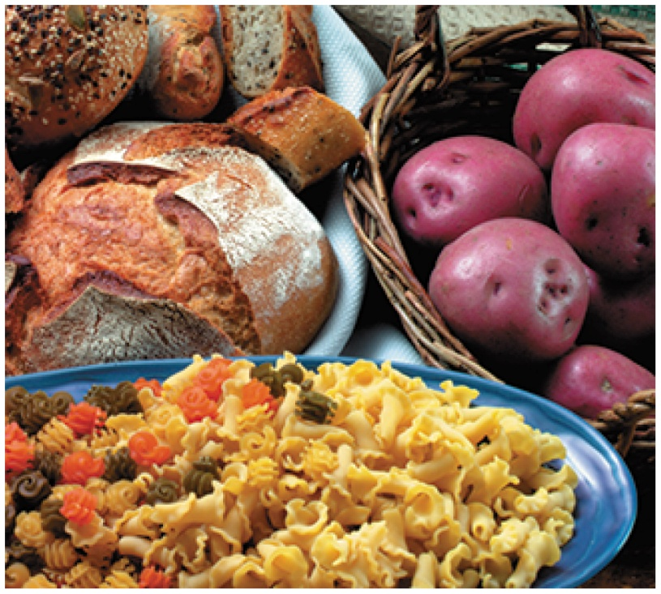
13.1 Carbohydrates
Carbohydrates are
a major source of energy from our diet
made from the elements carbon, hydrogen, and oxygen
also called saccharides, which means “sugars”
Learning Goal Classify a monosaccharide as an aldose or a ketose, and indicate the number of carbon atoms.

Slide 4
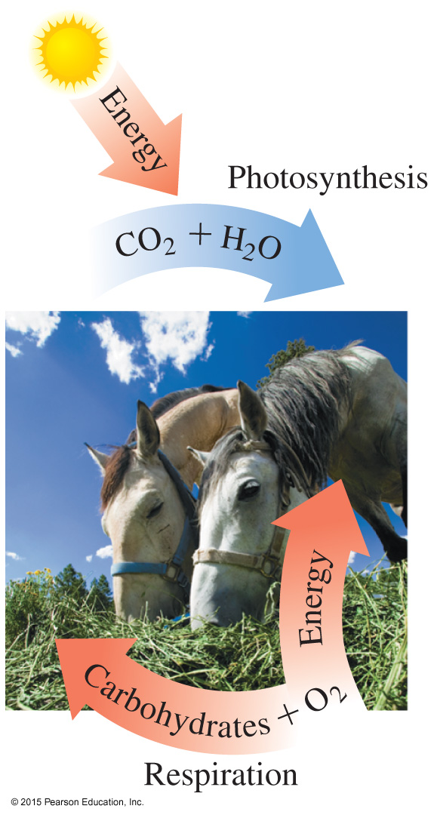
Carbohydrates
Carbohydrates, such as glucose,
are produced by photosynthesis in plants
are synthesized in plants from CO₂, H₂O, and energy from the sun
are oxidized in living cells to produce CO₂, H₂O, and energy

Slide 5
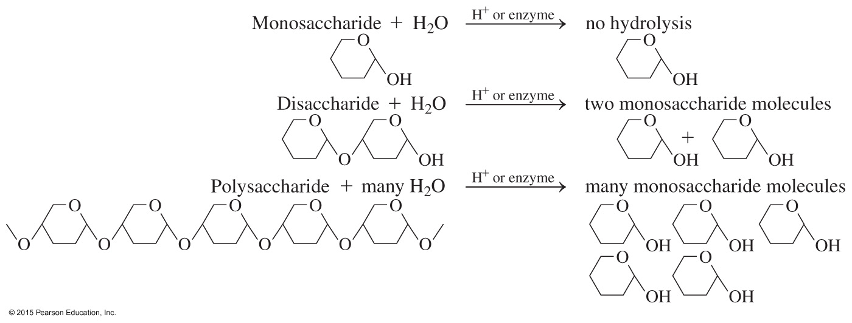
Types of Carbohydrates
The types of carbohydrates are
monosaccharides, the simplest carbohydrates
disaccharides, which consist of two monosaccharides
polysaccharides, which contain many monosaccharides

Slide 6
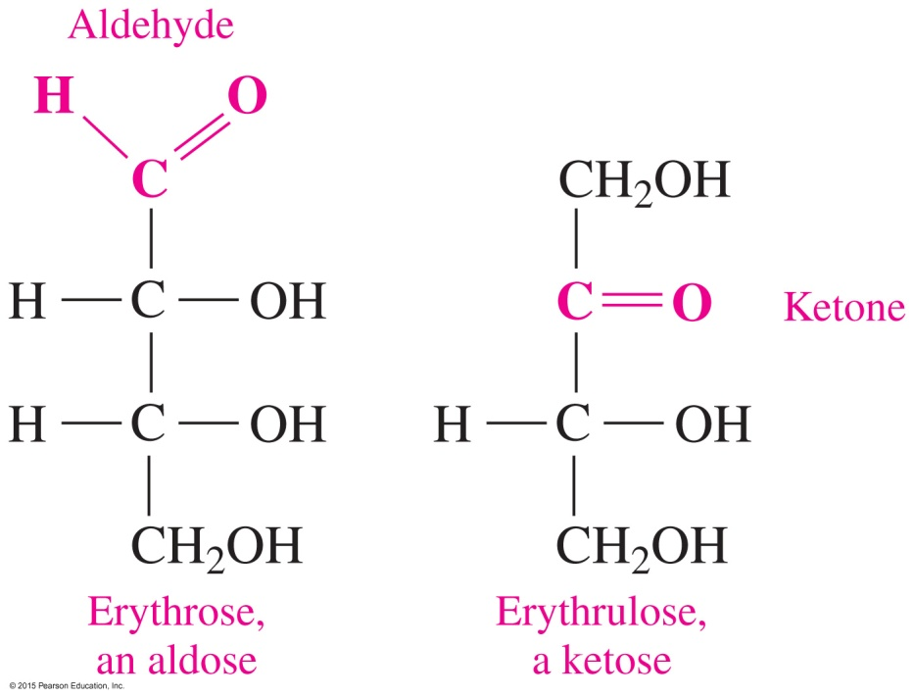
Monosaccharides
Monosaccharides
consist of three to eight carbon chains with one carbon in a carbonyl group
containing an aldehyde group are classified as an aldoses
containing a ketone group are classified as a ketoses
have hydroxyl groups on all carbons except the carbonyl carbon

Slide 7
Types of Monosaccharides
Monosaccharides are also classified by the number of carbon atoms present.
triose (three C atoms) tetrose (four C atoms)
pentose (five C atoms) hexose (six C atoms)
An aldopentose is a five-carbon saccharide with an aldehyde group.
A ketohexose is a six-carbon saccharide with a ketone group.

Slide 8
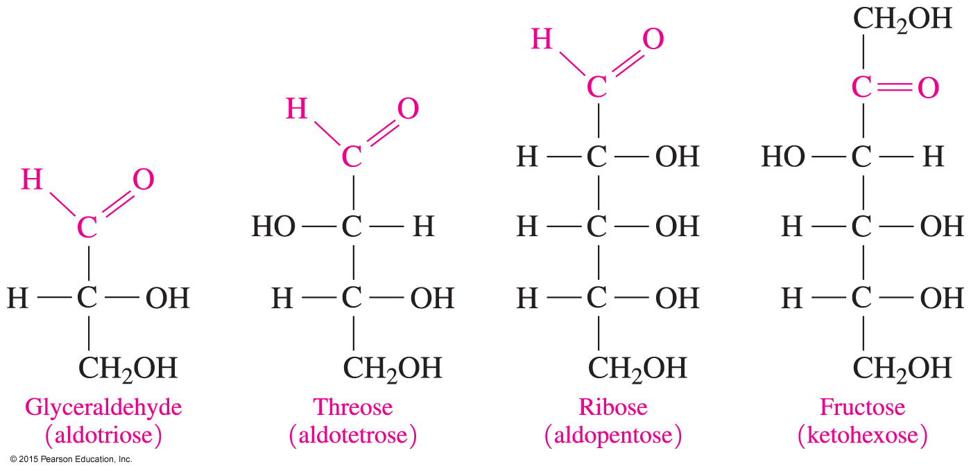
Types of Monosaccharides

Slide 9
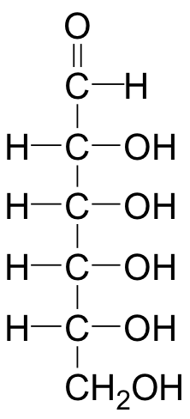
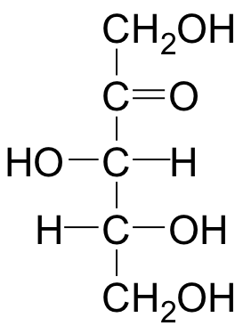
Study Check
Identify each as aldo or keto and as tetrose, pentose, or hexose.
A. B.

Slide 10
Solution
Identify each as aldo or keto and as tetrose, pentose, or hexose.
A. aldohexose B. ketopentose

