Slide 1
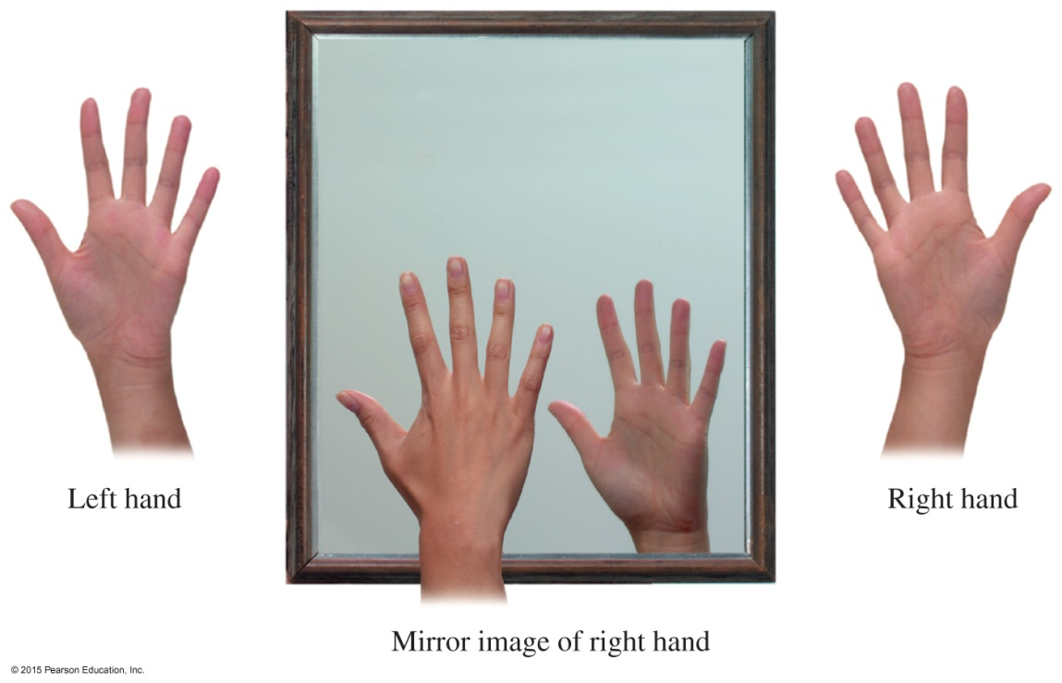
13.2 Chiral Molecules
Left and right hands are chiral because they have mirror images that cannot be superimposed on each other.
Learning Goal Identify chiral and achiral carbon atoms in an organic molecule.

Slide 2
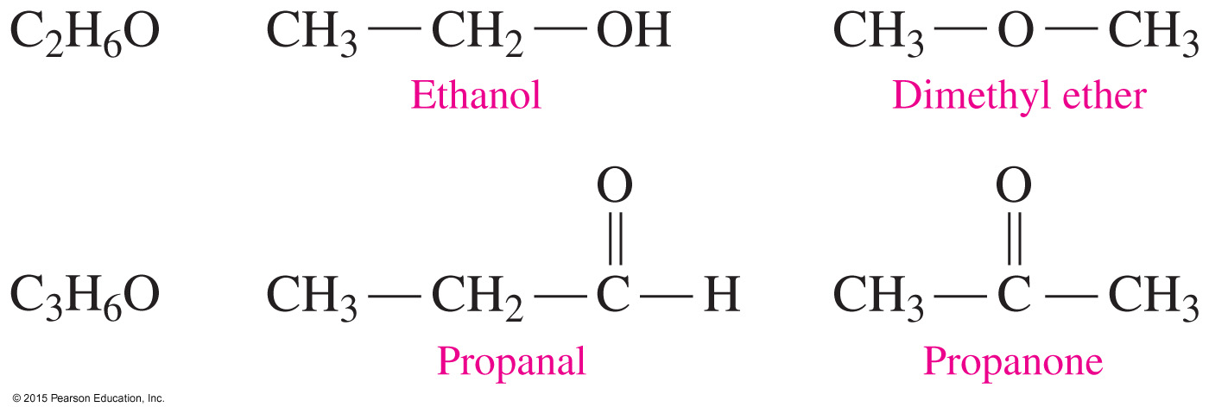
Structural Isomers
Molecules are structural isomers when they have the same molecular formula but different bonding arrangements.

Slide 3
Stereoisomers
Stereoisomers have identical molecular formulas
and are not structural isomers
with atoms bonded in the same sequence but differ in the way they are arranged in space
When the mirror images of organic molecules cannot be completely matched, they are
nonsuperimposable
chiral (pronunciation 'kai-rel)

Slide 4

Chirality
Chiral molecules have
the same number of atoms
but are arranged differently in space
a nonsuperimposable mirror image
Hands are like chiral molecules—they are mirror images and cannot be superimposed.
When the mirror images of molecules are identical and superimposable, the molecules are achiral.

Slide 5
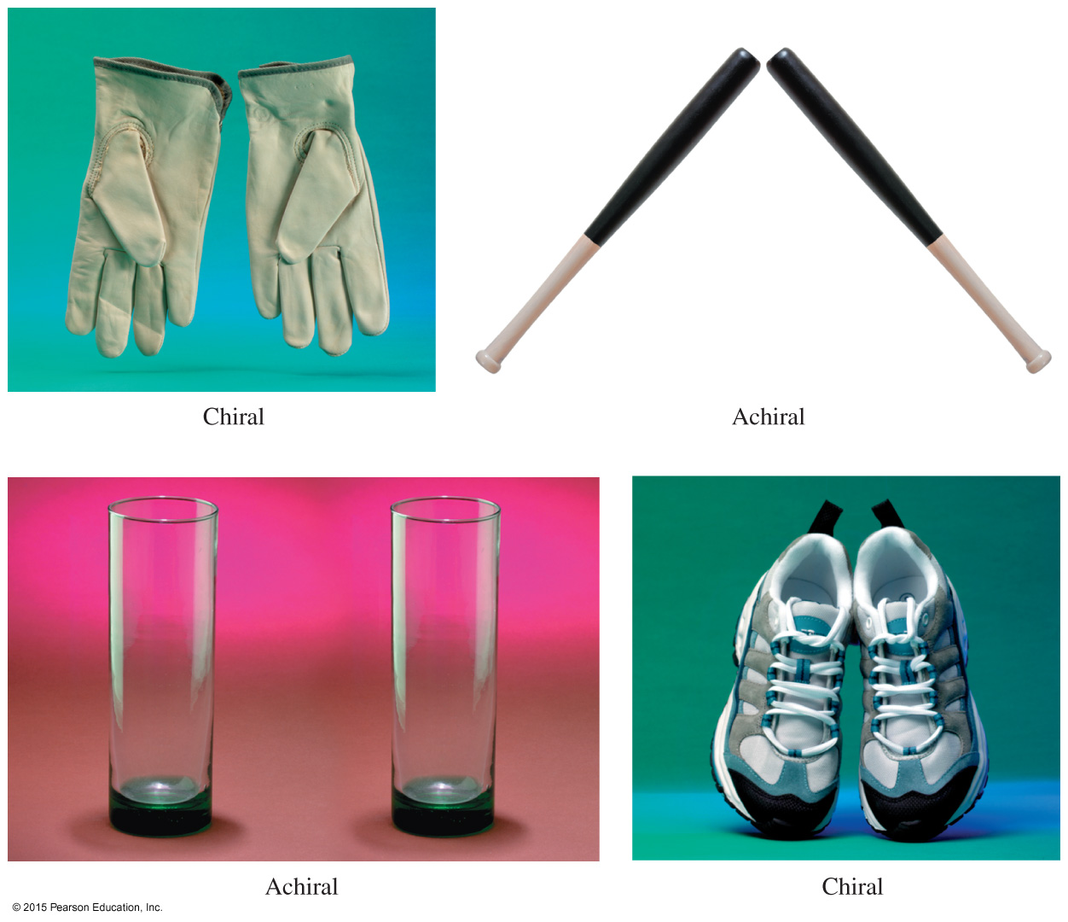
Everyday Objects, Chiral and Achiral

Slide 6
Chiral Carbon Atoms
Molecules are chiral when they have
at least one or more chiral carbon atoms
a carbon atom, bonded to four different groups
nonsuperimposable mirror images
Core Chemistry Skill Identifying Chiral Molecules

Slide 7
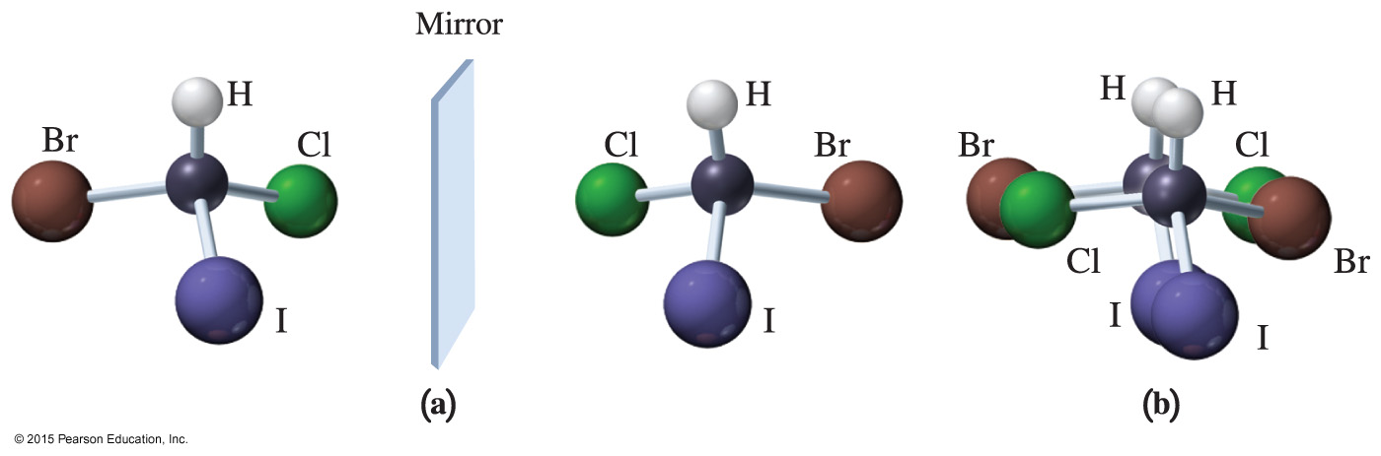
Chiral Carbon Atoms
The mirror image of a chiral compound cannot be superimposed.
When stereoisomers cannot be superimposed, they are called enantiomers.

Slide 8
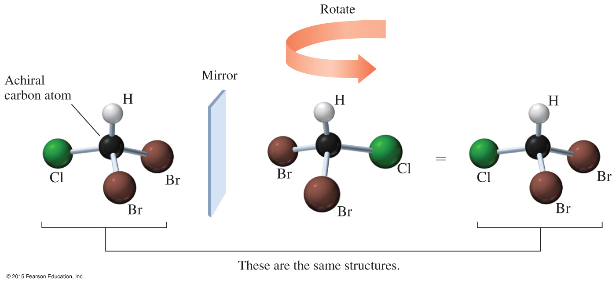
Achiral Carbon Atoms
When the mirror image of an achiral structure is rotated, and the structures can be aligned with each other, their mirror images are said to be superimposable.

Slide 9
Study Check
Identify each as a chiral or an achiral compound.
C
l
C
l
C
l
H
C
C
H
H
C
C
H
3
H
C
C
H
3
3
C
H
C
H
H
B
r
2
3
A.
B.
C.

Slide 10
Solution
Identify each as a chiral or an achiral compound.
chiral achiral chiral
C
l
C
l
C
l
H
C
C
H
H
C
C
H
3
H
C
C
H
3
3
C
H
C
H
H
B
r
2
3
A.
B.
C.

Slide 11
Drawing Fischer Projections
A Fischer projection
is a two-dimensional representation of a three-dimensional molecule
places the most highly oxidized carbon group at the top
uses vertical lines in place of dashes for bonds that go back
uses horizontal lines in place of wedges for bonds that
come forward

Slide 12
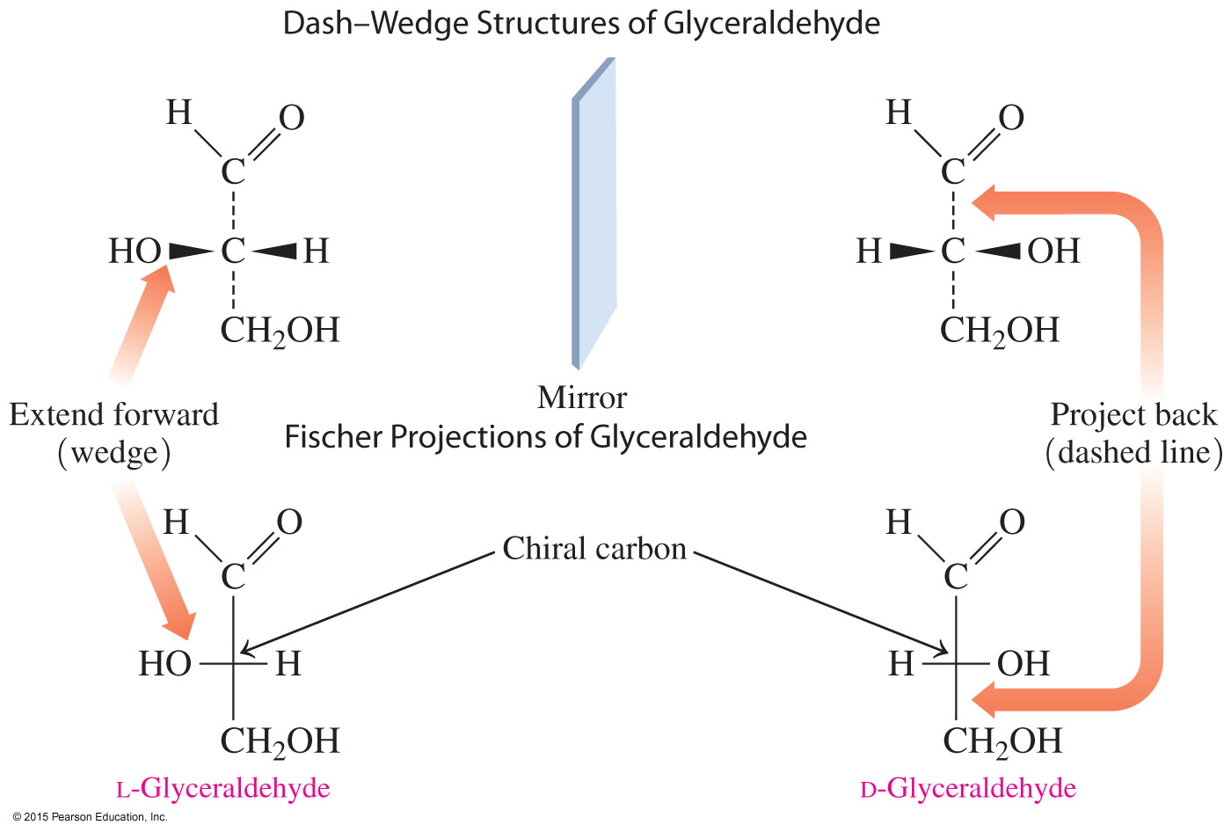
Chiral Carbon, Fischer Projections

Slide 13
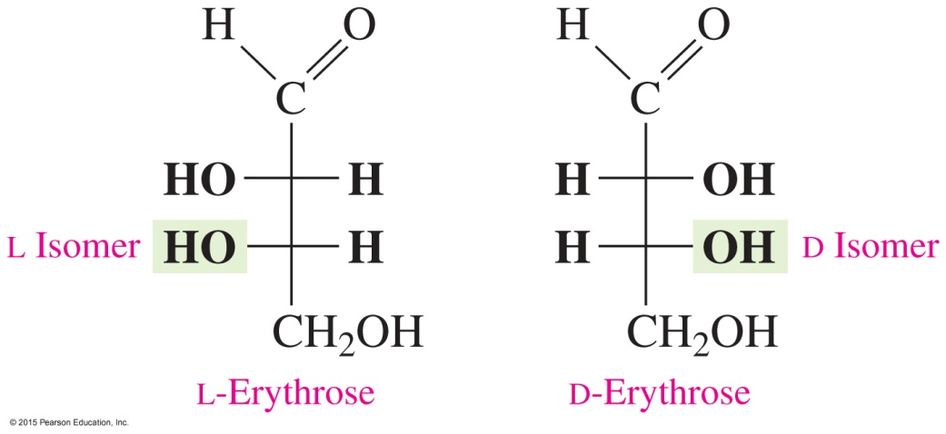
D and L Notations
D or L isomers are assigned according to the position of the
— OH group on the chiral carbon farthest from the carbonyl carbon.
The letter L is assigned to the structure with the — OH on the left.
The letter D is assigned to the structure with the — OH on the right.

Slide 14
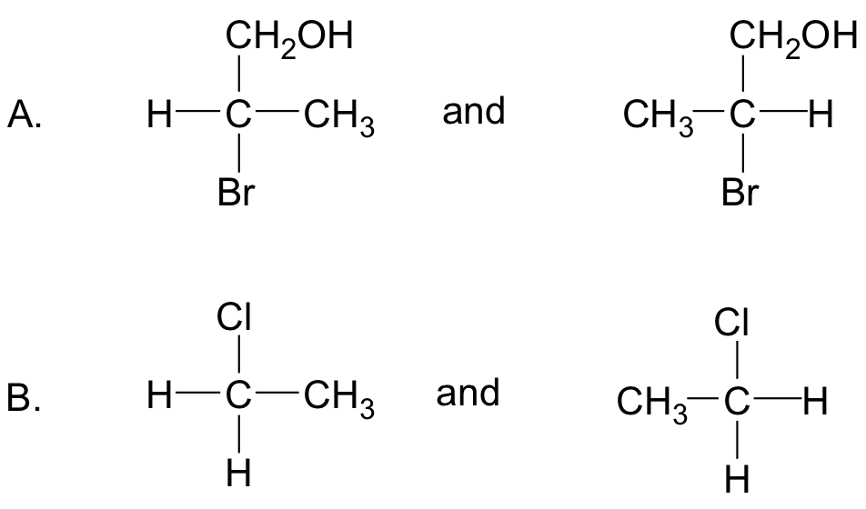
Study Check
Indicate whether each pair is a mirror image that cannot be superimposed (enantiomers).

Slide 15
Solution
Indicate whether each pair is a mirror image that cannot be superimposed (enantiomers).
Yes
No

Slide 16
Study Check
Identify the following Fischer projections of aldose as L or
D isomers:

Slide 17
Solution
Identify the following Fischer projections of aldose as L or
D isomers:
D-Isomer;
— OH is on the right.
L-Isomer;
— OH is on the left.

Slide 18
Chemistry Link to Health:
Enantiomers in Biological Systems
Many compounds in biological systems have only one enantiomer that is active. This happens because
the enzymes and cell surface receptors on which metabolic reactions take place are themselves chiral
only one enantiomer interacts with its enzymes or receptors; the other is inactive
the chiral receptor fits the arrangement of the substituents in only one enantiomer; its mirror image does not fit properly

Slide 19
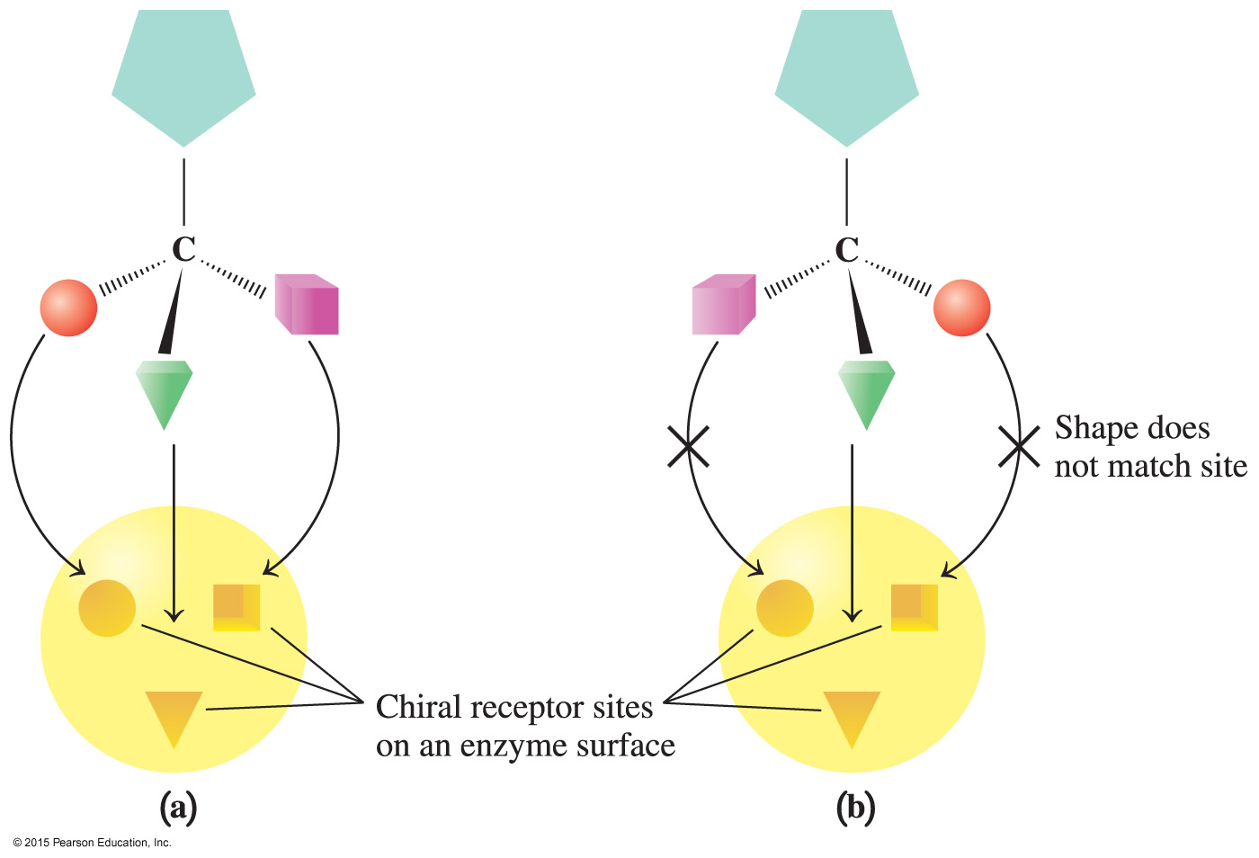
Chemistry Link to Health:
Enantiomers in Biological Systems

Slide 20
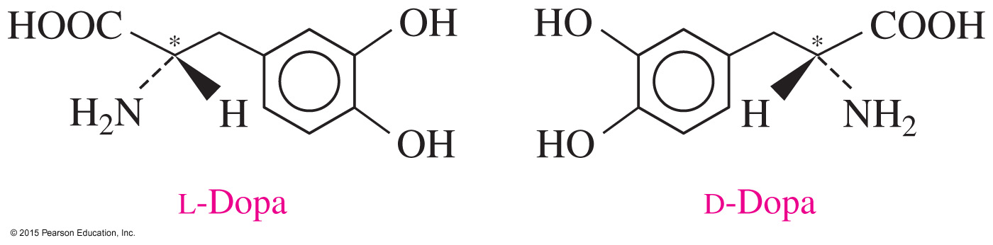
Chemistry Link to Health:
Enantiomers in Biological Systems
A substance used to treat Parkinson’s disease is L-dopa, which is converted to dopamine in the brain, where it raises the serotonin level.
The enantiomer, D-dopa, is not effective for the treatment of Parkinson’s disease.

Slide 21
Chemistry Link to Health:
Enantiomers in Biological Systems
For many drugs, only one of the enantiomers is
biologically active.
However, for many years, drugs have been produced that were mixtures of their enantiomers.
Today, drug researchers are using chiral technology to produce the active enantiomers of chiral drugs.

