Slide 1
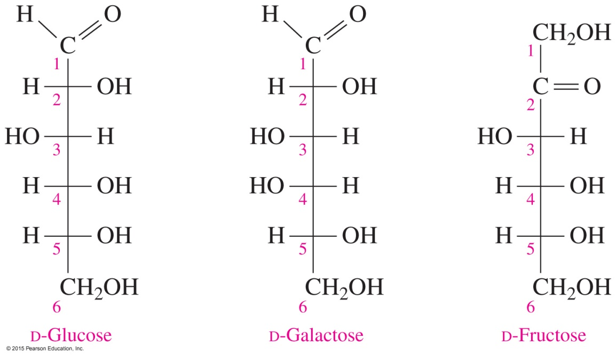
13.3 Fischer Projections of Monosaccharides
Glucose, galactose, and fructose are the most important monosaccharides.
Learning Goal Use Fischer projections to draw the
D or L stereoisomers of glucose, galactose, and fructose.

Slide 2
Fischer Projections
A Fischer projection used to represent carbohydrates
places the most oxidized group at the top
shows chiral carbons as the intersection of vertical and horizontal lines
shows the — H and — OH groups on the horizontal intersecting line
places the — CH₂OH group at the bottom of the Fischer projection, which is not chiral

Slide 3
D and L Notations
In a Fischer projection, the — OH group on the
chiral carbon farthest from the carbonyl group determines an L or D isomer
left is assigned the letter L
right is assigned the letter D
Core Chemistry Skill Identifying D- and L-Fischer
Projections

Slide 4
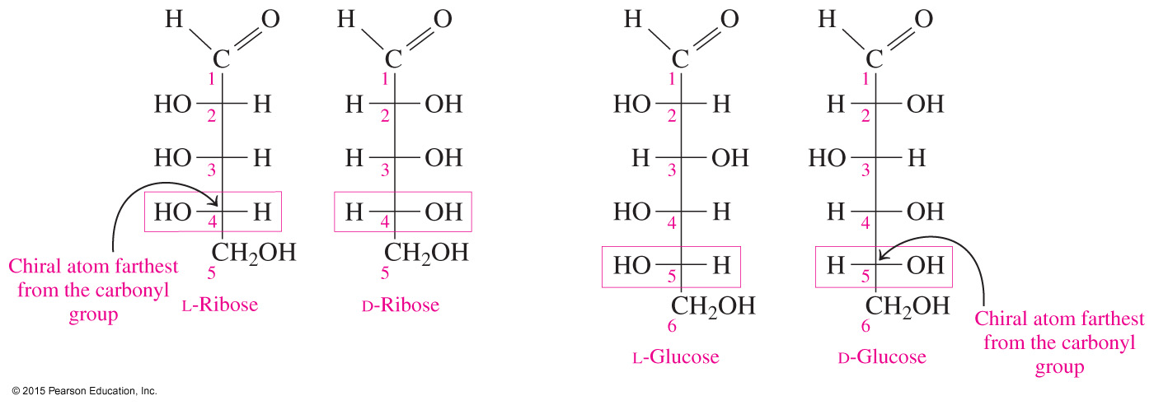
D and L Isomers of Monosaccharides

Slide 5
Study Check
In the following Fischer projection of mannose, identify the monosaccharide as a D or an L isomer.

Slide 6
Solution
In the following Fischer projection of mannose, identify the monosaccharide as a D or an L isomer.
Need to Identify Procedure
Carbon Chain Number the carbon chain, starting at the top of the Fischer projection.
Chiral Carbon Chiral carbon 5 has the
highest number.
Position of — OH The — OH group is drawn on the right side of carbon 5, which makes it D-mannose.
Mirror Image The — OH groups on the
chiral carbons are drawn on the opposite side.
ANALYZE
THE
PROBLEM

Slide 7
Solution
In the following Fischer projection of mannose, identify the monosaccharide as a D or an L isomer.
D-Mannose; the — OH on carbon 5 is on the right.

Slide 8
Study Check
In the following Fischer projection,
A. identify the number of chiral centers.
B. identify the monosaccharide as a D or an L isomer.

Slide 9
Solution
In the following Fischer projection,
identify the number of chiral centers.
B. identify the monosaccharide as a D or an L isomer.
two chiral centers
— OH is on the left;
it is an L isomer.

Slide 10
Glucose and Fructose
D-Glucose is
found in fruits, corn syrup, and honey
an aldohexose with the formula C₆H₁₂O₆
known as dextrose and blood sugar in the body
a building block in sucrose, lactose, maltose, and in polysaccharides such as cellulose and glycogen
D-Fructose, obtained from sucrose, is
a ketohexose with the formula C₆H₁₂O₆
the sweetest of the carbohydrates, twice as sweet as sucrose

Slide 11
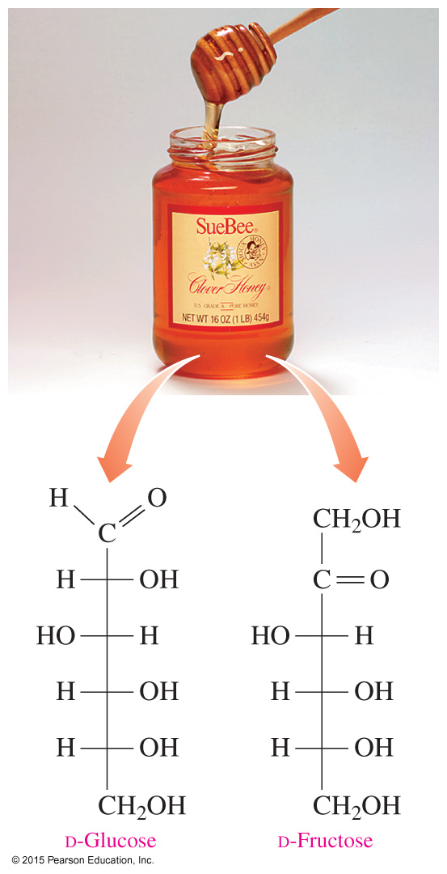
Glucose and Fructose
The sweet taste of honey comes from the monosaccharides D-glucose and D-fructose.

Slide 12
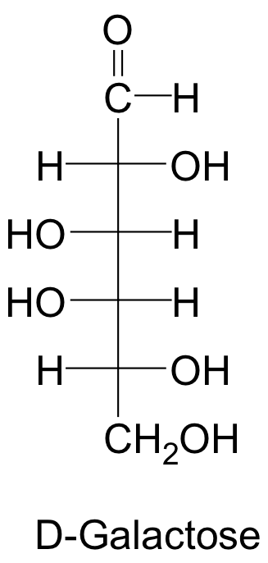
Galactose
D-Galactose
is an aldohexose, C₆H₁₂O₆
is not found free in nature
is obtained from the disaccharide lactose
has a similar structure to glucose except for the — OH on carbon 4
In a condition called galactosemia, an
enzyme needed to convert galactose to
glucose is missing.

Slide 13
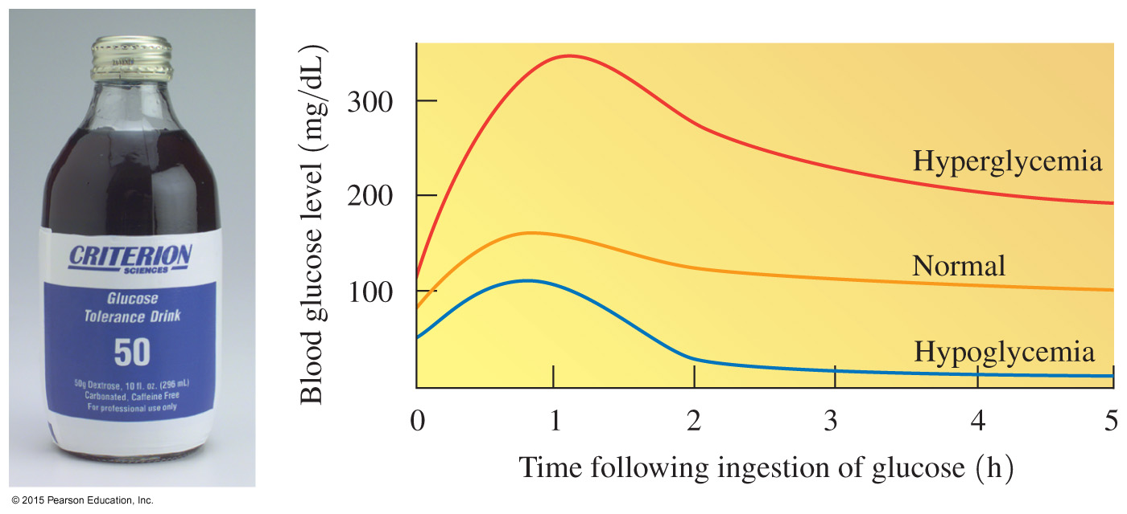
Chemistry Link to Health: Hyperglycemia and Hypoglycemia
In the body,
glucose has a normal blood level of 70–90 mg/dL
a glucose tolerance test measures blood glucose for several hours after ingesting glucose

Slide 14
Chemistry Link to Health: Hyperglycemia and Hypoglycemia
Diabetes mellitus can cause hyperglycemia, which
occurs when the pancreas is unable to produce sufficient quantities of insulin
allows glucose levels in the body fluids to rise as high as 350 mg/dL of plasma
Symptoms of diabetes include
thirst and excessive urination
increased appetite and weight loss
In older adults, diabetes is sometimes a consequence of excessive weight gain.

Slide 15
Chemistry Link to Health: Hyperglycemia and Hypoglycemia
When a person is hypoglycemic,
the blood glucose level rises and then decreases rapidly to levels as low as 40 mg/dL
low blood sugar may occur as a result of an overproduction of insulin by the pancreas
symptoms may appear, such as dizziness, general weakness, and muscle tremors
a diet may be prescribed that consists of several small meals high in protein and low in carbohydrates

Slide 16
Study Check
Draw the Fischer projections of D-fructose and L-fructose.

Slide 17
Solution
Draw the Fischer projections of D-fructose and L-fructose.
D-Fructose L-Fructose

