Slide 1
13.4 Haworth Structures of Monosaccharides
The most stable forms of pentose and hexose sugars are five- or six-atom rings.
These rings, known as Haworth structures, are produced from the reaction of a carbonyl group and a hydroxyl group in the same molecule.
Learning Goal Draw and identify the Haworth structures of monosaccharides.

Slide 2
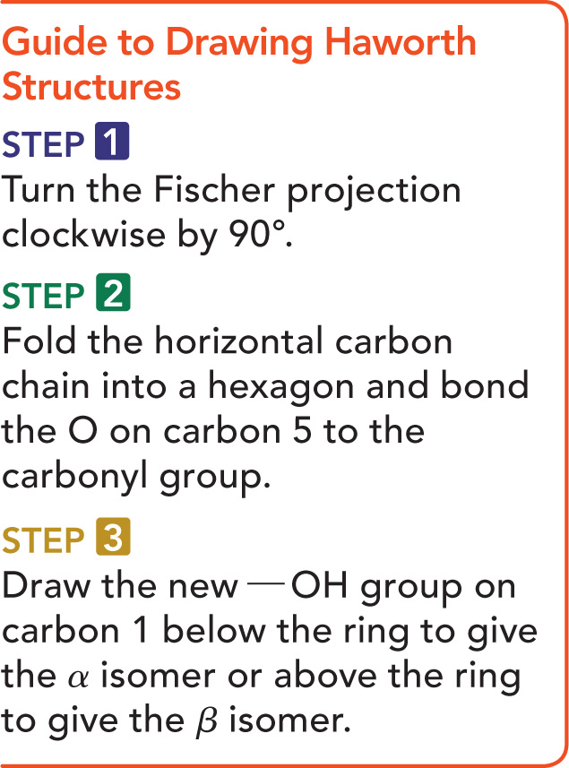
Guide for Drawing Hayworth Structures

Slide 3
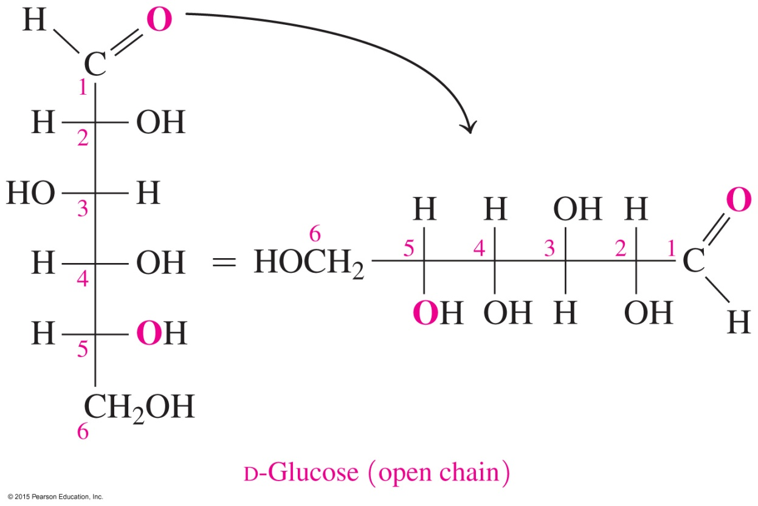
Cyclic Structure for Glucose
STEP 1 Turn the Fischer projection clockwise by 90°.

Slide 4
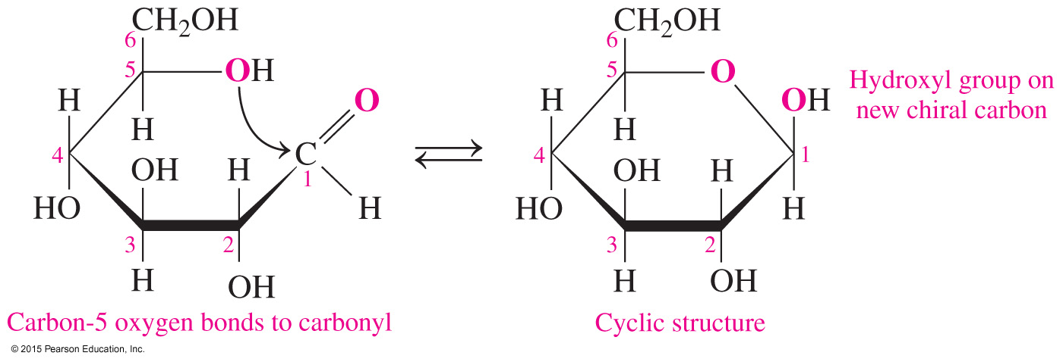
Cyclic Structure for Glucose
STEP 2 Fold clockwise to make a hexagon and bond the O on carbon 5 to carbon 1.
      Place the carbon 6 group in the — CH₂OH group above carbon 5.
      Draw a bond between the oxygen of the — OH group on carbon 5 to the carbonyl carbon.

Slide 5
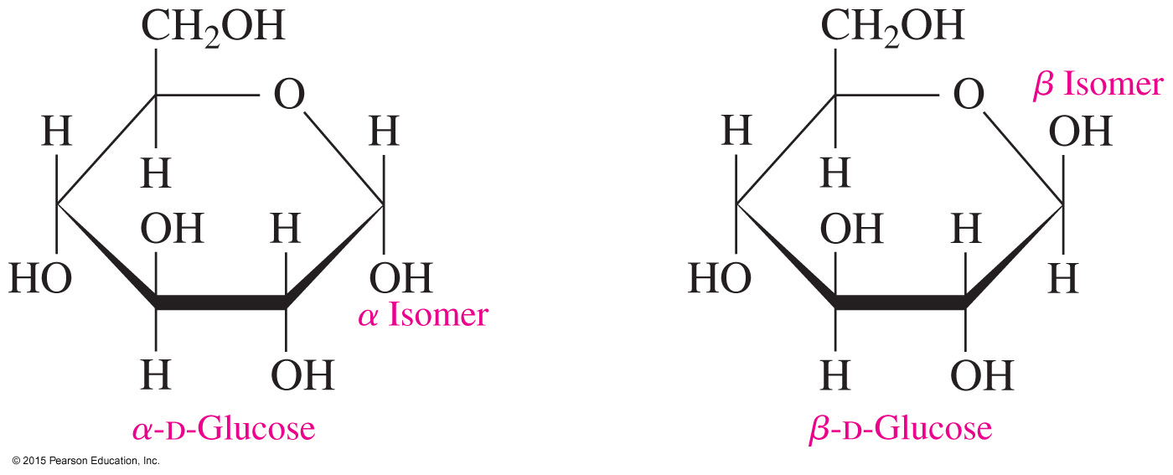
Cyclic Structure for Glucose
STEP 3 Draw the new — OH group on carbon 1 below the ring to give the α isomer or above the ring to give the β isomer.

Slide 6
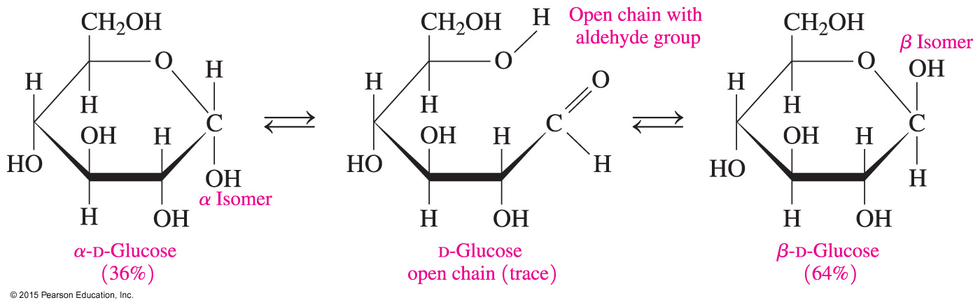
Mutarotation α- and β-D-Glucose
When placed in solution,
cyclic structures open and close
α-D-glucose converts to β-D-glucose and vice versa
at any time, only a small amount of open chain forms

Slide 7
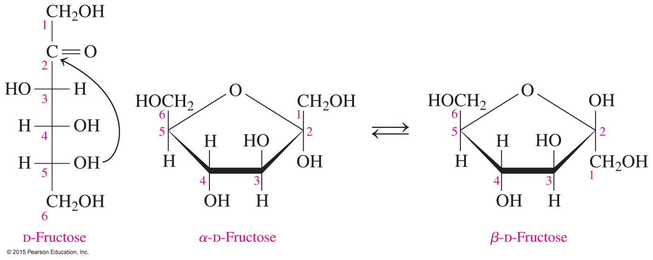
Haworth Structures of Fructose
Fructose
is a ketohexose
forms a five-atom ring structure with carbon 2 at the right corner of the ring
forms when the — OH group on carbon 5 reacts with carbon 2 in the carbonyl group

Slide 8
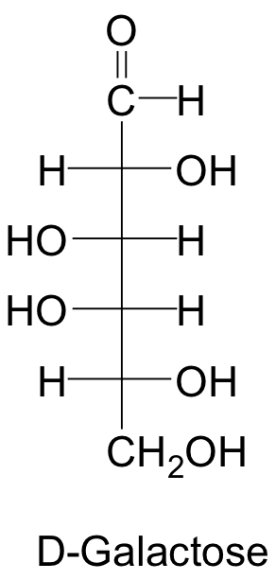
Study Check
Write the cyclic forms of D-galactose.

Slide 9
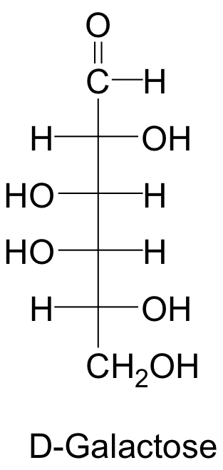
Solution
STEP 1 Turn the Fischer projection clockwise by 90°.
1
2
3
4
5
6
6 5 4 3 2 1

Slide 10
Solution
STEP 2 Fold clockwise to make a hexagon and bond the O on carbon 5 to the carbonyl group.
Place the carbon 6 group above the ring.
Write the — OH group on carbon 2
below the ring and the — OH groups
on carbon 3 and carbon 4 above
the ring.

Slide 11
Solution
STEP 3 Draw the new — OH group on carbon 1 below the ring to give the α isomer or above the ring to give the β isomer.
β
α
α-D-Galactose β-D-Galactose

