Slide 1
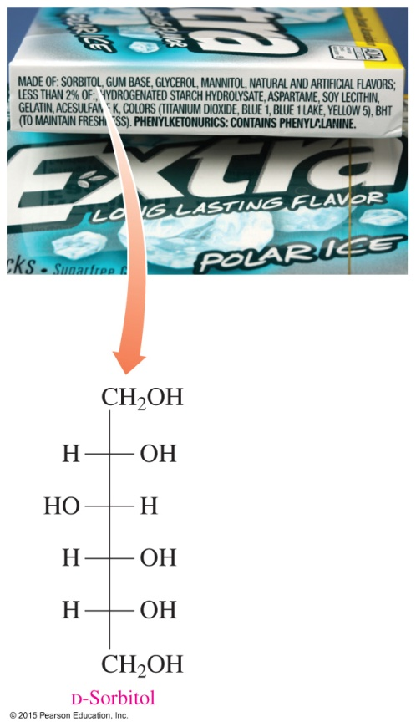
13.5 Chemical Properties of Monosaccharides
Sugar alcohols such as D-sorbitol, D-xylitol from D-xylose, and
D-mannitol from D-mannose are used as sweeteners in many sugar-free products such as diet drinks and sugarless gum as well as products for people with diabetes.
Learning Goal Identify the products of oxidation or reduction of monosaccharides; determine whether a carbohydrate is a reducing sugar.

Slide 2
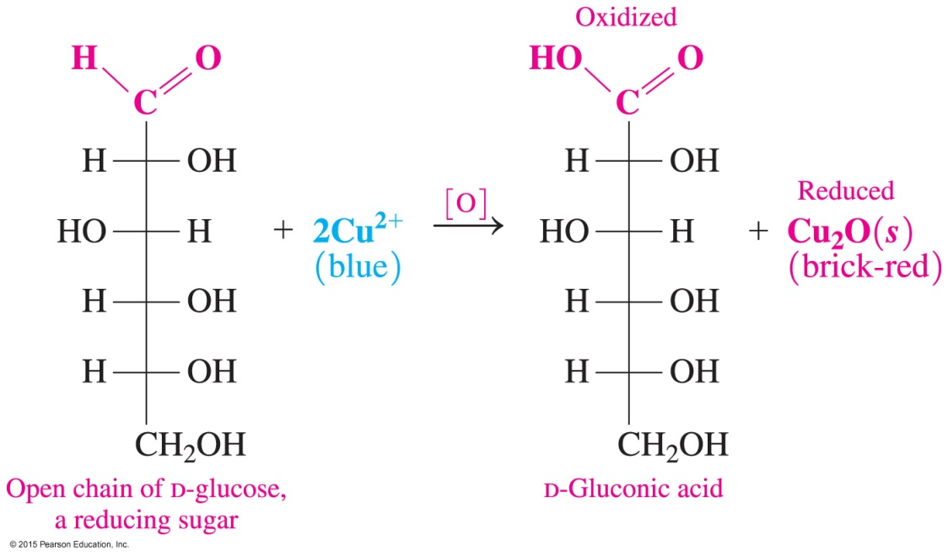
Oxidation of Monosaccharides
Monosaccharides in solution
have small amounts of the open-chain form present
have an aldehyde group with an adjacent hydroxyl group that can be oxidized to carboxylic acid by an oxidizing agent such as Benedict’s

Slide 3
Oxidation of Monosaccharides
Sugar acids
are produced from the oxidation of the aldehyde form as Cu²⁺ is reduced to Cu⁺
are named by replacing the ose ending of the monosaccharide with onic acid
A carbohydrate that reduces another substance (such as the open chain form of D-glucose) is called a reducing sugar.

Slide 4
Oxidation: Fructose to Glucose
Fructose, a ketohexose,
contains a ketone group, which usually can’t be oxidized
can be oxidized in a basic Benedict’s solution when a rearrangement occurs between the ketone group on carbon 2 and the hydroxyl group on carbon 1
is then converted to glucose, which produces an aldehyde group with an adjacent hydroxyl that can be oxidized

Slide 5
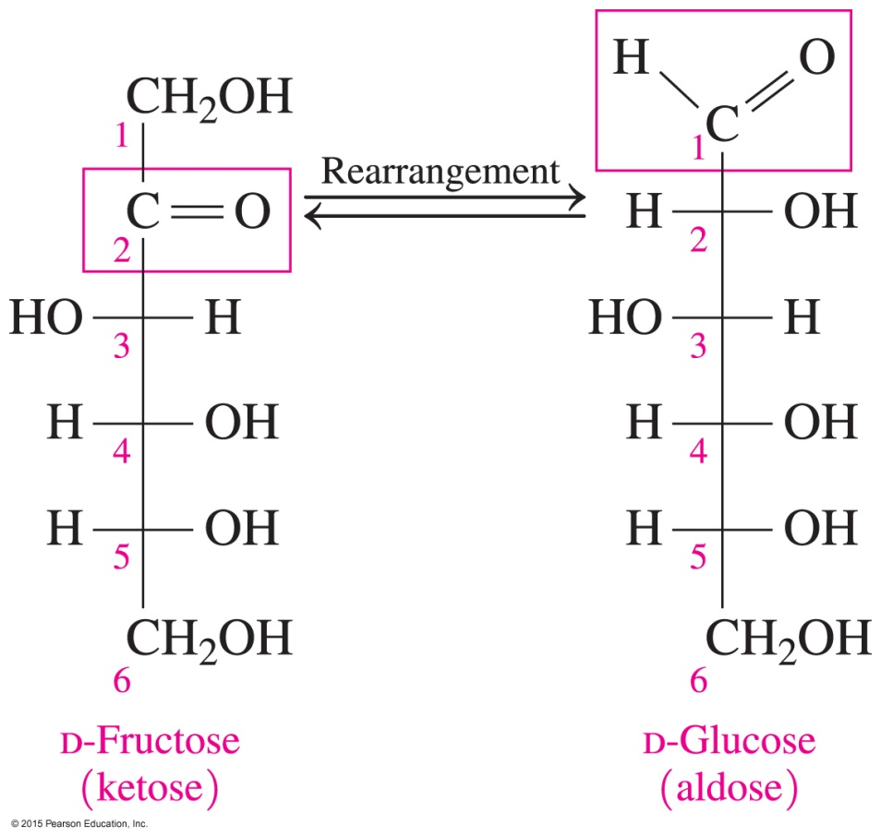
Oxidation: Fructose to Glucose
Fructose, a ketohexose, rearranges to form glucose and is then oxidized in Benedict’s.

Slide 6
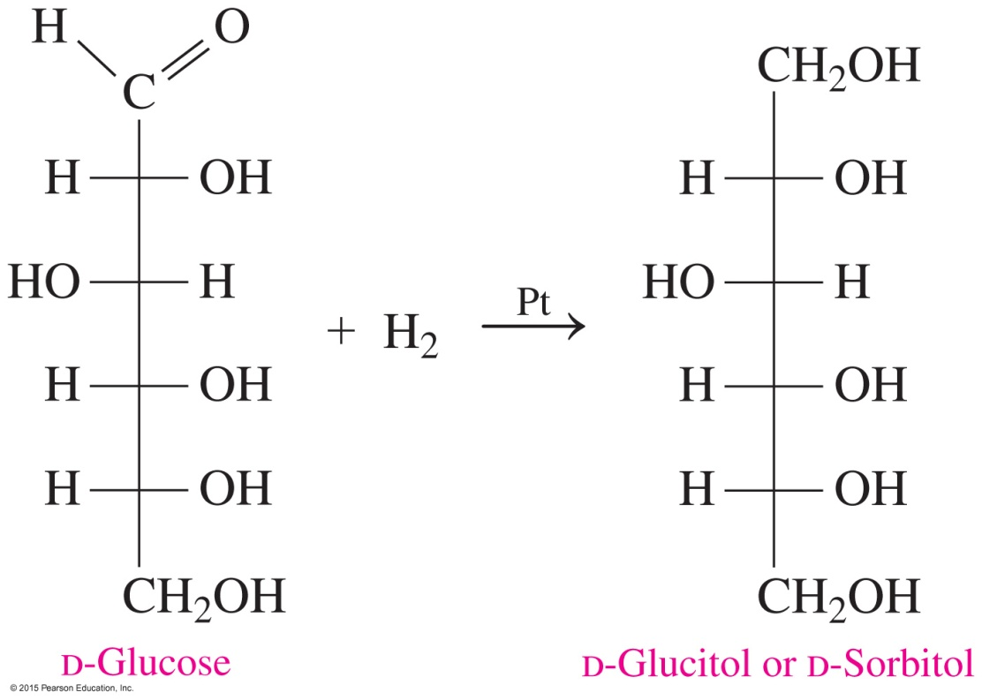
Reduction of Monosaccharides
The reduction of the carbonyl group in monosaccharides
produces sugar alcohols, which are also called alditols
converts D-glucose to the sugar alcohol D-sorbitol

Slide 7
Reducing Sugars
The sugar alcohols
are named by replacing the ose ending of the monosaccharide with itol
include D-sorbitol, D-xylitol from D-xylose, and D-mannitol from D-mannose
are used as sweeteners in many sugar-free products such as diet drinks and sugarless gum

Slide 8
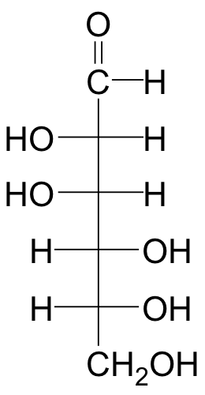
Study Check
Write the product of the reduction of D-mannose.
D-Mannose

Slide 9
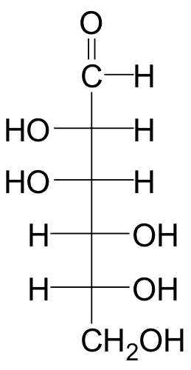
Solution
Write the product of the reduction of D-mannose.
Reduction
D-Mannose D-Mannitol

Slide 10
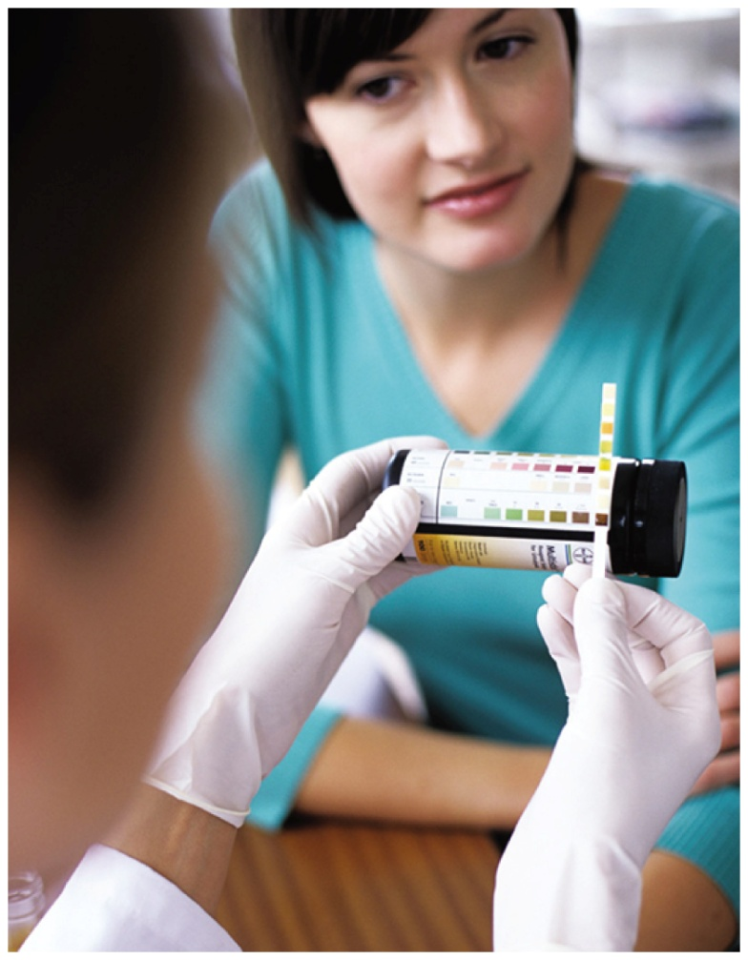
Chemistry Link to Health:
Glucose Testing
Normally, blood glucose flows through the kidneys and is reabsorbed into the bloodstream.
When the blood level exceeds about 160 mg of glucose/dL of blood, the kidneys cannot reabsorb all of the glucose, and it spills over into the urine, a condition known as glucosuria.

Slide 11
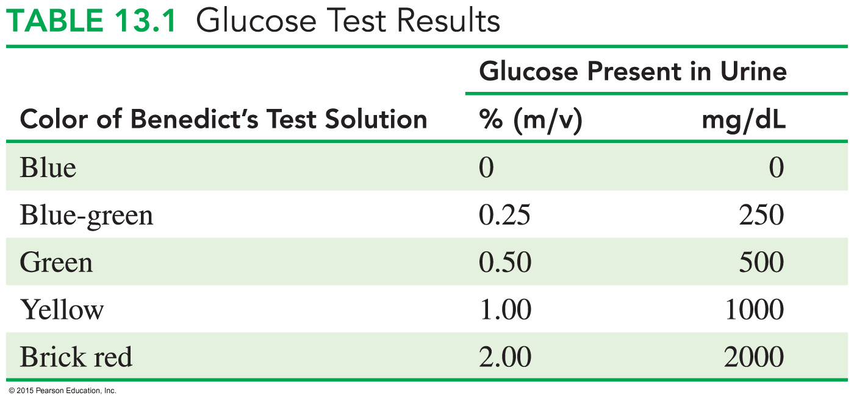
Chemistry Link to Health:
Glucose Testing
A symptom of diabetes mellitus is a high level of glucose in the urine, which can be identified using Benedict’s test.

