Slide 1
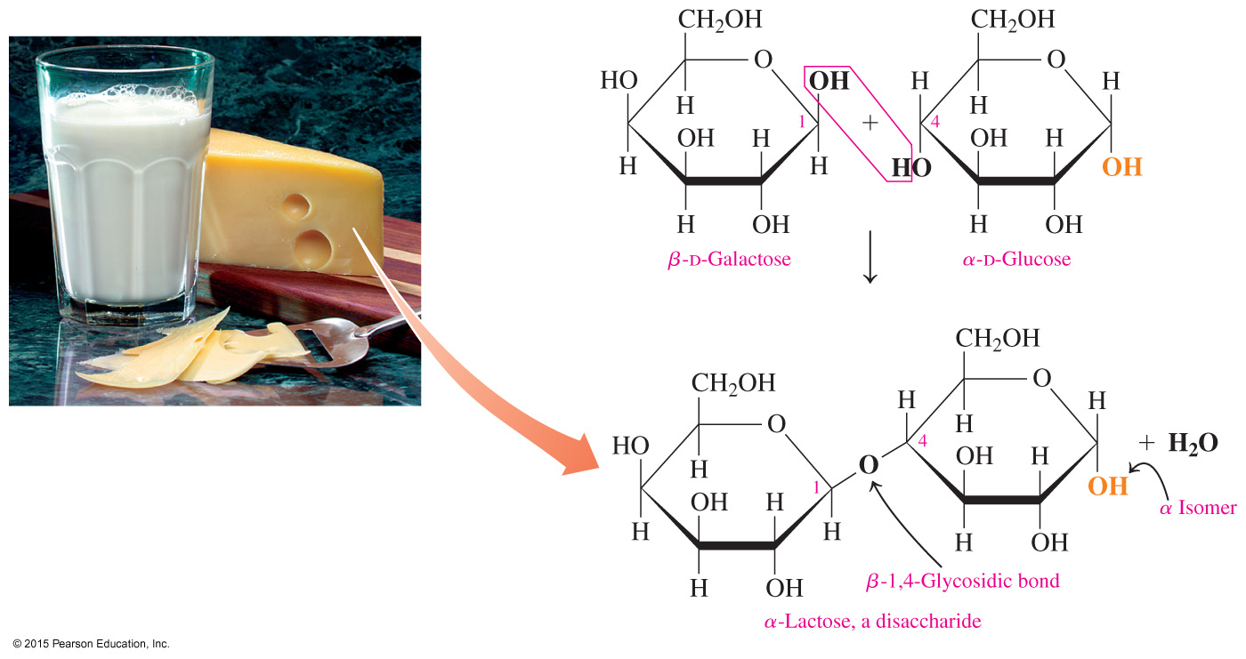
13.6 Disaccharides
Lactose is a disaccharide found in milk and milk products. It contains the monosaccharides galactose and glucose.
Learning Goal Describe the monosaccharide units and linkages in disaccharides.

Slide 2
Disaccharides
A disaccharide
consists of two monosaccharides linked together
is formed when two monosaccharides combine in a dehydration reaction
Monosaccharides Disaccharide
glucose + glucose maltose + H₂O
glucose + galactose lactose + H₂O glucose + fructose sucrose + H₂O
The most common disaccharides are maltose, lactose, and sucrose.

Slide 3
Maltose
Maltose is
a disaccharide also known as malt sugar
composed of two D-glucose molecules
obtained from the hydrolysis of starch
used in cereals, candies, and brewing
found in both the α and β forms

Slide 4
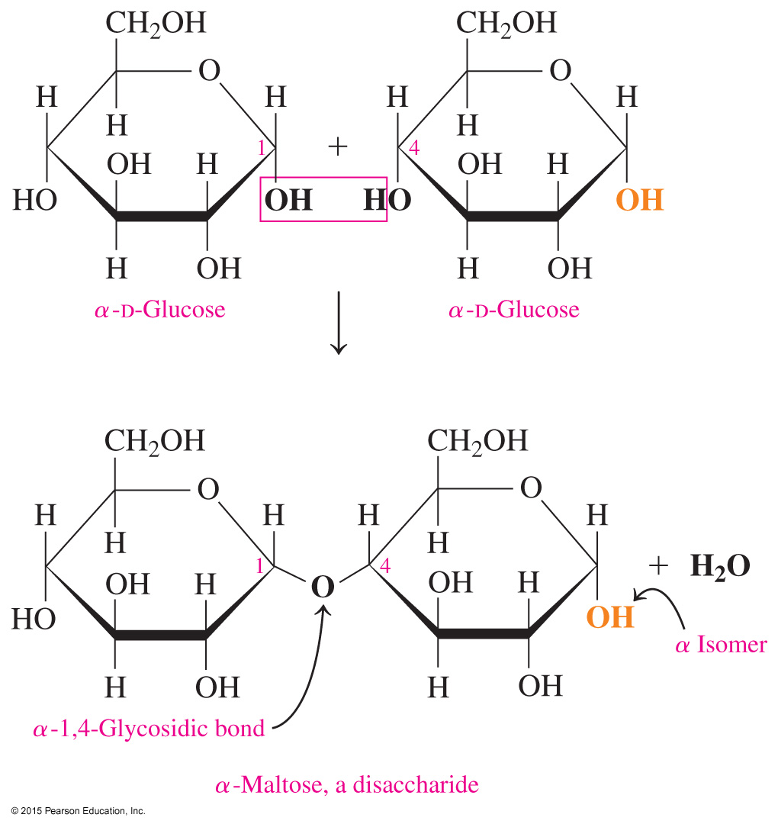
Formation of Maltose
Maltose is linked by an α-1,4-glycosidic bond formed from the α — OH on carbon 1 of the first glucose and — OH on carbon 4 of the second glucose.

Slide 5
Lactose, Milk Sugar
Lactose
is a disaccharide found in milk and milk products
makes up 6–8% of human milk and about 4–5% of cow’s milk

Slide 6
Lactose
Lactose is a disaccharide of β-D-galactose and α- or β-D-glucose.
The bond in lactose is a β-1,4-glycosidic bond because the — OH group on carbon 1 of β-D-galactose forms a glycosidic bond with the — OH group on carbon 4 of a D-glucose molecule.

Slide 7
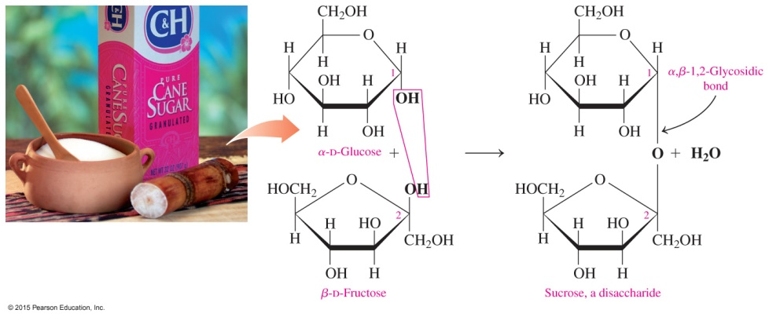
Sucrose, Table Sugar
Sucrose, or table sugar,
is obtained from sugar cane and sugar beets
consists of α-D-glucose and β-D-fructose
has an α,β-1,2-glycosidic bond between carbon 1 of glucose and carbon 2 of fructose
cannot form an open chain and cannot be oxidized
cannot react with Benedict’s reagent and is not a reducing sugar

Slide 8
Sucrose

Slide 9
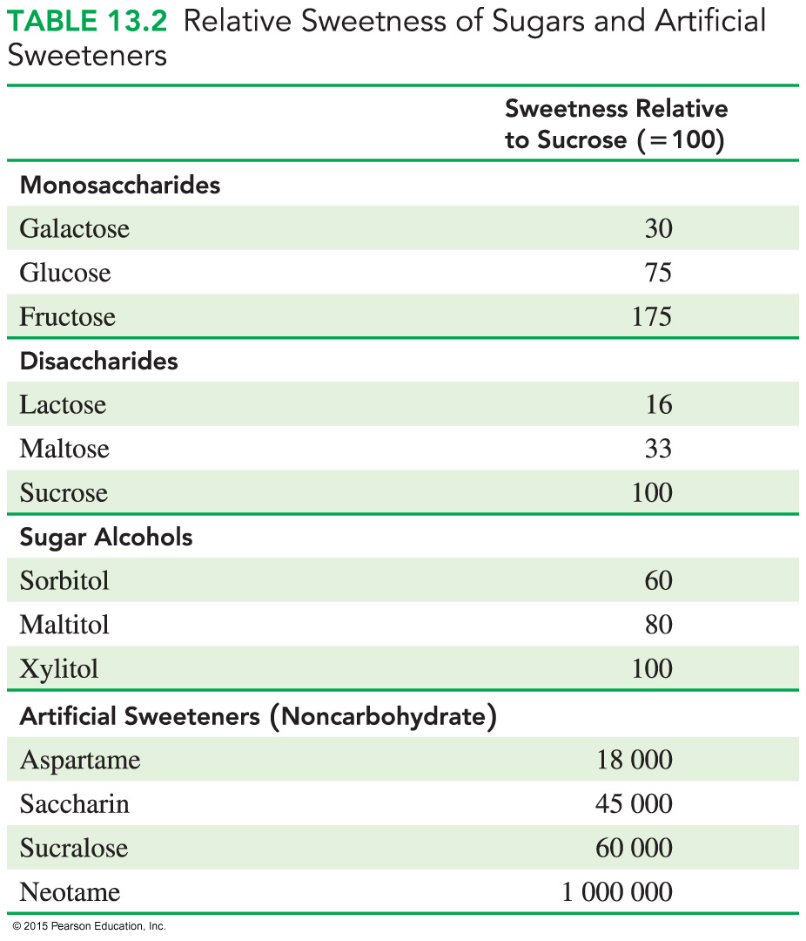
Sweetness of Sweeteners
Sugars and artificial
sweeteners
differ in sweetness
are compared to sucrose (table sugar), which is assigned a value of 100

Slide 10
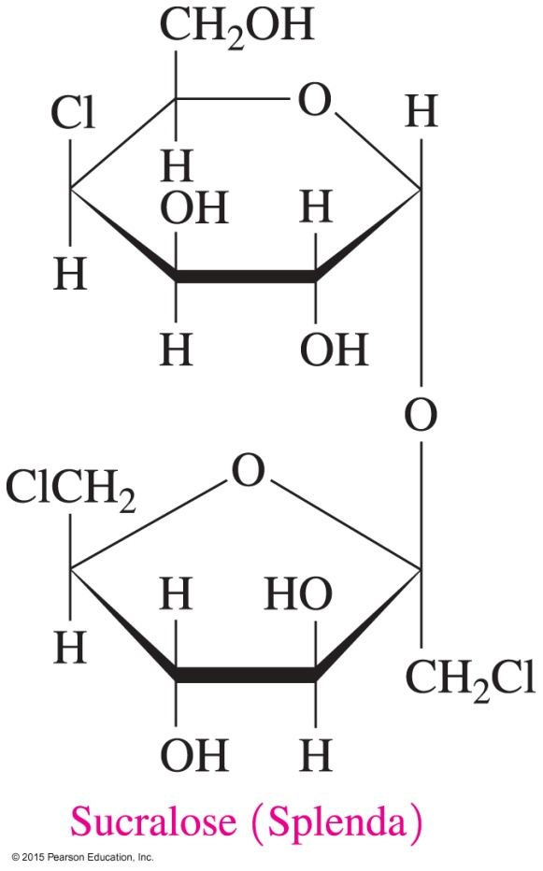
Artificial Sweeteners: Sucralose
Sucralose is
marketed as Splenda
made from sucrose by replacing some of the hydroxyl groups with chlorine atoms

Slide 11
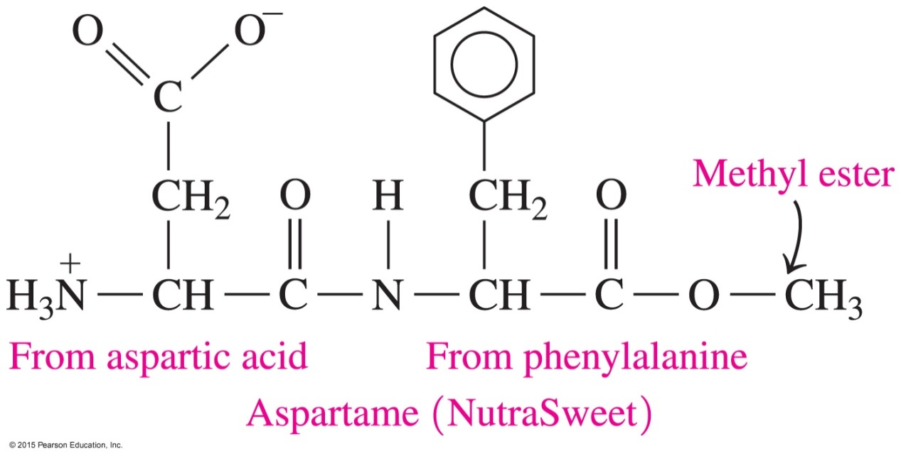
Artificial Sweeteners: Aspartame
Aspartame is
marketed as NutraSweet or Equal
a noncarbohydrate sweetener made from aspartic acid and a methyl ester of the amino acid phenylalanine

Slide 12
Study Check
Identify the monosaccharides in each of the following:
A. lactose
(1) α-D-glucose (2) β-D-fructose (3) β-D-galactose
B. maltose
(1) α-D-glucose (2) β-D-fructose (3) β-D-galactose
C. sucrose
(1) α-D-glucose (2) β-D-fructose (3) β-D-galactose

Slide 13
Solution
Identify the monosaccharides in each of the following:
A. lactose
(1) α-D-glucose (3) β-D-galactose
B. maltose
(1) α-D-glucose
C. sucrose
(1) α-D-glucose (2) β-D-fructose

Slide 14
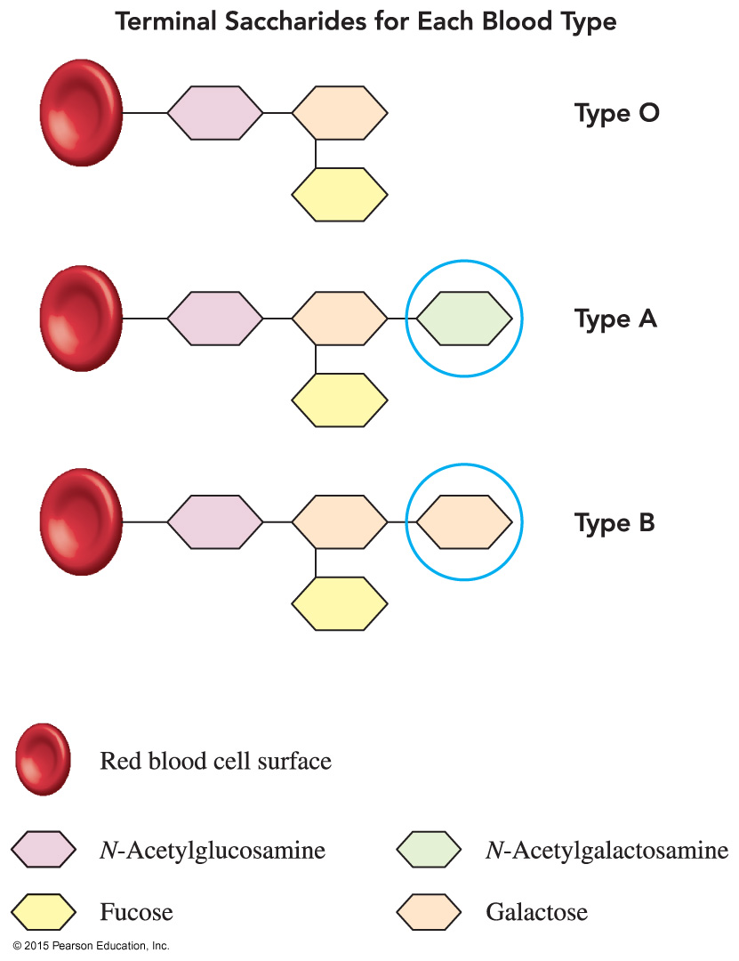
Chemistry Link to Health: Blood Types
Blood types A, B, AB, and O are determined by terminal saccharides attached to the surface of red blood cells.

Slide 15
Chemistry Link to Health: Blood Types
Blood type
O has three common terminal monosaccharides: N-acetylglucosamine, galactose, and fucose
A contains the same three monosaccharides, but in addition, a molecule of N-acetylgalactosamine is attached to galactose in the saccharide chain
B also contains the same three monosaccharides, but in addition, a second molecule of galactose is attached to the saccharide chain
AB consists of the same monosaccharides found in blood types A and B

Slide 16
Chemistry Link to Health: Blood Types
The structures of monosaccharides N-acetylglucosamine, galactose, and fucose are as follows:

Slide 17
Chemistry Link to Health: Blood Types
Persons with
type O blood, which contains the three common monosaccharides, produce antibodies against blood types A, B, and AB—they are universal donors
blood types A, B, and AB can receive type O blood
type AB blood, which contains all the terminal monosaccharides, produce no antibodies to type A, B, or O blood—they are universal recipients

Slide 18
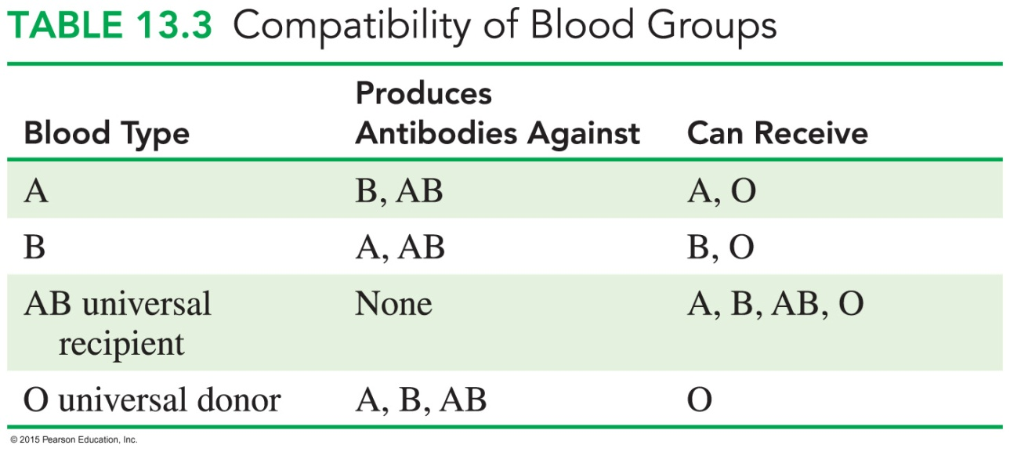
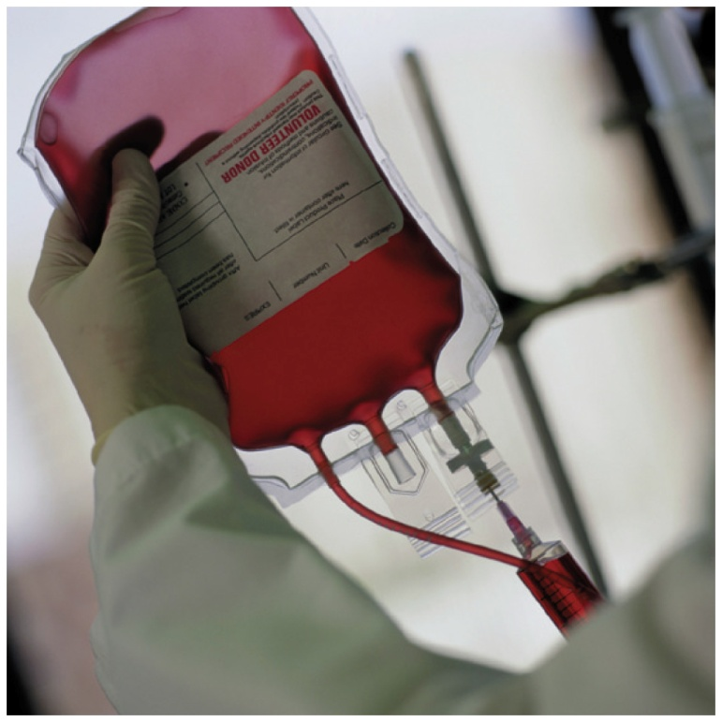
Chemistry Link to Health: Blood Types

Slide 19
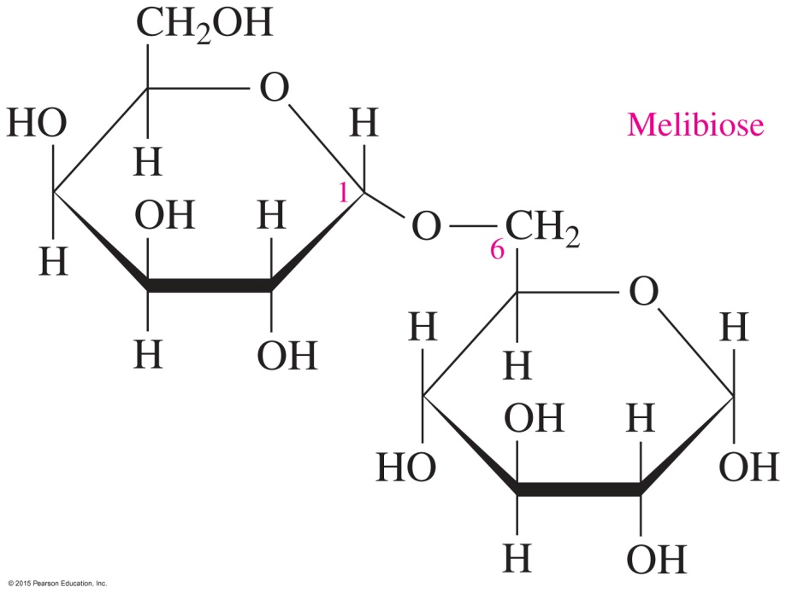
Study Check
Melibiose is a disaccharide that is 30 times sweeter than sucrose.
What are the monosaccharide units in melibiose?
What type of glycosidic bond links the monosaccharides?
C. Identify the structure as α- or β-melibiose.

Slide 20
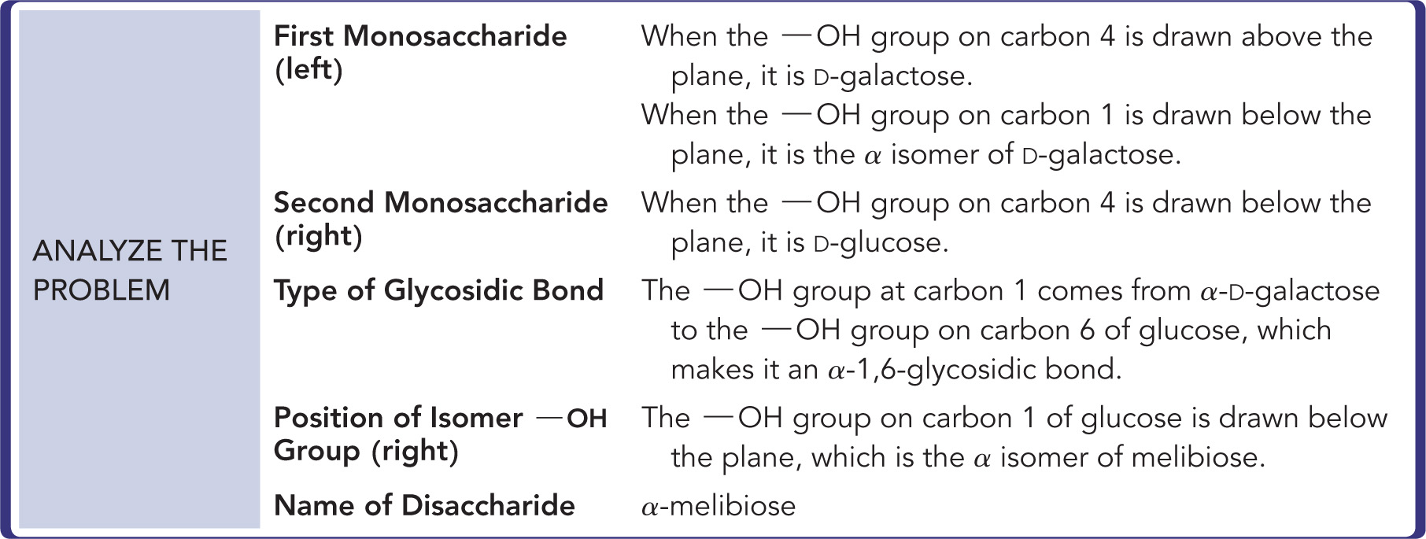
Solution
Melibiose is a disaccharide that is 30 times sweeter than sucrose.

Slide 21
Solution
Melibiose is a disaccharide that is 30 times sweeter than sucrose.
What are the monosaccharide units in melibiose?
α-D-galactose and α-D-glucose
What type of glycosidic bond links the monosaccharides?
α-1,6-glycosidic bond
Identify the structure as α- or β-melibiose.
α-melibiose
.

