Slide 1
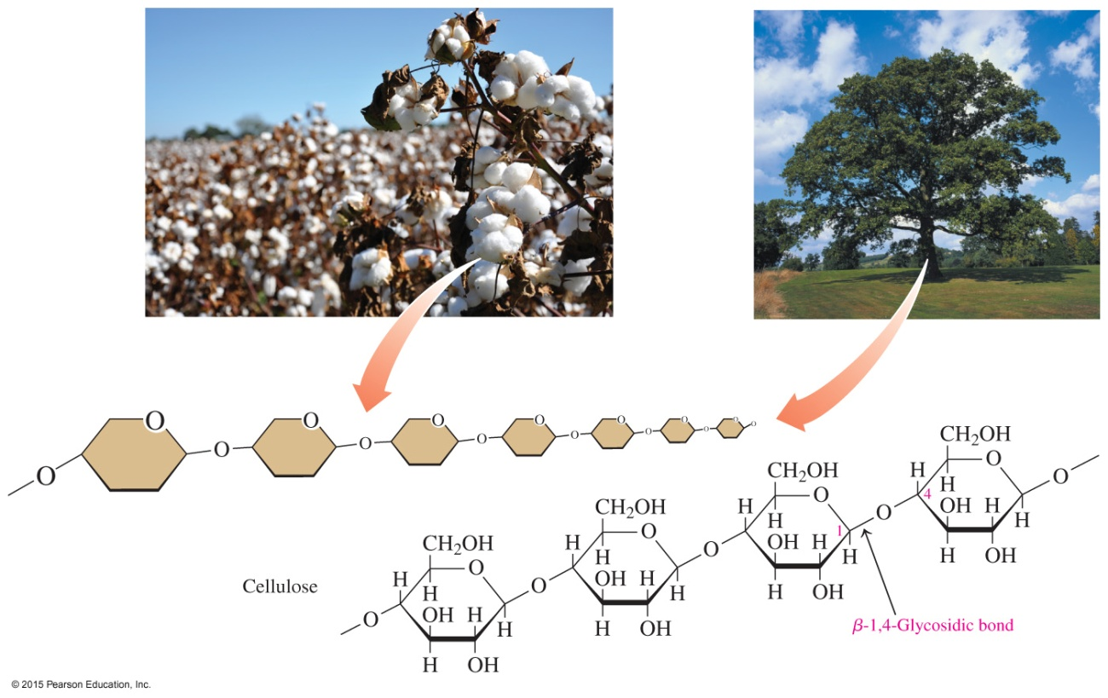
13.7 Polysaccharides
The polysaccharide cellulose is composed of glucose units connected by β-1,4-glycosidic bonds.
Learning Goal Describe the structural features of amylose, amylopectin, glycogen, and cellulose.

Slide 2
Polysaccharides
Polysaccharides
are formed when monosaccharides are
joined together
include amylose, amylopectin, and cellulose, which are polymers of α-D-glucose
α-D-Glucose

Slide 3
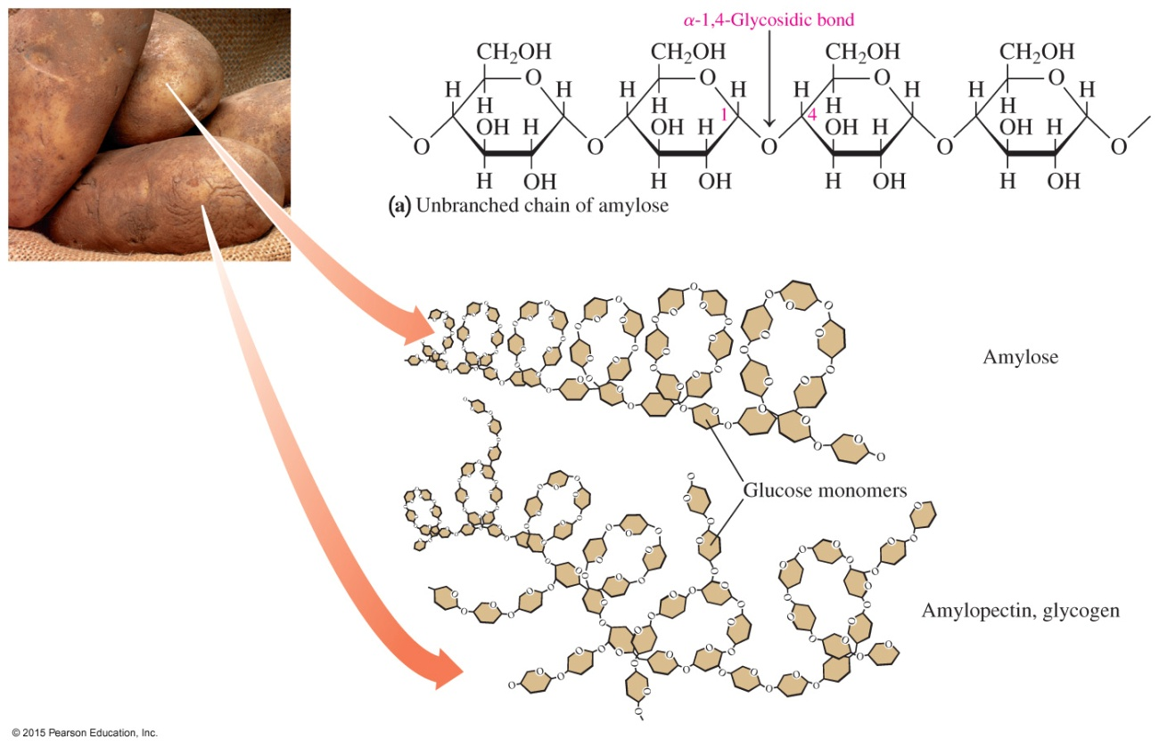
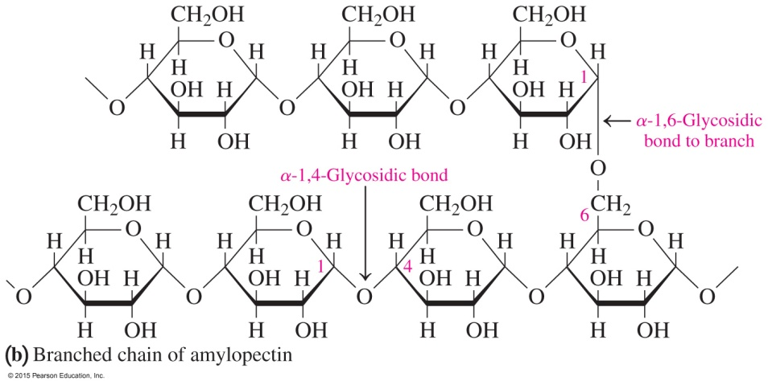
Polysaccharides: Amylose, Amylopectin
The structure of amylose (a) is a straight-chain polysaccharide
of glucose units. The structure of amylopectin (b) is a branched chain of glucose.

Slide 4
Amylose
Amylose
makes up about 20% of starch
consists of 250 to 4000 α-D-glucose molecules connected by α-1,4-glycosidic bonds in a continuous chain
is called a straight-chain polymer even though the polymers of amylose are actually coiled in helical fashion

Slide 5
Amylopectin
Amylopectin
makes up as much as 80% of starch
is a branched-chain polysaccharide
contains glucose molecules connected by α-1,4- and
α-1,6- glycosidic bonds
Starches hydrolyze easily in water and acid to give smaller saccharides, called dextrins, which then hydrolyze to maltose and finally glucose.

Slide 6
Glycogen
Glycogen is
a polymer of glucose that is stored in the liver and muscle
of animals
hydrolyzed in our cells at a rate that maintains the blood level of glucose and provides energy between meals
similar to amylopectin, but it is more highly branched
The glucose units in glycogen are joined by α-1,4-glycosidic bonds, with branches attached by α-1,6-glycosidic bonds that occur every 10–15 glucose units.

Slide 7
Cellulose
Cellulose, the major structural unit of wood,
is a polysaccharide of glucose units in unbranched chains with β-1,4-glycosidic bonds
cannot form hydrogen bonds with water; thus, it is insoluble
in water
gives a rigid structure to the cell walls in wood and fiber
is more resistant to hydrolysis than are the starches
cannot be digested by humans because humans cannot break down β-1,4-glycosidic bonds

Slide 8

Cellulose

Slide 9

Study Check
Identify the polysaccharides and types of glycosidic
bonds in each of the following:
A. B.

Slide 10
Solution
Identify the polysaccharides and types of glycosidic
bonds in each of the following:
A. cellulose β-1,4-glycosidic bonds
B. amylose α-1,4-glycosidic bonds
amylopectin α-1,4- and α-1,6-glycosidic bonds

Slide 11
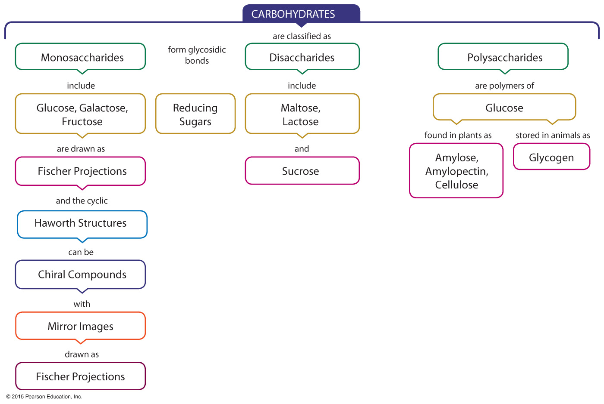
Carbohydrates—Concept Map

