Slide 1

Chapter 14 Carboxylic Acids, Esters, Amines, and Amides
Surgical technicians prepare the operating room and the patients for surgery by
creating a sterile environment in the surgical room
washing, shaving, and disinfecting incision sites
During the surgery, a surgical technician provides the sterile instruments and supplies to the surgeons and surgical assistants.

Slide 2
Chapter 14 Readiness
Core Chemistry Skills
Writing Equations for Reactions of Acids and Bases (10.6)
Naming and Drawing Alkanes (11.2)

Slide 3
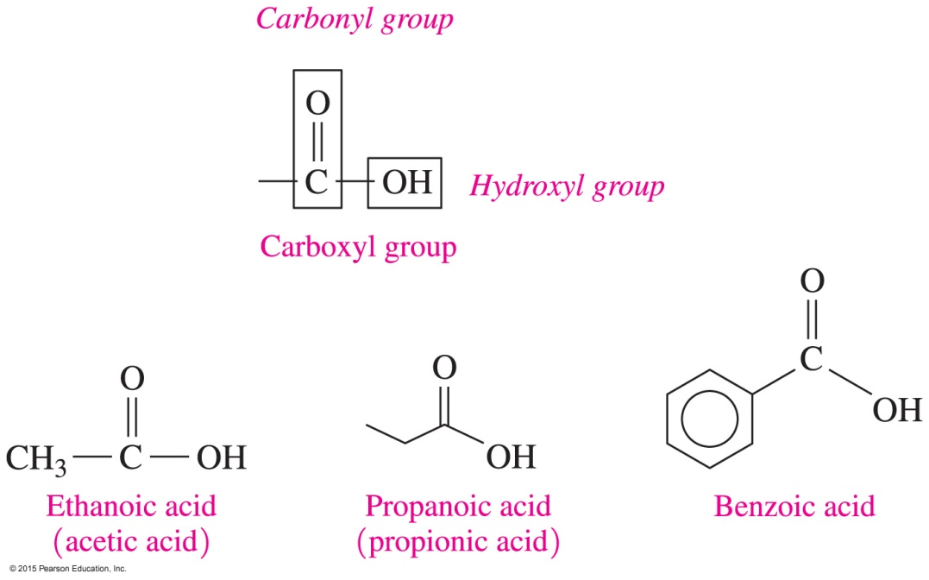
14.1 Carboxylic Acids
A carboxylic acid contains a carboxyl group, which consists of a hydroxyl group —OH attached to the carbon in a carbonyl group.
Learning Goal Give the IUPAC names and common names for carboxylic acids; draw their condensed structural formulas or skeletal formulas.

Slide 4
IUPAC Names for Carboxylic Acids
In the IUPAC names of carboxylic acids,
the -e in the alkane name is replaced with -oic acid
CH₄
Methane Methanoic acid
CH₃—CH₃
Ethane Ethanoic acid

Slide 5
IUPAC Names for Carboxylic Acids
In the IUPAC names of carboxylic acids,
substituents are numbered from the carboxyl bonded to carbon 1
4 3 2 1
3-Methylbutanoic acid
2,3-Dichlorobenzoic acid

Slide 6
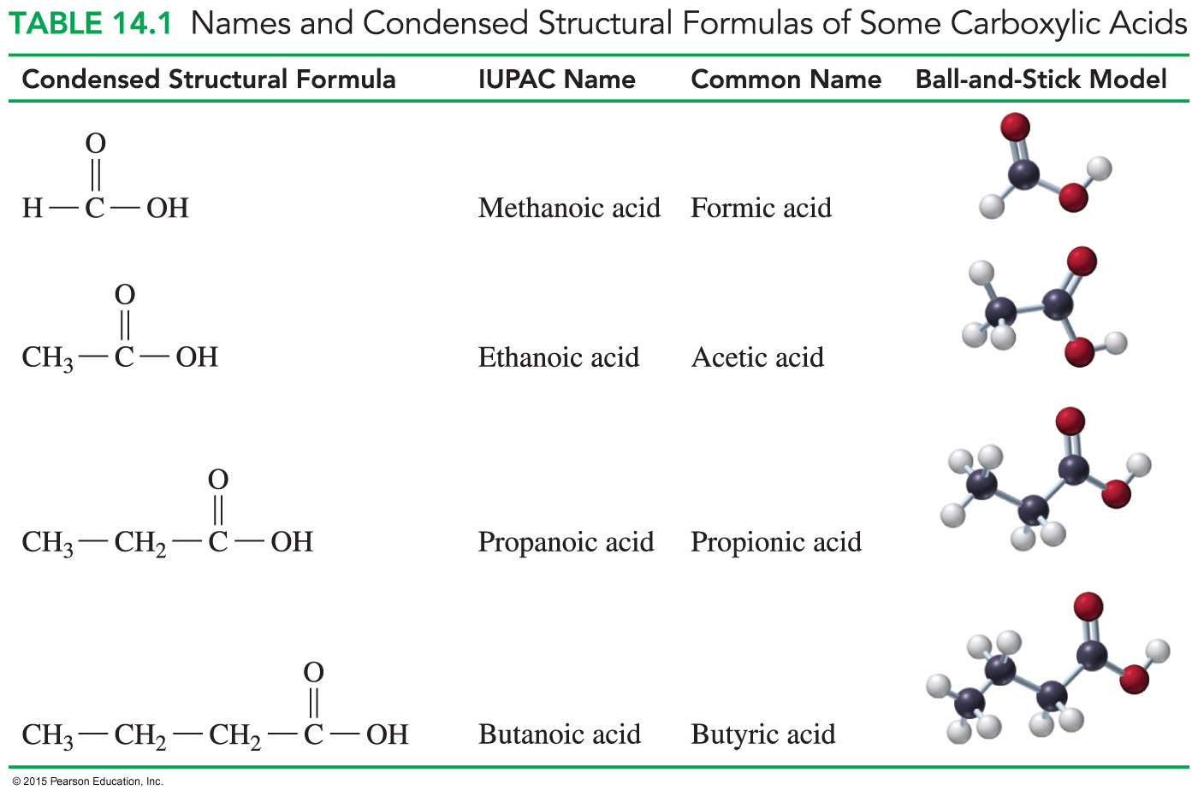
Common Names of Carboxylic Acids

Slide 7
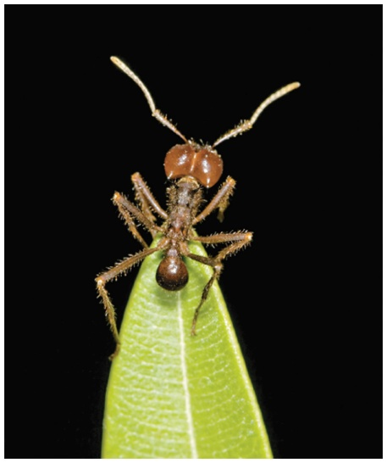
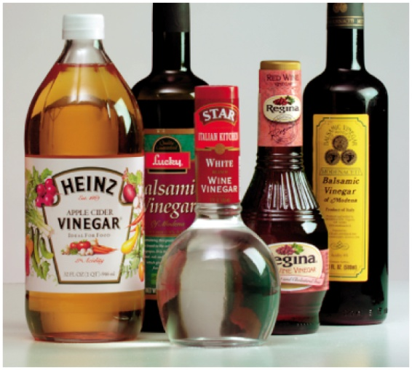
Common Carboxylic Acids
A red ant sting contains formic acid that irritates the skin.
The sour taste of vinegar is due to ethanoic acid (acetic acid).

Slide 8
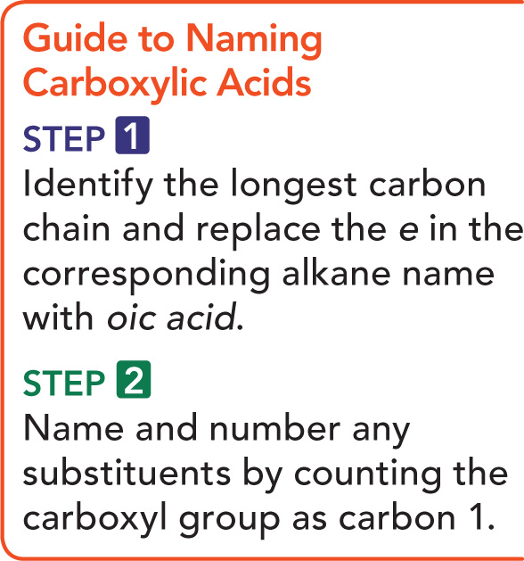
Guide to Naming Carboxylic Acids

Slide 9
Naming Carboxylic Acids
Give the IUPAC name for the
following carboxylic acid:
SOLUTION:
ANALYZE Functional Family IUPAC Naming
THE Group
PROBLEM carboxyl carboxylic
acid
Replace the e in the alkane name
with oic acid and count from
carbon 1 of the carboxyl group
for any substituents.

Slide 10
Naming Carboxylic Acids
Give the IUPAC name for the
following carboxylic acid:
STEP 1 Identify the carbon chain containing the carboxyl
group and replace the e in the alkane name with
oic acid.
pentanoic acid

Slide 11
Naming Carboxylic Acids
Give the IUPAC name for the
following carboxylic acid:
STEP 2 Give the location and name of each substituent on the main chain by counting the carboxyl carbon as 1.
2-methylpentanoic acid

Slide 12
Study Check
Give the IUPAC names of each compound.
A. B.

Slide 13
Solution
Give the IUPAC names of each compound.
A. B.
2-methylpropanoic acid
3-bromobenzoic acid

Slide 14
Study Check
Give the skeletal structure for 4-chlorohexanoic acid.

Slide 15
Solution
Give the skeletal structure for 4-chlorohexanoic acid.

