Slide 1
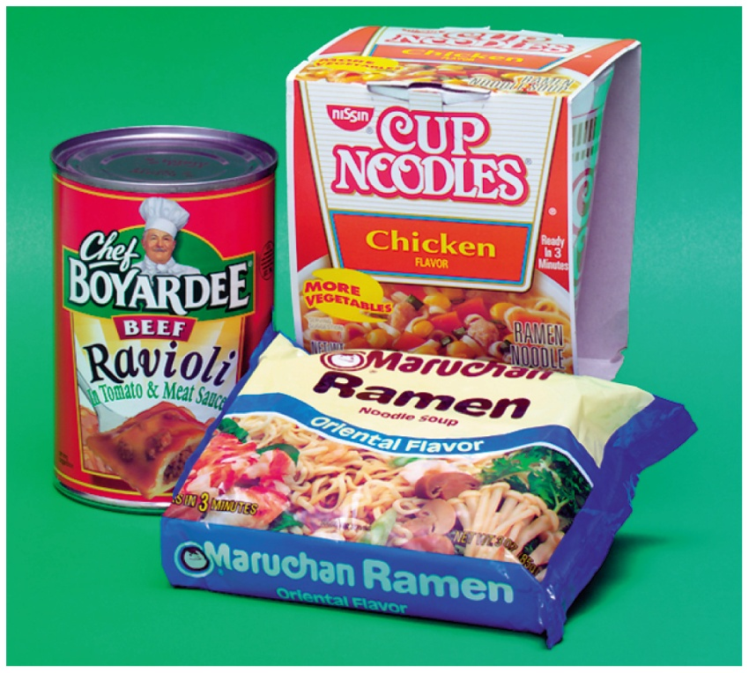
14.2 Properties of Carboxylic Acids
Carboxylate salts are often used as preservatives and flavor enhancers in soups and seasonings.
Sodium propionate, a preservative, is added to cheeses, bread, and other bakery items to inhibit the spoilage of the food by microorganisms.
Learning Goal Describe the solubility and ionization of carboxylic acids in water.

Slide 2
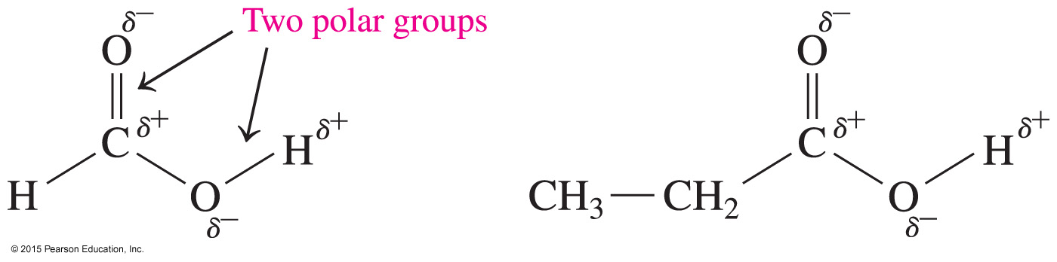
Polarity of Carboxylic Acids
Carboxylic acids are strongly polar because they have
two polar groups:
hydroxyl group (—OH)
carbonyl group (C O)

Slide 3
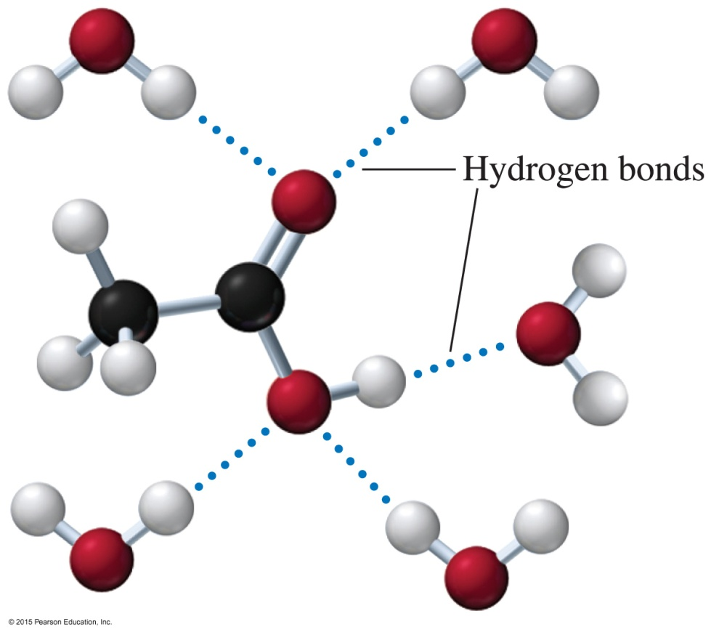
Solubility in Water
Carboxylic acids
form hydrogen bonds with many water molecules
with one to four carbon atoms are very soluble in water
As the number of carbons increases, the solubility of
the carboxylic acid in water
is reduced.
Acetic acid forms hydrogen bonds with water molecules.

Slide 4
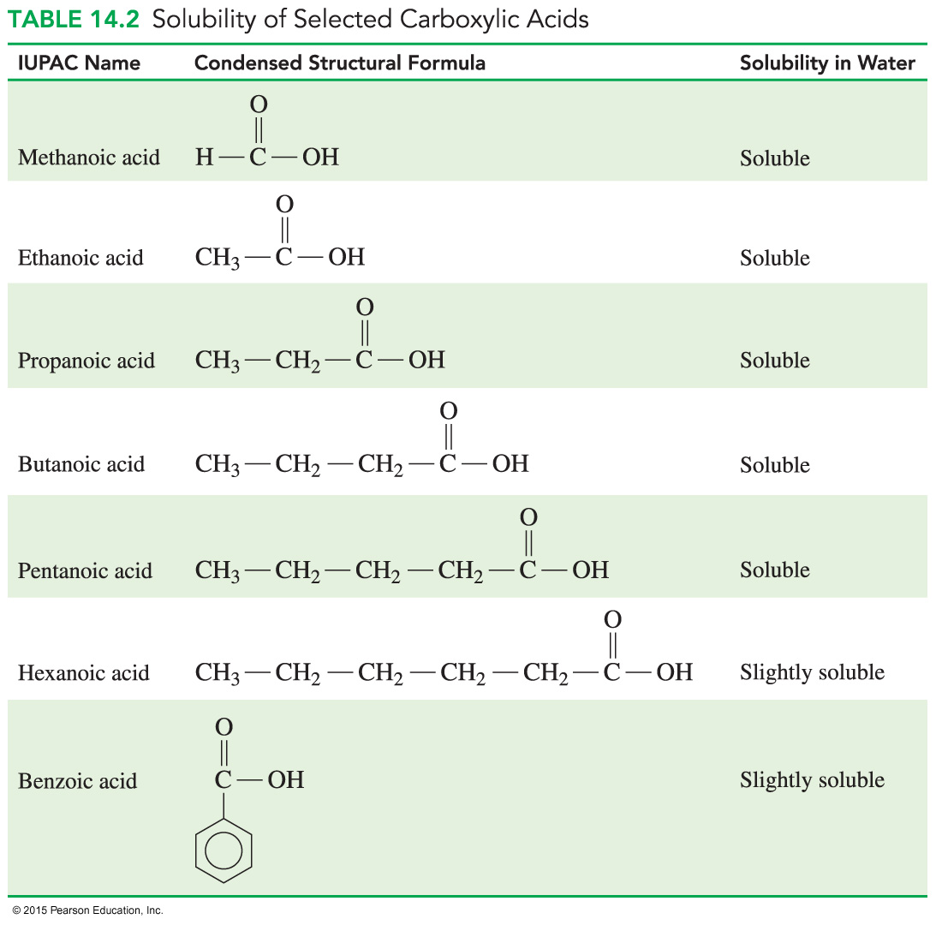
Solubility in Water

Slide 5
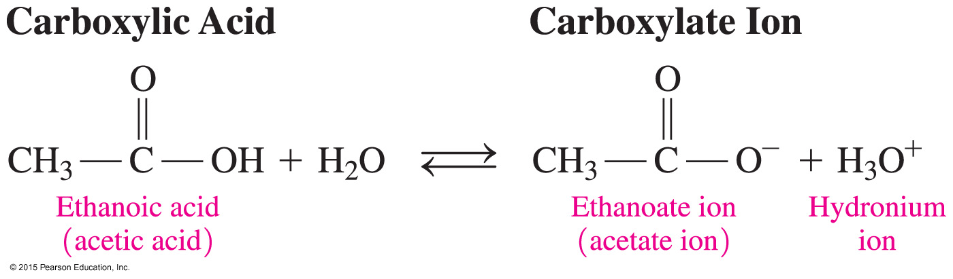
Acidity of Carboxylic Acids
Carboxylic acids
are weak acids
ionize in water to produce carboxylate ions
and hydronium ions
can lose a proton because two oxygen atoms in the carboxylate ion stabilize negative charge

Slide 6
Study Check
Write the balanced equation for the ionization of butanoic acid in water and identify the carboxylate ion.

Slide 7
Solution
Write the balanced equation for the ionization of butanoic acid in water and identify the carboxylate ion.
+ H₂O
– + H₃O⁺
carboxylate ion

Slide 8
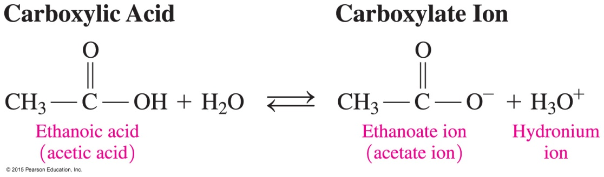

Neutralization of Carboxylic Acids
Carboxylic acid salts
are a product of the neutralization of a carboxylic acid with a strong base, such as NaOH or KOH
(carboxylic acid salt)
are used as preservatives and flavor
enhancers

Slide 9
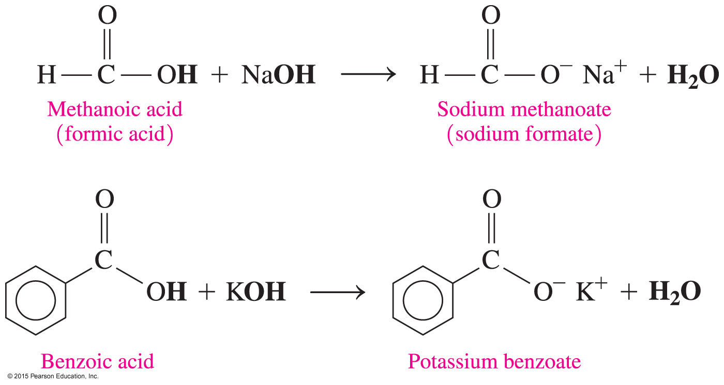
Carboxylic Acid Salts
The carboxylate ion is named by replacing the ic acid ending of the acid name with ate.

Slide 10
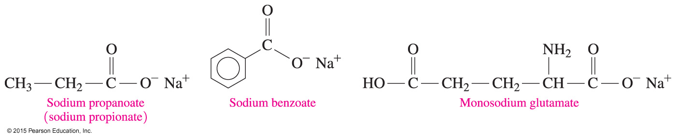
Carboxylic Acid Salts
Carboxylic acid salts
are ionic compounds with strong attractive forces between ions
are solids at room temperature
have high melting points
are usually soluble in water

Slide 11
Carboxylic Acid Salts
Carboxylic acid salts are used as preservatives and flavor
enhancers such as
sodium propionate, which is used in cheese and breads
sodium benzoate, which inhibits growth of mold and bacteria and is added to fruit juices, margarine, relishes, salads, and jams
monosodium glutamate, MSG, which is added to meats,
fish, vegetables, and baked goods to enhance flavor

Slide 12
Study Check
Write the equation for the reaction of propanoic acid with NaOH.

Slide 13
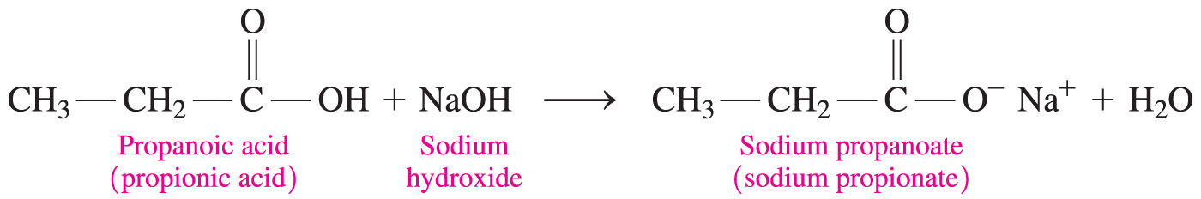
Solution
Write the equation for the reaction of propanoic acid with NaOH.

Slide 14
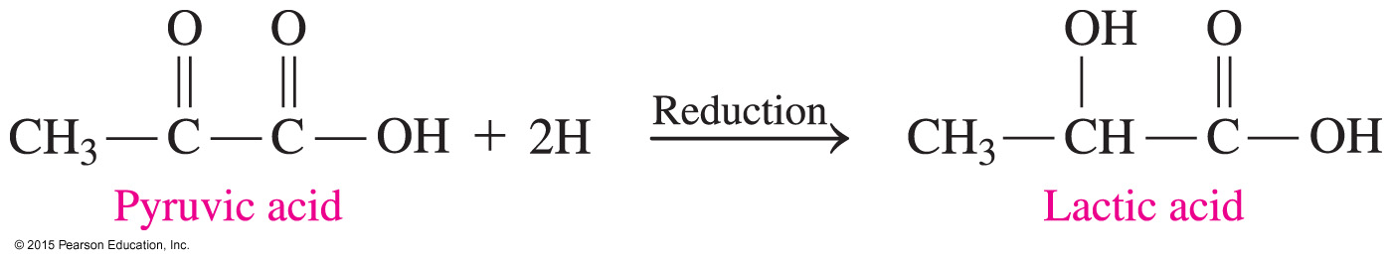
Chemistry Link to Health:
Carboxylic Acids in Metabolism
Carboxylic acids are part of the metabolic processes within our cells. For example,
during glycolysis, a molecule of glucose is broken down into two molecules of pyruvate, the carboxylate salt of pyruvic acid
during strenuous exercise, when oxygen levels are low (anaerobic), pyruvic acid is reduced to give lactic acid or the lactate ion

Slide 15

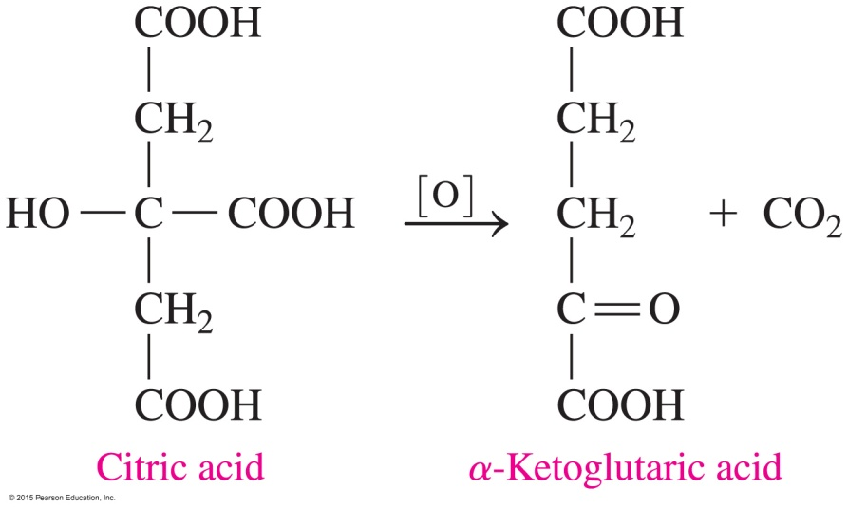
Chemistry Link to Health:
Carboxylic Acids in Metabolism
In the critic acid cycle (Krebs cycle), di- and tricarboxylic acids are oxidized and decarboxylated (loss of CO₂) to produce energy for cells.
At the start of the citric acid cycle, citric acid is oxidized to a five-carbon α-ketoglutaric acid:

Slide 16
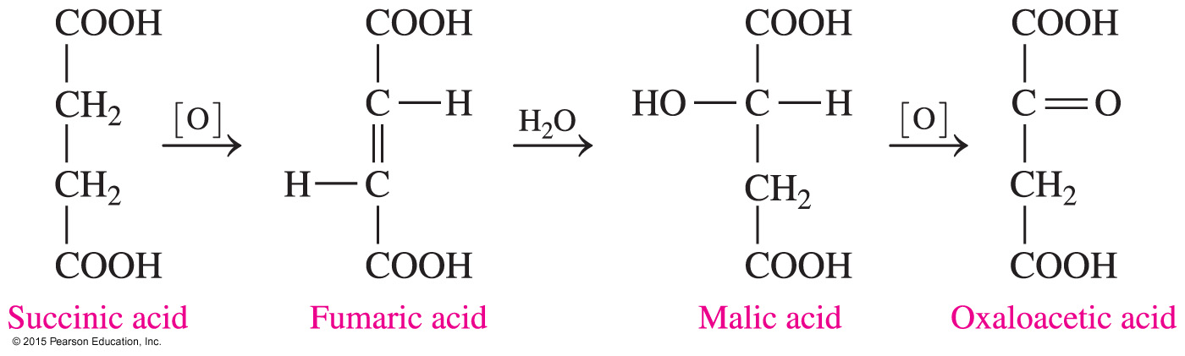
Chemistry Link to Health:
Carboxylic Acids in Metabolism
The citric acid cycle continues as α-ketoglutaric acid loses CO₂ to give a four-carbon succinic acid. Then a series of reactions converts succinic acid to oxaloacetic acid.
Some of the functional groups we have studied, including hydration and oxidation, are part of the metabolic processes that take place in our cells.

