Slide 1

14.3 Esters
By the 1800s, chemists discovered that
salicin from the willow tree bark and leaves was responsible for pain relief
the body converts salicin to salicylic acid, which irritates the stomach lining
Bayer soon discovered that an ester of salicylic acid, acetylsalicylic acid, is less irritating but still effective in pain relief.
Learning Goal Give the IUPAC and common names for an ester; write the balanced chemical equation for the formation of an ester.

Slide 2
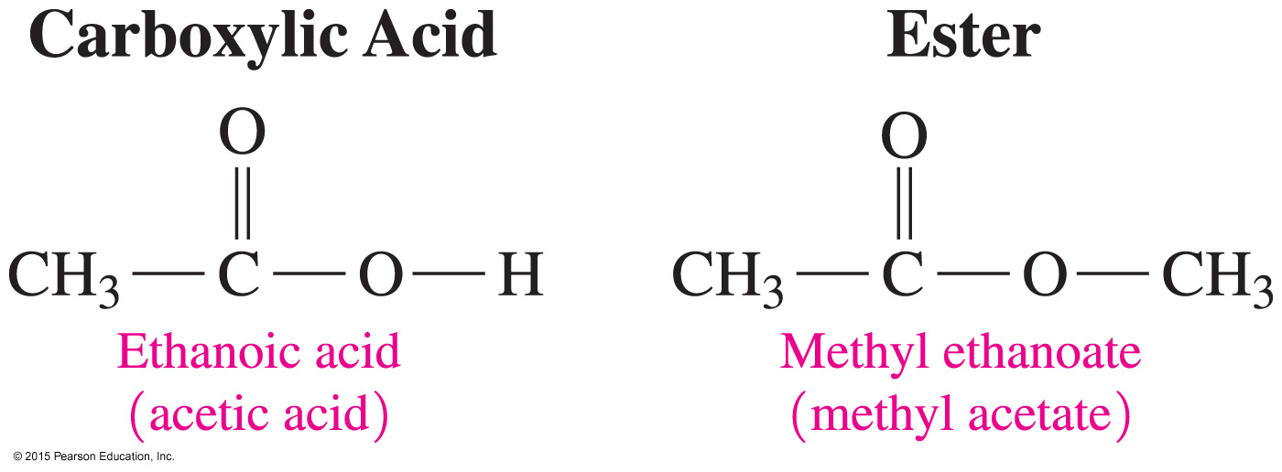
Esters
Esters are
synthesized from the reaction of a carboxylic acid and alcohol
found in fats and oils
responsible for the aroma and flavor of bananas, oranges, and strawberries

Slide 3
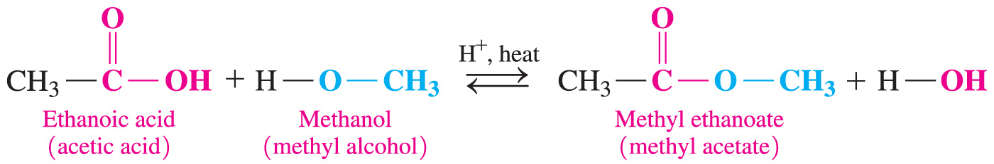
Esterification
Esterification is
the reaction of a carboxylic acid and alcohol in the presence of an acid catalyst and heat to produce an ester
the replacement of the hydrogen atom in the carboxylic acid
—OH group with an alkyl group from an alcohol

Slide 4
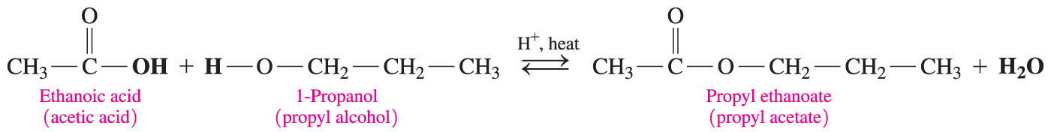
Esterification
An example of esterification is the reaction of a ethanoic acid with 1-propanol to produce an ester called propylethanoate, responsible for the smell of pears.

Slide 5
Study Check
Write the equation for the reaction of propanoic acid and methanol in the presence of heat and an acid catalyst.

Slide 6
Solution
Write the equation for the reaction of propanoic acid and methanol in the presence of heat and an acid catalyst.

Slide 7
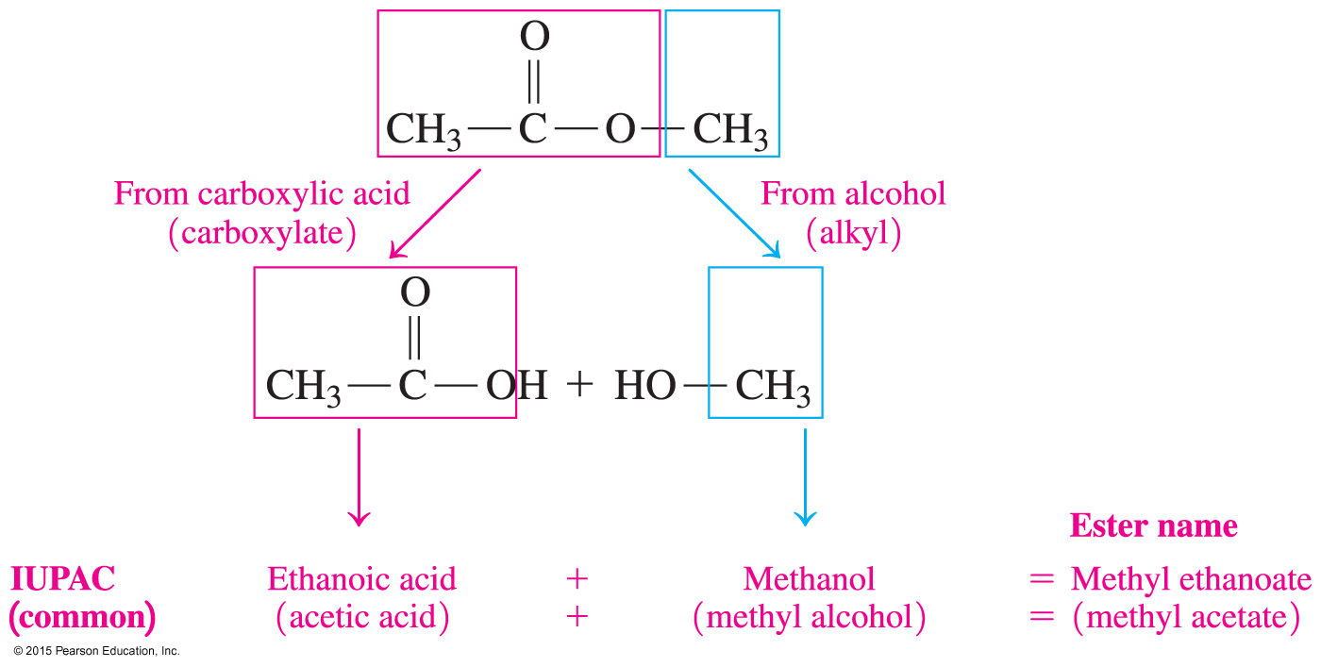
Naming Esters
The name of an ester consists of two words:
1. The first word indicates the alkyl part from the alcohol.
2. The second word is the carboxylate name of the
carboxylic acid.

Slide 8
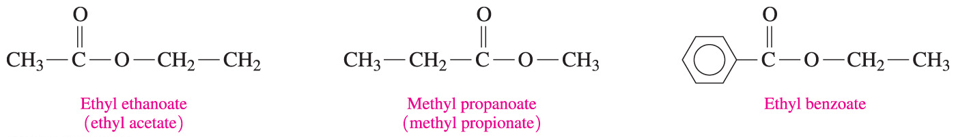
Naming Esters
Esters have IUPAC and common names:

Slide 9

Chemistry Link to Health:
Salicylic Acid from a Willow Tree
In 1899, the Bayer chemical company
produced an ester of salicylic acid and acetic acid less irritating to the stomach than salicylic acid
called the ester acetylsalicylic acid (aspirin)
Many people take a daily low-dose aspirin, which has been found to lower the risk of heart attack and stroke.

Slide 10
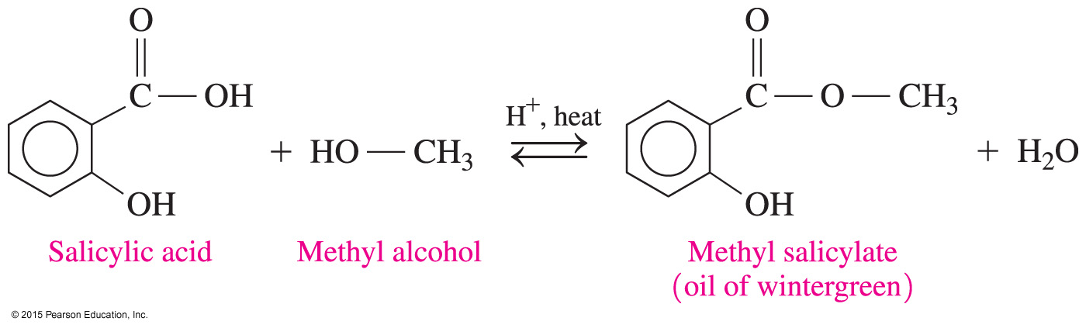
Chemistry Link to Health:
Salicylic Acid from a Willow Tree
Oil of wintergreen, or methyl salicylate, has a pungent, minty odor and flavor and
is used in skin ointments
can pass through the skin
acts as a counter-irritant, producing heat to soothe sore muscles

Slide 11
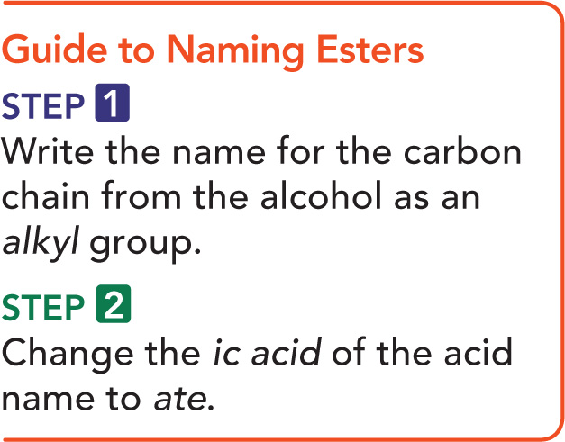
Guide to Naming Esters

Slide 12
Naming Esters
What is the IUPAC name of the following ester?
SOLUTION:
ANALYZE Functional Group Family IUPAC
THE carboxyl ester
PROBLEM
Write the alkyl name for
the carbon chain of the
alcohol, and change the
ic acid in the acid name
to ate.

Slide 13
Naming Esters
What is the IUPAC name of the following ester?
STEP 1 Write the name of the carbon chain from the alcohol as an alkyl group.
ethyl

Slide 14
Guide to Naming Esters
What is the IUPAC name of the following ester?
STEP 2 Change the ic acid of the acid name to ate.
ethyl propanoate

Slide 15
Study Check
Give the IUPAC and common names of the following compound, which is responsible for the flavor and odor
of pears.

Slide 16
Solution
Give the IUPAC and common names of the following compound, which is responsible for the flavor and odor
of pears.
STEP 1 Write the name of the carbon chain from the alcohol as an alkyl group.
propyl

Slide 17
Solution
Give the IUPAC and common names of the following compound, which is responsible for the flavor and odor
of pears.
STEP 2 Change the ic acid of the acid name to ate.
propyl ethanoate propyl acetate

Slide 18
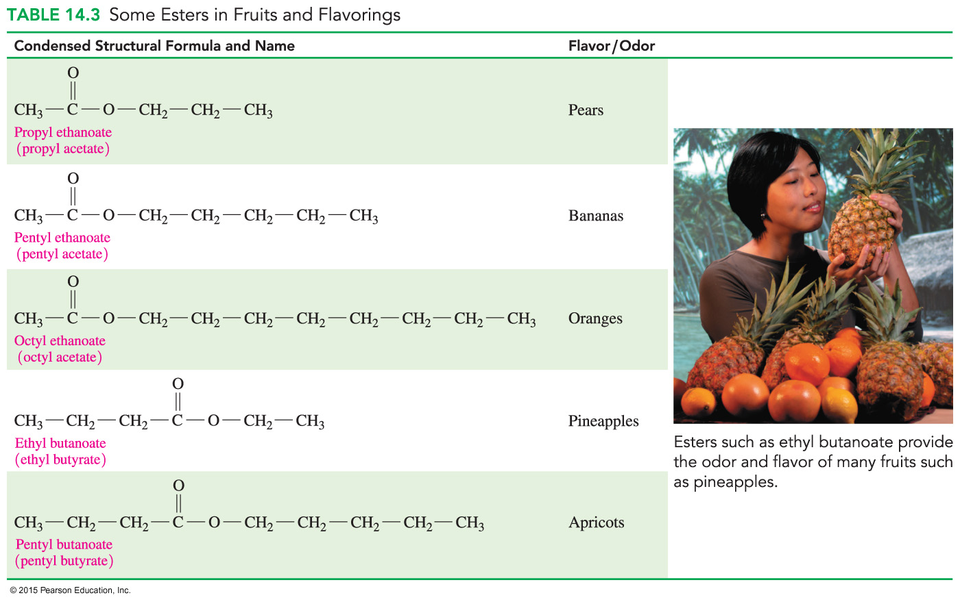
Esters in Fruits
Many of the fragrances of perfumes and flowers and the flavors of fruits are due to esters.
Small esters are volatile, so we can smell them, and they are soluble in water, so we can taste them.

Slide 19
Esters in Fruits and Flavoring

Slide 20
Study Check
Draw the structures of the following compounds:
A. 3-bromobutanoic acid
B. ethyl propanoate

Slide 21
Solution
Draw the structures of the following compounds:
A. 3-bromobutanoic acid
B. ethyl propanoate

