Slide 1
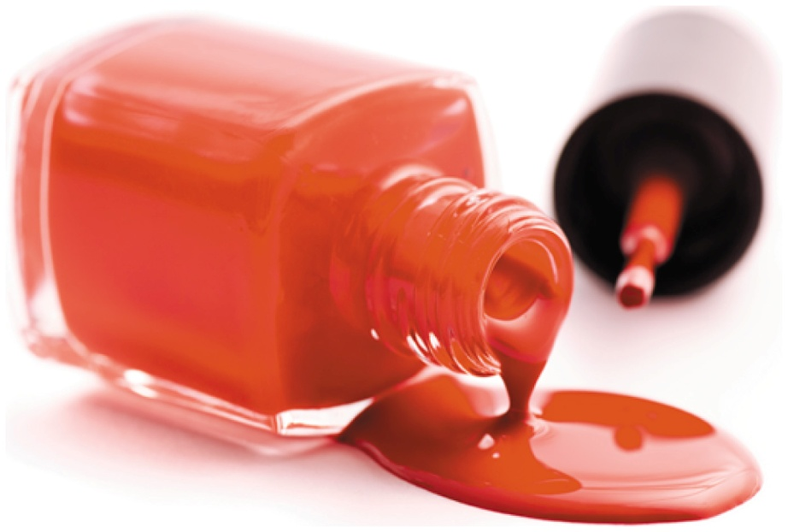
14.4 Hydrolysis of Esters
Ethyl acetate is the solvent in fingernail polish, plastics, and lacquers.
Learning Goal Draw the condensed structural formulas for the products from acid and base hydrolysis of esters.

Slide 2
Acid Hydrolysis of Esters
In acid hydrolysis,
an ester reacts with water to produce a carboxylic acid and an alcohol
a water molecule provides the —OH group to convert the carbonyl group of the ester to a carboxyl group
an acid catalyst and heat are required

Slide 3
Base Hydrolysis (Saponification)
Base hydrolysis, or saponification,
is the reaction of an ester with a strong base in the presence of heat
produces the salt of the carboxylic acid and an alcohol

Slide 4
Study Check
Write the organic products when methyl acetate reacts with
A. water, heat, and an acid catalyst
B. KOH, heat

Slide 5
Solution
Write the organic products when methyl acetate reacts with
A. water, heat, and an acid catalyst
B. KOH, heat
–

