Slide 1
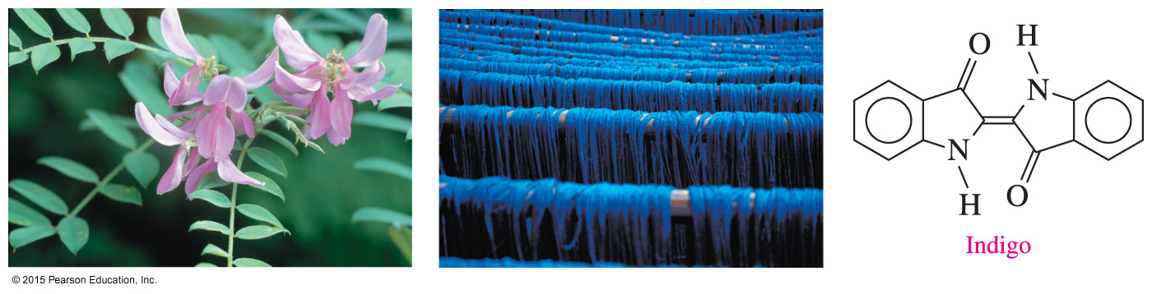
14.5 Amines
Indigo used in blue dyes can be obtained from topical plants such as Indigofera tinctoria.
Learning Goal Write the common names for amines; draw the condensed structural formulas when given their names. Classify amines as primary (1°), secondary (2°), or tertiary (3°). Describe the solubility, ionization, and neutralization of amines.

Slide 2
Amines
Amines
are derivatives of ammonia, NH₃, in which one or more hydrogen atoms are replaced with alkyl or aromatic groups
contain N attached to one or more alkyl or aromatic groups

Slide 3
Classification of Amines
Amines are classified as primary, secondary, or tertiary:
A primary (1°) amine has one carbon group bonded to the nitrogen atom.
A secondary (2°) amine has two carbon groups bonded to the nitrogen atom.
A tertiary (3°) amine has three carbon groups bonded to the nitrogen atom.
1° 2° 3°

Slide 4
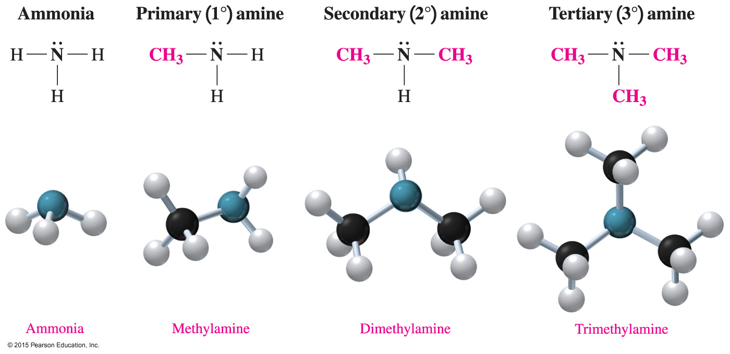
Classification of Amines
Amines have one or more carbon atoms bonded to the N atom.

Slide 5
Naming Amines
Simple amines
are named as alkylamines
list the names of the alkyl groups bonded to the N atom
in alphabetical order in front of amine
use prefixes to identify duplicate alkyl substituents
Ethylamine
Dimethylamine
Ethyldimethylamine

Slide 6
Study Check
Give the common name for each amine and classify it as primary, secondary, or tertiary.
A. CH₃—CH₂—CH₂—NH₂
B.

Slide 7
Solution
Give the common name for each amine and classify it as primary, secondary, or tertiary.
A. CH₃—CH₂—CH₂—NH₂ propylamine, 1°
B. ethyldimethylamine, 3°

Slide 8
Aromatic Amines
The amine of benzene is named aniline.
Alkyl groups on the N use the prefix N- with the alkyl name.
N-Methylaniline Aniline 3-Chloroaniline
Aniline is used to make many dyes, which give color to wool, cotton, and silk fibers, as well as blue jeans.

Slide 9
Study Check
Give the common name of each amine compound.
A.
B.

Slide 10
Solution
Give the common name of each amine compound.
A. diethylmethylamine
B. N-ethylaniline

Slide 11
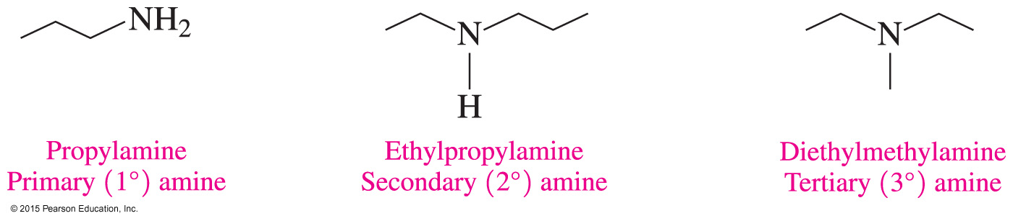
Skeletal Structures of Amines
The skeletal structures show the shapes of amine molecules with one or more alkyl groups bonded to the nitrogen atom.

Slide 12
Solubility of Amines: Hydrogen Bonds
Primary and secondary amines with fewer than six carbons are soluble in water; thus, they can form hydrogen bonds with water molecules.
Tertiary amines can form hydrogen bonds only with water molecules.

Slide 13
Solubility of Amines: Hydrogen Bonds
Because amines contain a polar N —H bond, they form hydrogen bonds with water.
Primary (1°) amines, — NH₂, can form more hydrogen bonds than the secondary (2°) amines.
Tertiary (3°) amines have no hydrogen on the nitrogen atom and can form only hydrogen bonds with water from the N atom.
Like alcohols, the smaller amines, including tertiary ones, are soluble because they form hydrogen bonds with water.

Slide 14
Solubility of Amines in Water
In amines with more than six carbon atoms,
the effect of hydrogen bonding is diminished
the nonpolar hydrocarbon chains of the amine decrease its solubility in water

Slide 15
Study Check
Which of the following compounds are soluble in water?
A. CH₃ — CH₂ — CH₂ — NH₂
B. CH₃ — CH₂ — NH — CH₃
C. CH₃ — CH₂ — CH₂ — CH₃

Slide 16
Solution
Which of the following compounds are soluble in water?
Both A and B are amines that can form hydrogen bonds with water and are therefore soluble in water. C is an alkane and therefore not soluble in water.
A. CH₃ — CH₂ — CH₂ — NH₂
B. CH₃ — CH₂ — NH — CH₃
C. CH₃ — CH₂ — CH₂ — CH₃

Slide 17
Amines Act as Bases in Water
Ammonia (NH₃), as well as 1° and 2° amines, acts as a Brønsted–Lowry base because the lone electron pair on the nitrogen accepts H⁺ from water to produce an ammonium ion (NH₄⁺) and a hydroxide ion (OH–).
NH₃ + H₂O NH₄⁺ + OH–
ammonia ammonium ion hydroxide ion
CH₃ — NH₂ + H₂O CH₃ — NH₃⁺ + OH–
methylamine methylammonium ion hydroxide ion

Slide 18
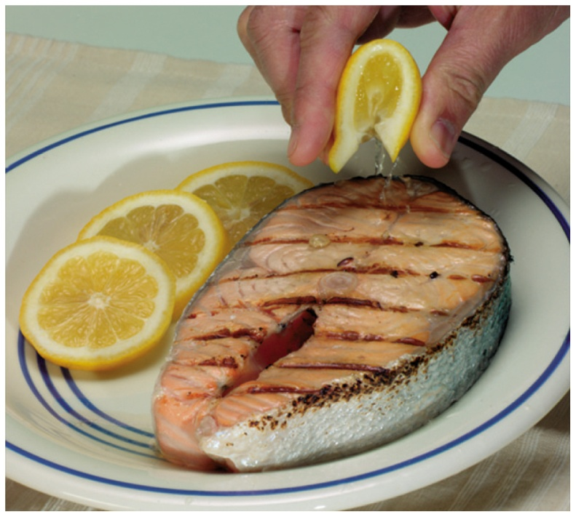
Neutralization Forms Amine Salts
An amine salt forms when
amines such as those responsible for the odor in fish are neutralized by an acid
amines react as Brønsted–Lowry bases in a neutralization reaction with citric acid
The amines in fish react with the
acid in lemon juice to neutralize the “fishy” odor.

Slide 19
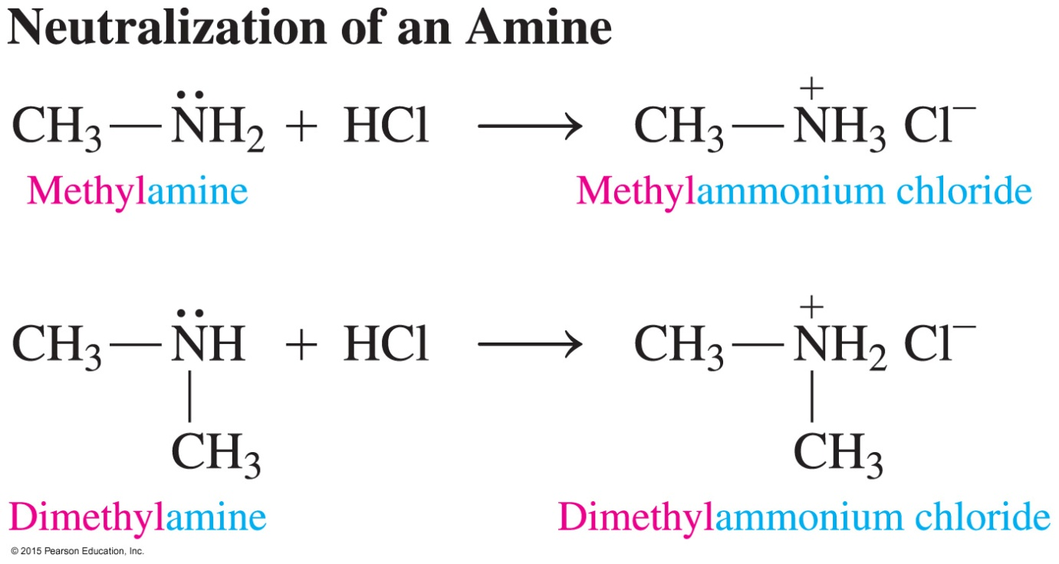
Neutralization Forms Amine Salts
An ammonium salt is named by using its alkylammonium ion name, followed by the name of the negative ion.

Slide 20
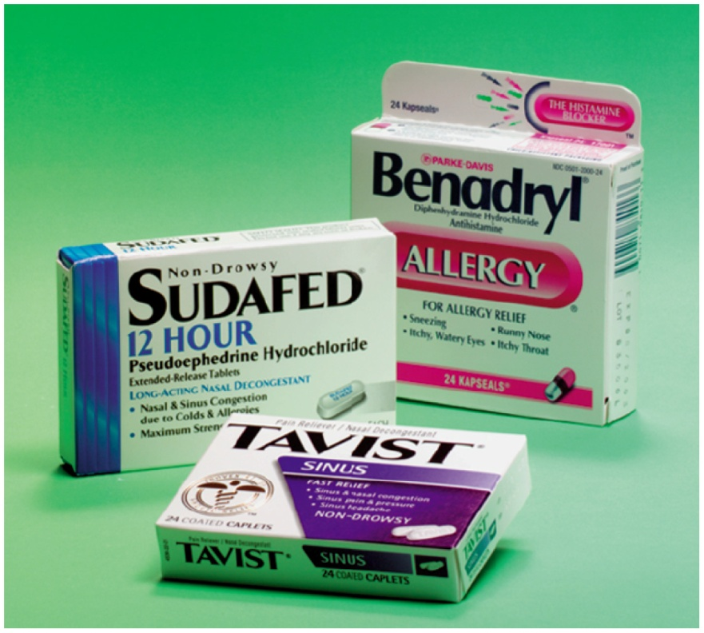
Properties of Ammonium Salts
Amines are usually converted
to their ammonium salt before
being used as drugs. The
ammonium salts are solids at
room temperature, odorless and
soluble in water and body fluids.

Slide 21
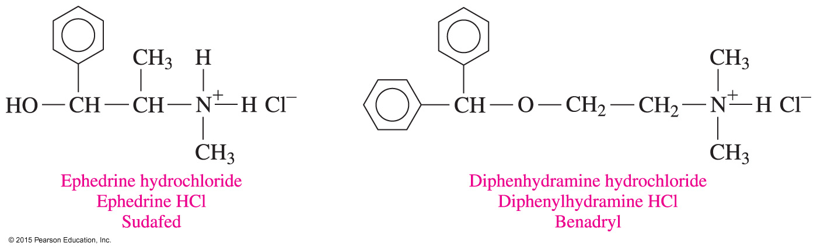
Properties of Ammonium Salts: Medications
Ammonium salts are used as the active ingredients in medications:
Ephedrine is used as a bronchodilator in the decongestant Sudafed.
Diphenylhydramine, found in Benadryl, is used for relief of itching and pain from skin irritations and rashes.

Slide 22
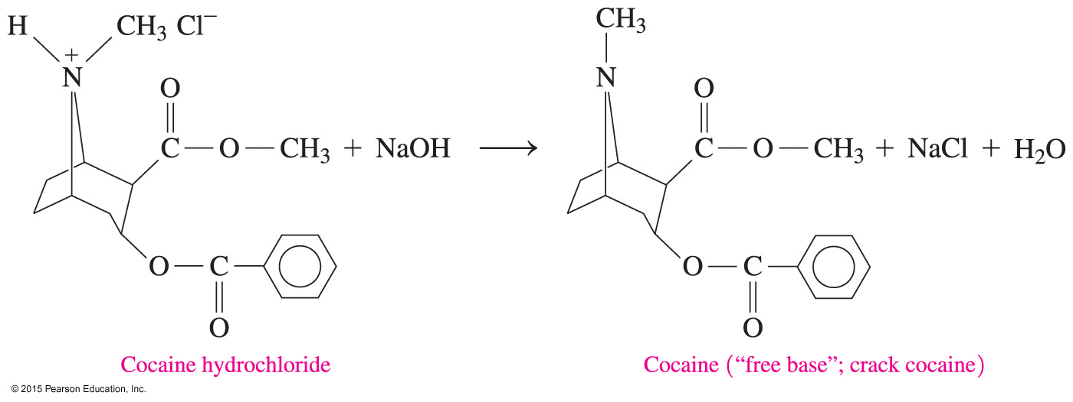
Properties of Ammonium Salts: Cocaine
The narcotic cocaine, extracted from coca leaves using an acidic HCl solution, is smuggled and used illegally in the form of cocaine hydrochloride, an ammonium salt.

Slide 23
Properties of Ammonium Salts: Cocaine
Cocaine hydrochloride, an ammonium salt, can be converted back to its free amine or free base form, “crack cocaine” by treating it with a strong base.

Slide 24
Heterocyclic Amines
A heterocyclic amine consists of five or six atoms in the ring with one or more nitrogen atoms.
Pyrrolidine Pyrrole

Slide 25
Chemistry Link to Health: Alkaloids: Amines in Plants
Alkaloids are
physiologically active compounds produced by plants that contain heterocyclic amines
used in anesthetics, in antidepressants, and as stimulants, and many are habit forming
Nicotine is a stimulant that increases
the level of adrenaline in the blood
heart rate and blood pressure
Nicotine is addictive because it activates
pleasure centers in the brain.

Slide 26
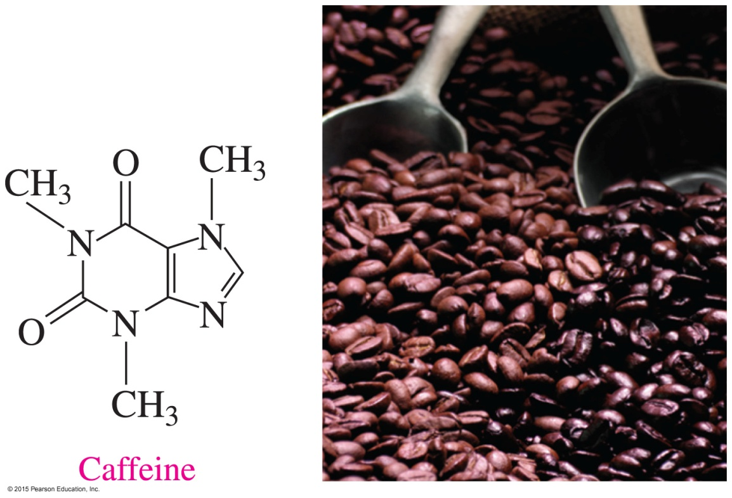
Chemistry Link to Health:
Alkaloids: Amines in Plants
Caffeine
is an alkaloid found in coffee beans, tea, chocolate, and soft drinks
is a stimulant of the central nervous system
increases alertness but may cause insomnia

Slide 27
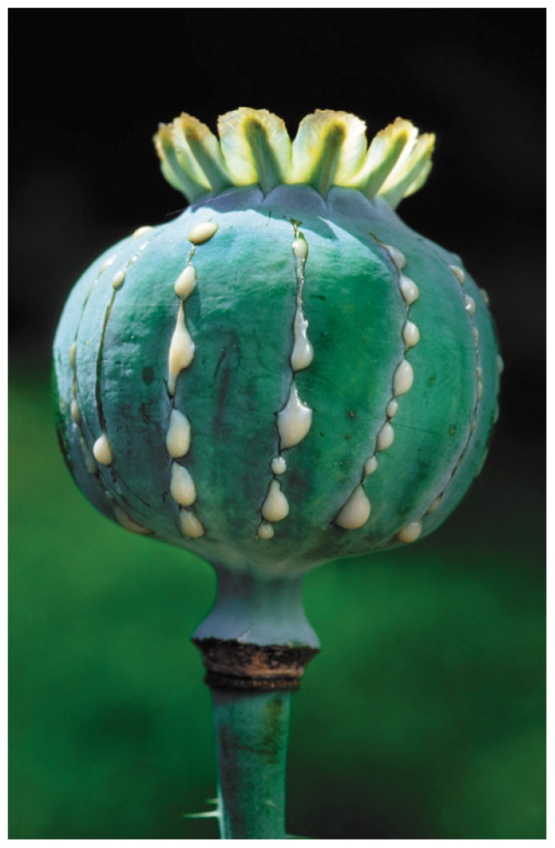
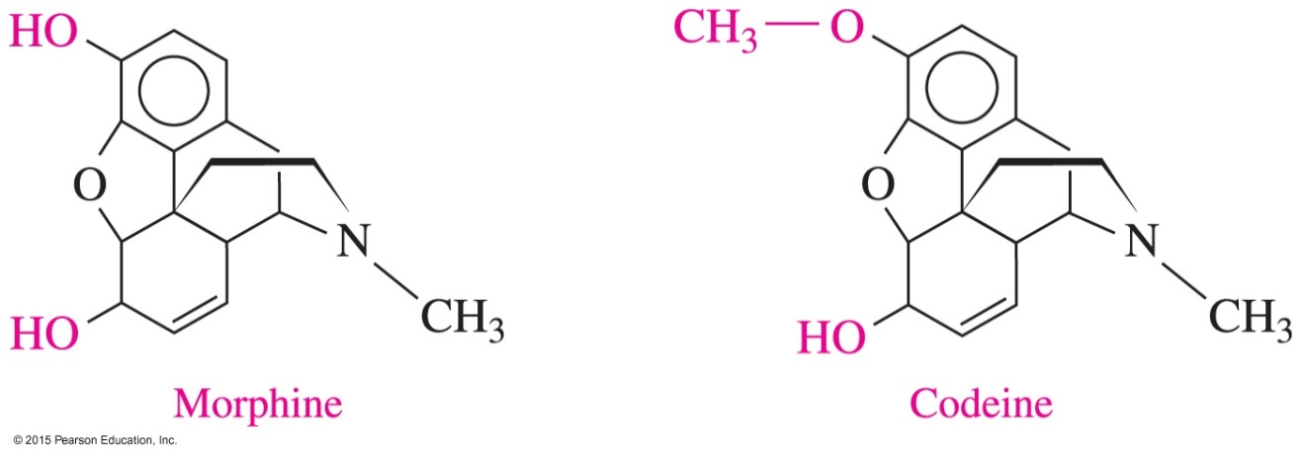
Chemistry Link to Health:
Alkaloids: Amines in Plants
Morphine and codeine are
alkaloids, obtained from the oriental poppy plant
used as painkillers

Slide 28
Study Check
Write the structural formula for
A. methylpropylamine
B. 2-chloroaniline

Slide 29
Solution
Write the structural formula for
A. methylpropylamine CH₃ — CH₂ — CH₂ — NH — CH₃
B. 2-chloroaniline

