Slide 1
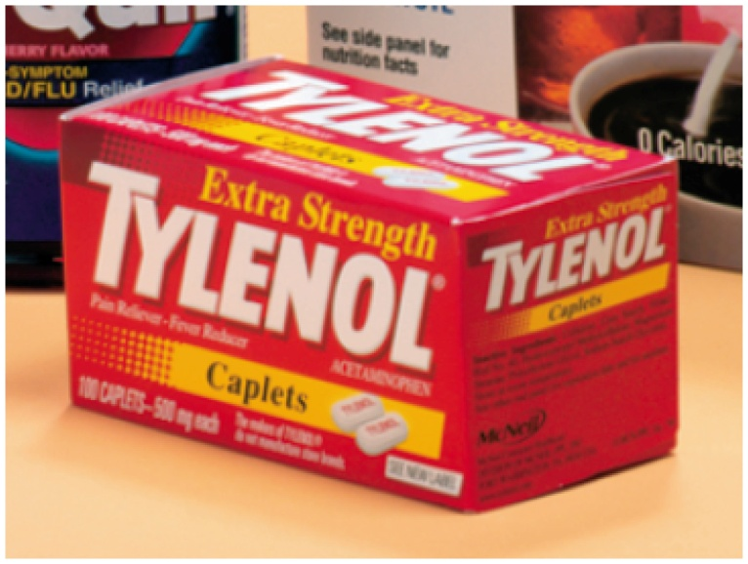
14.6 Amides
Tylenol, an aspirin substitute, contains acetaminophen. Acetaminophen is an amide. It acts to reduce fever and pain; however, it has little anti-inflammatory effect.
Learning Goal Write the common and IUPAC names for amides and the products of formation and hydrolysis.

Slide 2
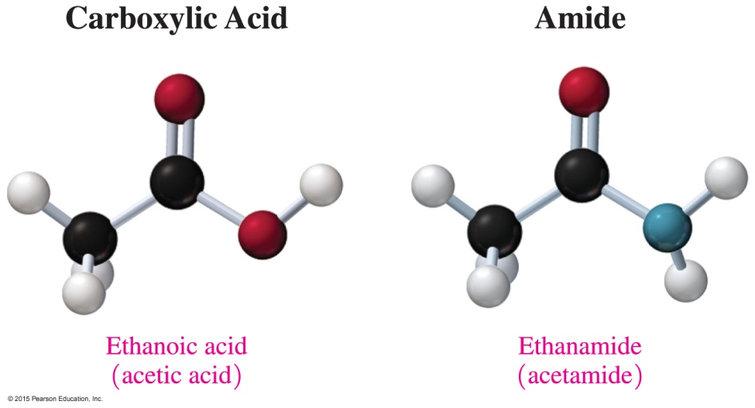
Amides
Amides are derivatives of carboxylic acids in which a nitrogen group (—NH₂) replaces the hydroxyl (—OH) group of carboxylic acids.
Core Chemistry Skill Forming Amides

Slide 3
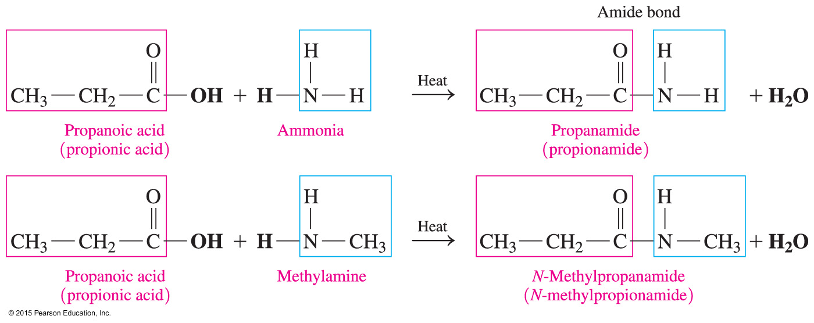
Preparation of Amides: Amidation
Amides are produced by reacting a carboxylic acid with ammonia, or a primary or secondary amine, and heat.

Slide 4
Study Check
Predict the product of the following amidation reaction:

Slide 5
Solution
Predict the product of the following amidation reaction:

Slide 6
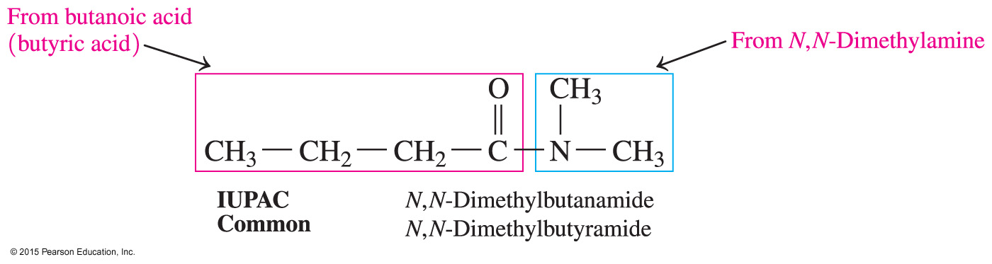
Naming Amides
In both the common and IUPAC names, amides are named by dropping the oic acid (IUPAC) or ic acid (common) from the carboxylic acid name and adding the suffix amide.
Alkyl groups attached to the nitrogen of an amide are named with the prefix N-, followed by the alkyl name.

Slide 7
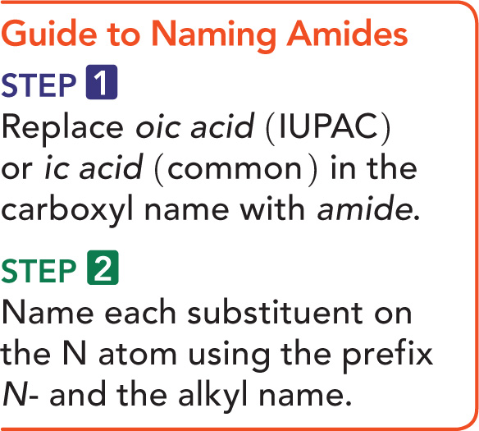
Guide to Naming Amides

Slide 8
Naming Amides
Give the IUPAC and common names for the following amide:
SOLUTION:
ANALYZE Functional Group Naming the Amide N-Substituent
THE amide
PROBLEM
Replace the oic acid methyl
(IUPAC) or ic acid
(common) in the
carbonyl name with
amide.

Slide 9
Naming Amides
Give the IUPAC and common names for the following amide:
STEP 1 Replace oic acid (IUPAC) or ic acid (common) in the carboxyl name with amide.
butanamide

Slide 10
Naming Amides
Give the IUPAC and common names for the following amide:
STEP 2 Name each substituent on the N atom using the prefix N- and the alkyl name.
N-methylbutanamide

Slide 11
Study Check
Give the IUPAC and common names for the following amides:
A.
B.

Slide 12
Solution
Give the IUPAC and common names for the following amides.
A. formamide (IUPAC)
ethanamide (common)
B.
N-ethylpropionamide (IUPAC)
N-ethylpropanamide (common)

Slide 13
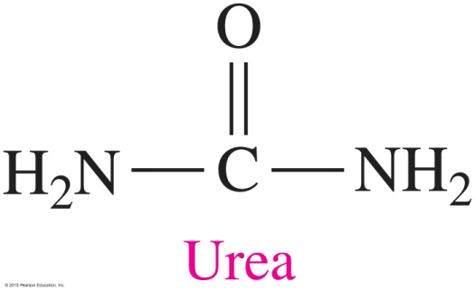
Chemistry Link to Health:
Amides and Medicine
Urea is
the end product of protein metabolism
removed from the blood by the kidneys
excreted in the urine
If the kidneys malfunction, urea is not removed and builds to a toxic level, a condition called uremia.

Slide 14
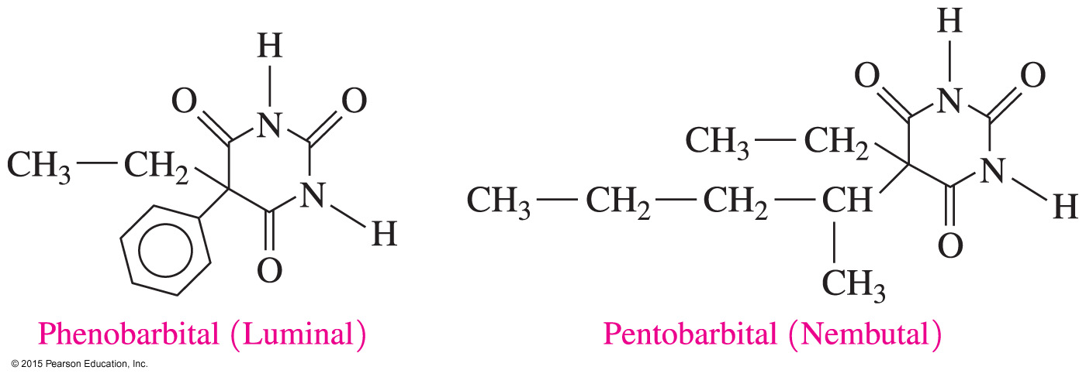
Chemistry Link to Health:
Amides and Medicine
Many barbiturates
are cyclic amides of barbituric acid
act as sedatives in small doses or sleep inducers in large doses
are habit forming
Barbiturate drugs include phenobarbital (Luminal) and pentobarbital (Nembutal).

Slide 15
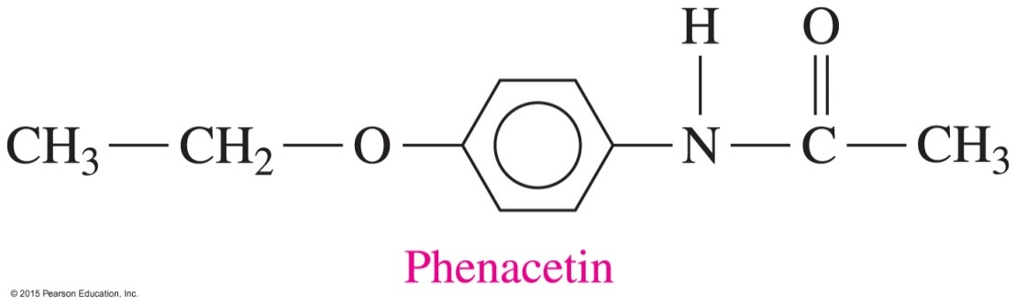
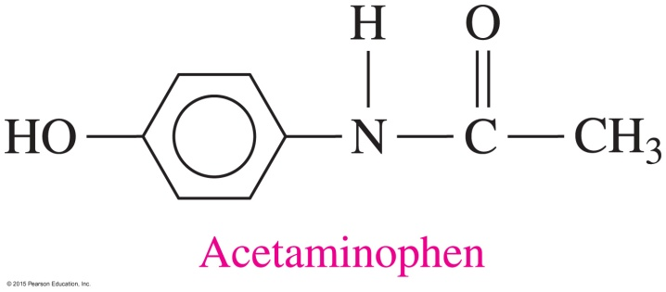
Chemistry Link to Health:
Amides and Medicine
Aspirin substitutes
contain phenacetin or acetaminophen
act to reduce fever and pain but have little anti-inflammatory effect

Slide 16
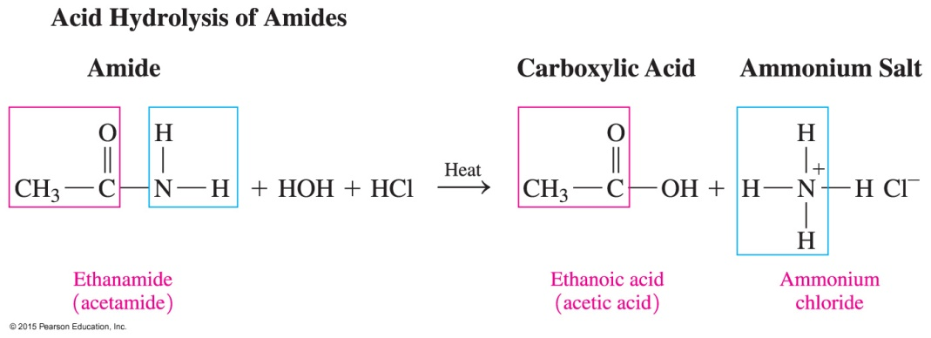
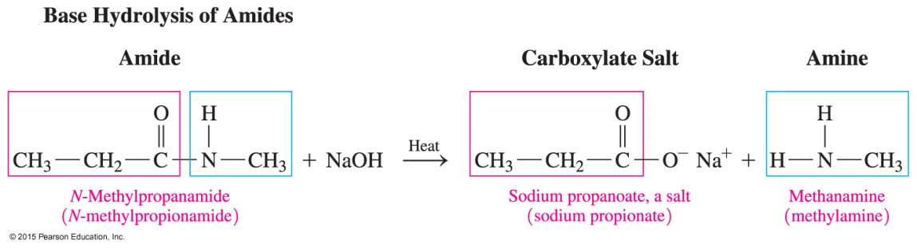
Hydrolysis of Amides
Amides undergo
acid hydrolysis to produce a carboxylic acid and an ammonium salt
base hydrolysis with heat to produce the salt of a carboxylic acid and an amine or ammonia

Slide 17
Base Hydrolysis of Amides
Draw the condensed structural formulas for the products from the hydrolysis of N-methylpentanamide with NaOH.
SOLUTION:
ANALYZE Reaction Type Reactants Products
THE base hydrolysis
PROBLEM
N-methylpentanamide
NaOH
sodium pentanoate
methylamine

Slide 18
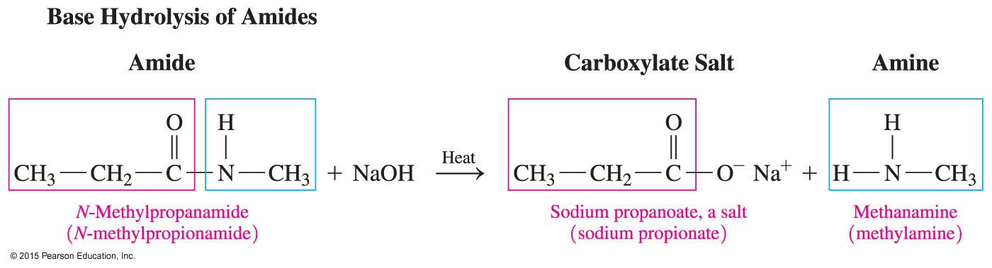
Base Hydrolysis of Amides
Draw the condensed structural formulas for the products from the hydrolysis of N-methylpentanamide with NaOH.
In the base hydrolysis of the amide,
the amide bond is broken between the carboxyl carbon atom and the nitrogen atom
the products are the carboxylate salt and an amine

Slide 19
Study Check
Draw the structures of the following:
A. pentanamide
B. N-ethylbenzamide

Slide 20
Solution
Draw the structures of the following:
A. pentanamide
B. N-ethylbenzamide

Slide 21
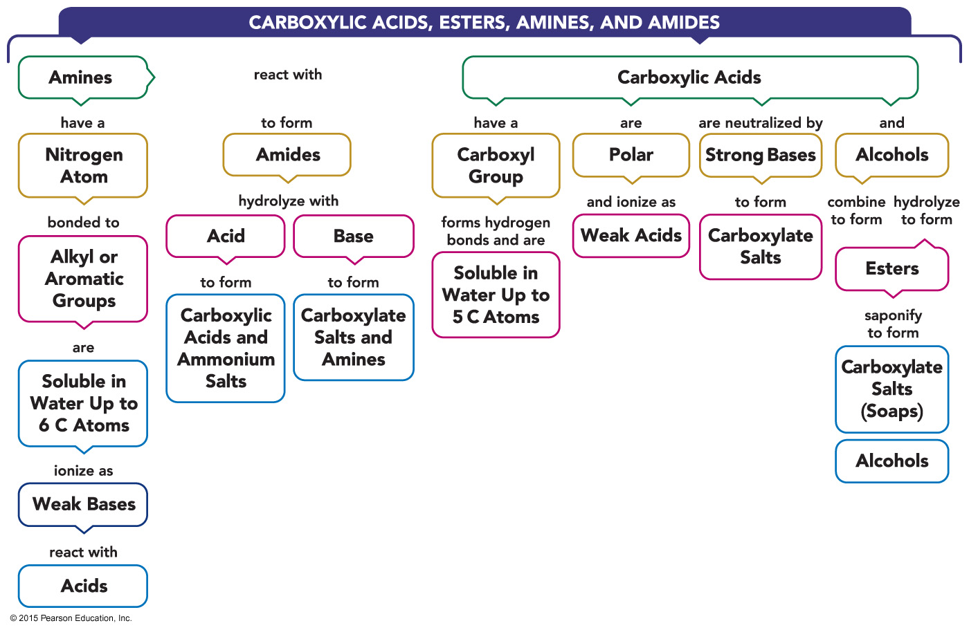
Carboxylic Acids, Esters, Amines, and Amides—Concept Map

