Slide 1
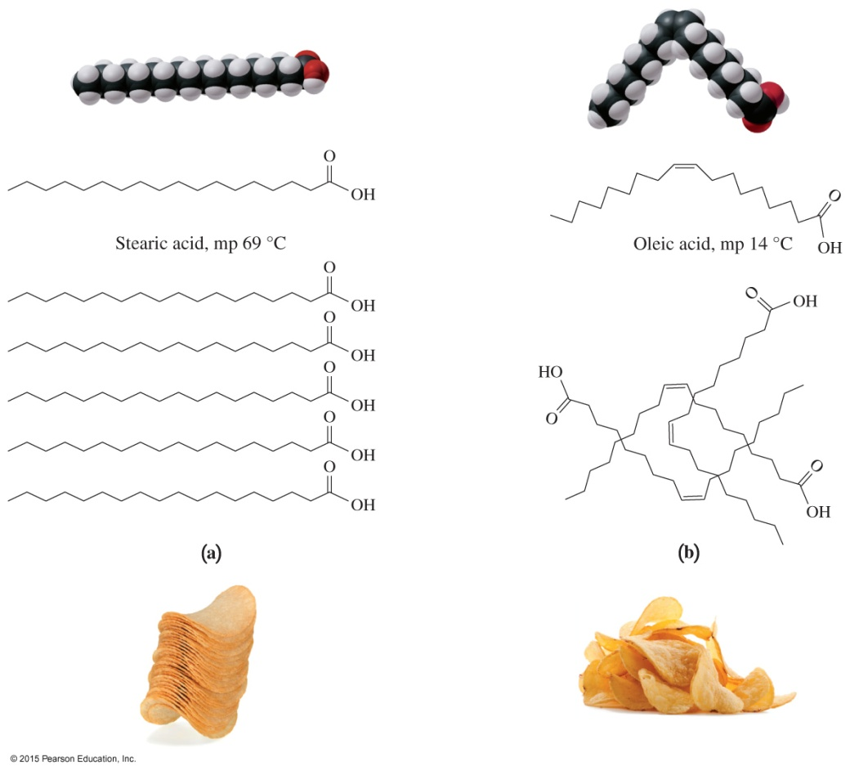
15.2 Fatty Acids
We might think of saturated fatty acids as chips with regular shapes that stack closely together in a can.
Similarly, irregularly shaped chips would be like unsaturated fatty acids that do not fit closely together.
Learning Goal Draw the condensed structural formula for a fatty acid and identify it as saturated or unsaturated.

Slide 2
Fatty Acids
Fatty acids are
long, unbranched carbon chains with a carboxylic acid group at the end
typically 12– to 18–carbon atoms long
insoluble in water because of the long carbon chain
saturated when they do not contain C C double bonds in the carbon chain
unsaturated when they contain C C double bonds in the carbon chain
Core Chemistry Skill Identifying Fatty Acids

Slide 3
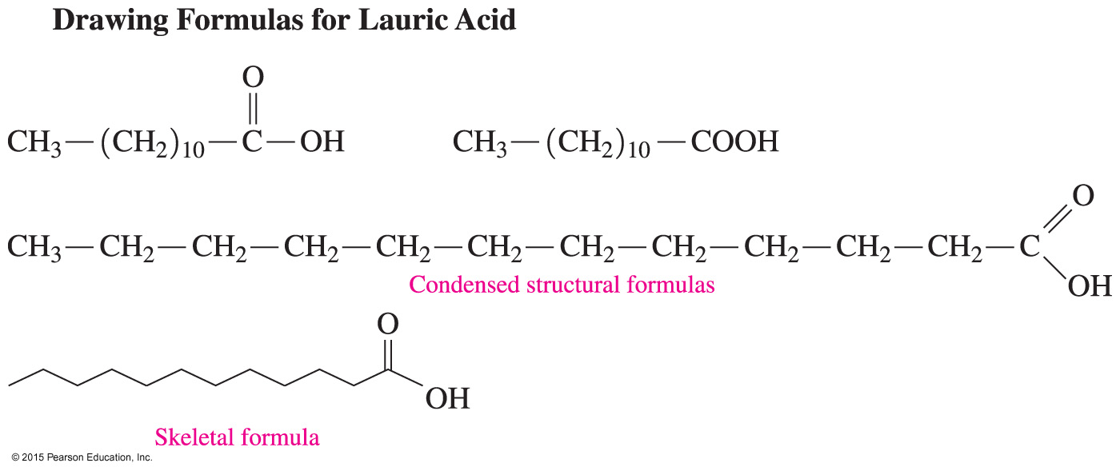
Drawing Fatty Acids
In a skeletal formula of a fatty acid, the ends and bends of the line are the carbon atoms.
The structural formula of lauric acid can be drawn in several forms.

Slide 4
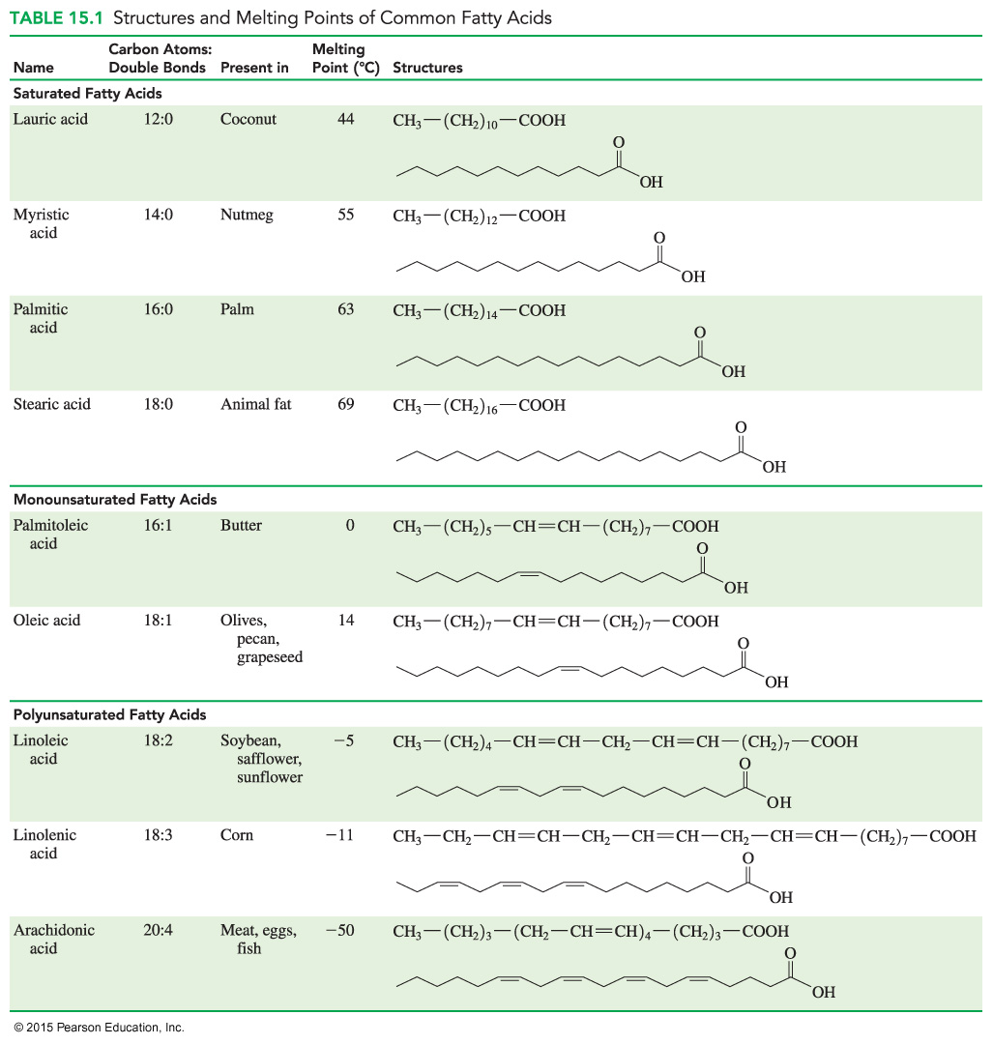
Saturated Fatty Acids
Fatty acids can be saturated, with only C — C single bonds in the carbon chain.

Slide 5
Monounsaturated Fatty Acids
Fatty acids can be monounsaturated, with only one double C C bond in the carbon chain.

Slide 6
Polyunsaturated Fatty Acids
Fatty acids can be polyunsaturated, with at least two double C C bonds in the carbon chain.

Slide 7
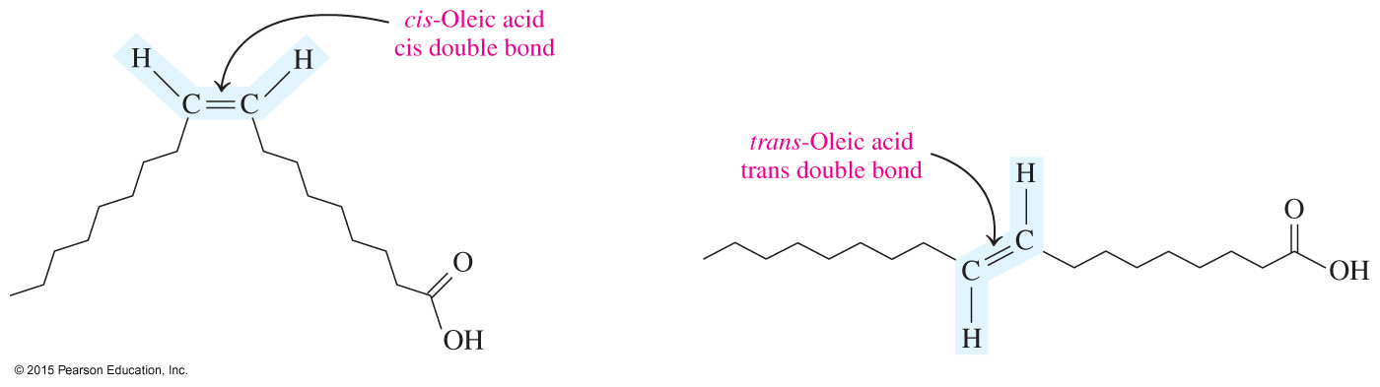
Cis and Trans Unsaturated Fatty Acids
Unsaturated fatty acids can be drawn as cis and trans isomers.
Oleic acid is a monounsaturated fatty acid found in olives, with one double bond at carbon 9.
Almost all naturally occurring unsaturated fatty acids have one or more
cis double bonds.

Slide 8
Essential Fatty Acids
Humans
are capable of synthesizing some fatty acids from carbohydrates or other fatty acids
cannot synthesize sufficient amounts of polyunsaturated fatty acids such as linoleic acid, linolenic acid, and arachidonic acid
Because these polyunsaturated fatty acids must be obtained from the diet, they are known as essential fatty acids.

Slide 9
Properties of Saturated Fatty Acids
Saturated fatty acids
contain only single C — C bonds and fit close together in a regular pattern
have strong dispersion forces between long carbon chains
have higher melting points and are usually solids at
room temperature

Slide 10
Properties of Saturated Fatty Acids
In unsaturated fatty acids, the cis double bonds cause the carbon chain to bend or kink, giving the molecules an irregular shape and allowing fewer interactions between molecules.
The reduced interactions in fatty acids with cis bonds reduces the melting point of the molecules.

Slide 11
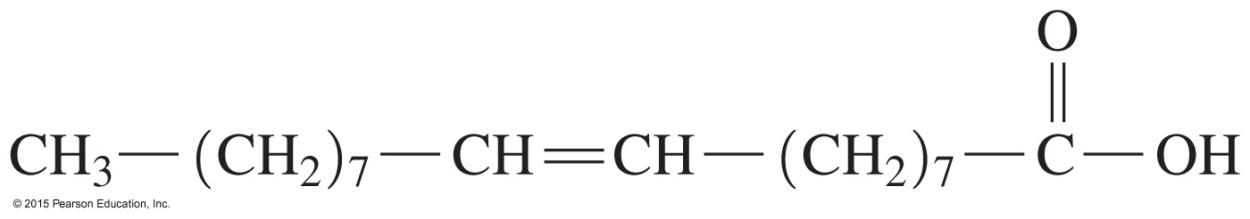
Study Check
Consider the condensed structural formula for oleic acid.
Why is this molecule an acid?
How many total carbon atoms are in oleic acid?
Is this a saturated, monounsaturated, or polyunsaturated fatty acid?
Is it likely to be a solid or liquid at room temperature?
Would it be soluble in water?

Slide 12
Solution
Consider the condensed structural formula for oleic acid.
Why is this molecule an acid? It contains a carboxylic acid functional group.
How many total carbon atoms are in oleic acid?
Oleic acid contains 18 carbon atoms.

Slide 13
Solution
Consider the condensed structural formula for oleic acid.
Is this a saturated, monounsaturated, or polyunsaturated fatty acid?
Oleic acid is a monounsaturated fatty acid.
Is it likely to be a solid or liquid at room temperature?
It is a liquid at room temperature.
Would it be soluble in water?
The long carbon chain makes it insoluble in water.

Slide 14
Prostaglandins
Prostaglandins
are hormone-like substances produced in cells
are also known as eicosanoids, formed from arachidonic acid, a polyunsaturated fatty acid with 20 carbon atoms
differ by the substituents attached to the five-carbon ring
have many functions, such as lowering or raising blood
pressure and stimulating contraction and relaxation of
the smooth muscle of the uterus

Slide 15
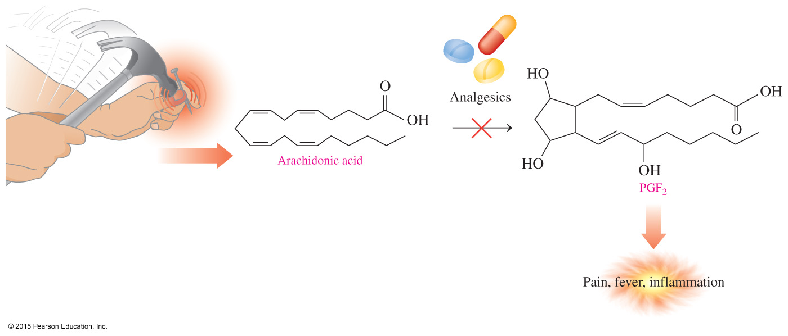
Prostaglandins
When tissues are injured, arachidonic acid is converted
to prostaglandins that produce inflammation and pain in the area.
Nonsteroidal anti-inflammatory drugs (NSAIDs), such as aspirin, block the production of prostaglandins.

Slide 16
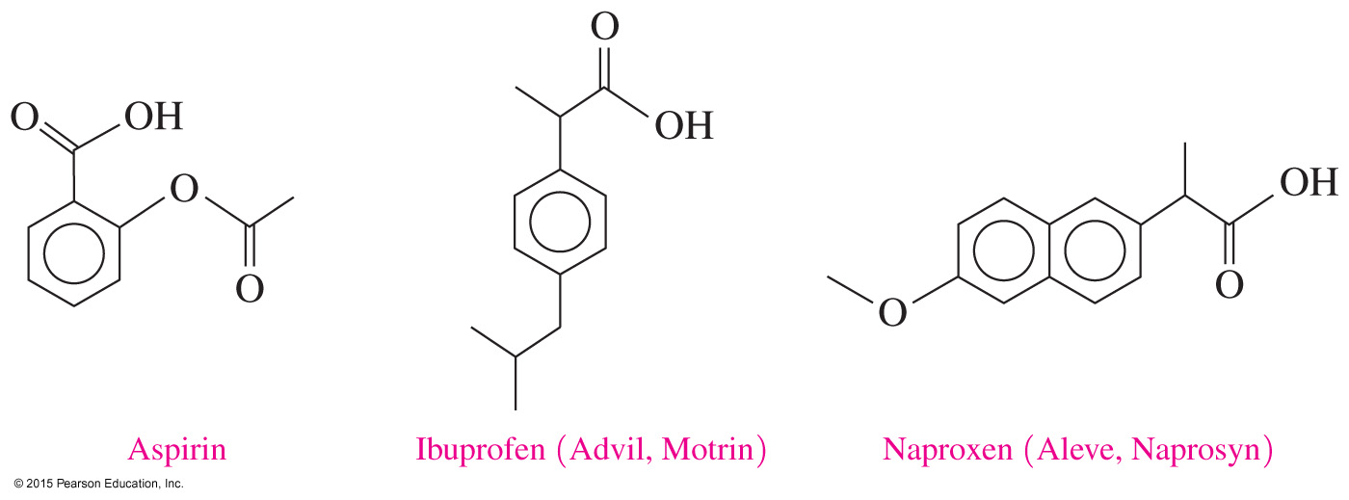
Prostaglandins: NSAIDs
Nonsteroidal anti-inflammatory drugs (NSAIDs) block production of prostaglandins, decreasing pain and inflammation.
NSAIDs include naproxen (Aleve and Naprosyn), ketoprofen (Actron), and nabumetone (Relafen).

Slide 17
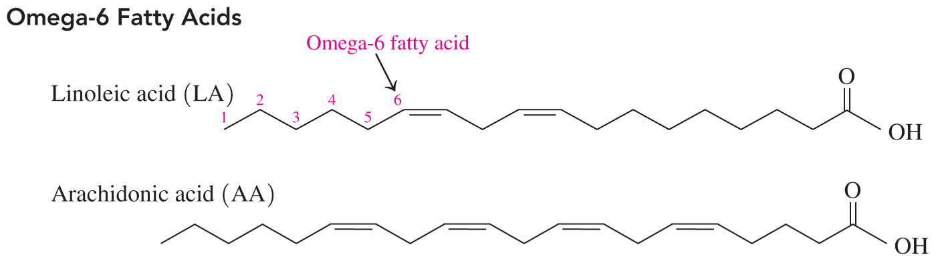
Chemistry Link to Health:
Omega-6 Fatty Acids
Unsaturated fats such as those in vegetable oils and fish are recognized as more beneficial to health than saturated fats.
Vegetables contain omega-6 acids, meaning the first double bond occurs at carbon 6 counting from the methyl end of the carbon chain. Examples of omega-6 acids are linoleic and arachidonic acids.

Slide 18
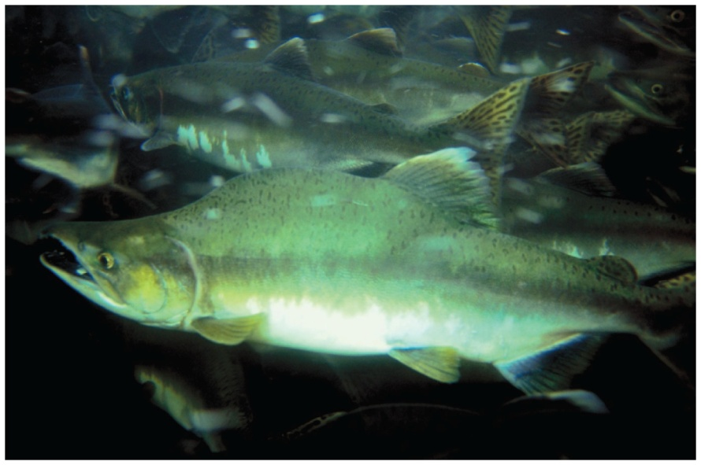
Chemistry Link to Health:
Omega-3 Fatty Acids
Fish has high levels of omega-3 acids, meaning the first double bond occurs at carbon 3, counting from the methyl end of the chain. Examples of omega-3 acids include linolenic, eicosapentaenoic, and docosahexaenoic acids.
Cold-water fish are a source of omega-3 fatty acids.

Slide 19
Chemistry Link to Health:
Omega-3 Fatty Acids
In atherosclerosis and heart disease,
cholesterol forms plaques that adhere to the walls of the
blood vessels
blood pressure rises as blood has to squeeze through a smaller opening in the blood vessel
more plaque forms; there is also a possibility of blood clots blocking the blood vessels and causing a heart attack
Omega-3 fatty acids lower the tendency of blood platelets to stick together, reducing the possibility of blood clots.

Slide 20
Study Check
Label each of the following fatty acids as saturated,
monounsaturated, or polyunsaturated.
A. linolenic acid
B. palmitoleic acid
C. stearic acid

Slide 21
Solution
Label each of the following fatty acids as saturated,
monounsaturated, or polyunsaturated.
A. linolenic acid polyunsaturated
B. palmitoleic acid monounsaturated
C. stearic acid saturated

