Slide 1
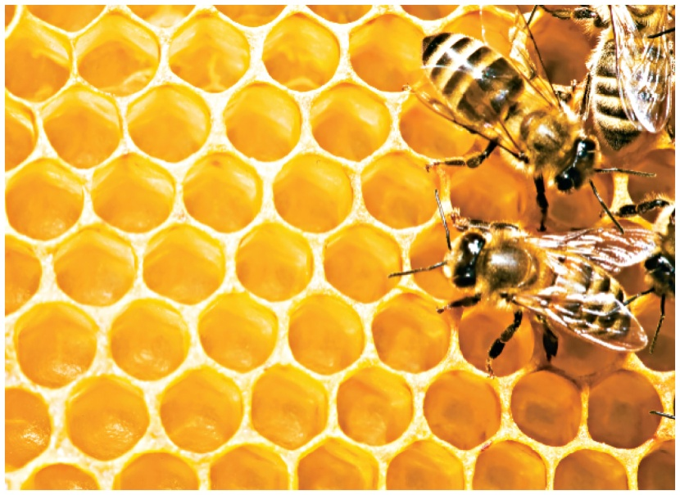
15.3 Waxes and Triacylglycerols
Natural waxes are found on the surface of fruits and on the leaves and stems of plants, where they help prevent loss of water and damage from pests.
Waxes on the skin, fur, and feathers of animals provide a waterproof coating.
Learning Goal Draw the condensed structural formula for a wax or triacylglycerol produced by the reaction of a fatty acid and an alcohol or glycerol.

Slide 2
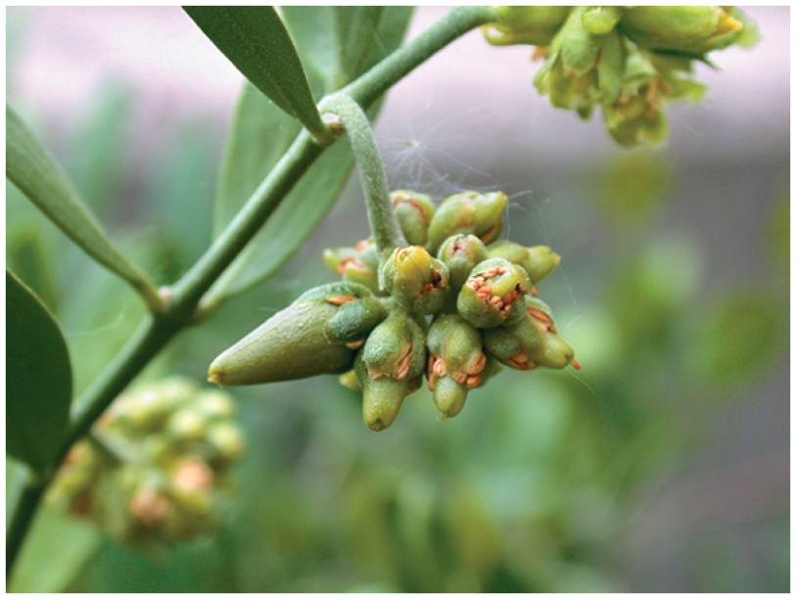
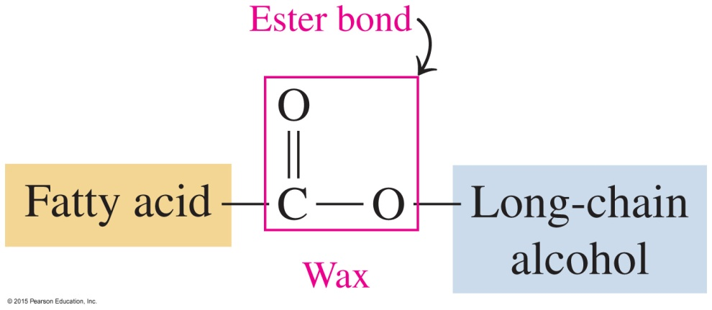
Waxes
Waxes are
esters of saturated fatty acids and long-chain alcohols, each containing from 14 to 30 carbon atoms
coatings that prevent loss of water by leaves of plants

Slide 3
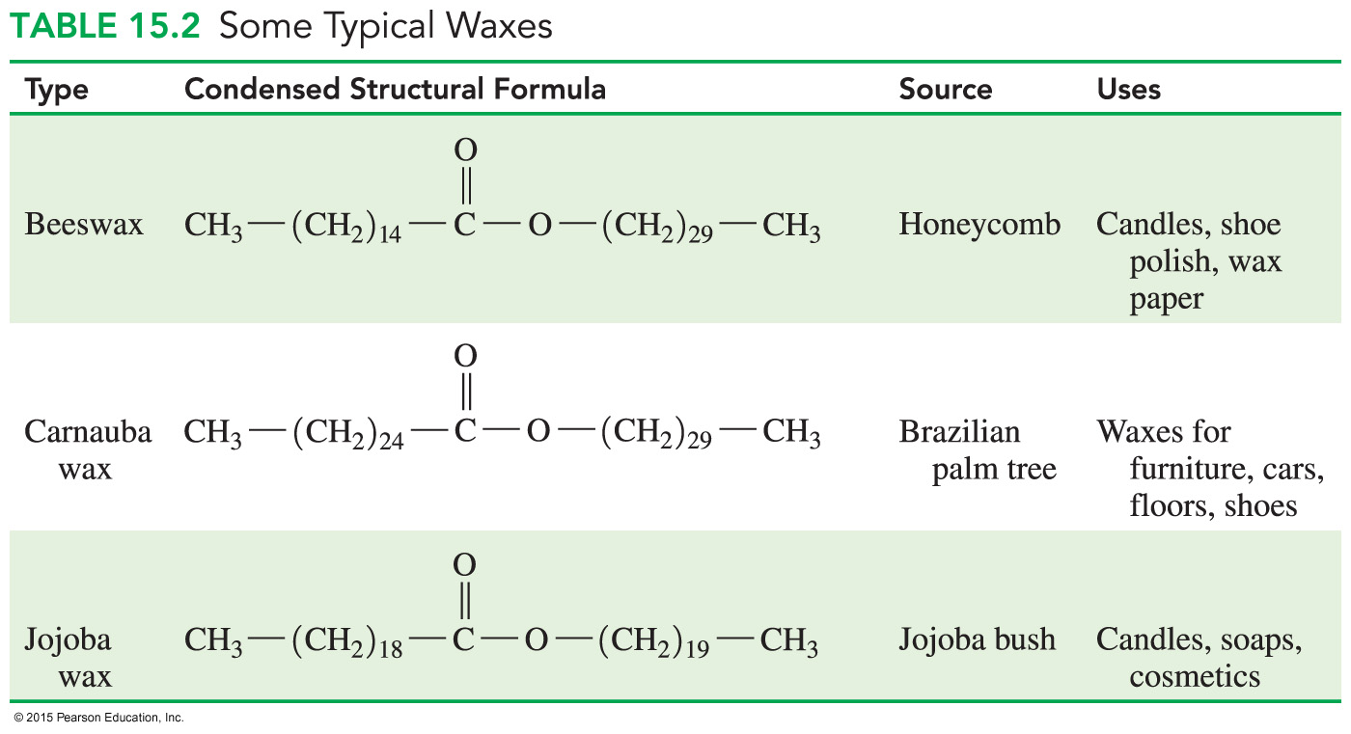
Typical Waxes

Slide 4
Triacylglycerols
In the body, fatty acids are stored as triacylglycerols (triglycerides), which are
esters of glycerol (a trihydroxy alcohol) and fatty acids
formed when three hydroxyl groups of glycerol react with the carboxyl groups of three fatty acids
named by changing glycerol to glyceryl and naming the fatty acids as carboxylates
Core Chemistry Skill Drawing Structures for Triacylglycerols

Slide 5
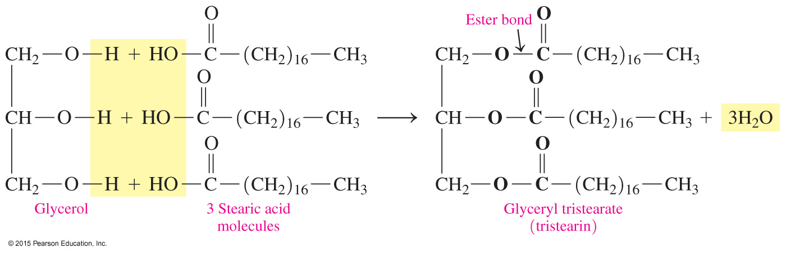
Triacylglycerol: Glyceryl Tristearate
The name of the fatty acid formed with three stearic acids becomes glyceryl tristearate.
The common name of this compound is tristearin.

Slide 6
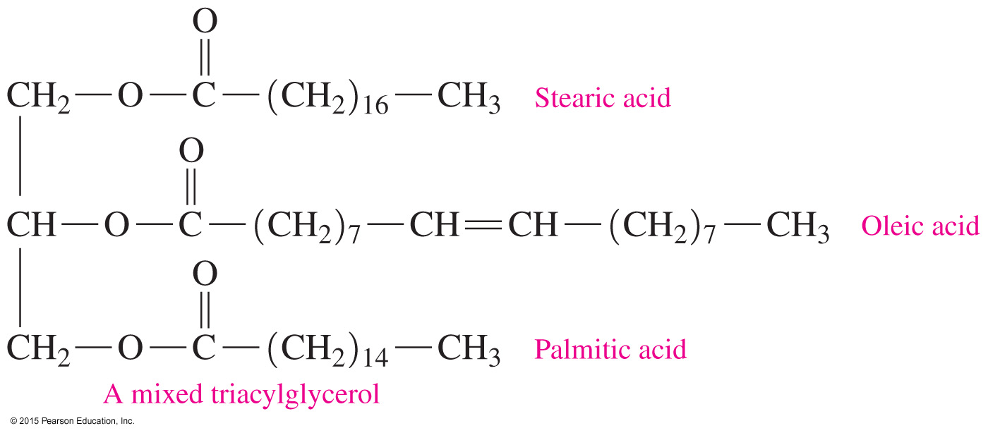
Mixed Triacylglycerols
Triacylglycerol may contain different fatty acids, such as the triacylglycerol made from stearic, oleic, and palmetic acids.

Slide 7
Triacylglycerols: Energy Storage
Triacylglycerols are the major form of energy storage for animals.
Animals that hibernate eat large quantities of plants, seeds, and nuts that are high in calories.
As the external temperature drops, the animal goes into hibernation and the body temperature drops to nearly freezing, reducing cellular activity, respiration, and heart rate.

Slide 8
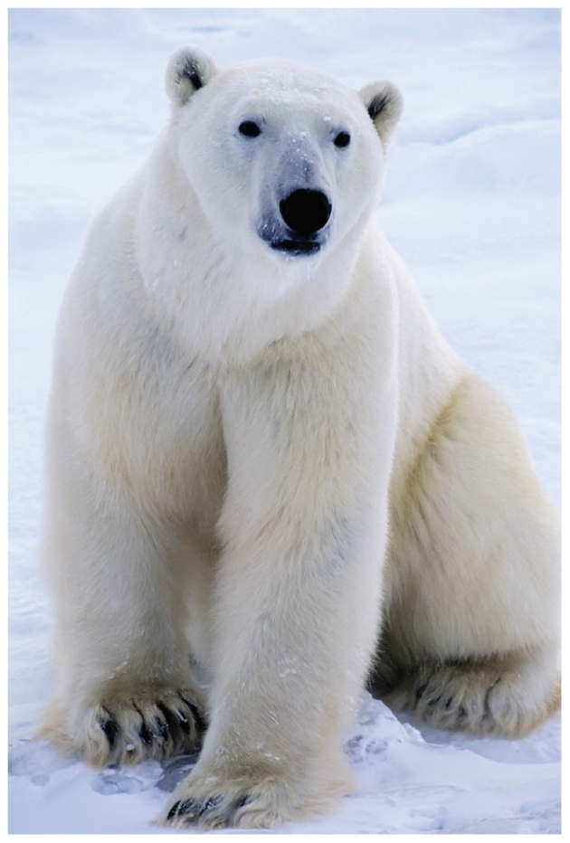
Triacylglycerols: Energy Storage
During hibernation, the animal’s stored fat in the form of triacylglycerols is its only source of energy.
Prior to hibernation, a polar bear
eats food with a high caloric content.

Slide 9
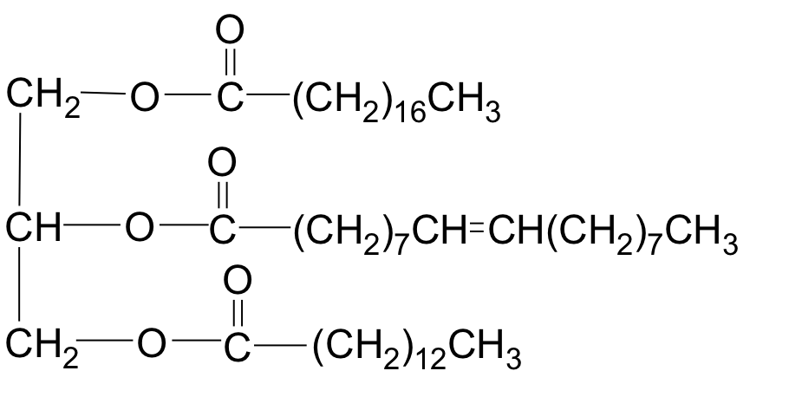
Study Check
What are the fatty acids in the following triacylglycerol?

Slide 10

Solution
What are the fatty acids in the following triacylglycerol?
stearic acid
oleic acid
myristic acid

Slide 11
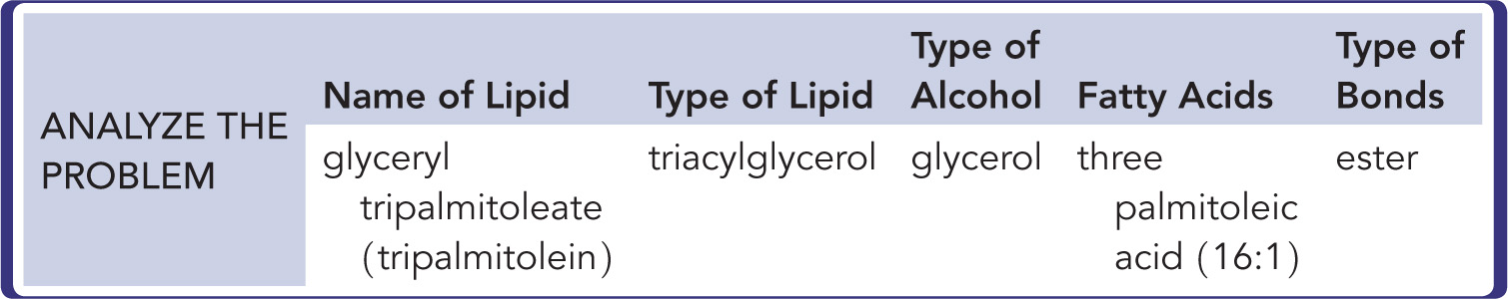
Drawing the Structure of a Triacylglycerol
Draw the condensed structural formula for glyceryl tripalmitoleate (tripalmitolein).
SOLUTION:
Glyceryl tripalmitoleate (tripalmitolein) is the triacylglycerol that contains ester bonds between glycerol and three palmitoleic acids acid molecules.

Slide 12
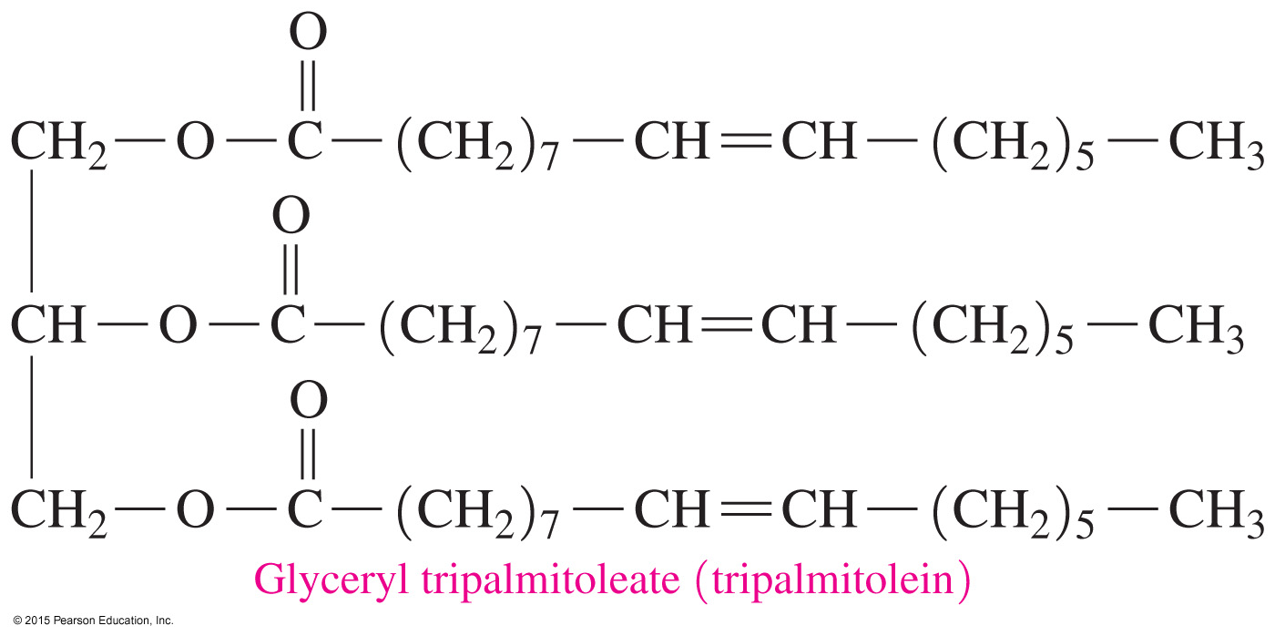
Drawing the Structure of a Triacylglycerol
Draw the condensed structural formula for glyceryl tripalmitoleate (tripalmitolein).

Slide 13
Study Check
Draw the condensed structural formula for the triacylglycerol containing three molecules of myristic acid (14:0).

Slide 14
Solution
Draw the condensed structural formula for the triacylglycerol containing three molecules of myristic acid (14:0).

Slide 15
Melting Points of Fats and Oils
A fat
is usually solid at room temperature
usually comes from animal sources such as meat, whole milk, butter, and cheese
An oil
is usually liquid at room temperature
is usually obtained from a plant source such as palm oil and coconut oil

Slide 16
Oils with Unsaturated Fatty Acids
Oils from
olive and peanut are monounsaturated; they contain large amounts of oleic acid
corn, cottonseed, safflower seed, and sunflower seed are polyunsaturated because they contain large amounts of fatty acids with two or more double bonds
palm and coconut are solids at room temperature because they consist mostly of saturated fatty acids

Slide 17
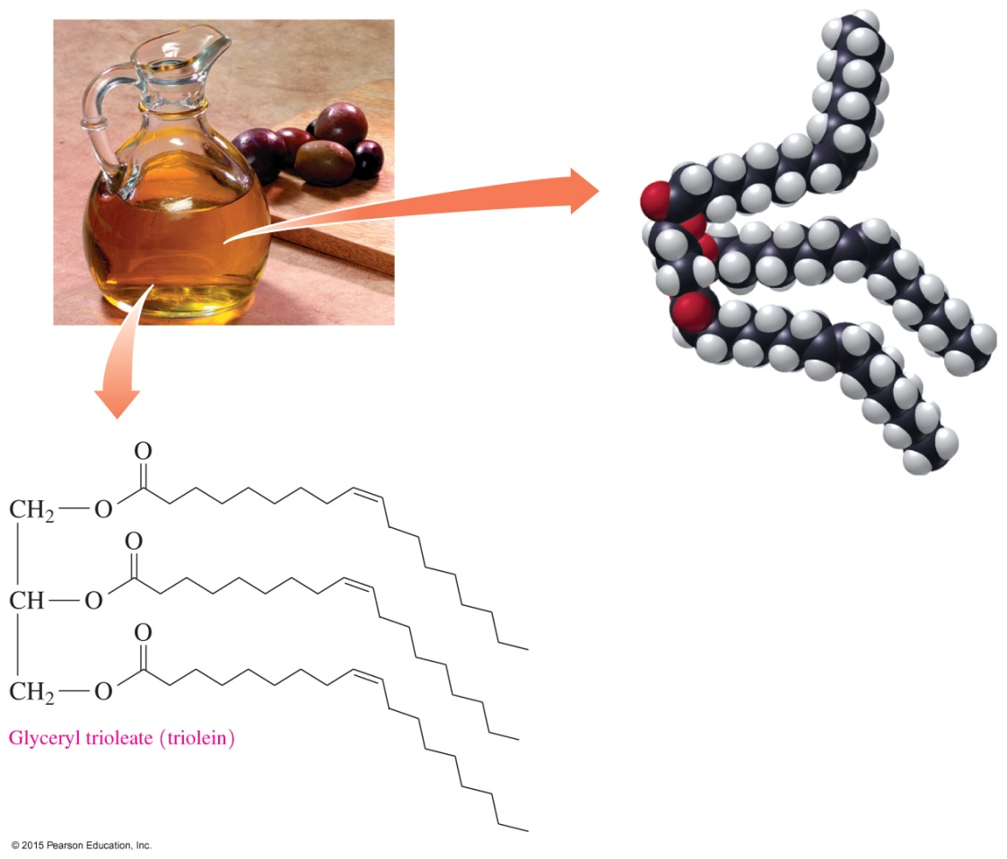
Saturated and Unsaturated
Melting Points
Saturated fatty acids
have higher melting points than unsaturated fatty acids because they pack together more tightly
are usually found in animal fats and in coconut and palm oils

Slide 18
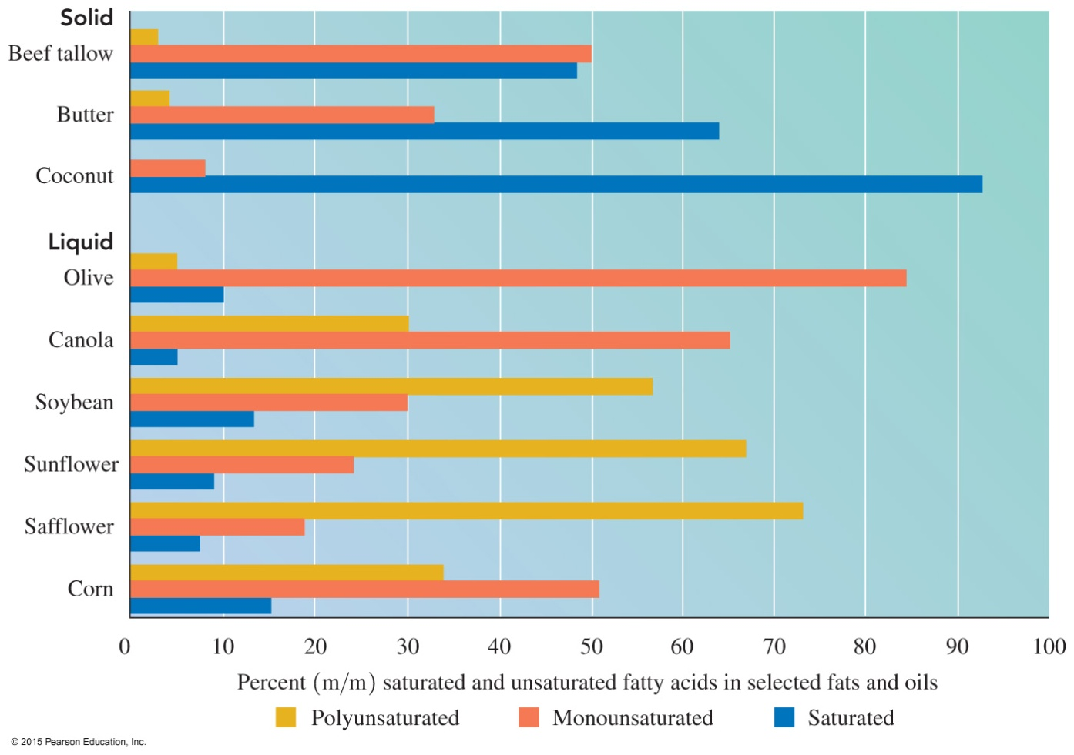
Percent Saturated and Unsaturated Fatty Acids in Fats and Oils
Vegetable oils have low melting points because they have a higher percentage of unsaturated fatty acids than do animal fats.

