Slide 1
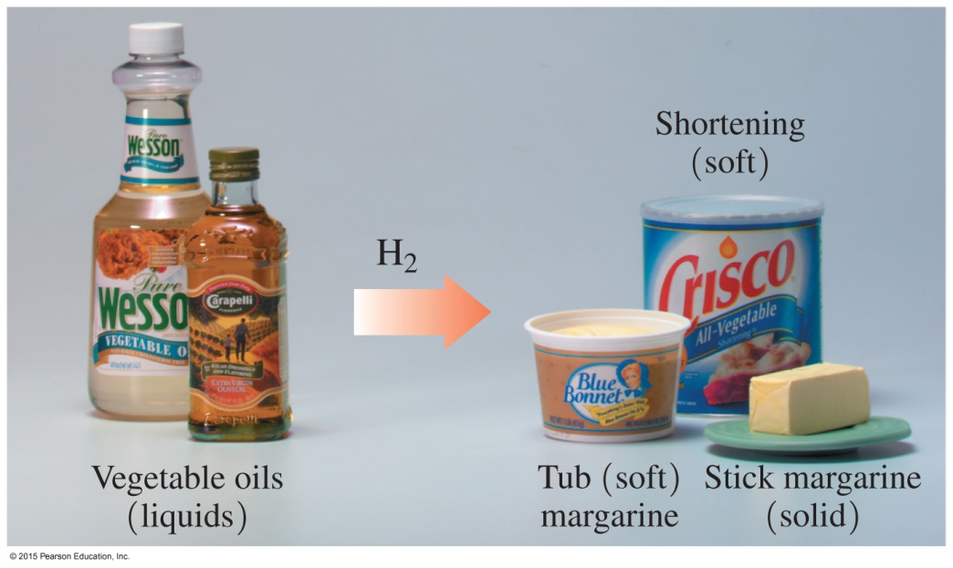
15.4 Chemical Properties of Triacylglycerols
Many soft margarines, stick margarines, and solid shortenings are produced by the partial hydrogenation of vegetable oils.
Learning Goal Draw the condensed structural formula for the product of a triacylglycerol that undergoes hydrogenation, hydrolysis, or saponification.

Slide 2
Triacylglycerols: Hydrogenation
In hydrogenation reactions,
double bonds in unsaturated fatty acids react with hydrogen gas to produce carbon–carbon single bonds
hydrogen gas is bubbled through the heated oil, typically in the presence of a nickel catalyst
Core Chemistry Skill Identifying the Products for the Hydrogenation, Hydrolysis, and Saponification of a Triacylglycerol

Slide 3
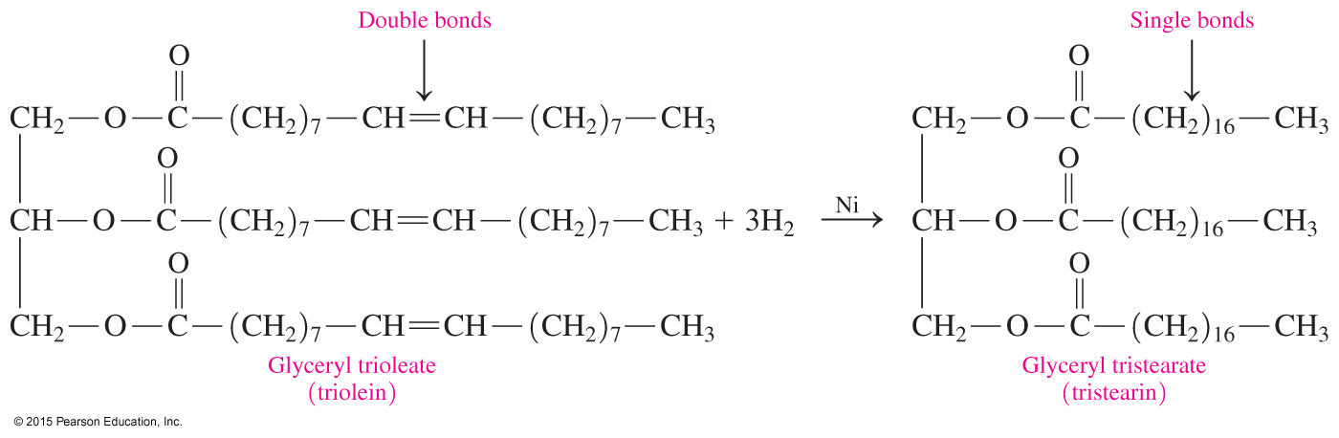
Hydrogenation Reactions
When hydrogen adds to all of the double bonds of glyceryl trioleate (triolein) using a nickel catalyst, the product is the saturated fat glyceryl tristearate (tristearin).

Slide 4

Hydrogenation Reactions
In commercial hydrogenation,
the addition of hydrogen is stopped before all the double bonds in a liquid vegetable oil become completely saturated
the partial hydrogenation of a liquid vegetable oil changes it to a soft, semisolid fat
the more saturated product has a higher melting point

Slide 5
Study Check
What products are obtained from the complete hydrogenation
of glyceryl trioleate?
A. glycerol and three oleic acids
B. glyceryltristearate
C. glycerol and three stearic acids

Slide 6
Solution
What products are obtained from the complete hydrogenation of glyceryl trioleate?
B. glyceryltristearate

Slide 7
Chemistry Link to Health:
Trans Fatty Acids
Unsaturated fatty acids can be
cis, with bulky groups on the same side of C C
trans, with bulky groups on opposite sides of C C

Slide 8
Hydrogenation: Trans Fatty Acids
During hydrogenation,
double bonds are converted to C — C single bonds
a small number of the cis double bonds are converted to more stable trans double bonds, causing a change in the overall structure of the fatty acids
In the body, trans fatty acids
behave like saturated fatty acids
are estimated to be 2–4% of our total calories
raise LDL-cholesterol and lower HDL-cholesterol

Slide 9
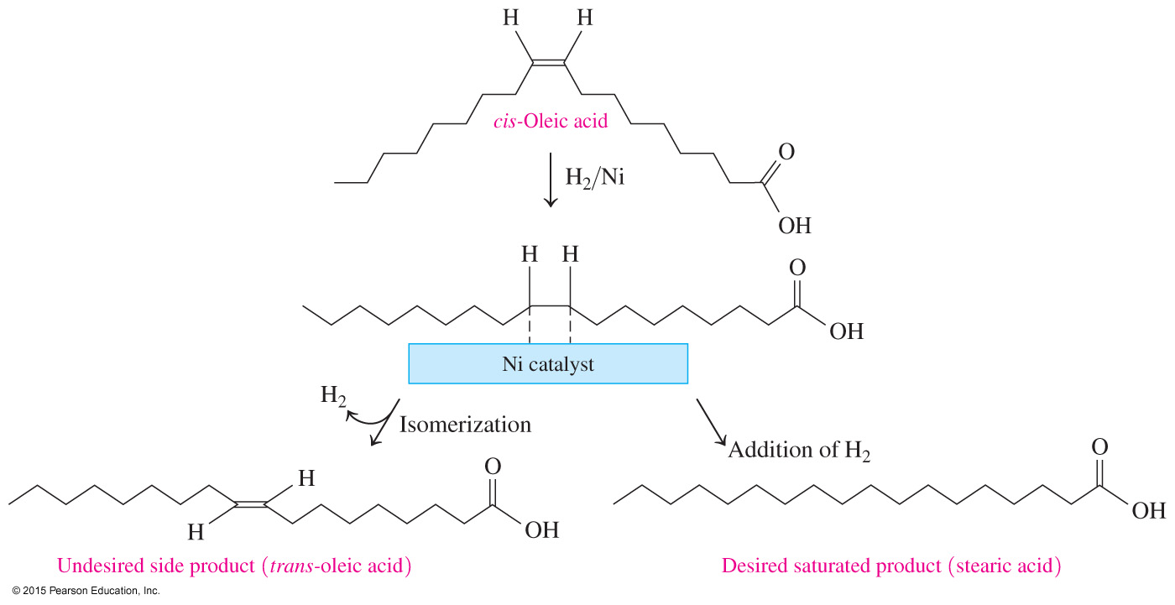
Hydrogenation: Trans Fatty Acids

Slide 10
Trans Fatty Acids in Foods
Foods containing naturally occurring trans fatty acids include milk, eggs, and beef.
Foods that contain trans fatty acids from the hydrogenation process include
deep-fried foods
bread, baked goods, and cookies
crackers and chips
stick and soft margarines
vegetable shortening

Slide 11
Study Check
Which of the following statements are true and which are false?
A. There are more unsaturated fats in vegetable oils.
B. Vegetable oils have higher melting points than fats.
C. Hydrogenation of oils converts some cis double bonds to
trans double bonds.
D. Animal fats have more saturated fats.

Slide 12
Solution
Which of the following statements are true and which are false?
A. True There are more unsaturated fats in vegetable oils.
B. False Vegetable oils have higher melting points than fats.
C. True Hydrogenation of oils converts some cis double bonds to trans double bonds.
D. True Animal fats have more saturated fats.

Slide 13
Study Check
Draw the condensed structural formula for the product of a
glyceryl tripalmitoleate that undergoes hydrogenation.

Slide 14
Solution
Draw the condensed structural formula for the product of a
glyceryl tripalmitoleate that undergoes hydrogenation.
glyceryl
tripalmitoleate

Slide 15
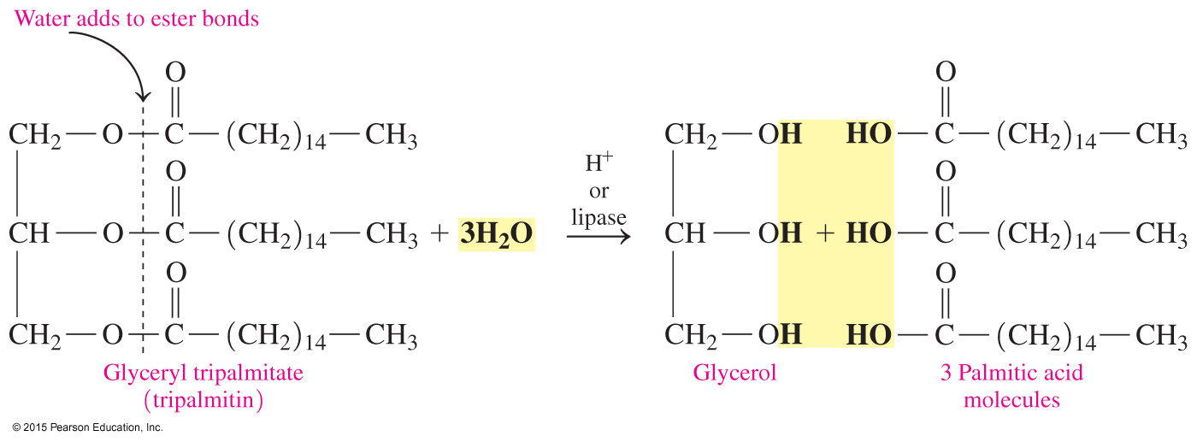
Hydrolysis
In hydrolysis,
triacylglycerols split into glycerol and three fatty acids
a strong acid, HCl or H₂SO₄, or digestive enzymes called lipases are required

Slide 16
Saponification and Soap
Saponification
is the reaction of a fat with a strong base such as NaOH in
the presence of heat
splits triacylglycerols into glycerol and the sodium salts of fatty acids
is the process of forming “soaps” (salts of fatty acids)
with NaOH gives solid soaps that can be molded into
different shapes
with KOH gives softer, liquid soaps

Slide 17
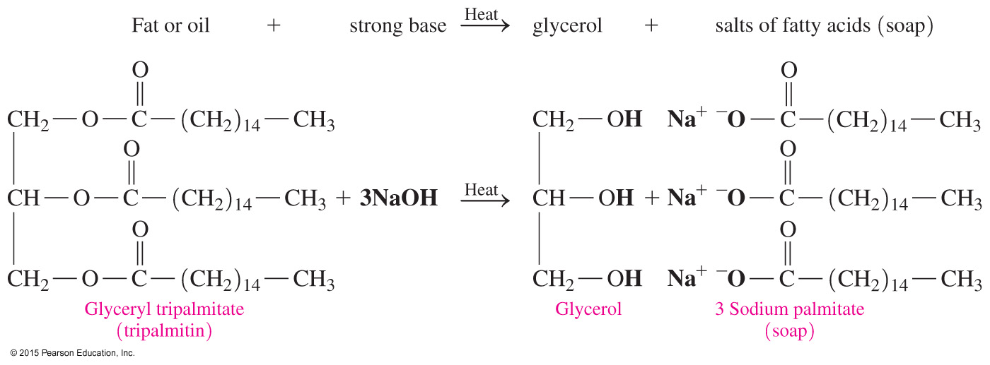
Saponification and Soap

Slide 18
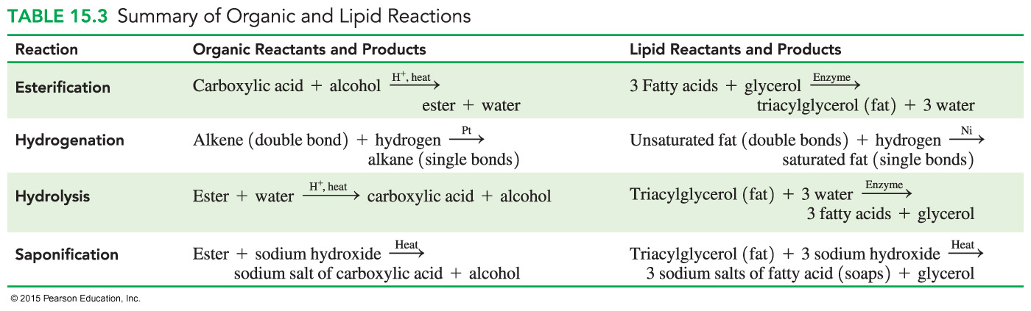
Organic and Lipid Reactions

Slide 19
Study Check
Write the equation for the reaction catalyzed by the enzyme lipase that hydrolyzes glyceryl trilaurate (trilaurin) during the digestion process.

Slide 20
Solution
Write the equation for the reaction catalyzed by the enzyme lipase that hydrolyzes glyceryl trilaurate (trilaurin) during the digestion process.
glyceryl
trilaurate

