Slide 1
15.5 Phospholipids
The phospholipids are a family of lipids similar in structure to triacylglycerols; they
include glycerophospholipids and sphingomyelin.
Glycerol
Fatty acid
Fatty acid
PO₄
Amino
alcohol
Glycerophospholipid
Learning Goal Describe the structure of a phospholipid containing glycerol or sphingosine.

Slide 2
Glycerophospholipids
Glycerophospholipids contain
two fatty acids that form ester bonds with the first and second hydroxyl groups of glycerol
a hydroxyl group that forms an ester with phosphoric acid, which forms another phosphoester bond with an amino alcohol
Glycerol
Fatty acid
Fatty acid
PO₄
Amino
alcohol

Slide 3
Sphingomyelin
Sphingomyelin
contains sphingosine instead of glycerol
contains a fatty acid, phosphate, and an amino alcohol
Sphingosine
Fatty acid
PO₄
Amino
alcohol

Slide 4
Amino Alcohols
Amino alcohols found in glycerophospolipids
are choline, erine, and ethanolamine
are ionized at physiological pH of 7.4

Slide 5
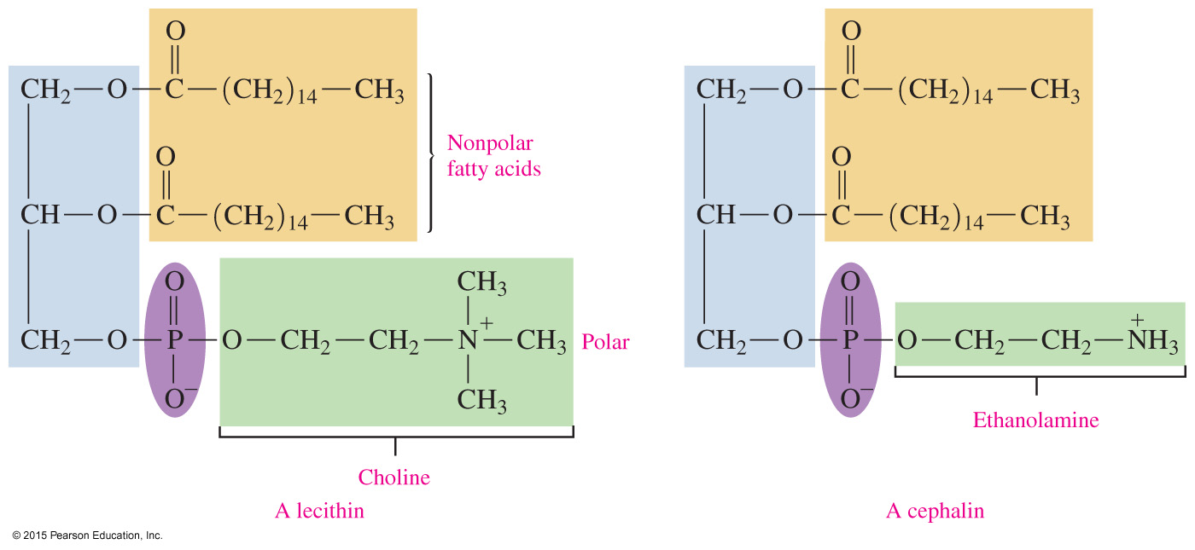
Lecithin and Cephalin
Lecithin and cephalin are types of glycerophospholipids that are
abundant in brain and nerve tissues
found in egg yolk, wheat germ, and yeast

Slide 6
Structure and Polarity of a Glycerophospholipid
Glycerophospholipids
have both polar and nonpolar regions that allow them to interact with polar and nonpolar substances
have a polar head containing the ionized amino alcohol and phosphate portion, which is strongly attracted to water
have a nonpolar hydrocarbon tail portion soluble only in nonpolar substances such as lipids
are the most abundant lipids in cell membranes and play an important role in cellular permeability

Slide 7
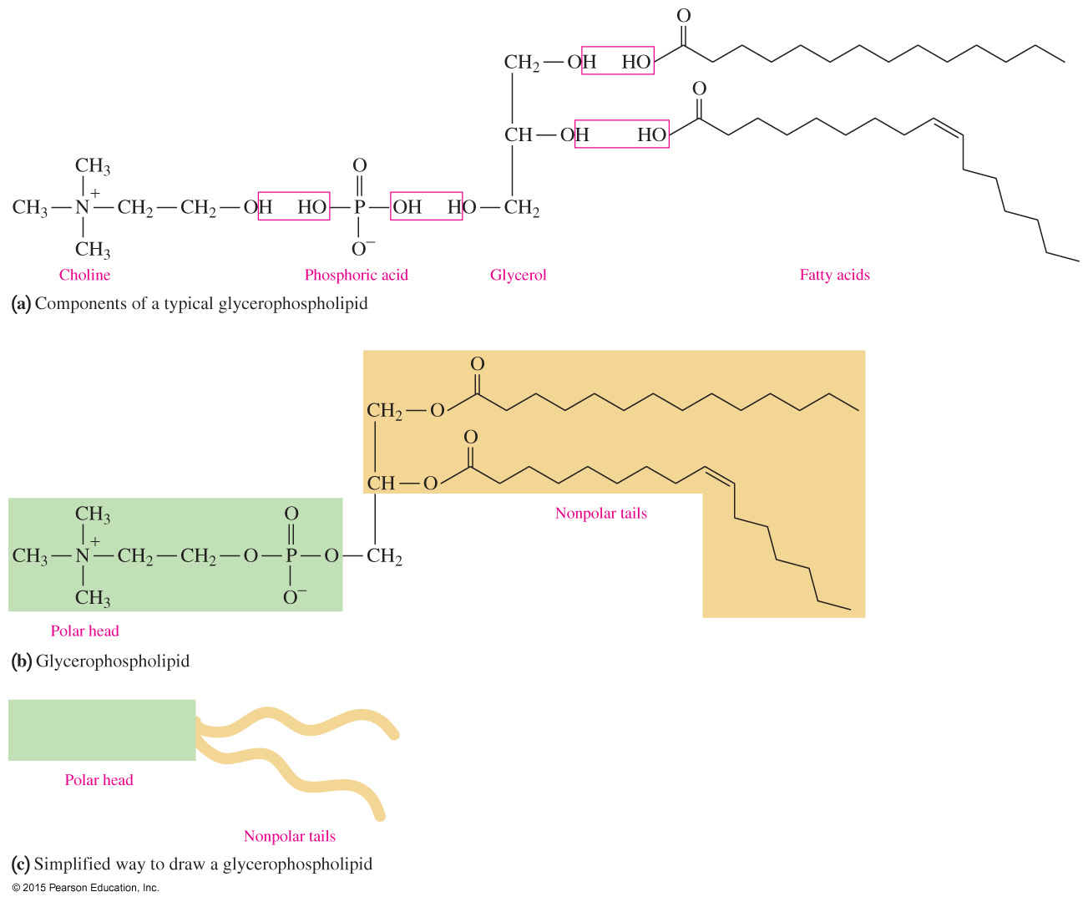
Structure and Polarity of a Glycerophospholipid
(a) The components of a typical glycerophospholipid: an amino alcohol, phosphoric acid, glycerol, and two fatty acids. (b) In a glycerophospholipid, a polar “head” contains the ionized amino alcohol and phosphate, while the hydrocarbon chains of two fatty acids make up the nonpolar “tails.” (c) A simplified drawing indicates the polar region and the nonpolar region.

Slide 8
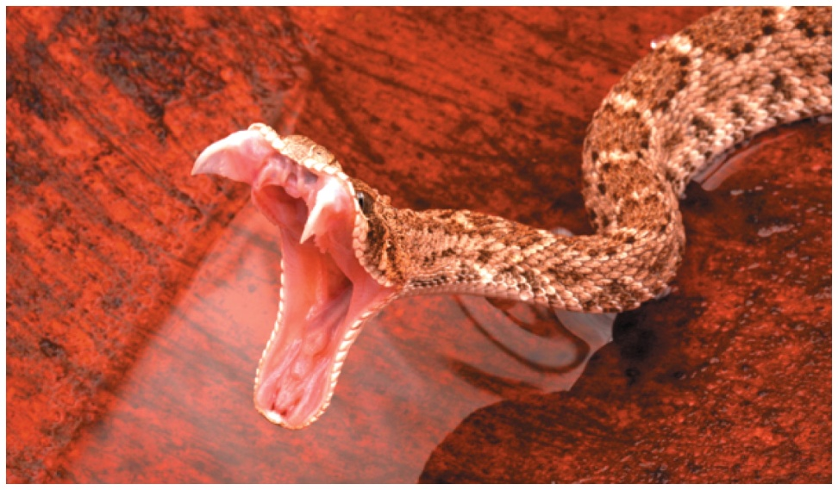
Glycerophospholipid: Snake Venom
Snake venom is produced by the modified saliva glands of a poisonous snake and is ejected through the fang of the snake.
Poisonous snake venom contains phospholipases that hydrolyze phospholipids in red blood cells.

Slide 9
Study Check
Identify each of the following as a fatty acid, a triacylglycerol, an amino alcohol, or a glycerophospholipid.
A. glyceryl trioleate
B. cephalin
C. choline
D. palmitic acid

Slide 10
Solution
Identify each of the following as a fatty acid, a triacylglycerol, an amino alcohol, or a glycerophospholipid.
A. glyceryl trioleate triacylglycerol
B. cephalin glycerophospholipid
C. choline amino alcohol
D. palmitic acid fatty acid

Slide 11
Study Check
Draw the condensed structural formula of a cephalin that contains
stearic acid and serine.

Slide 12
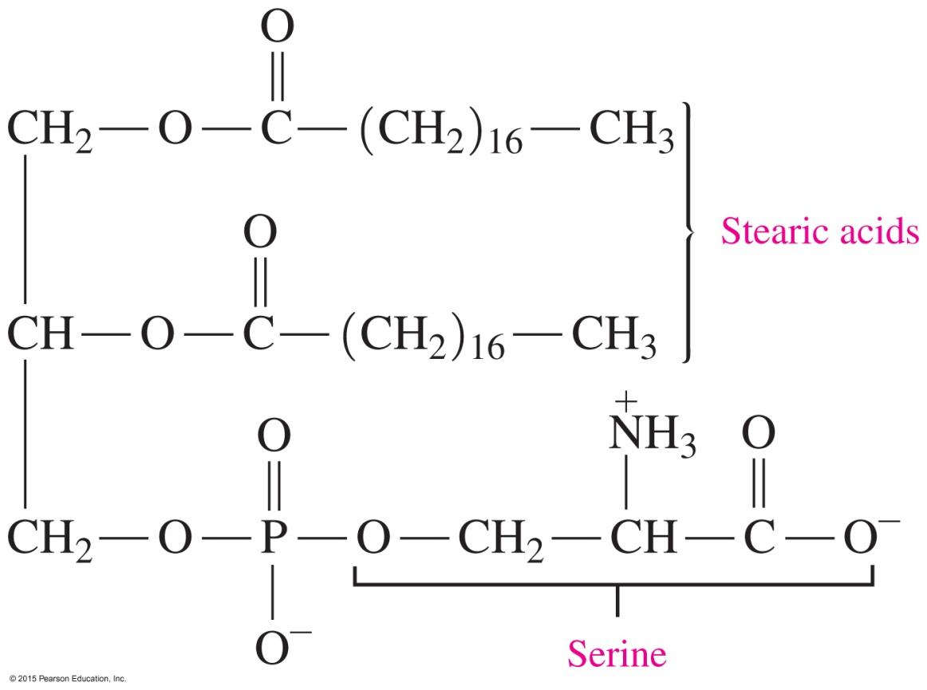
Solution
Draw the condensed structural formula of a cephalin that contains
stearic acid and serine.

Slide 13
Sphingomyelin
In a sphingomyelin,
the amine group of sphingosine forms an amide bond to a fatty acid
the hydroxyl group forms an ester bond with phosphate, which forms another phosphoester bond to choline or ethanolamine
Sphingomyelins are abundant in the white matter of the myelin sheath, a coating surrounding the nerve cells that increases the speed of nerve impulses and insulates and protects the nerve cells.

Slide 14
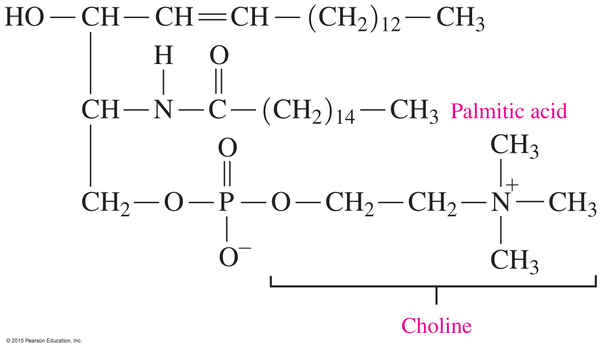
Sphingomyelin
Structure of a sphingomyelin containing myristic acid and choline.

Slide 15
Study Check
Palmitic acid, the 16-carbon saturated fatty acid, is the most common fatty acid found along with the ionized amino alcohol choline in the sphingomyelin of eggs.
Draw the condensed structural formula for this sphingomyelin.

Slide 16
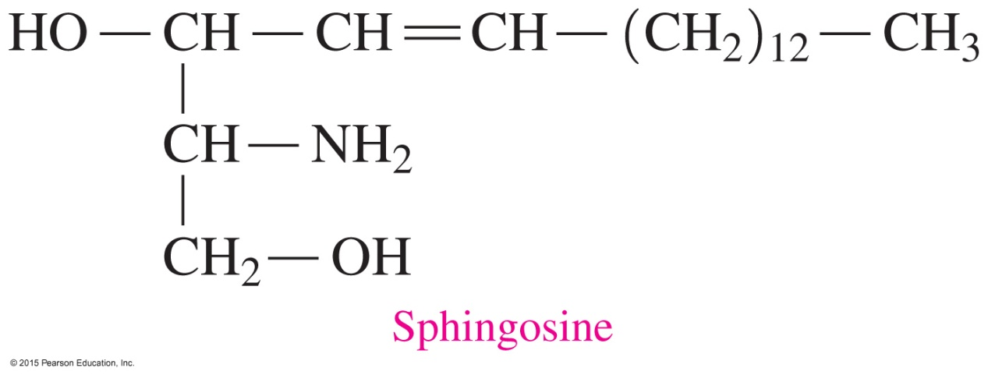
Solution
Palmitic acid, the 16-carbon saturated fatty acid, is the most common fatty acid found along with the ionized amino alcohol choline in the sphingomyelin of eggs.
Draw the condensed structural formula for this sphingomyelin.

