Slide 1
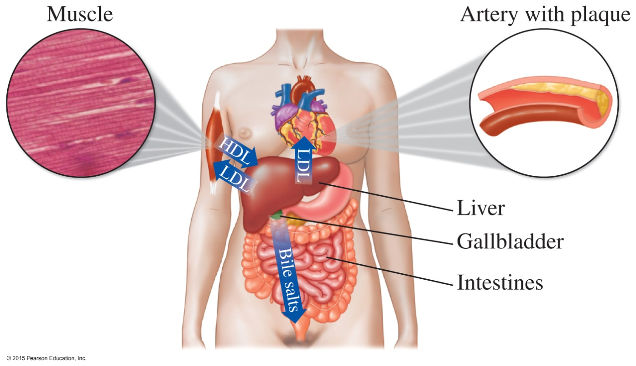
15.6 Steroids: Cholesterol, Bile Salts, and Steroid Hormones
High- and low-density lipoproteins transport cholesterol between the tissues and the liver.
Learning Goal Describe the structures of steroids.

Slide 2
Steroid Nucleus
A steroid nucleus consists of
three cyclohexane rings and one cylopentane ring, fused together
rings designated as A, B, C, and D
numbered carbon atoms beginning in ring A
two methyl groups at positions 18 and 19
Steroid nucleus
Core Chemistry Skill Identifying the Steroid Nucleus

Slide 3
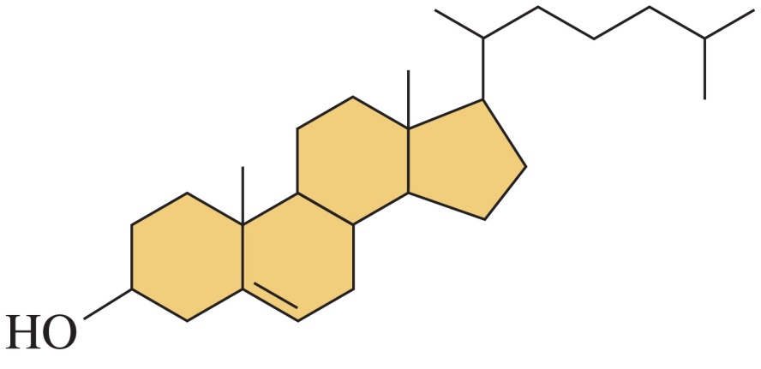
Cholesterol
Cholesterol
is the most important and abundant steroid in the body
has an hydroxyl group (— OH) on (carbon 3)
has a double bond between carbons 5 and 6
has methyl groups at carbons 10 and 13
has an alkyl chain at carbon 17
Cholesterol

Slide 4
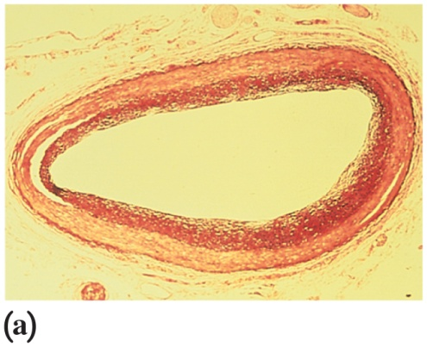
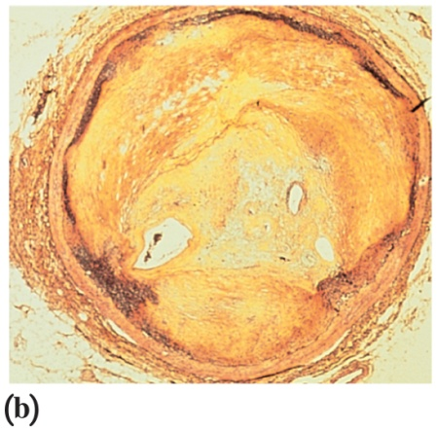
Cholesterol in the Body
Cholesterol
is obtained from meats, milk, and eggs
is synthesized in the liver
is needed for cell membranes, brain and nerve tissue, steroid hormones, and vitamin D
clogs arteries when high levels form plaque
Cross-sections of arteries show how plaque clogs the arteries.
A normal, open artery.
An artery clogged by cholesterol plaque

Slide 5
Cholesterol in Foods
Cholesterol
is considered elevated if plasma cholesterol exceeds 200 mg/dL
is synthesized in the liver and obtained from foods
A diet that is low in foods containing cholesterol and saturated fats appears to be helpful in reducing the serum cholesterol level.

Slide 6
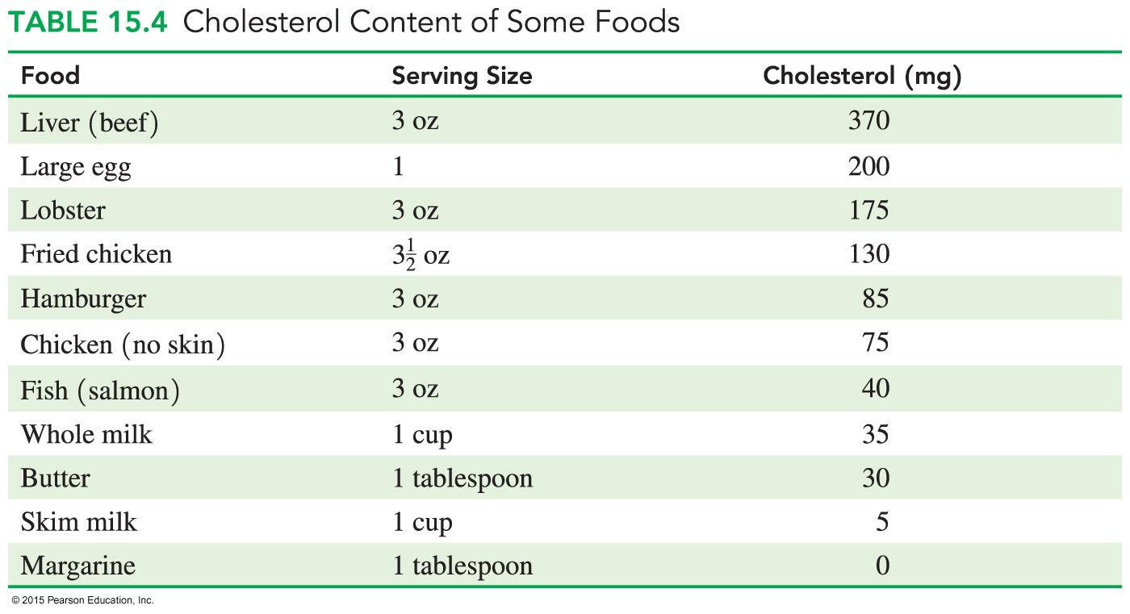
Cholesterol in Foods

Slide 7
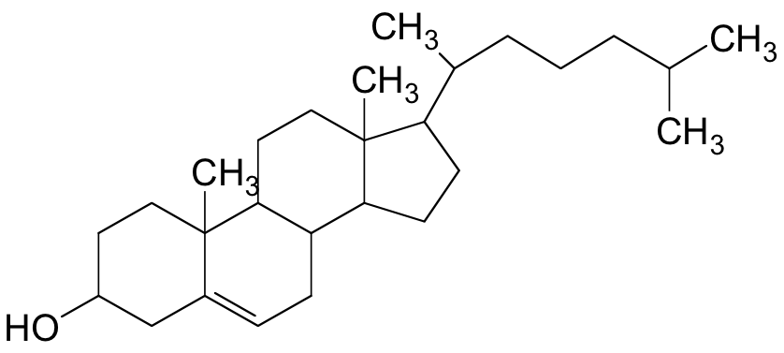
Study Check
Match the components of the cholesterol molecule with
the following:
___ carbon chain ___ hydroxyl group
___ steroid nucleus ___ methyl group
D
B
A
C

Slide 8
Solution
Match the components of the cholesterol molecule with
the following:
D carbon chain A hydroxyl group
C steroid nucleus B methyl group
D
B
A
C

Slide 9
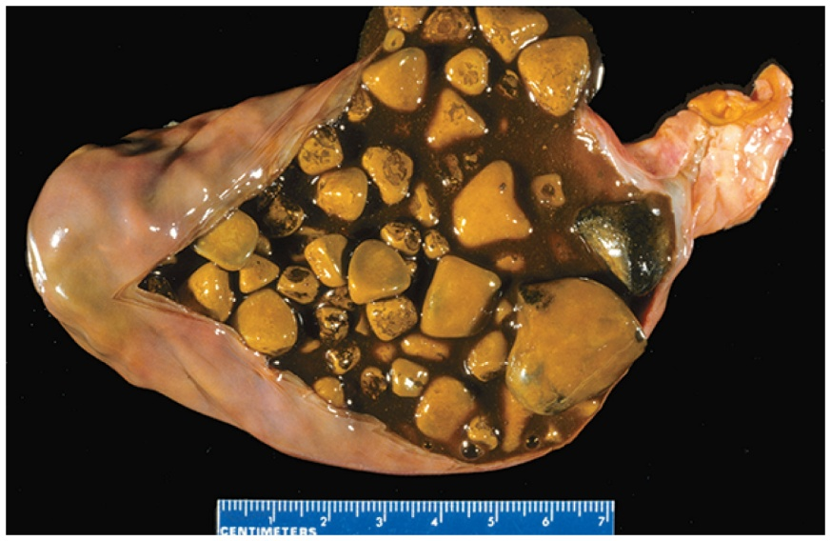
Bile Salts
Bile salts
are synthesized in the liver from cholesterol and stored in the gallbladder
have polar and nonpolar regions that act like soaps to make fat soluble in water
help in absorption of cholesterol
When large amounts of cholesterol
accumulate in the gallbladder,
gallstones are formed.
Gallstones form in the gallbladder when cholesterol levels are high.

Slide 10
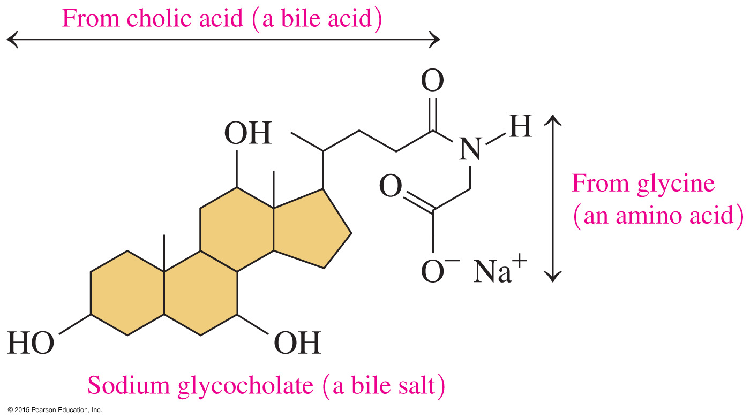
Bile Salts

Slide 11
Lipoproteins: Lipid Transport
Lipids are nonpolar and made more soluble by combining them with glycerophospholipids and proteins to form water-soluble complexes called lipoproteins.

Slide 12
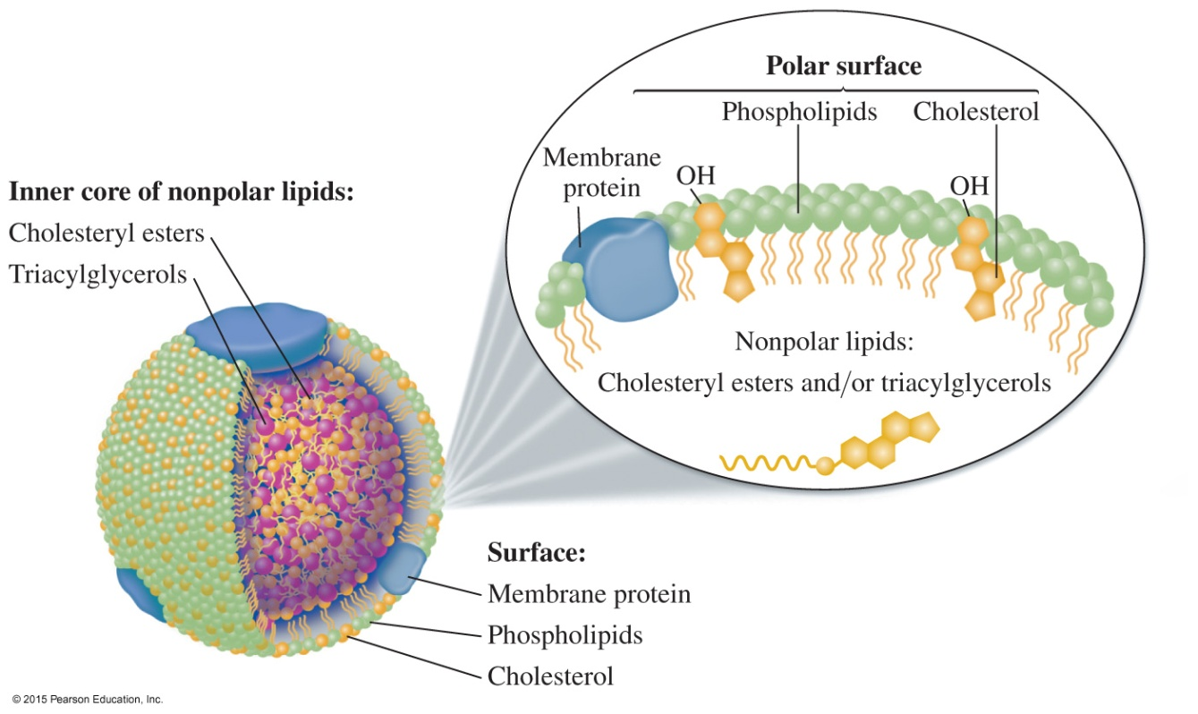
Lipoproteins
Lipoproteins
surround nonpolar lipids with polar lipids and protein for transport to cells
are soluble in water because the surface consists of polar lipids
A spherical lipoprotein particle surrounds nonpolar lipids with polar lipids and protein for transport to body cells.

Slide 13
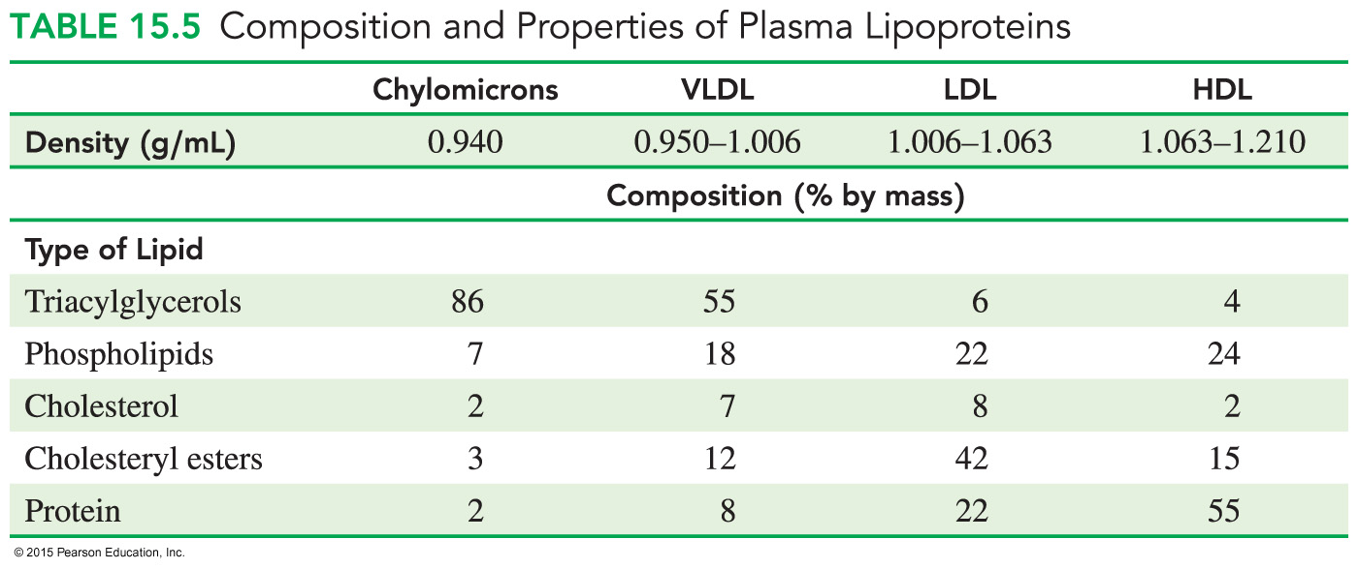
Types of Lipoproteins
Lipoproteins
differ in density, composition, and function
include low-density lipoproteins (LDLs) and high-density lipoproteins (HDLs)

Slide 14
Transport of Lipoproteins in the Body
Lipoproteins such as HDLs and LDLs transport nonpolar lipids and cholesterol to cells and the liver.

Slide 15
Steroid Hormones
Steroid hormones are
chemical messengers that serve as a communication system for the body
produced from cholesterol
male sex hormones, testosterone and androsterone
female sex hormones, estrogens and progesterone
adrenal corticosteroids from adrenal glands
– mineralocorticoids (electrolyte balance)
– glucocorticoids (regulate glucose level)

Slide 16
Structures of Steroid Hormones

Slide 17
Chemistry Link to Health: Anabolic Steroids
Anabolic steroids
are derivatives of testosterone
are used illegally to increase muscle mass
have side effects including fluid retention, hair growth, sleep disturbance, and liver damage

Slide 18
Adrenal Corticosteroids
Steroid hormones called adrenal corticosteroids
are produced by the adrenal glands located on the top of each kidney
include aldosterone, which regulates electrolytes and water balance by the kidneys
include cortisone, a glucocorticoid, which increases blood glucose level and stimulates the synthesis of glycogen in the liver

Slide 19
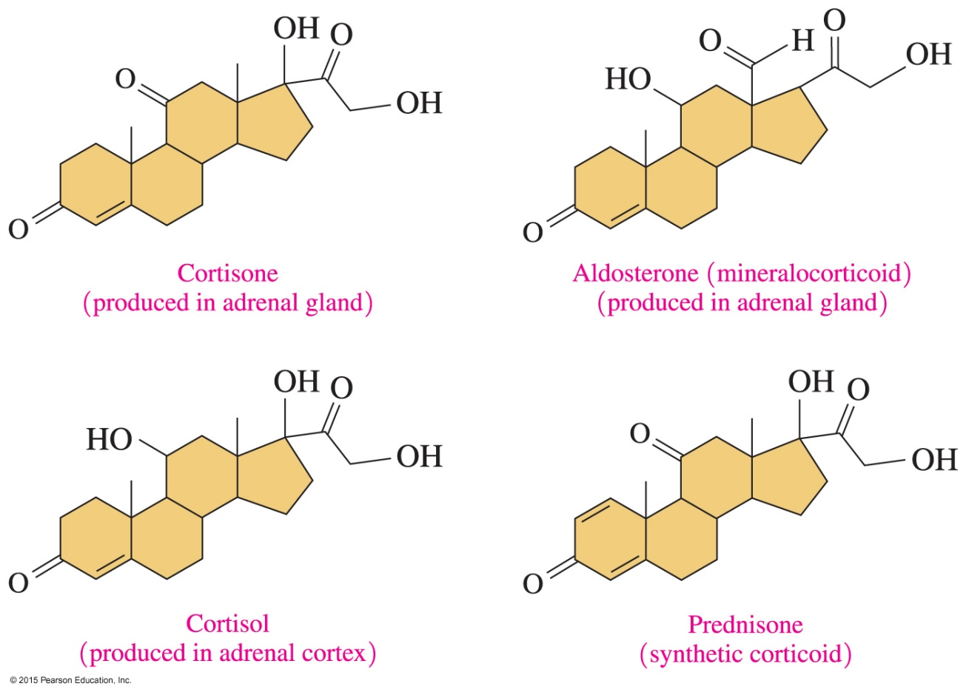
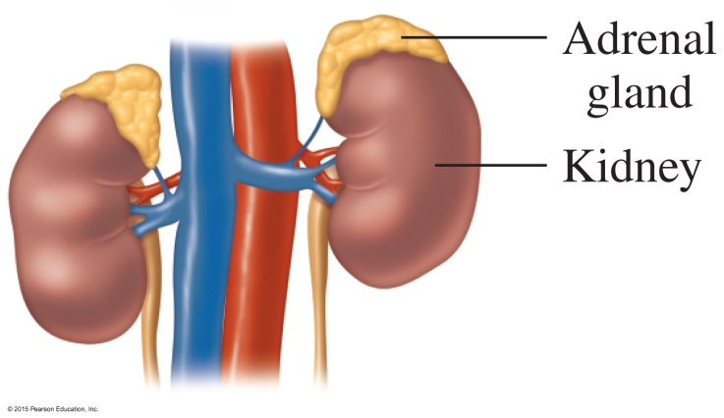
Adrenal Corticosteroids

Slide 20
Study Check
Identify each of the following as a fatty acid, steroid,
or triacylglycerol.
A. cholesterol
B. stearic acid
C. glyceryl tristearate
D. estradiol
E. contains no fatty acids

Slide 21
Solution
Identify each of the following as a fatty acid, steroid,
or triacylglycerol.
A. cholesterol steroid
B. stearic acid fatty acid
C. glyceryl tristearate triacylglycerol
D. estradiol steroid
E. contains no fatty acids steroid

