Slide 1
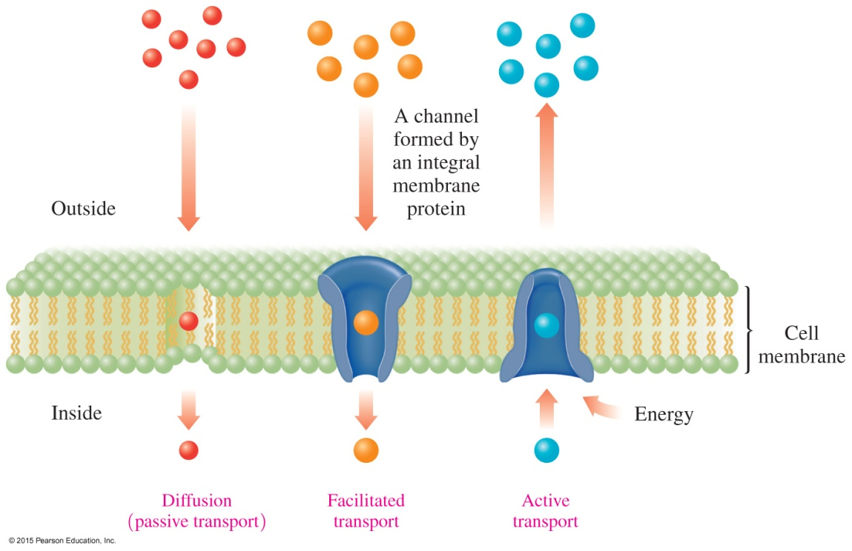
15.7 Cell Membranes
Substances are transported across a cell membrane by either diffusion, facilitated transport, or active transport.
Learning Goal Describe the composition and function of the lipid bilayer in cell membranes.

Slide 2
Cell Membranes
Cell membranes
separate cellular contents from the external environment
consist of a lipid bilayer made of two rows of phospholipids
have an inner portion made of the nonpolar tails of phospholipids with the polar heads at the outer and inner surfaces

Slide 3
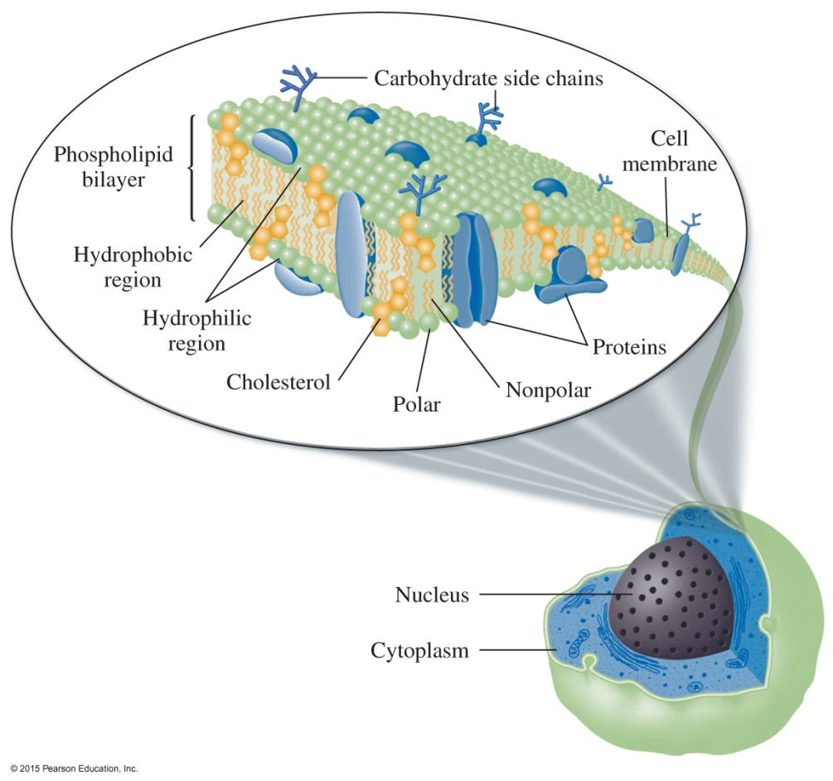
Fluid Mosaic Model: Cell Membrane
In the fluid mosaic model of a cell membrane,
proteins and cholesterol are embedded in a lipid bilayer of phospholipids
the bilayer forms a membrane-type barrier with polar heads at the membrane surfaces and the nonpolar tails in the center away from the water

Slide 4
Fluid Mosaic Model: Cell Membrane
The lipid bilayer
contains proteins, carbohydrates, and cholesterol
has unsaturated fatty acids that make cell membranes fluid-like rather than rigid
has proteins and carbohydrates on the surface that communicate with hormones and neurotransmitters

Slide 5
Transport through Cell Membranes
The transport of substances through cell membranes involves
diffusion (passive transport), which moves particles from a higher to a lower concentration
facilitated transport, which uses protein channels to increase the rate of diffusion
active transport, which moves ions against a concentration gradient

Slide 6
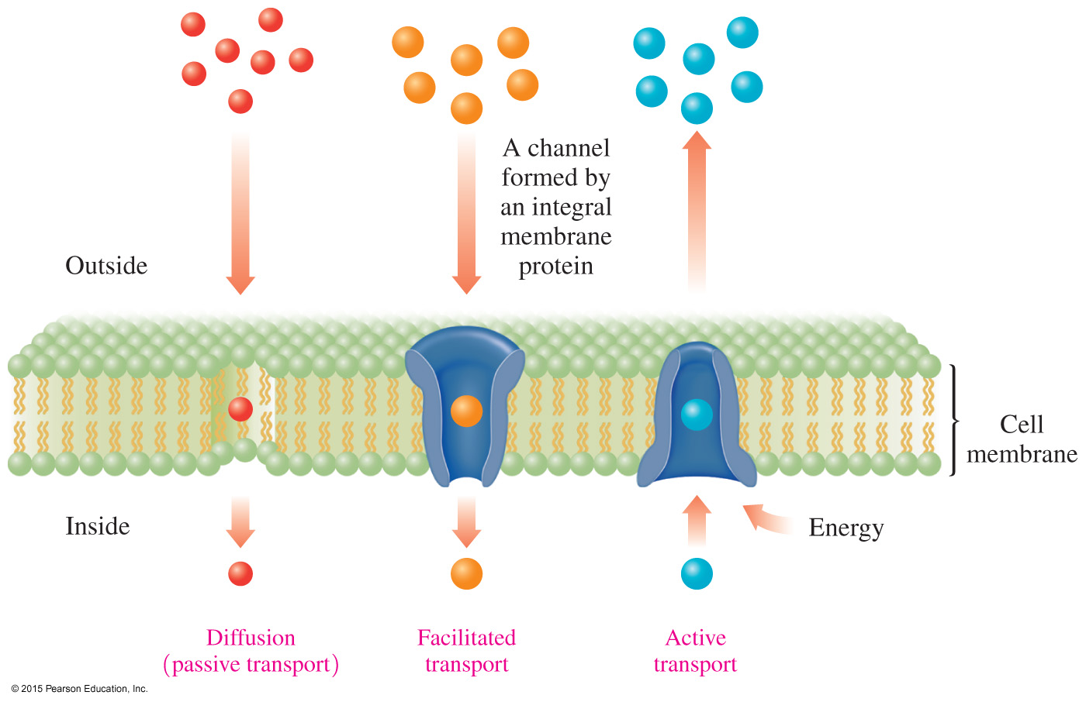
Transport Pathways through Cell Membranes
Substances are transported across a cell membrane by diffusion (passive) transport, facilitated transport, or active transport.

Slide 7
Study Check
The transport of particles across a cell membrane from high
concentration to low concentration is called
A. facilitated transport
B. diffusion
C. active transport

Slide 8
Solution
The transport of particles across a cell membrane from high
concentration to low concentration is called
The answer is B, diffusion.

Slide 9
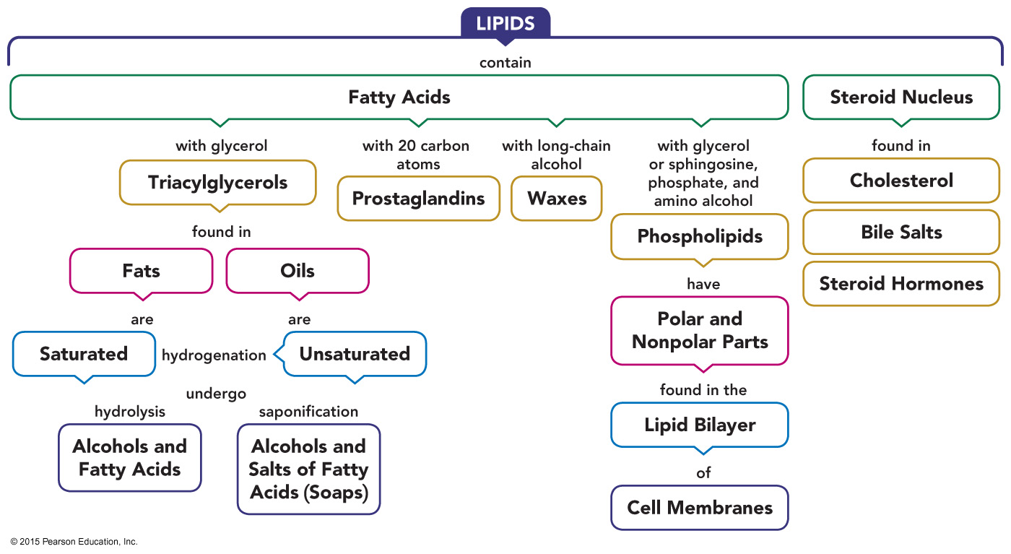
Lipids—Concept Map

