Slide 1

Chapter 16 Amino Acids, Proteins, and Enzymes
Many physician assistants take on the role of the primary caregiver.
Their duties may include
obtaining patient medical records and histories
diagnosing illnesses
educating and counseling patients
referring the patient, when needed, to a specialist

Slide 2
Chapter 16 Readiness
Key Math Skill
Calculating pH from [H₃O⁺] (10.5)
Core Chemistry Skills
Writing Equations for Reactions of Acids and Bases (10.6)
Naming Carboxylic Acids (14.1)
Forming Amides (14.6)

Slide 3
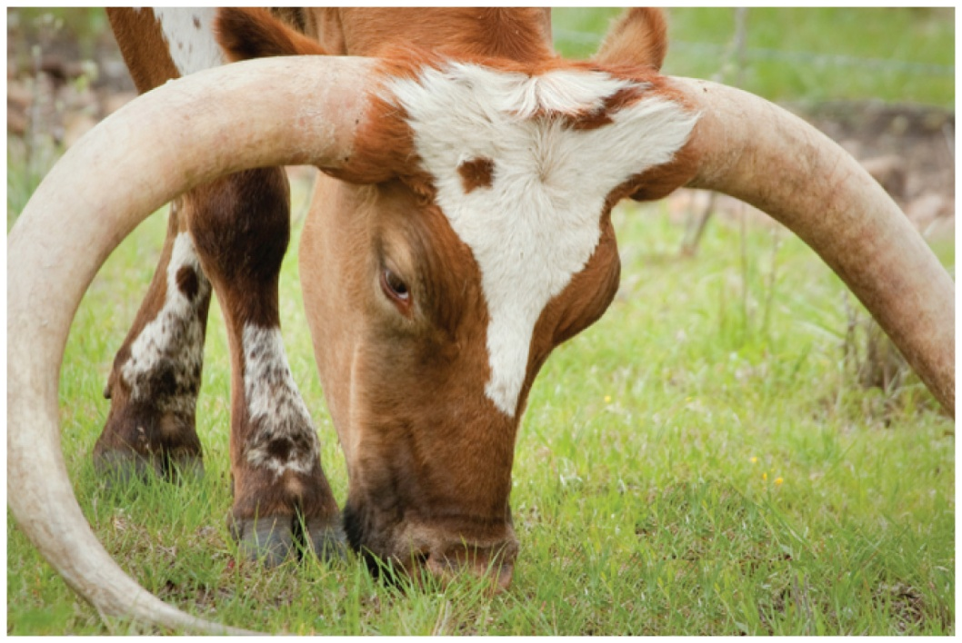
16.1 Proteins and Amino Acids
Protein molecules, compared with many of the compounds we have studied, can be gigantic.
The horns of animals are made of proteins.
Learning Goal Classify proteins by their functions. Give the name and abbreviation for an amino acid and draw its ionized structure.

Slide 4
Functions of Proteins
Proteins
in the body are polymers made from 20 different amino acids
differ in characteristics and functions that depend on the
order of amino acids that make up the protein
form structural components such as cartilage, muscles, hair, and nails
function as enzymes to regulate biological reactions such as digestion and cellular metabolism
such as hemoglobin and myoglobin transport oxygen in
the blood

Slide 5
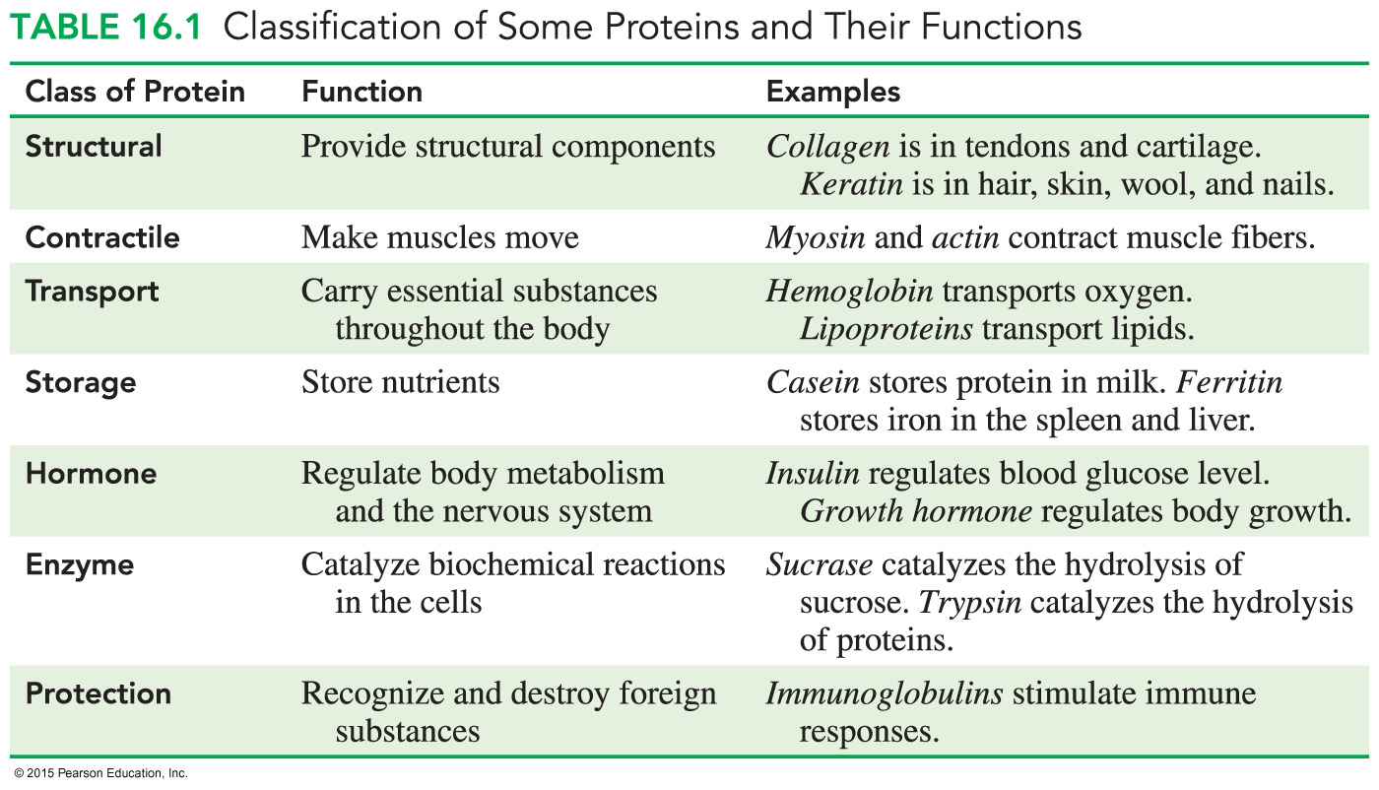
Structural Classification of Proteins

Slide 6
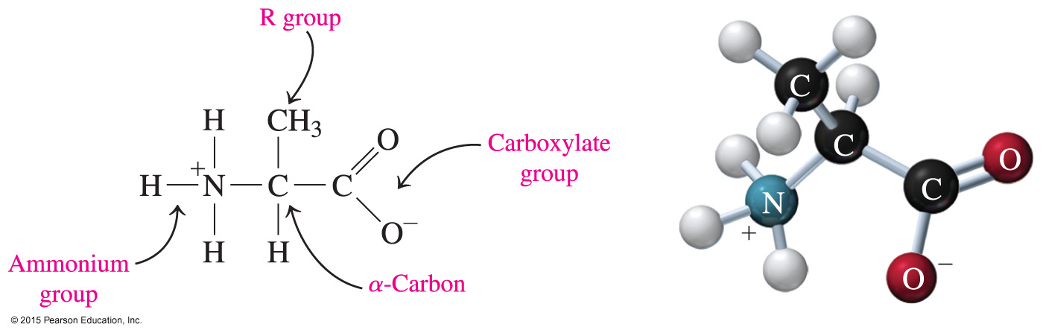
Amino Acids
Amino acids, the molecular building blocks of proteins,
have a central carbon atom called the α-carbon bonded to two functional groups: an ammonium group (— NH₃⁺) and a carboxylate group (— COO⁻)
have a central carbon atom bonded to a hydrogen atom and
R group or side chain in addition to the carboxylate and ammonium groups

Slide 7
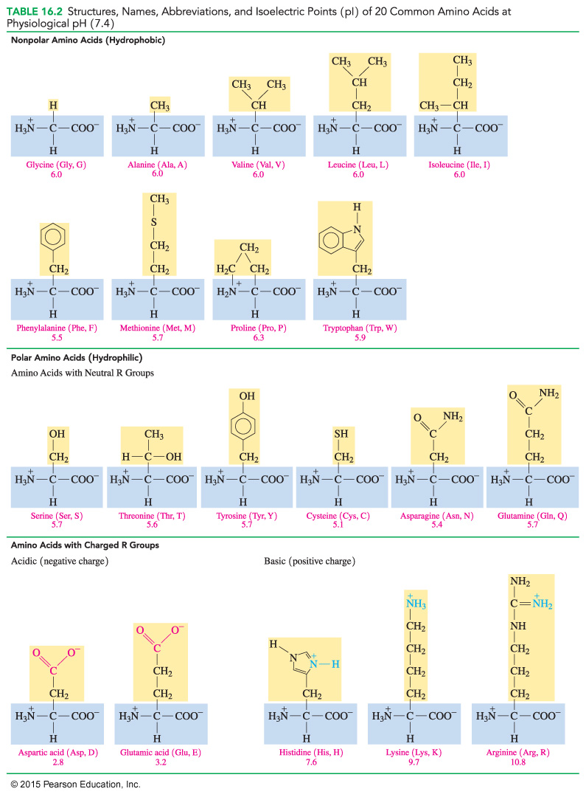
Classification of Amino Acids
Amino acids are classified as
nonpolar (hydrophobic) with hydrocarbon side chains
polar (hydrophilic) with polar or ionic side chains
Nonpolar Polar
Valine Asparagine

Slide 8
Nonpolar Amino Acids
An amino acid is nonpolar when the R group is H, alkyl,
or aromatic.

Slide 9
Polar Amino Acids
An amino acid is polar when the R group is an alcohol, a thiol,
or an amide.

Slide 10
Structural Formulas of Amino Acids
An amino acid has
an α-carbon atom that is attached to three components: — NH₃⁺, — COO⁻, and — H group
a fourth component, an R group that differs for each particular amino acid (see Table 16.2)
a three-letter or one-letter abbreviation derived from its name
Core Chemistry Skill Drawing the Ionized Form for an Amino Acid

Slide 11
Drawing Amino Acids
All amino acids have — NH₃⁺, — COO⁻, and — H on the α-carbon.
Amino acids differ by their R groups.
R Group
Aspartic acid (Asp, D) Asparagine (Asn, N)
pH 2.8 pH 5.4

Slide 12
Acidic Amino Acids
An amino acid is acidic when the R group is a carboxylic acid.

Slide 13
Basic Amino Acids
An amino acid is basic when the R group is an amine.

Slide 14
Study Check
Identify each of the following amino acids as polar or nonpolar:
A. Glycine
B. Threonine

Slide 15
Solution
Identify each of the following amino acids as polar or nonpolar.
A. Glycine nonpolar
B. Threonine polar

Slide 16
Study Check
Draw the ionized form for each of the following amino acids, and write the three-letter and one-letter abbreviations:
A. valine
B. cysteine

Slide 17
Solution
Draw the ionized form for each of the following amino acids, and write the three-letter and one-letter abbreviations:
A. valine (Val, V)
B. cysteine (Cys, C)

Slide 18
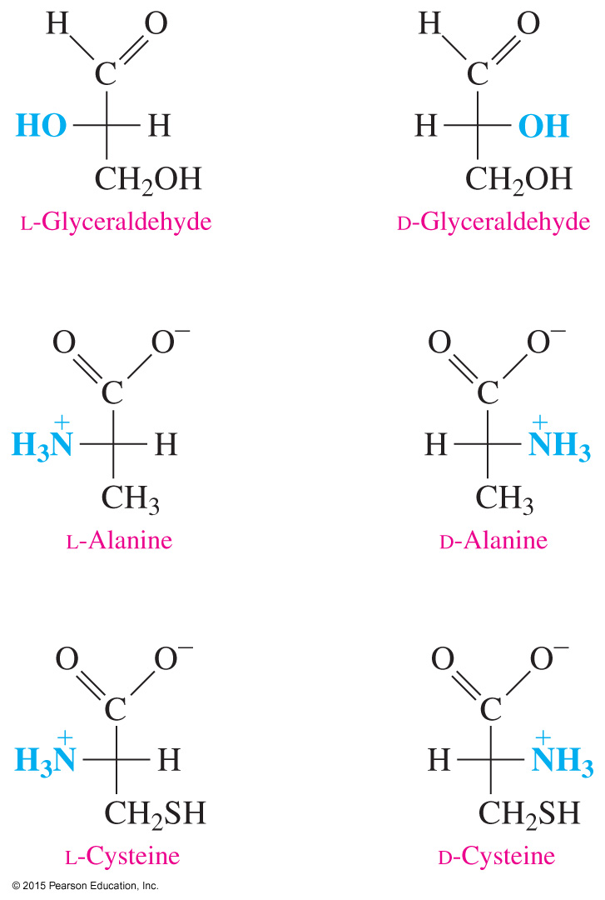
Amino Acid Stereoisomers
All the α-amino acids except for glycine are chiral.
The α-carbon is attached to four different atoms.
The — NH₃⁺ group appears on the right or left of the chiral carbon to give D or L enantiomers.

Slide 19
Study Check
Identify the following amino acids as D or L enantiomers:
A. B.

Slide 20
Solution
Identify the following amino acids as D or L enantiomers:
A. B.
L-Phenylalanine D-Serine

Slide 21
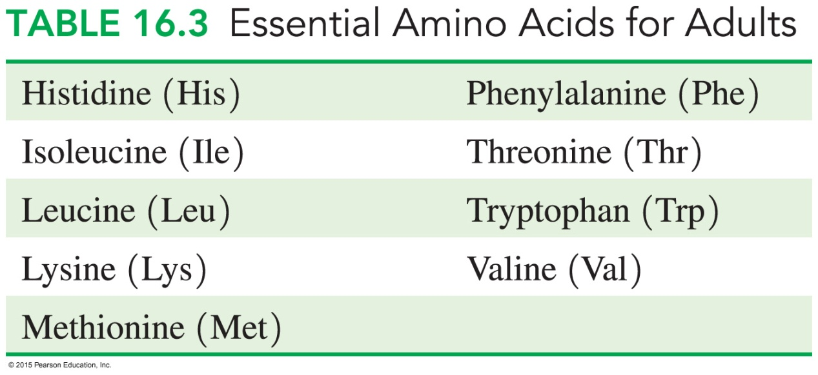
Chemistry Link to Health:
Essential Amino Acids
Of the 20 amino acids used to build the proteins in the body,
only 11 can be synthesized in the body
the other 9 amino acids are essential amino acids that must be obtained from the proteins in the diet

Slide 22
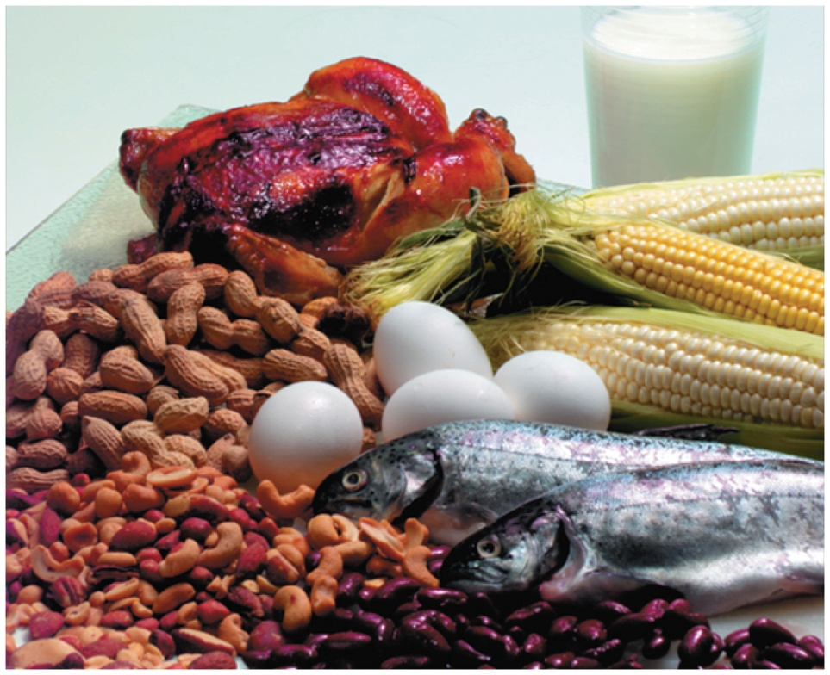
Chemistry Link to Health:
Essential Amino Acids
Complete proteins such as eggs, milk, meat, and fish contain all of the essential amino acids.
Incomplete proteins from plants such as grains, beans, and nuts are deficient in one or more essential amino acids.

