Slide 1
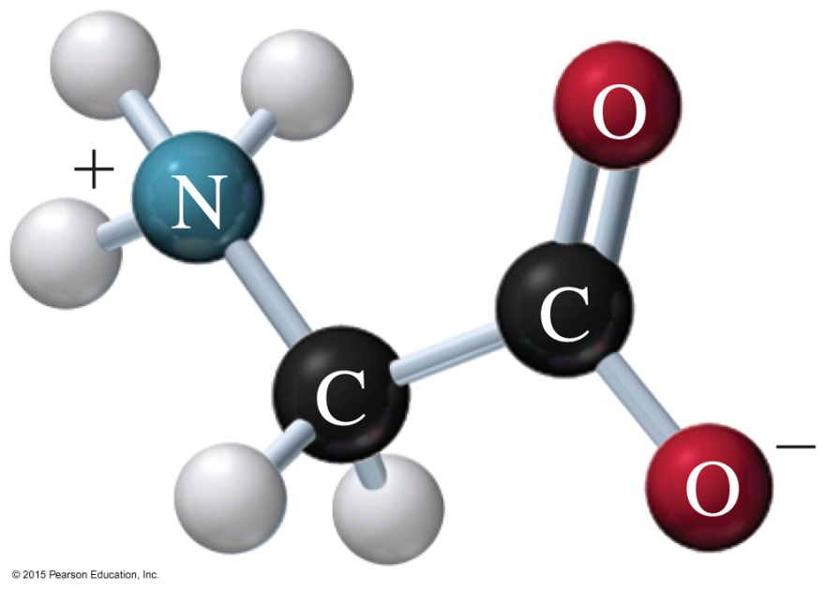
16.2 Amino Acids as Acids and Bases
When an amino acid with positive and negative charges is overall neutral in charge, it is said to be at its isoelectric point (pI).
Ball-and-stick model of glycine at its pI of 6.0.
Learning Goal Draw the condensed structural formula for an amino acid at pH values above or below its isoelectric point.

Slide 2
Isoelectric Point
The isoelectric point of an amino acid is the pH at which
the charged groups on an amino acid are balanced
the amino acid is neutral
An amino acid can exist as
a positive ion if a solution is more acidic (lower pH)
than its pI
as a negative ion if a solution is more basic (higher pH)
than its pI

Slide 3
Ionized Forms of Amino Acids
The pI values for nonpolar and
and polar neutral amino acids
are from pH 5.1 to 6.3.
Alanine has a zero overall charge at its pI of 6.0 with a carboxylate anion (— COO⁻) and an ammonium cation (— NH₃⁺).

Slide 4
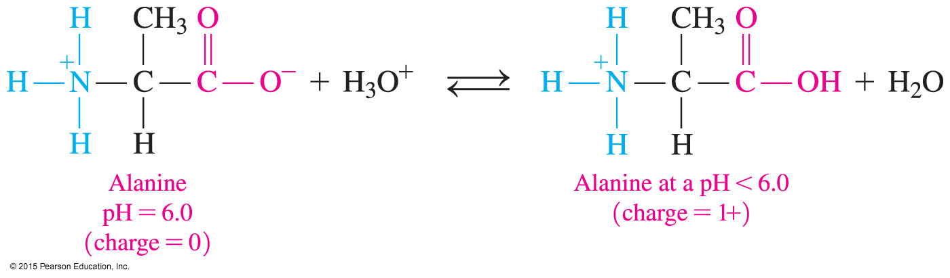
Ionized Forms of Amino Acids
Alanine adds an H⁺ to the carboxyl group (— COO⁻) when the solution is more acidic than its pI (pH < 6).

Slide 5
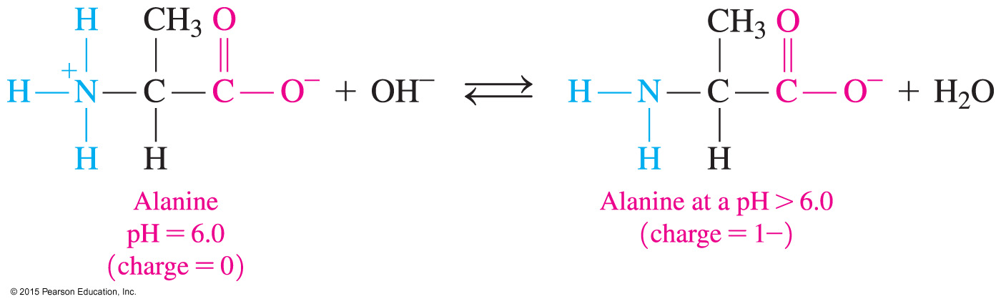
Ionized Forms of Amino Acids
At a pH higher than 6.0, the — NH₃⁺ group loses H⁺ and forms an amino group (— NH₂) that has no charge.
Because the — COO⁻ group has a charge of 1−, alanine has an overall negative charge (1−) at a pH higher than 6.0.

Slide 6
pH and Ionization
H⁺ OH–
+ +
H₃N–CH₂–COOH H₃N–CH₂–COO– H₂N–CH₂–COO–
Positive ion, Negative ion,
low pH pI high pH

Slide 7
Study Check
CH₃ CH₃
₊ | |
H₃N—CH—COOH H₂N—CH—COO–
(1) (2)
Which structure represents
A. alanine at a pH above its pI?
B. alanine at a pH below its pI?

Slide 8
Solution
CH₃ CH₃
₊ | |
H₃N—CH—COOH H₂N—CH—COO–
(1) (2)
Which structure represents
A. alanine at a pH above its pI? (2)
B. alanine at a pH below its pI? (1)

Slide 9
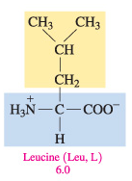
Study Check
Consider the amino acid leucine with a pI of 6.0.
A. At a pH of 3.0, how does leucine change?
B. At a pH of 9.0, how does leucine change?

Slide 10
Solution
Consider the amino acid leucine with a pI of 6.0.
A. At a pH of 3.0, how does leucine change?
Because the pH of 3.0 is more acidic than the pI at 6.0, the
— COO⁻ group gains an H⁺ to give — COOH. The remaining — NH₃⁺ gives leucine an overall positive charge (1+).
B. At a pH of 9.0, how does leucine change?
Because a pH of 9.0 is more basic and above the pI of leucine, the — NH₃⁺ loses H⁺ to give — NH₂. The remaining COO⁻ gives leucine an overall negative charge (1−).

