Slide 1
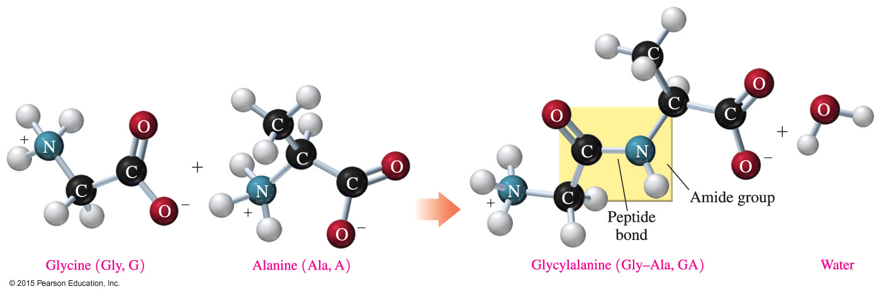
16.3 Proteins: Primary Structure
A peptide bond is an amide bond that forms when the — COO⁻ group of one amino acid reacts with the — NH₃⁺ group of the next amino acid.
The linking of two or more amino acids by peptide bonds forms a peptide.
Learning Goal Draw the condensed structural formula for
a peptide and give its name. Describe the primary structure
for a protein.

Slide 2
Formation of Peptides
The linking of two or more amino acids by peptide bonds forms a peptide.
Peptides formed from
two amino acids are called dipeptides
three amino acids are called tripeptides
four amino acids are called tetrapeptides

Slide 3
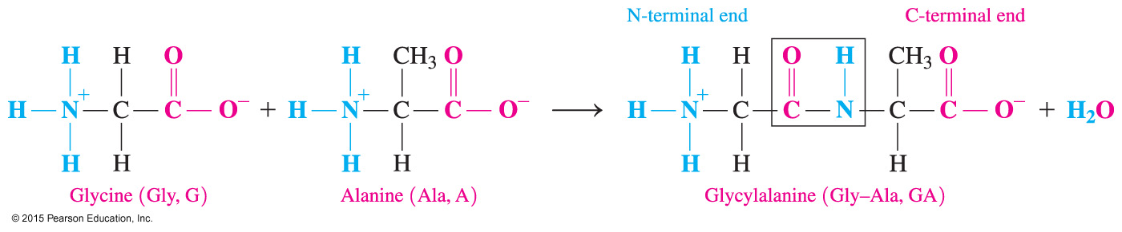
Formation of Peptides
A peptide bond
is an amide bond
forms between the — COO⁻ group of one amino acid and the — NH₃⁺ group of the next amino acid

Slide 4
Formation of a Dipeptide
A peptide bond between glycine and alanine forms the dipeptide glycylalanine.

Slide 5
Study Check
Draw the dipeptide Ser–Thr.

Slide 6
Solution
Draw the dipeptide Ser–Thr.

Slide 7
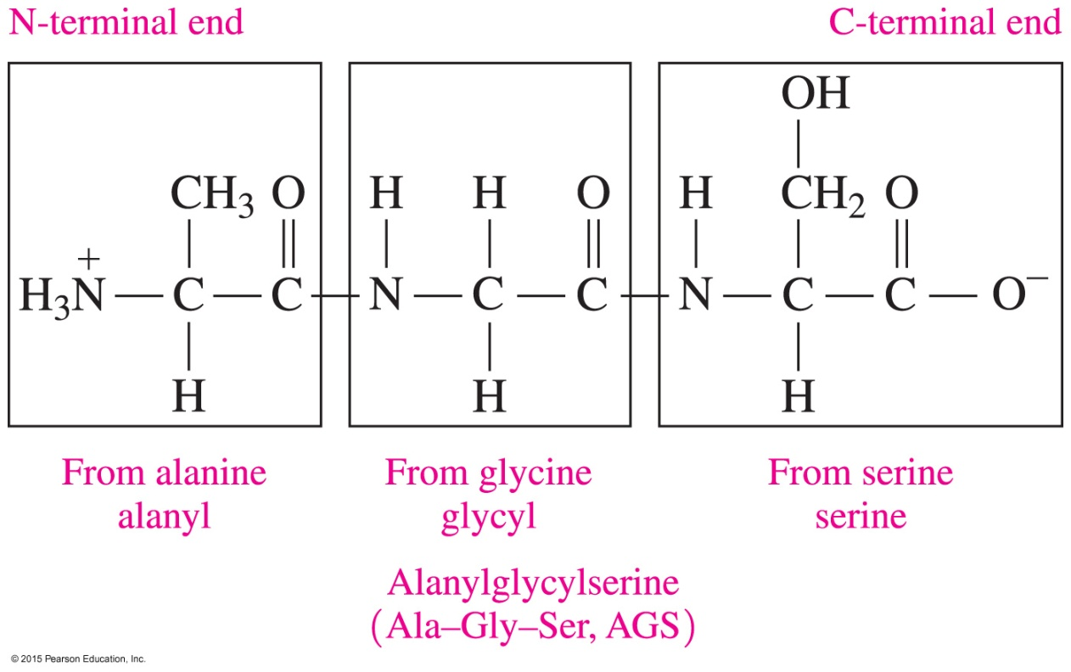
Naming Peptides
With the exception of the C-terminal amino acid, the names of all the other amino acids in a peptide end with yl.

Slide 8
Study Check
Write the three-letter abbreviation and name for the
following tetrapeptide.
Alanine Leucine Cysteine Methionine

Slide 9
Solution
Ala-Leu-Cys-Met Alanylleucylcysteinylmethionine
Alanine Leucine Cysteine Methionine

Slide 10
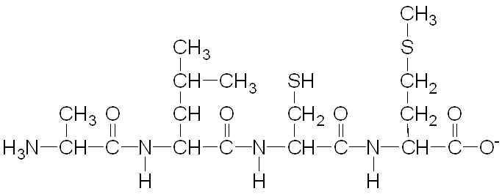
Primary Structure of Proteins
A protein is a polypeptide of 50 or more amino acids that has biological activity.
The primary structure of a protein is the particular sequence of amino acids held together by peptide bonds.
Ala–Leu–Cys–Met

Slide 11
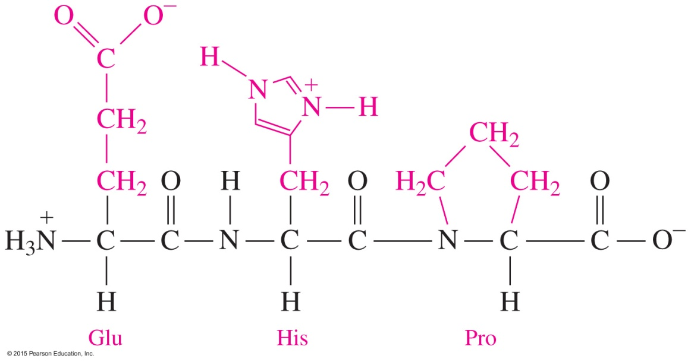
Primary Structure
A thyroid hormone that stimulates the release of thyroxin is a tripeptide with the amino acid sequence Glu–His–Pro.
Although other amino acid sequences of these three amino acids are possible, only the specific sequence or primary structure of Glu−His−Pro produces hormonal activity.

Slide 12
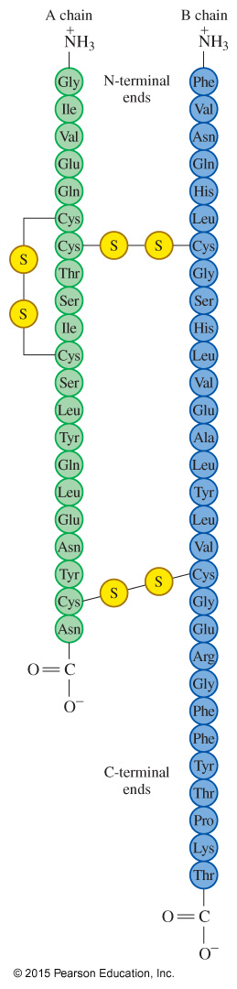
Primary Structure of Insulin
Insulin
was the first protein to have its primary structure determined
has a primary structure of two polypeptide chains linked by
disulfide bonds
has a chain A with 21 amino acids and a chain B with
30 amino acids

Slide 13
Study Check
Answer the questions
for the tripeptide that
is shown below:
What is the N-terminal amino acid?
What is the C-terminal amino acid?
C. What is the name of the tripeptide?

Slide 14
Solution
Answer the questions
for the tripeptide that
is shown below:
What is the N-terminal amino acid? Phe
What is the C-terminal amino acid? Ala
C. What is the name of the tripeptide? phenylalanylcysteinylalanine

Slide 15
Study Check
Write the names and three-letter abbreviations of the tripeptides that could form from two glycines and one alanine.

Slide 16
Solution
Write the names and three-letter abbreviations of the tripeptides that could form from two glycines and one alanine.
glycylglycylalanine Gly-Gly-Ala
glycylalanylglycine Gly-Ala-Gly
alanylglycylglycine Ala-Gly-Gly

