Slide 1
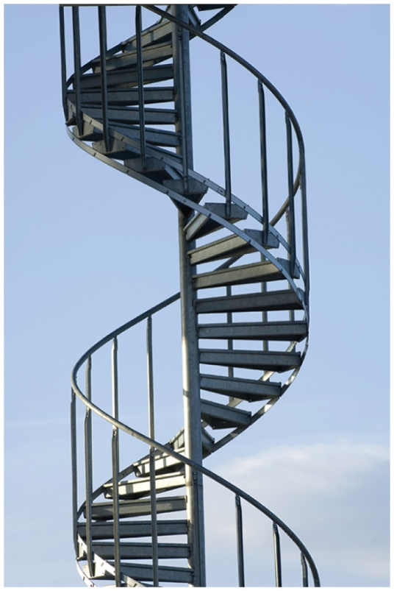
16.4 Proteins: Secondary, Tertiary, and Quaternary Structures
The shape of an alpha helix is similar to that of a spiral staircase.
The α helix acquires a coiled shape from hydrogen bonds between the oxygen of the C O group and the hydrogen of the N — H group in the next turn.
Learning Goal Describe the secondary, tertiary, and quaternary structures for a protein; describe the denaturation of a protein.

Slide 2
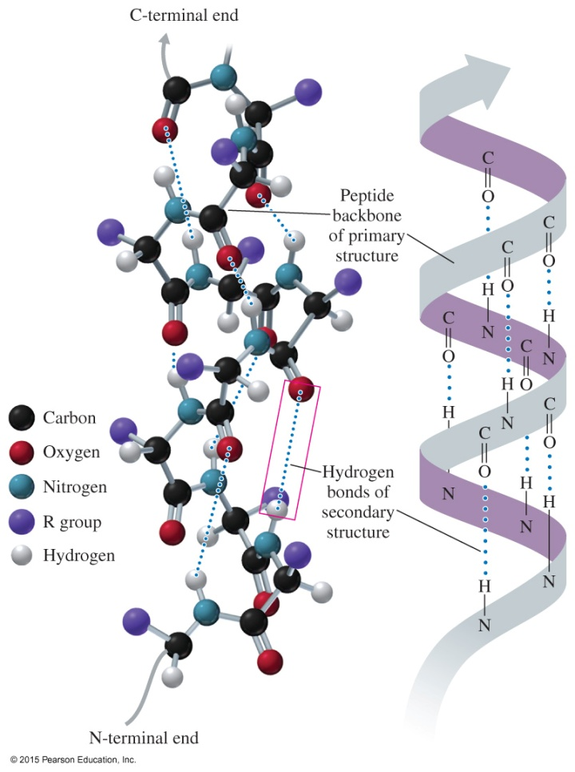
Secondary Structure: Alpha Helix
In the secondary structure of an
alpha helix (α helix),
hydrogen bonds form between the oxygen of the C O groups and the hydrogen of N — H groups of the amide bonds in the next turn of the α helix
the formation of many hydrogen bonds along the polypeptide chain gives the helical shape of a spiral staircase
Core Chemistry Skill Identifying the Primary, Secondary,
Tertiary, and Quaternary Structures of Proteins

Slide 3
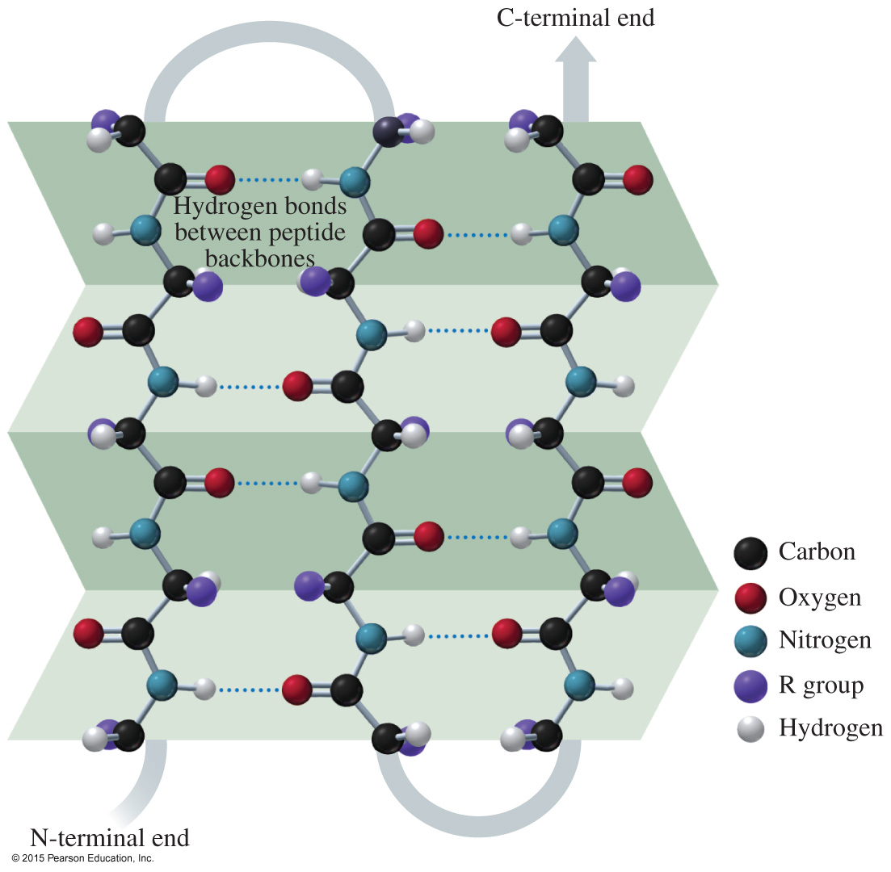
Secondary Structure: Beta-Pleated Sheet
In the secondary structure of a beta-pleated sheet (β-pleated sheet), hydrogen bonds form between the carbonyl oxygen atoms and hydrogen atoms in the amide groups bending the polypeptide chain into a sheet.

Slide 4
Secondary Structure: Triple Helix
In the secondary structure of a triple helix,
three polypeptide chains are woven together
hydrogen bonds hold the chains together, giving the polypeptide the added strength typical of collagen, connective tissue, skin, tendons, and cartilage
Collagen fibers are triple helices of polypeptide chains held together by hydrogen bonds.

Slide 5
Tertiary Structure
The tertiary structure of a protein
is an overall three-dimensional shape caused by interactions of different parts of the chain, causing it to bend and twist
is determined by cross-links, the attractions and repulsions between the side chains (R groups) of the amino acids in a peptide chain

Slide 6
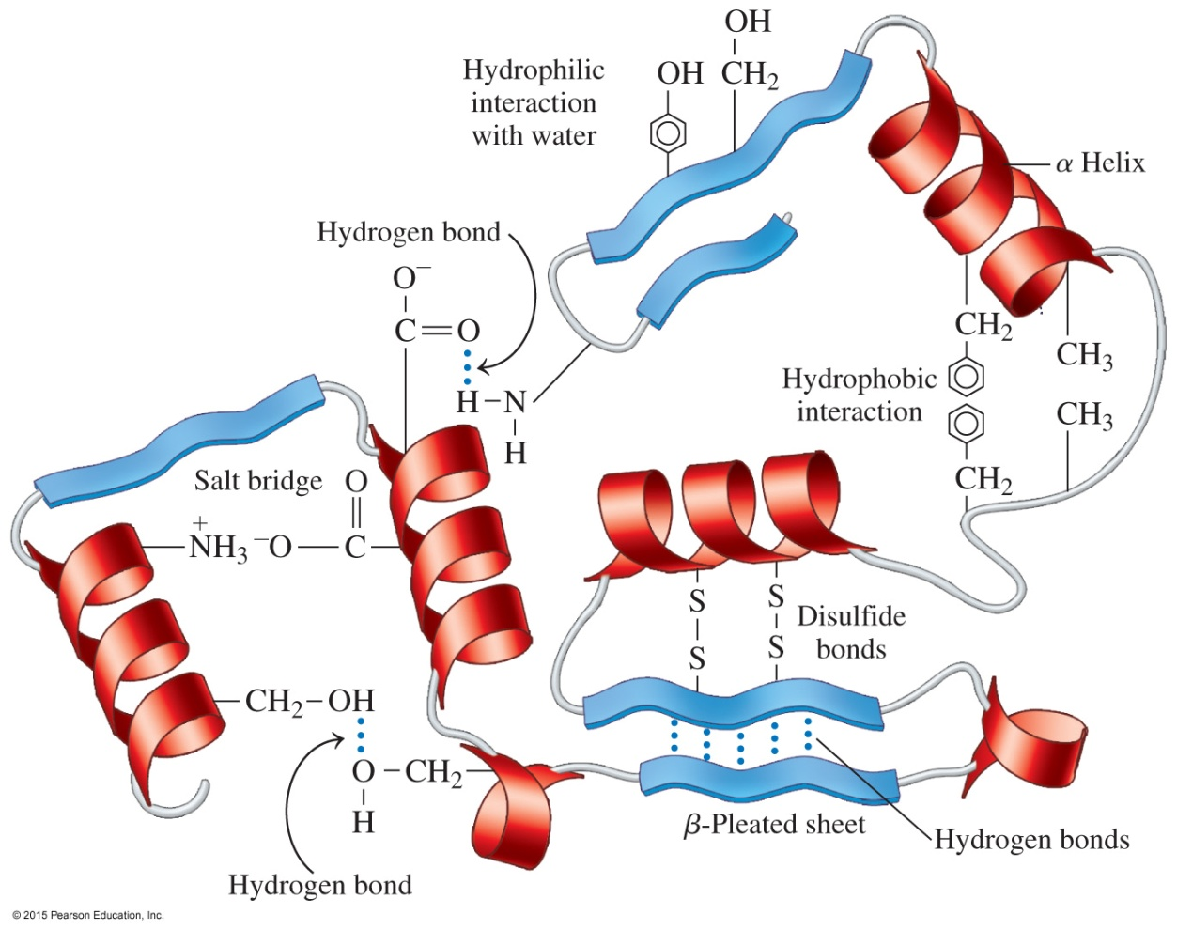
Tertiary Structure
Interactions between amino acid R groups fold a protein into a specific three-dimensional shape called its tertiary structure.

Slide 7
Tertiary Structure
Sections of a protein interact to create the tertiary structure of a protein due to
hydrophobic interactions between two nonpolar amino acids
hydrophilic interactions between the external aqueous environment and the R groups of polar amino acids
salt bridges, ionic bonds between ionized R groups of basic and acidic amino acids
hydrogen bonds between H of a polar R group and the O or N of another amino acid
disulfide bonds — S — S — between the — SH groups of cysteine amino acids

Slide 8
Chemistry Link to Health: Sickle-Cell Anemia
Sickle-cell anemia is caused by an abnormality in the shape of one of the subunits of the hemoglobin protein.
The sixth amino acid in the β-chain, polar acidic glutamic acid, is replaced by valine, a nonpolar amino acid.
The nonpolar R group on valine is attracted to the nonpolar regions within the beta hemoglobin chains.
The red blood cells change from a rounded shape to a crescent shape, like a sickle, which interferes with their ability to transport enough oxygen.

Slide 9
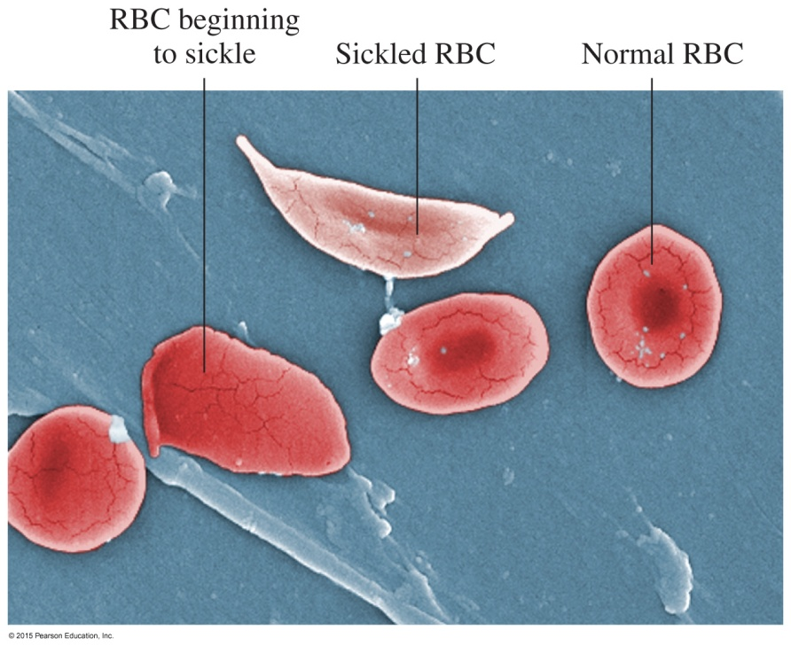
Chemistry Link to Health: Sickle-Cell Anemia
Hydrophobic interactions also cause sickle-cell hemoglobin molecules to stick together. They form insoluble fibers of sickle-cell hemoglobin that
clog capillaries
cause inflammation, pain, and organ damage
cause low oxygen levels in the affected tissues

Slide 10
Study Check
Indicate the type of protein structure.
primary alpha helix
beta-pleated sheet triple helix
A. polypeptide chains held side by side by H bonds
B. sequence of amino acids in a polypeptide chain
C. corkscrew shape with H bonds between amino acids
D. three peptide chains woven like a rope

Slide 11
Solution
A. polypeptide chains held side by side by H bonds
beta-pleated sheet
B. sequence of amino acids in a polypeptide chain
primary
C. corkscrew shape with H bonds between amino acids
alpha helix
D. three peptide chains woven like a rope
triple helix

Slide 12
Study Check
Select the type of tertiary interaction.
disulfide ionic
H bonds hydrophobic
A. leucine and valine
B. two cysteines
C. aspartic acid and lysine
D. serine and threonine

Slide 13
Solution
Select the type of tertiary interaction.
disulfide ionic
H bonds hydrophobic
A. leucine and valine hydrophobic
B. two cysteines disulfide
C. aspartic acid and lysine ionic
D. serine and threonine H bonds

Slide 14
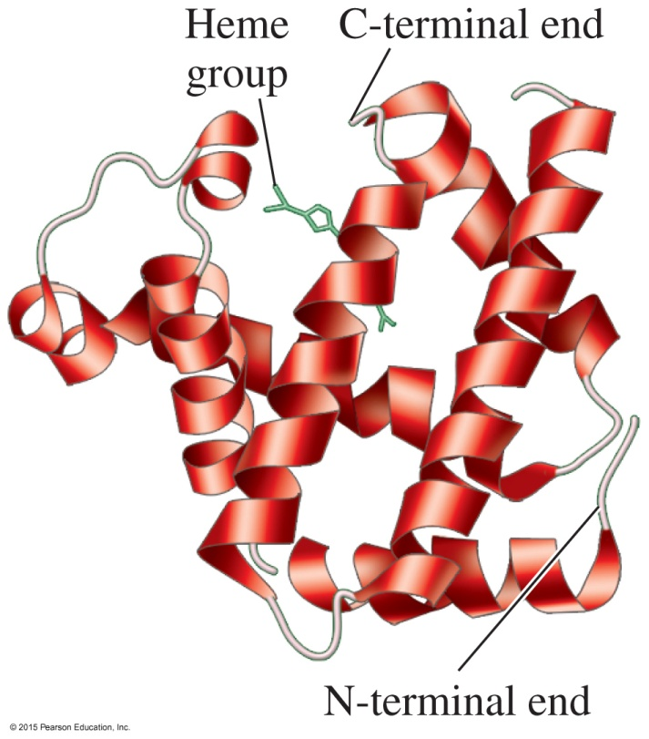
Globular Proteins
Globular proteins
have compact, spherical shapes
carry out synthesis, transport, and metabolism in the cells
transport and store oxygen in muscle
The ribbon structure represents
the tertiary structure of myoglobin.
Myoglobin and hemoglobin transport and store oxygen in the body.

Slide 15
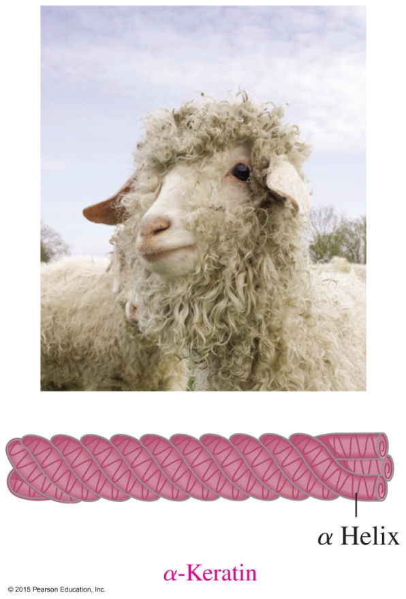
Fibrous Proteins
Fibrous proteins consist of long, fiber-like shapes such as
alpha keratins, which make up hair, wool, skin, and nails
beta keratins in feathers, which contain large amounts of beta-pleated sheet structures
The fibrous proteins of α-keratin wrap together to for fibrils of hair and wool.

Slide 16
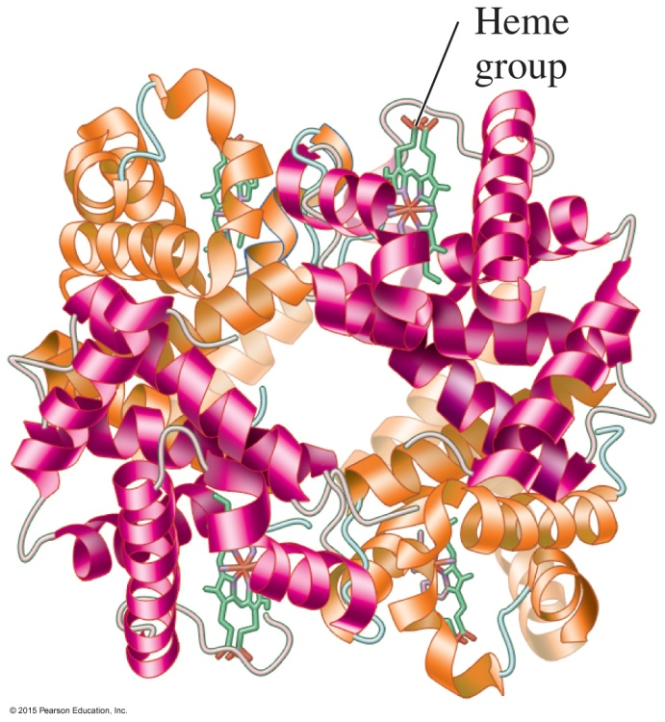
Quaternary Structure
The quaternary structure
is the combination of two or more protein units
consists of four polypeptide chains as subunits in hemoglobin
is stabilized by the same interactions found in tertiary structures
In the ribbon structure of hemoglobin, the quaternary structure is made up of four polypeptide subunits: two (red) are α chains and two (blue) are β chains. The heme groups (green) in the four subunits bind oxygen.

Slide 17
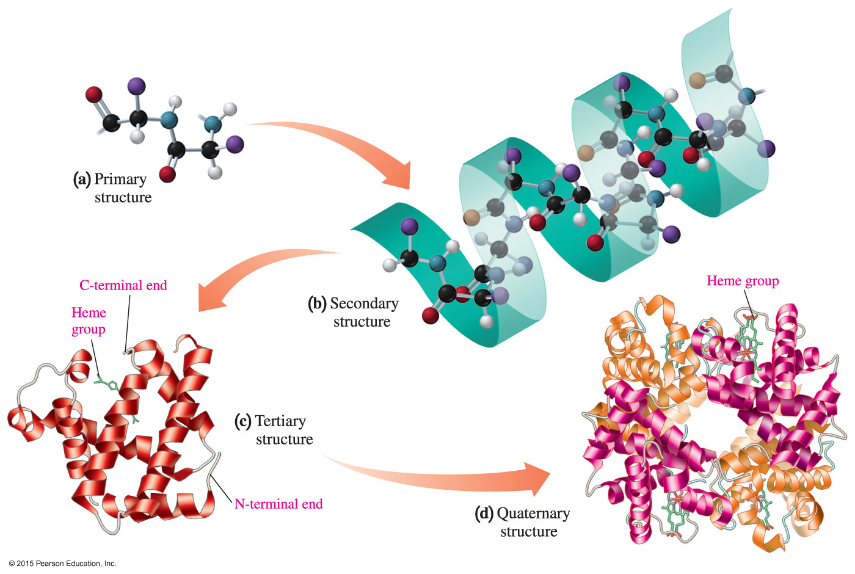
Protein Structural Levels
The structural levels of protein are (a) primary, (b) secondary,
(c) tertiary, and sometimes (d) quaternary.

Slide 18
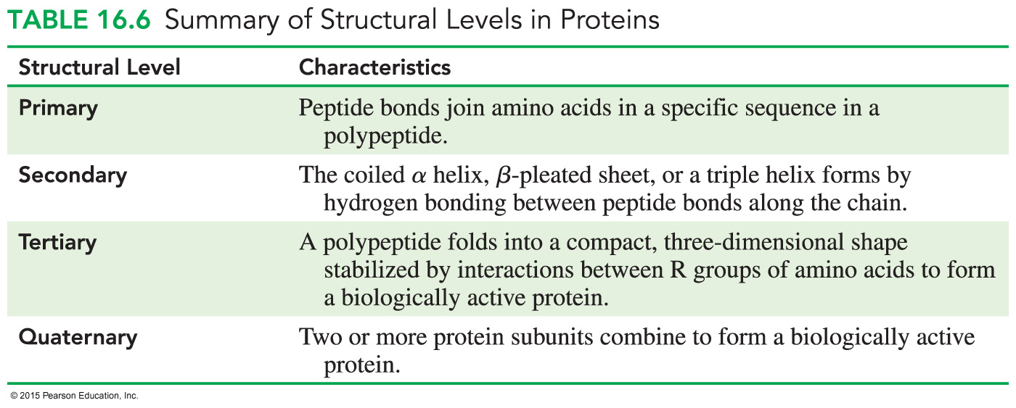
Protein Structural Levels—Summary

Slide 19
Study Check
Identify the level of protein structure.
primary secondary
tertiary quaternary
A. beta-pleated sheet
B. order of amino acids in a protein
C. a protein with two or more peptide chains
D. the shape of a globular protein
E. disulfide bonds between R groups

Slide 20
Solution
Identify the level of protein structure.
primary secondary
tertiary quaternary
A. beta-pleated sheet secondary
B. order of amino acids in a protein primary
C. a protein with two or more peptide chains quaternary
D. the shape of a globular protein tertiary
E. disulfide bonds between R groups tertiary

Slide 21
Denaturation of Proteins
Denaturation involves the disruption of bonds in the secondary, tertiary, and quaternary protein structures by
heat and organic compounds that break apart H bonds and disrupt hydrophobic interactions
acids and bases that break H bonds between polar R groups and disrupt ionic bonds
heavy metal ions that react with S — S bonds to form solids
agitation, such as whipping, that stretches peptide chains until bonds break

Slide 22
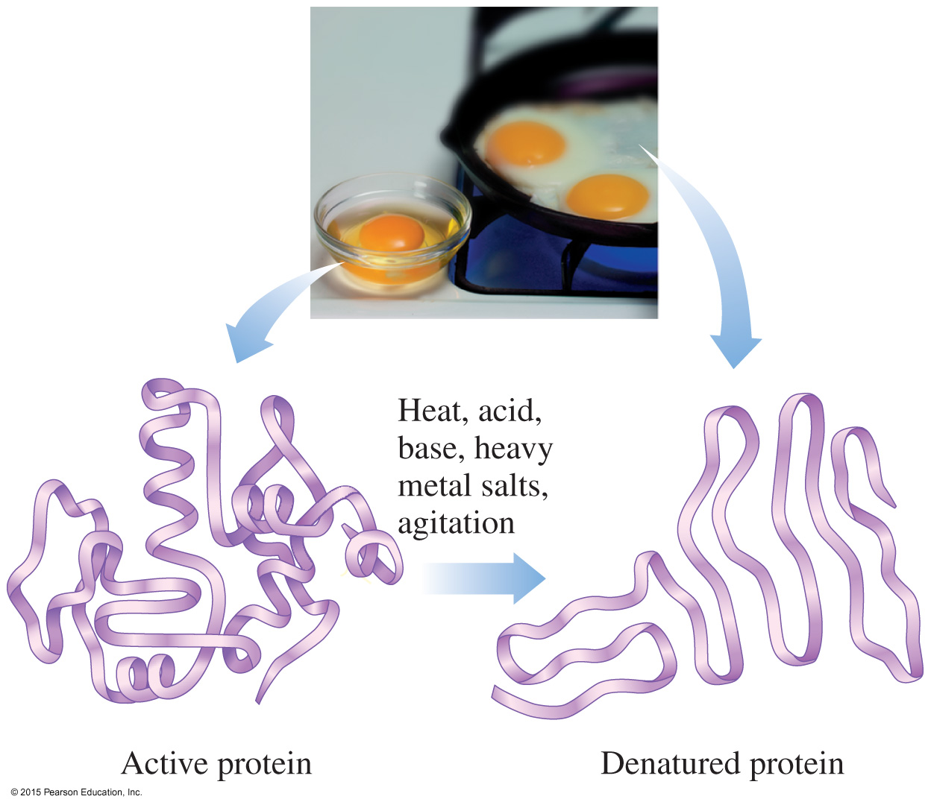
Applications of Denaturation
Denaturation of protein occurs when an egg is cooked.
Denaturation of egg protein occurs when the bonds of the tertiary structure are disrupted.

Slide 23
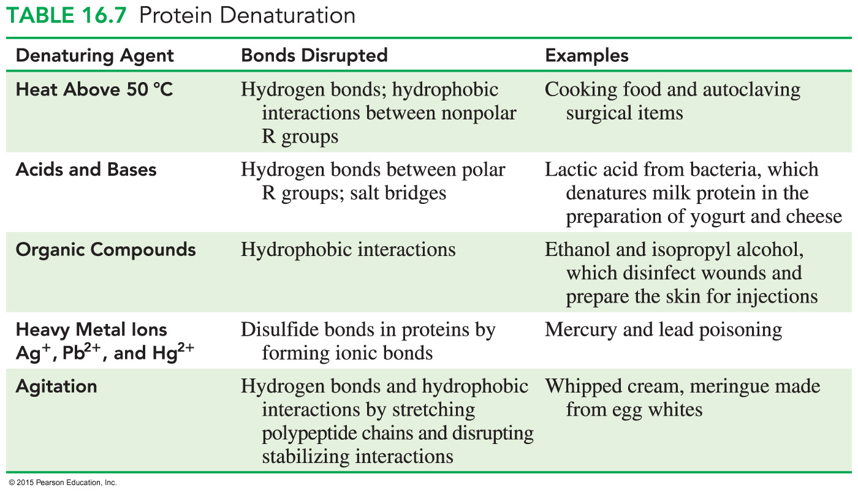
Protein Denaturation

Slide 24
Study Check
Tannic acid is used to form a scab on a burn. An egg is hard boiled by placing it in boiling water.
What is similar about these two events?

Slide 25
Solution
Tannic acid is used to form a scab on a burn. An egg is hard boiled by placing it in boiling water.
What is similar about these two events?
Acid and heat cause the denaturation of protein. They both break bonds in the secondary, tertiary, and quaternary structures of proteins.

