Slide 1
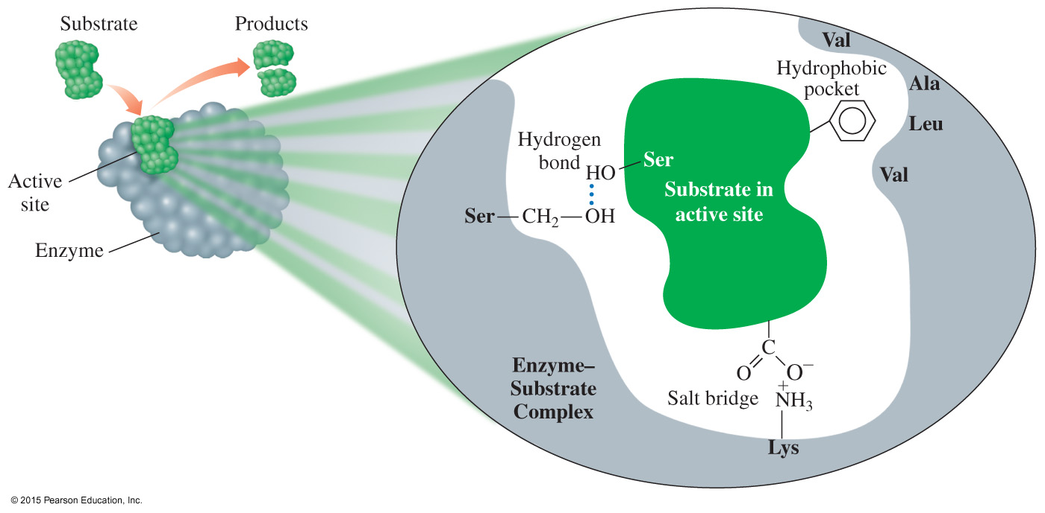
16.5 Enzymes
Enzymes are proteins that act as biological catalysts. On the surface of an enzyme, a small region called an active site binds a substrate and catalyzes a specific reaction for that substrate.
Learning Goal Describe enzymes and their role in enzyme-catalyzed reactions.

Slide 2
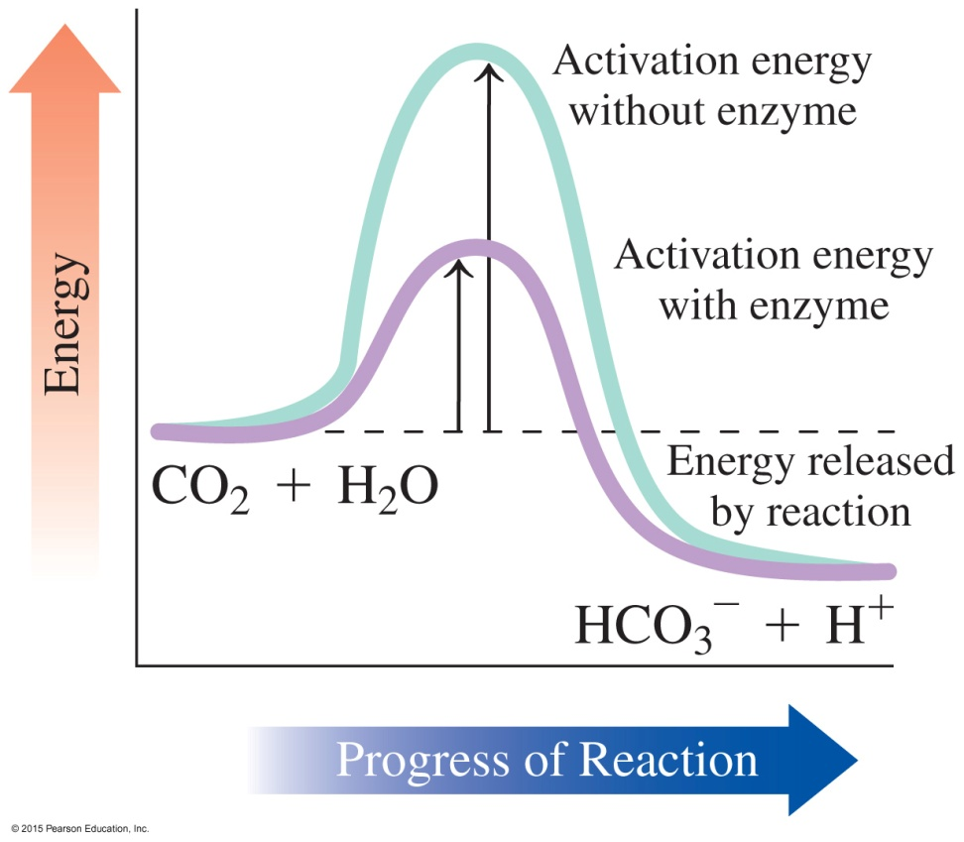
Enzymes Are Biological Catalysts
Enzymes
catalyze nearly all the chemical reactions taking place in the cells of the body
increase the rate of reaction by lowering the energy of activation
The enzyme carbonic anhydrase lowers the activation energy for the reaction:
CO₂ + H₂O HCO₃⁻ + H⁺

Slide 3
Enzyme Names
The name of an enzyme
is derived by replacing the end of the name of the reaction or reacting compound with the suffix ase
identifies the reacting substance—for example, sucrase catalyzes the reaction of sucrose
describes the compound or the reaction that is catalyzed—for example, oxidase catalyzes an oxidation reaction
could be a common name, particularly for the digestion enzymes, such as pepsin and trypsin

Slide 4
Classification of Enzymes
Enzymes are classified by the reaction they catalyze. There are
six main classes of enzymes.
Class Type of Reactions Catalyzed
Oxidoreductases Oxidation–reduction
Transferases Transfer groups of atoms
Hydrolases Hydrolysis
Lyases Add or remove atoms to or from a double bond
Isomerases Rearrange atoms
Ligases Use ATP to combine small molecules

Slide 5
Study Check
Match the type of reaction catalyzed with an enzyme class.
hydrolases isomerases
transferases ligases
A. form bonds between molecules using ATP energy
B. rearrange atoms in a molecule to form an isomer
C. transfer a group between two compounds
D. hydrolysis reactions

Slide 6
Solution
Match the type of reaction catalyzed with an enzyme class.
hydrolases isomerases
transferases ligases
A. form bonds between molecules using ATP energy
ligases
B. rearrange atoms in a molecule to form an isomer
isomerases
C. transfer a group between two compounds transferases
D. hydrolysis reactions hydrolases

Slide 7
Active Site Binds the Substrate
On the surface of an enzyme, a small region called an active site binds a substrate and catalyzes a reaction of that substrate.

Slide 8
Active Site Binds the Substrate
The active site
is a region within an enzyme that fits the shape of the reacting molecule called a substrate
contains amino acid R groups that bind the substrate
releases products when the reaction is complete

Slide 9
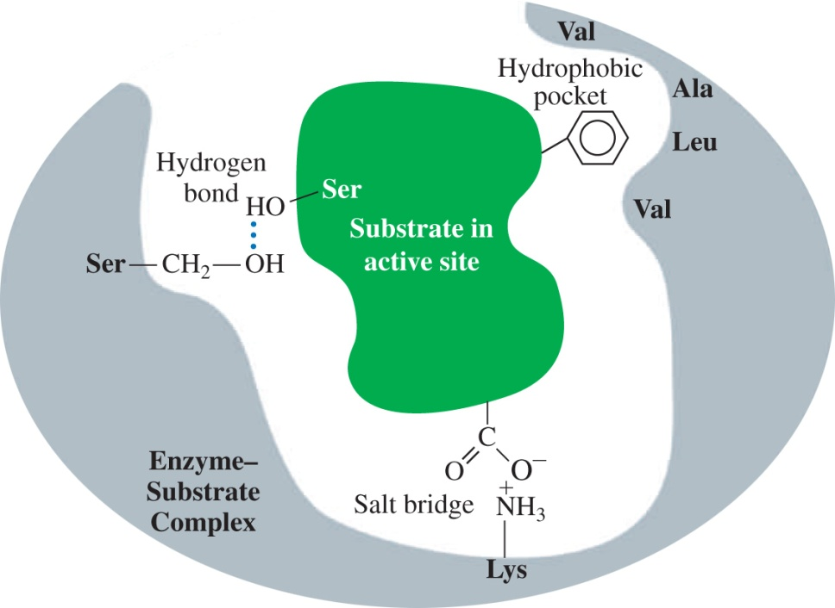
Enzyme-Catalyzed Reaction
In an enzyme-catalyzed reaction,
a substrate attaches to the active site
an enzyme–substrate (ES) complex forms
reaction occurs and products are released
an enzyme is used over and over
E + S ES E + P
Binding of a substrate occurs when it interacts with the amino acids within the active site.

Slide 10
Enzyme-Catalyzed Reaction
In the hydrolysis of the disaccharide sucrose,
the ES complex is formed as sucrose binds to the active site of sucrase
the glycosidic bond of sucrose is in position for hydrolysis
the R groups on the amino acids in the active site catalyze the hydrolysis of sucrose, producing glucose and fructose
the product structures are no longer attracted to the active site, so they are released to allow sucrase to react with another sucrose molecule
E + S ES E + P
sucrase + sucrose ES complex sucrase + product

Slide 11
Enzyme Action: Lock-and-Key Model
In the lock-and-key model, the
active site has a rigid, nonflexible shape
enzyme binds only substrates that exactly fit the active site like a lock
substrate is the key that fits that lock
This model was a static one that did not include the flexibility of the tertiary shape of an enzyme and the way the active site can adjust to the shape of a substrate.

Slide 12
Enzyme Action: Induced-Fit Model
In the induced-fit model,
enzyme structure is flexible, not rigid, and adjusts to the shape of the active site in order to bind the substrate
the range of substrate specificity increases
shape changes improve catalysis during reaction

Slide 13
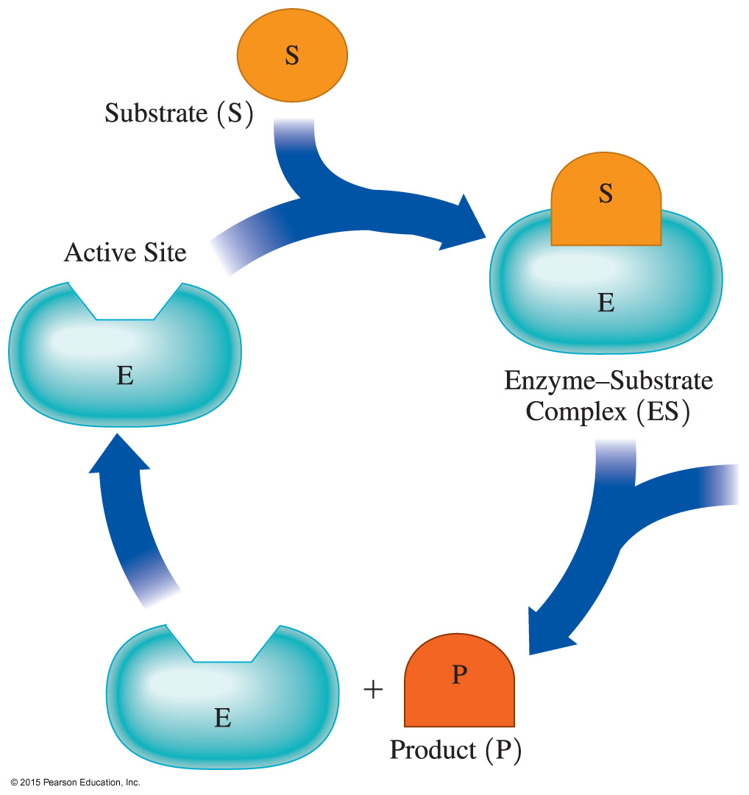
Enzyme Action: Induced-Fit Model
In the induced-fit model, substrate and enzyme work together to acquire a geometrical arrangement that lowers the activation energy of the reaction.

Slide 14
Chemistry Link to Health: Isoenzymes as Diagnostic Tools
Isoenzymes
are different forms of an enzyme that catalyze the same reaction in different cells or tissues of the body
consist of quaternary structures with slight variations in the amino acids in the polypeptide subunits
There are five isoenzymes of lactate dehydrogenase (LDH) that catalyze the conversion between lactate and pyruvate.

Slide 15
Chemistry Link to Health: Isoenzymes as Diagnostic Tools
Each LDH isoenzyme contains a mix of polypeptide subunits, M and H. Different combinations of M and H are used to to convert lactate to pyruvate in different organs.
In the liver and muscle, lactate is converted to pyruvate by the LDH₅ isoenzyme with four M subunits (M₄).
In the heart, the same reaction is catalyzed by the LDH₁ isoenzyme (H₄) containing four H subunits.

Slide 16
Chemistry Link to Health: Isoenzymes as Diagnostic Tools
A myocardial infarction may be indicated by an increase in the levels of creatine kinase (CK) and lactate dehydrogenase (LDH).
When a myocardial infarction (MI) or heart attack damages heart muscle, an increase in the level of LDH₁ (H₄) isoenzyme is detected in the blood serum.
An elevation in serum LDH₅, M₄, indicates liver damage or disease.

Slide 17
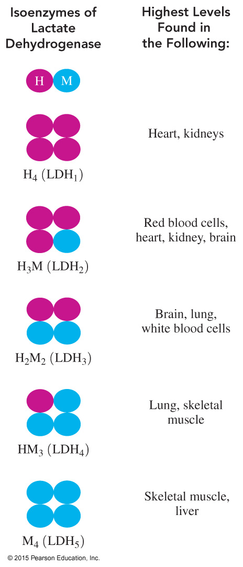
Chemistry Link to Health: Isoenzymes as Diagnostic Tools
The different isoenzymes of lactate
dehydrogenase (LDH) indicate damage
to different organs in the body.

Slide 18
Study Check
1. The active site is
A. the enzyme
B. a section of the enzyme
C. the substrate
2. In the induced-fit model, the shape of the enzyme when substrate binds
A. stays the same
B. adapts to the shape of the substrate

Slide 19
Solution
1. The active site is
B. a section of the enzyme
2. In the induced-fit model, the shape of the enzyme when substrate binds
B. adapts to the shape of the substrate

