Slide 1
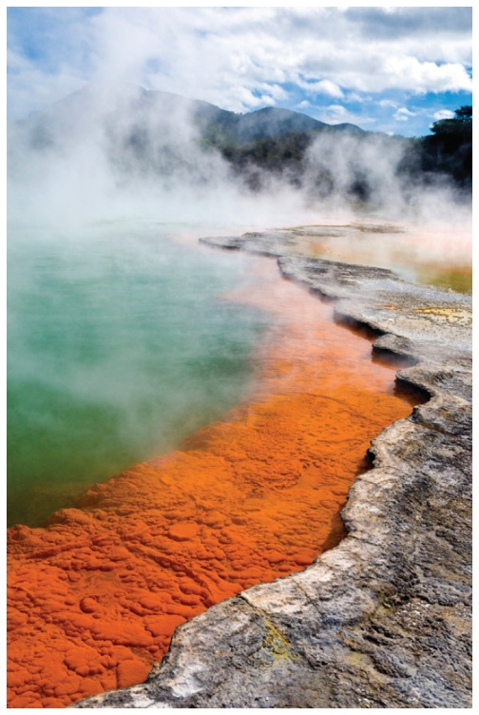
16.6 Factors Affecting Enzyme Activity
The activity of an enzyme
describes how fast an enzyme catalyzes the reaction that converts a substrate to product
is strongly affected by reaction conditions, which include temperature, pH, and the presence of inhibitors
Thermophiles survive in the high temperatures (50 °C to 120 °C) of a hot spring.
Learning Goal Describe the effect of temperature, pH, and inhibitors on enzyme activity.

Slide 2
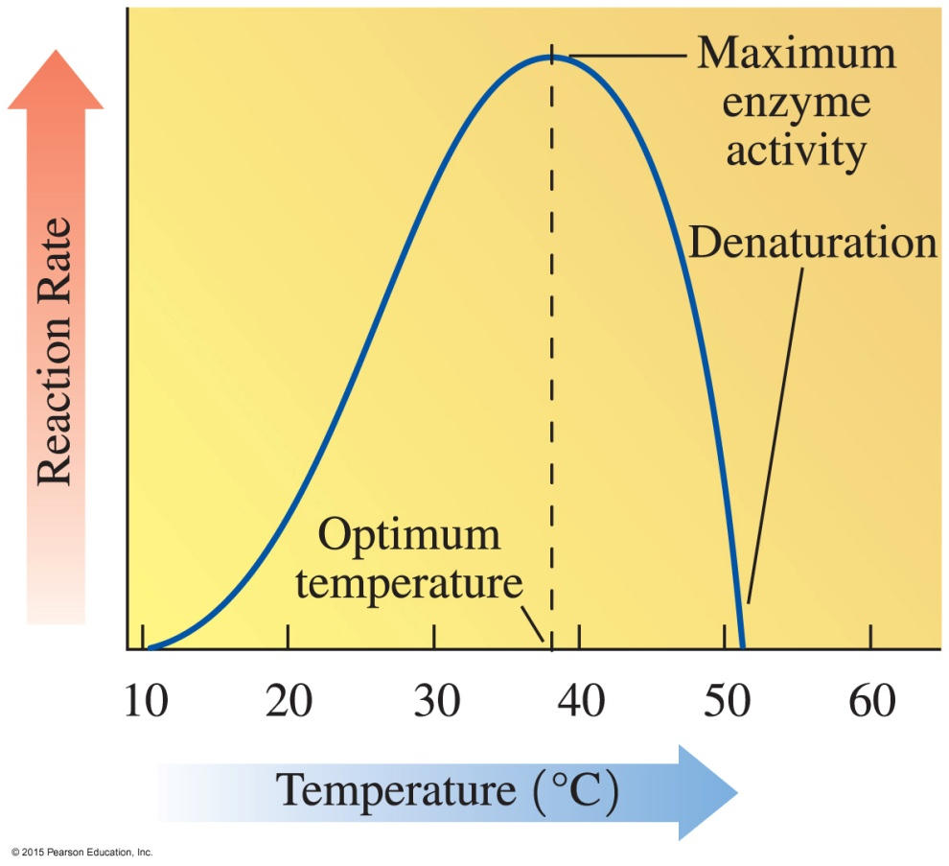
Temperature and Enzyme Activity
Enzymes
are most active at an optimum temperature (usually 37 °C in humans)
show little activity at low temperatures.
lose activity at temperatures above 50 °C as denaturation occurs with loss of catalytic activity

Slide 3
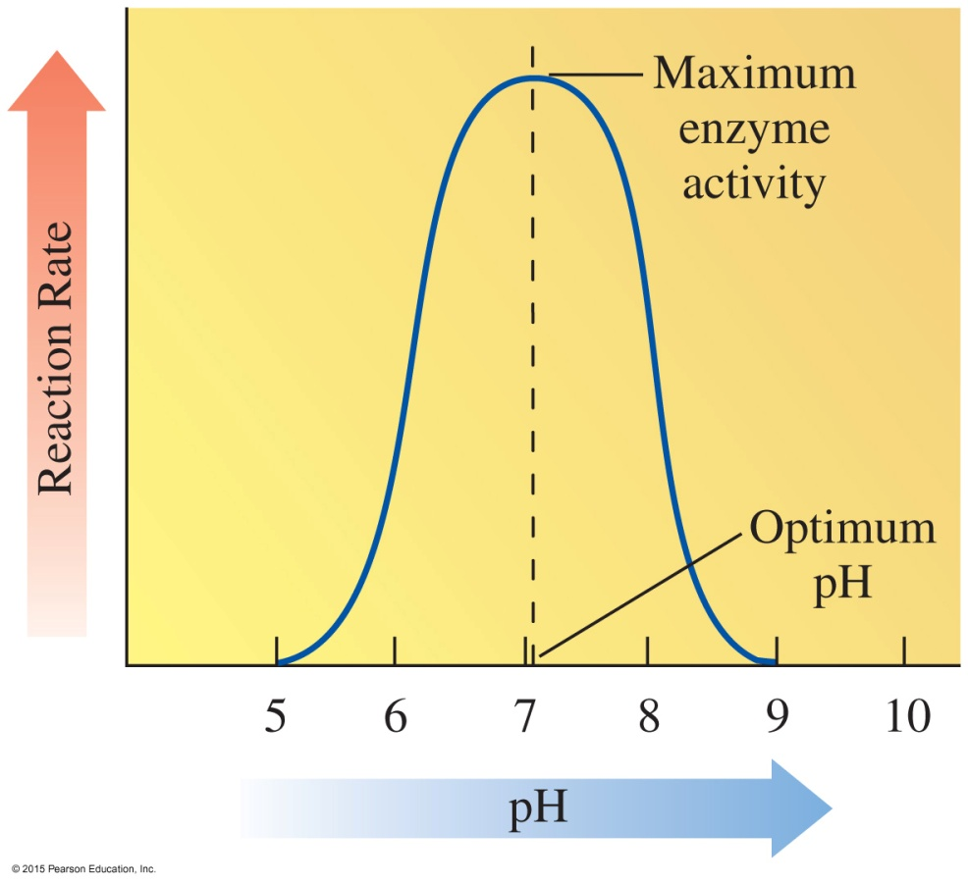
pH and Enzyme Activity
Enzymes
are most active at optimum pH
contain R groups of amino acids with proper charges at optimum pH
lose activity in low or high pH as tertiary structure is disrupted

Slide 4
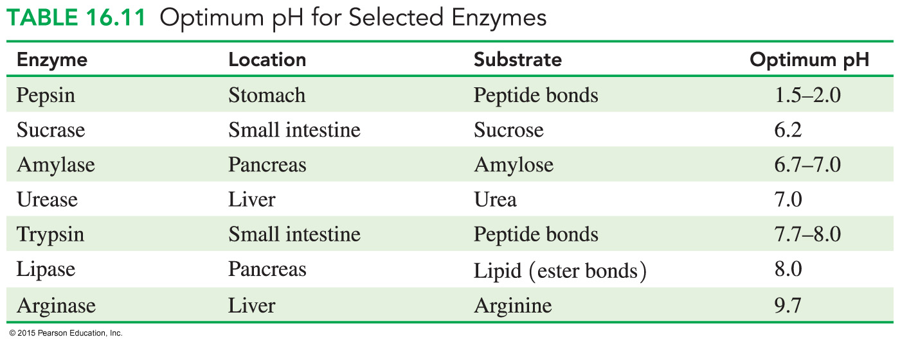
Optimum pH Values
Enzymes in
the body have an optimum pH of about 7.4
certain organs operate at lower and higher optimum pH values

Slide 5
Study Check
Sucrase has an optimum temperature of 37 °C and an optimum pH of 6.2. Determine the impact of each change on the enzyme activity.
no change increases decreases
A. changing the pH to 4
B. running the reaction at 70 °C

Slide 6
Solution
Sucrase has an optimum temperature of 37 °C and an optimum pH of 6.2. Determine the impact of each change on the enzyme activity.
no change increases decreases
A. changing the pH to 4 decreases
B. running the reaction at 70 °C decreases

Slide 7
Enzyme Inhibition
Inhibitors
are molecules that cause a loss of catalytic activity
prevent substrates from fitting into the active sites
E + S ES E + P
E + I EI no P

Slide 8
Competitive Inhibition
A competitive inhibitor
has a structure that is similar to that of the substrate
competes with the substrate for the active site
has its effect reversed by increasing substrate concentration

Slide 9
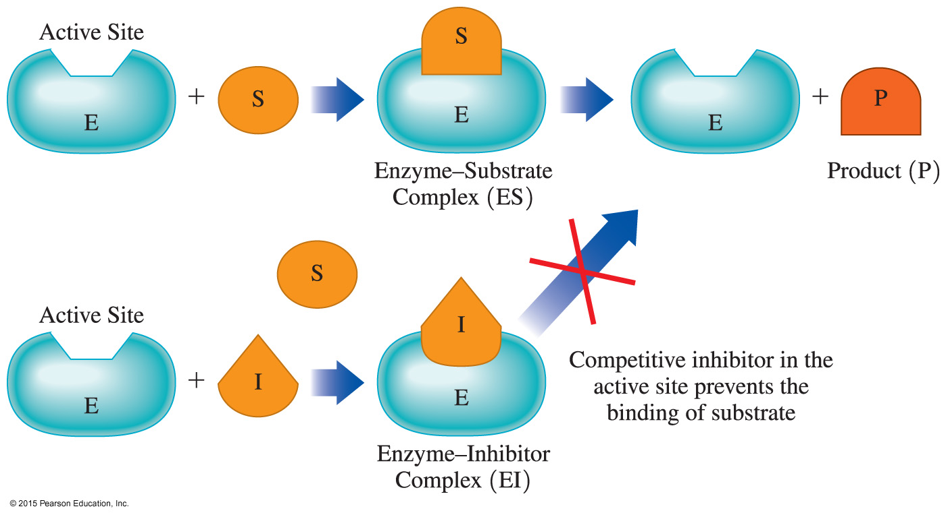
Competitive Inhibition

Slide 10
Noncompetitive Inhibition
A noncompetitive inhibitor
has a structure that is much different than that of the substrate
binds to an enzyme at a site other than the active site and distorts the shape of the enzyme by altering the shape of the active site
prevents the binding of the substrate
cannot have its effect reversed by adding more substrate

Slide 11
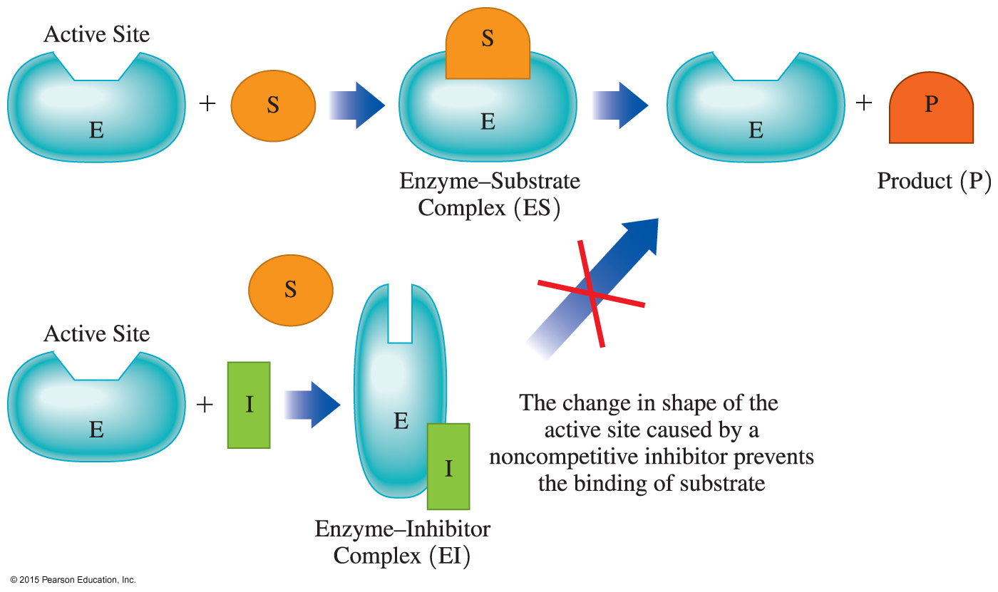
Noncompetitive Inhibition

Slide 12
Irreversible Inhibition
An irreversible inhibitor
is a molecule that causes the enzyme to lose all activity
is often a toxic substance that destroys enzymes
usually forms a covalent bond with an amino acid side chain preventing catalytic activity
may be a nerve gas, an insecticide, or an antibiotic

Slide 13
Competitive, Noncompetitive, and Irreversible Inhibitors

Slide 14
Study Check
Identify each description as an inhibitor that is competitive
or noncompetitive.
A. Increasing substrate reverses inhibition.
B. It binds to enzyme surface but not to the active site.
C. Its structure is similar to that of substrate.
D. Inhibition is not reversed by adding more substrate.

Slide 15
Solution
A. Increasing substrate reverses inhibition. competitive
B. It binds to enzyme surface but not to the active site. noncompetitive
C. Its structure is similar to that of substrate.
competitive
D. Inhibition is not reversed by adding more substrate.
noncompetitive

Slide 16
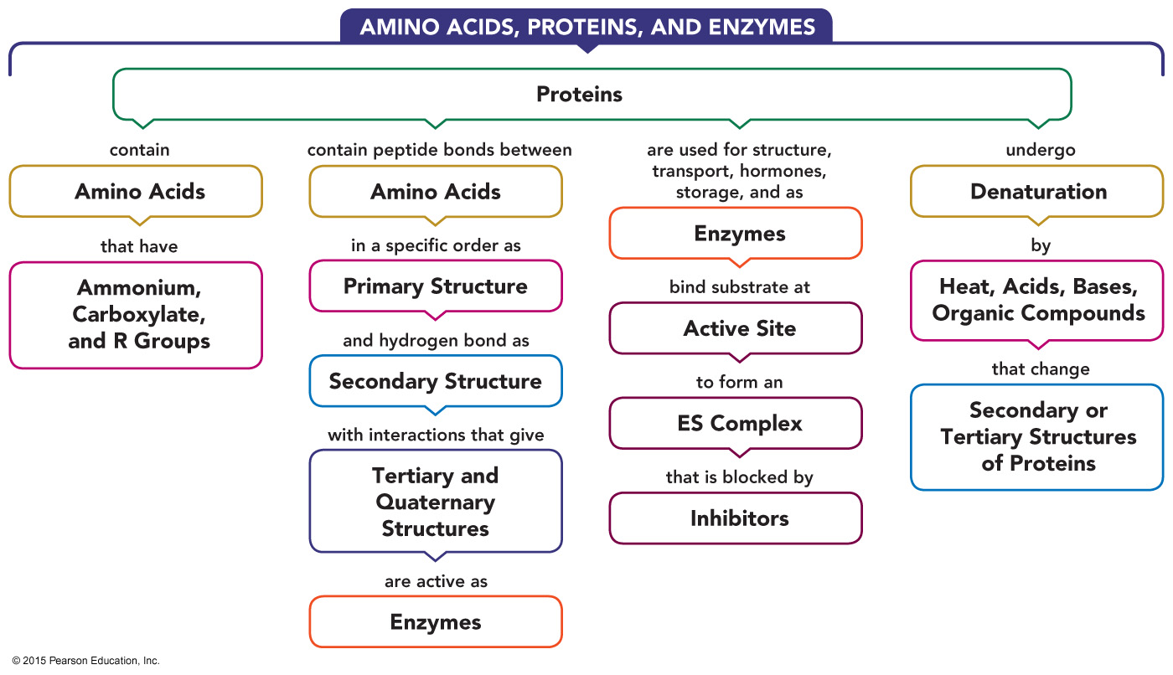
Proteins—Concept Map

