Slide 1
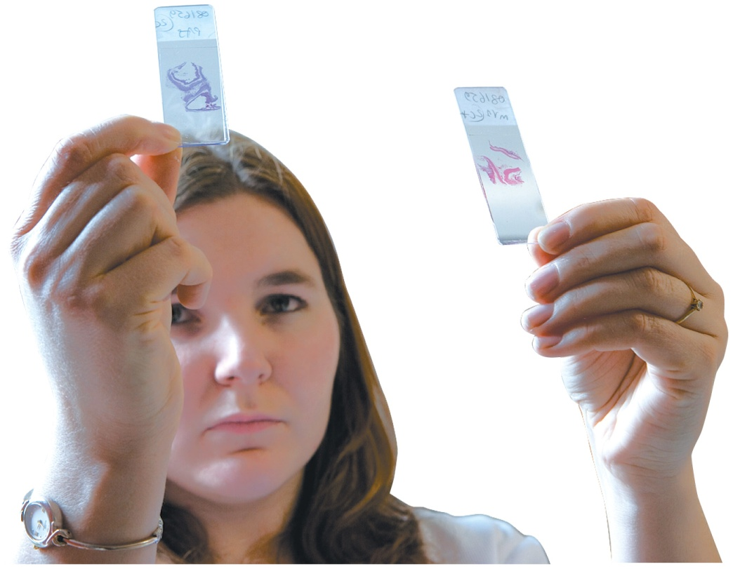
Chapter 17 Nucleic Acids and
Protein Synthesis
A histology technician studies the microscopic makeup of tissues, cells, and bodily fluids with the purpose of detecting and identifying the presence of a specific disease.
They determine blood types and the concentrations of drugs and other substances
in the blood.

Slide 2
Chapter 17 Readiness
Core Chemistry Skills
Forming Amides (14.6)
Drawing the Ionized Form for an Amino Acid (16.1)
Identifying the Primary, Secondary, Tertiary, and Quaternary Structures of Proteins (16.3, 16.4)

Slide 3
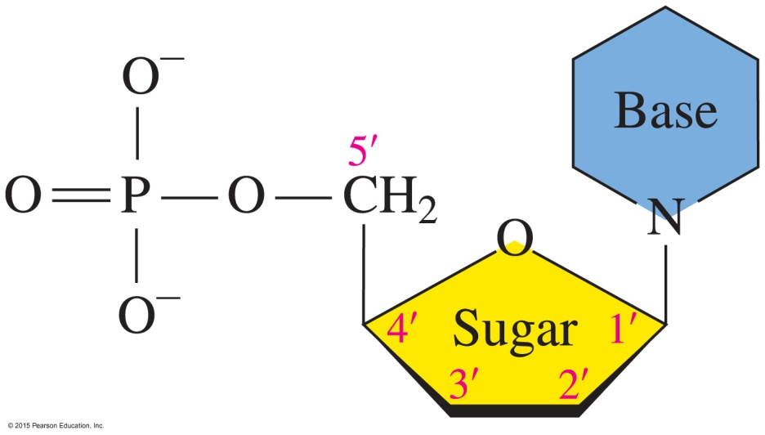
17.1 Components of Nucleic Acids
The general structure of a nucleotide includes a nitrogen-containing base, a sugar, and a phosphate group.
In DNA, the purine bases are adenine, guanine, cytosine, and thymine. RNA contains the same bases, except thymine is replaced by uracil.
Learning Goal Describe the bases and ribose sugars that make up the nucleic acids DNA and RNA.

Slide 4
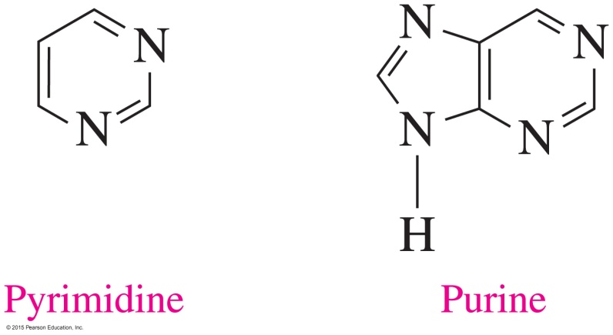
Bases
The nitrogen-containing bases in nucleic acids are derivatives of pyrimidine or purine.
In DNA, the purine bases with double rings are adenine (A) and guanine (G), and the pyrimidine bases with single rings are cytosine (C) and thymine (T).
RNA has the same bases, except thymine (5-methyluracil) is replaced by uracil (U).

Slide 5
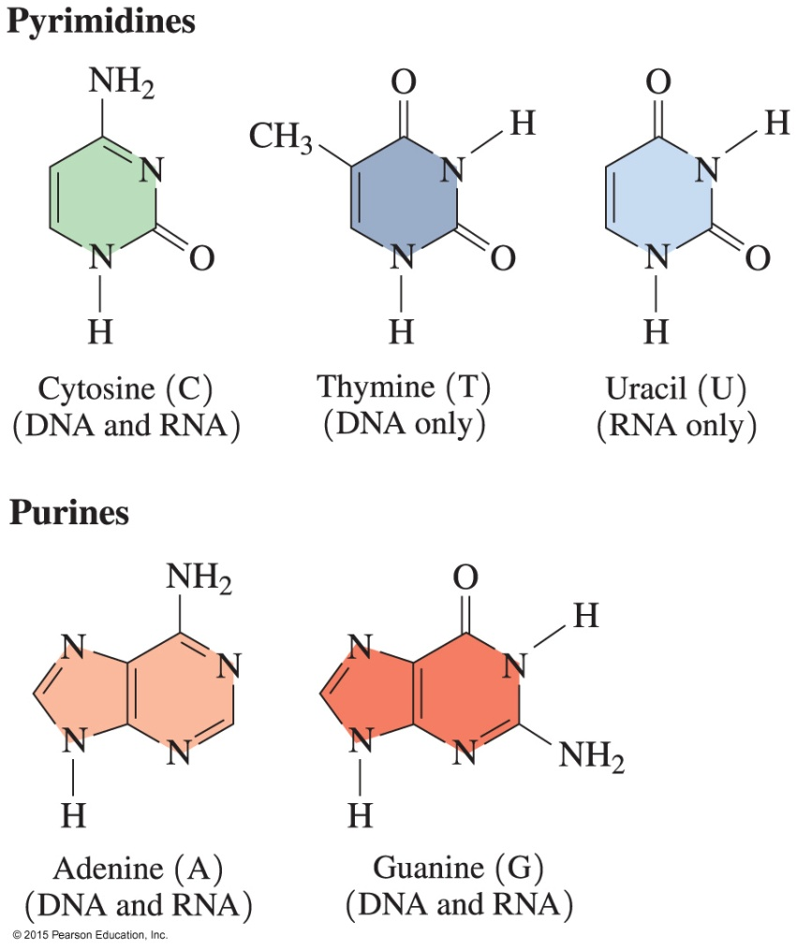
DNA and RNA Bases
DNA contains the bases A, G, C, and T; RNA contains A, G, C, and U.

Slide 6
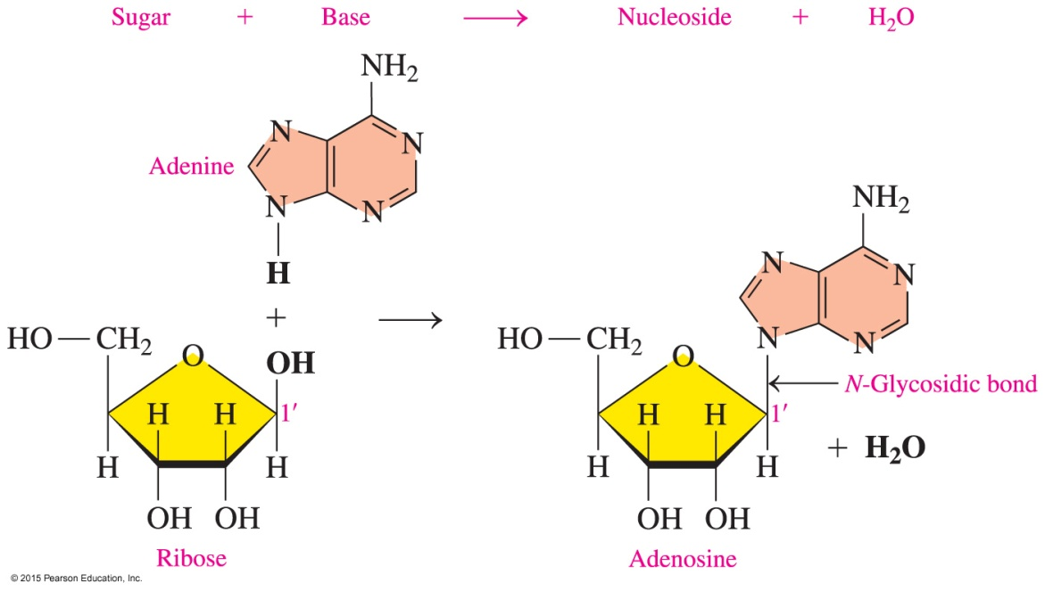
Pentose Sugars
The pentose (five-carbon) sugar
in RNA is ribose
in DNA is deoxyribose, with no O atom on carbon 2'
has carbon atoms numbered with primes to distinguish them from the atoms in the bases

Slide 7
Nucleosides
A nucleoside
is a combination of a sugar and base
is produced when the nitrogen atom in a pyrimidine or a purine base forms an N-glycosidic bond to carbon 1 (C1′) of a sugar, either ribose or deoxyribose
is named by changing the base ending to osine for purines and idine for pyrimidines

Slide 8
Nucleosides
For example, adenine and ribose form a nucleoside called adenosine.

Slide 9
Nucleotides
Nucleotides
are nucleosides in which a phosphate group bonds to the — OH group on carbon 5 (C5′) of ribose or deoxyribose to produce a phosphate ester
are not formed when other hydroxyl groups on ribose form phosphate esters; only the 5′-monophosphate nucleotides are found in RNA and DNA

Slide 10
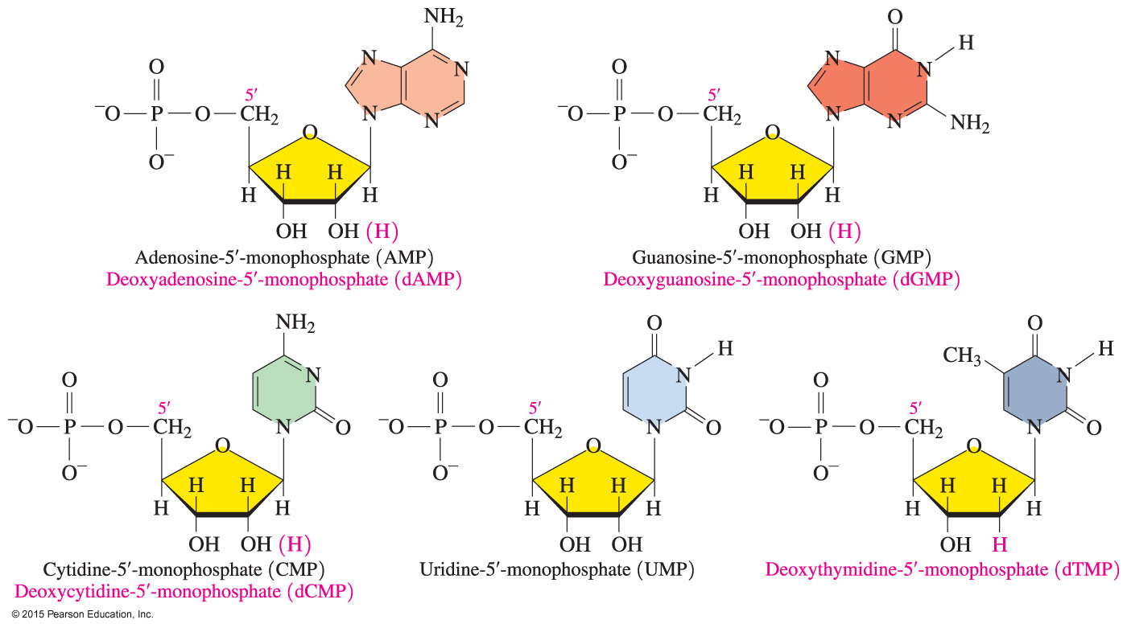
Nucleotides
The nucleotides of RNA are identical to those of DNA, except in DNA the sugar is deoxyribose and deoxythymidine replaces uridine.

Slide 11
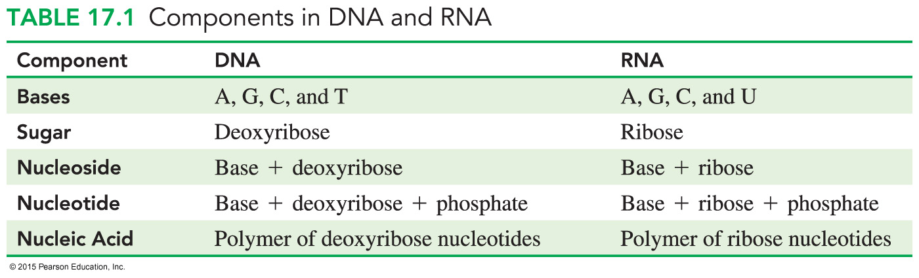
Components in DNA and RNA

Slide 12
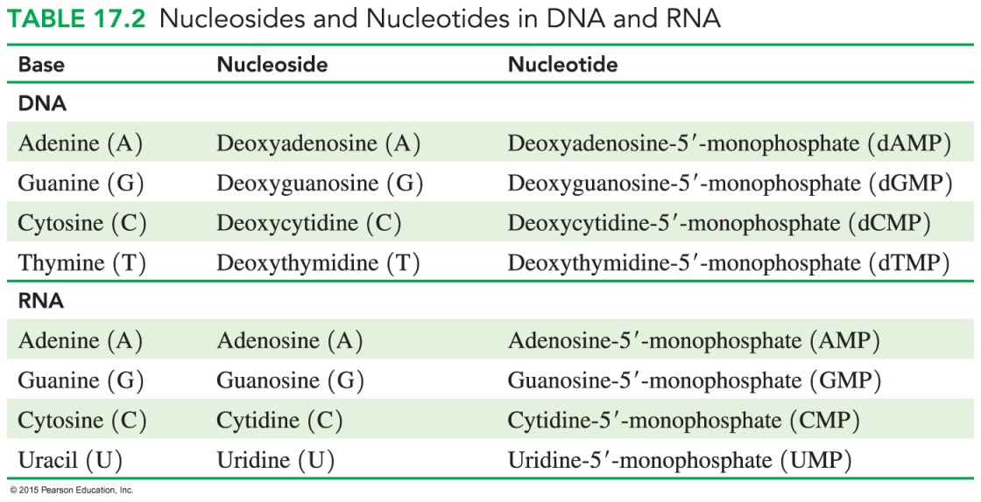
Naming Nucleosides and Nucleotides
The names of
DNA nucleosides add deoxy to the beginning of their names
RNA and DNA nucleotides are given by adding
-5′-monophosphate
The letters A, G, C, U, and T represent bases and are often used in the abbreviations of the respective nucleosides and nucleotides.

Slide 13
Study Check
Identify the following bases as a purine or pyrimidine:
A. adenine B. cytosine

Slide 14
Solution
Identify the following bases as a purine or pyrimidine:
A. adenine B. cytosine
purine pyrimidine

Slide 15
Study Check
Identify each of the following bases as a component of DNA, RNA, or both:
A. guanine
B. adenine
C. thymine
D. uracil

Slide 16
Solution
Identify each of the following bases as a component of DNA, RNA, or both:
A. guanine DNA and RNA
adenine DNA and RNA
thymine DNA only
D. uracil RNA only

