Slide 1
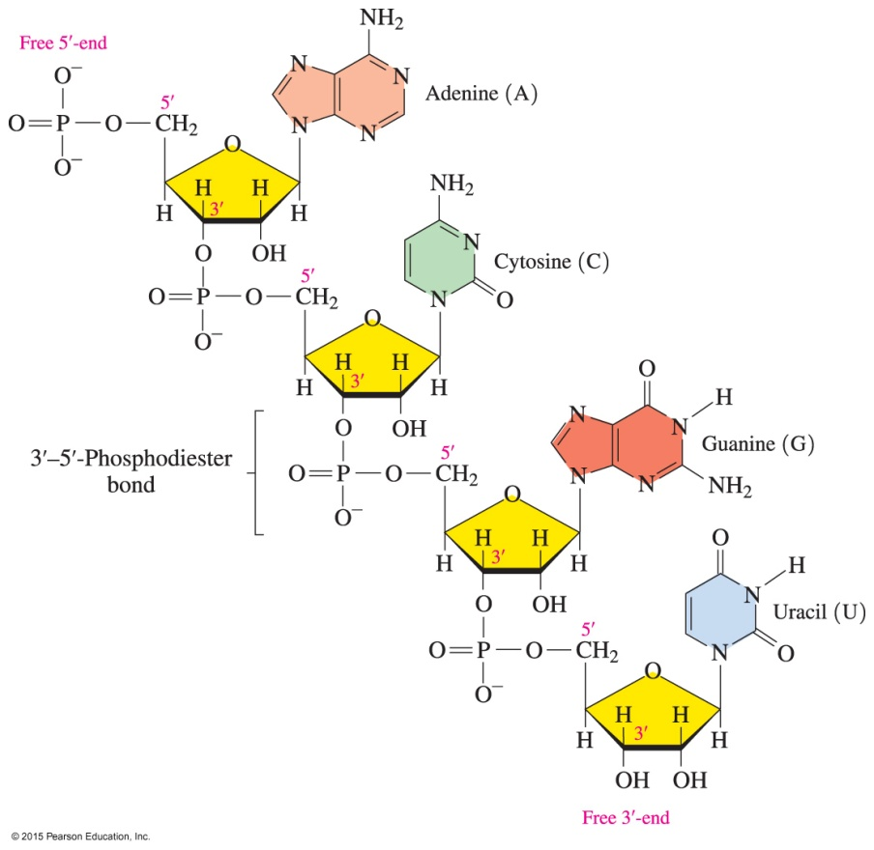
17.2 Primary Structure of Nucleic Acids
Each nucleic acid has its own unique sequence of bases that carries the genetic information from one cell to the next.
Learning Goal Describe the primary structures of DNA and RNA.

Slide 2
Nucleic Acid Structure
Nucleic acids
are polymers of many nucleotides in which the 3′-hydroxyl group of the sugar in one nucleotide bonds to the phosphate group on the 5′-carbon atom in the sugar of the next nucleotide
have a unique sequence of bases, which is called their primary structure
have one terminal end with an unreacted or free sugar with a 5′-phosphate
have a sugar at the other end with a free 3′-hydroxyl group

Slide 3
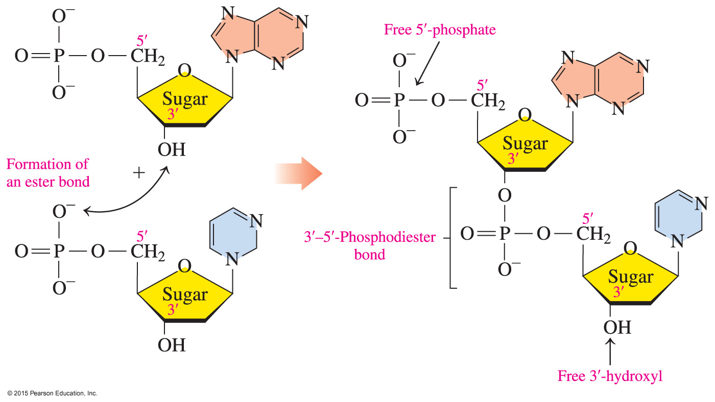
Nucleic Acid Structure
The link between the sugars in adjacent nucleotides is referred to as a phosphodiester bond.

Slide 4
Study Check
Draw the condensed structural formula for the RNA dinucleotide formed by two cytidine-5′-monophosphates.

Slide 5
Solution
Draw the condensed structural formula for the RNA dinucleotide formed by two cytidine-5′-monophosphates.
SOLUTION:
The dinucleotide is drawn by connecting the 3′-hydroxyl group on the first cytidine-5′-monophosphate with the 5′-phosphate group on the second.

Slide 6
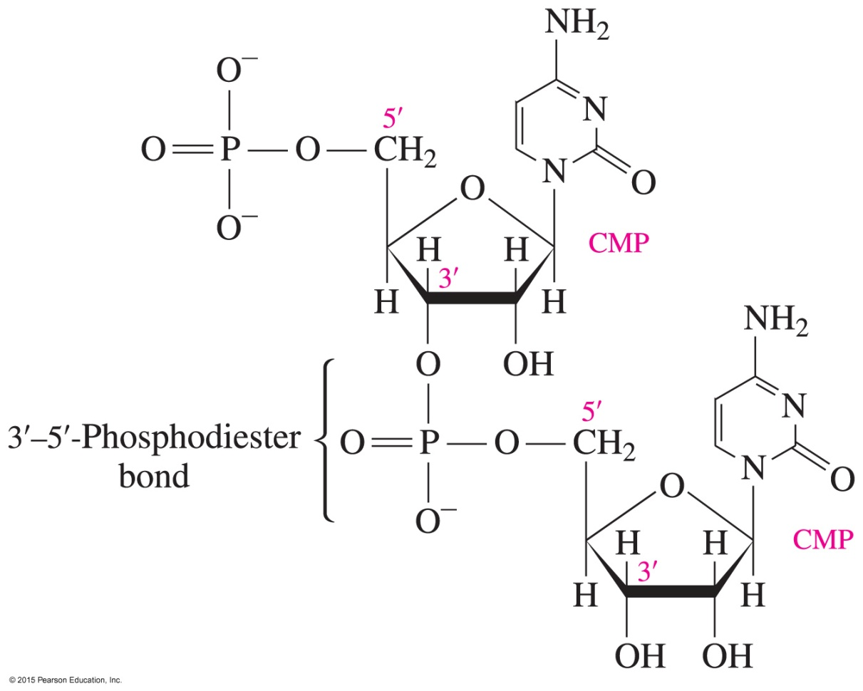
Solution
Draw the condensed structural formula for the RNA dinucleotide formed by two cytidine-5′-monophosphates.

Slide 7
Nucleic Acid Sequence
A nucleic acid sequence is read from the sugar with free 5′-phosphate to the sugar with the free 3′-hydroxyl group.
The sequence is written using the letters of the bases: — A C G U —

Slide 8
Study Check
Fill in the blank.
In a nucleic acid, the nucleotides are joined by a
_____________ bond that joins the 3′-OH group of the sugar to the phosphate group on the 5′C on the next nucleotide.

Slide 9
Solution
Fill in the blank:
In a nucleic acid, the nucleotides are joined by a phosphodiester bond that joins the 3′-OH group of the sugar to the phosphate group on the 5′C on the next nucleotide.

Slide 10
Study Check
In the nucleic acid — C G A U —, which base is at the free
5′-phosphate end?
cytosine
uracil
thymine
adenine

Slide 11
Solution
In the nucleic acid — C G A U —, which base is at the free
5′-phosphate end?
cytosine
uracil
thymine
adenine
The correct answer is A. Cytosine is at the free 5′-phosphate end.

