Slide 1
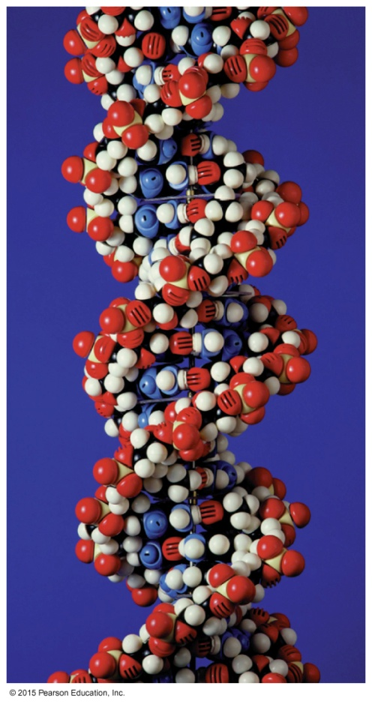
17.3 DNA Double Helix
An atomic model of a DNA molecule shows the double helix as the characteristic shape of DNA molecules.
Learning Goal Describe the double helix of DNA and the process of DNA replication.

Slide 2
DNA Base Pairs
During the 1940s, biologists determined that the bases in DNA had a specific relationship:
the amount of adenine (A) was equal to the amount of thymine (T)
the amount of guanine (G) was equal to the amount of cytosine (C)
Scientists subsequently determined that adenine is always paired with thymine, and guanine is always paired with cytosine.
Number of purine bases = Number of pyrimidine bases
Adenine (A) = Thymine (T)
Guanine (G) = Cytosine (C)

Slide 3
James Watson and Francis Crick
In 1953 James Watson and Francis Crick proposed that DNA was a double helix that
consisted of two polynucleotide strands winding about each other like a spiral staircase
contained sugar–phosphate backbones analogous to outside stair railings with the bases arranged like steps along the inside
has one strand that goes from the 5′ to 3′ direction next to a second strand that goes from the 3′ to 5′ direction

Slide 4
Complementary Base Pairs
DNA contains complementary base pairs, equal amounts of A and T and equal amounts of G and C bases in which
adenine is linked only to thymine by two hydrogen bonds
guanine is linked only to cytosine by three hydrogen bonds

Slide 5
DNA Double Helix
A double helix
has two strands of nucleotides that wind together
is held in place by two hydrogen bonds that form between the base pairs AT
is held in place by three hydrogen bonds that form between the base pairs GC

Slide 6
DNA Double Helix
The two strands of the double helix are held together by hydrogen bonds that link bases A and T and G and C.

Slide 7
Study Check
Write the complementary base sequence for the matching strand in the following DNA section:
—A—G—T—C—C—A—A—T—C—

Slide 8
Solution
Write the complementary base sequence for the matching strand in the following DNA section:
—A—G—T—C—C—A—A—T—C—
—T—C—A—G—G—T—T—A—G—

Slide 9
DNA Replication
As cells divide, copies of DNA are produced that transfer genetic information to the new cells.
In DNA replication,
the strands in the original or parent DNA molecule separate to allow the synthesis of complementary DNA strands
an enzyme called helicase catalyzes the unwinding of a part of the double helix by breaking the hydrogen bonds between the complementary bases
the resulting single strands act as templates for the synthesis of new complementary strands of DNA

Slide 10
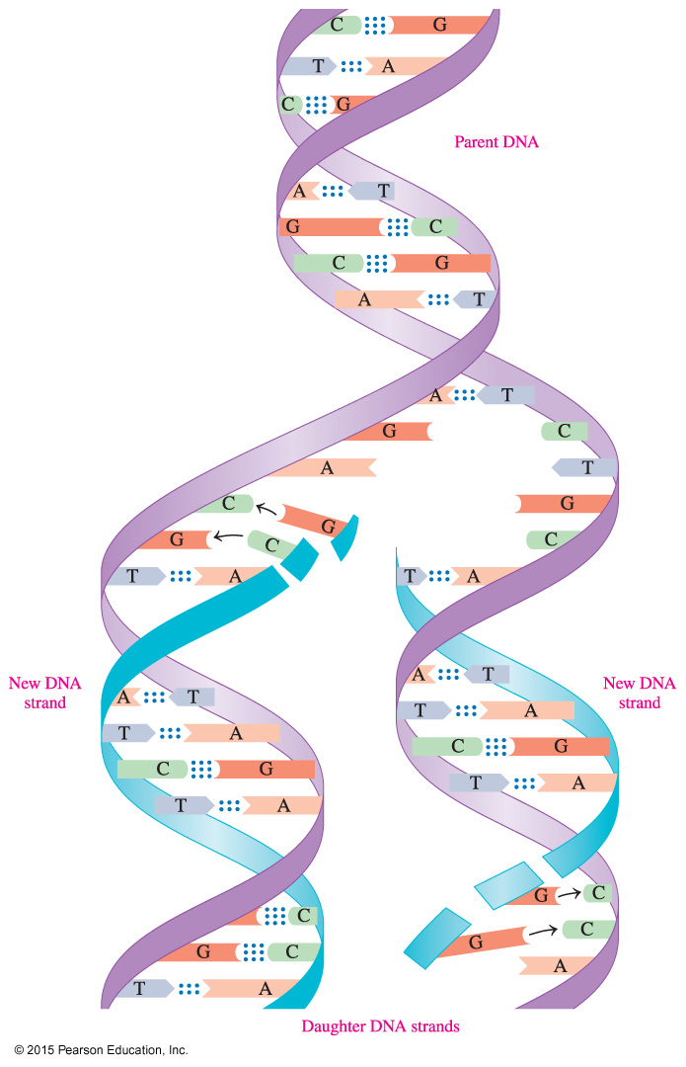
DNA Replication
In DNA replication, the separate strands of the parent DNA are the templates for the synthesis of complementary strands, which produces two exact copies of DNA.

Slide 11
DNA Replication
As the complementary base pairs come together,
DNA polymerase catalyzes the formation of phosphodiester bonds between the nucleotides
the entire double helix of the parent DNA is copied
This process produces two new DNA strands, identical to each other and exact copies of the parent DNA. They are called daughter DNA.
Complementary base pairing ensures the correct placement of bases in the new DNA strands.

Slide 12
Study Check
How many hydrogen bonds link each of the following
base pairs?
A. A — T
B. G — C

Slide 13
Solution
How many hydrogen bonds link each of the following
base pairs?
A. A — T bases are linked by two hydrogen bonds.
B. G — C bases are linked by three hydrogen bonds.

Slide 14
Chemistry Link to Health: DNA Fingerprinting
In a process called DNA fingerprinting,
enzymes are used to cut DNA strands into smaller sections
the resulting fragments are separated by size and treated with a radioactive isotope that adheres to specific base sequences
the resulting pattern of bands is known as a DNA fingerprint
One application of DNA fingerprinting is in forensic science, in which DNA from samples such as blood, hair, or semen is used to connect a suspect with a crime.

Slide 15
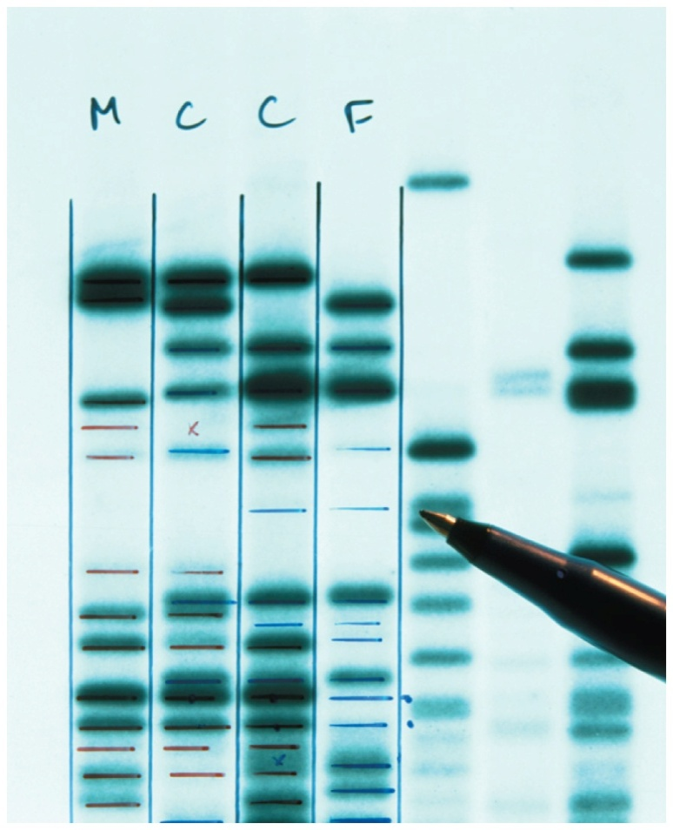
Chemistry Link to Health: DNA Fingerprinting
Dark and light bands on X-ray film show up as a result of the radioactive isotope that adheres to specific sequences.

