Slide 1
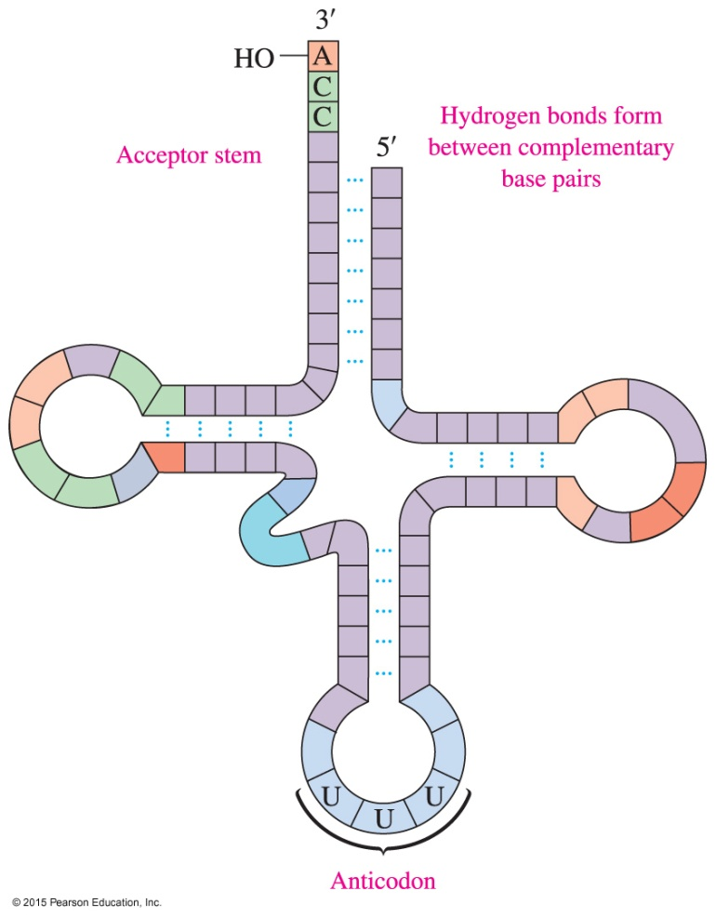
17.4 RNA and the Genetic Code
A typical tRNA molecule has a cloverleaf shape when hydrogen bonds form between complementary bases within the tRNA. The acceptor stem attaches to an amino acid and its anticodon bonds with a codon on mRNA.
Learning Goal Identify the different types of RNA; describe the synthesis of mRNA.

Slide 2
RNA and the Genetic Code
RNA
makes up most of the nucleic acid found in the cell
transmits the genetic information needed for cell operation
molecules are polymers of nucleotides and differ from DNA molecules in four ways:
1. The sugar in RNA is ribose rather than the deoxyribose
found in DNA.
2. The base uracil replaces thymine.
3. RNA molecules are single stranded; DNA is double
stranded.
4. RNA molecules are much smaller than DNA molecules.

Slide 3
Types of RNA
RNA transmits information from DNA to make proteins and has several types:
Messenger RNA (mRNA) carries genetic information from DNA in the nucleus to the ribosomes in the cytoplasm.
Transfer RNA (tRNA) interprets the genetic information in mRNA and brings specific amino acids to the ribosome for protein synthesis.
Ribosomal RNA (rRNA), the most abundant type of RNA, is combined with proteins to form ribosomes.

Slide 4
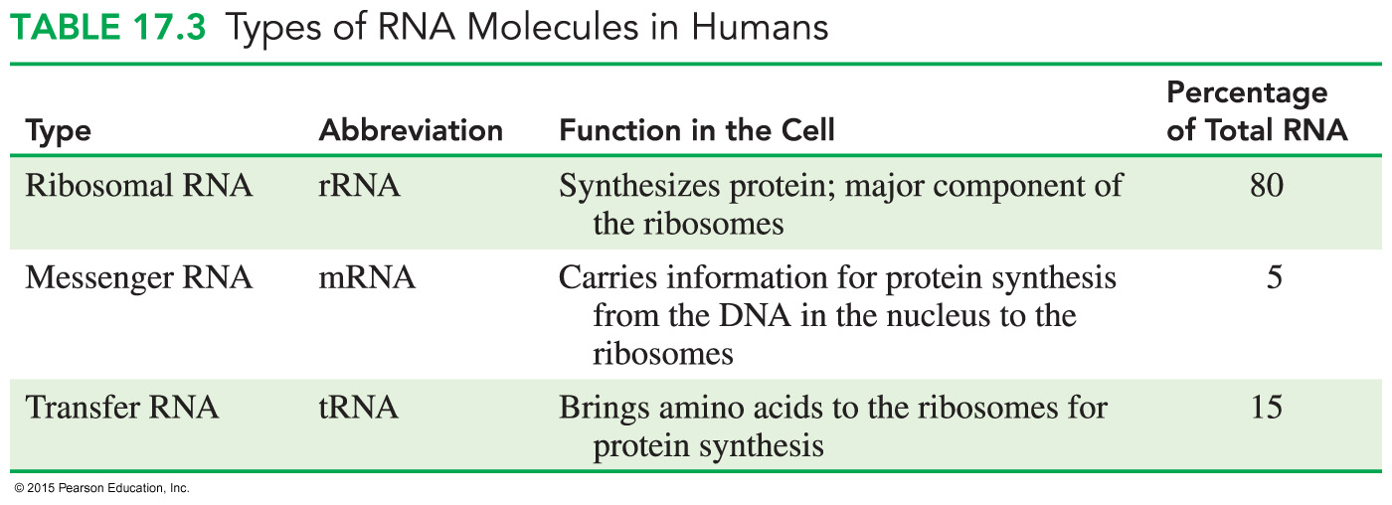
Types of RNA in Humans

Slide 5
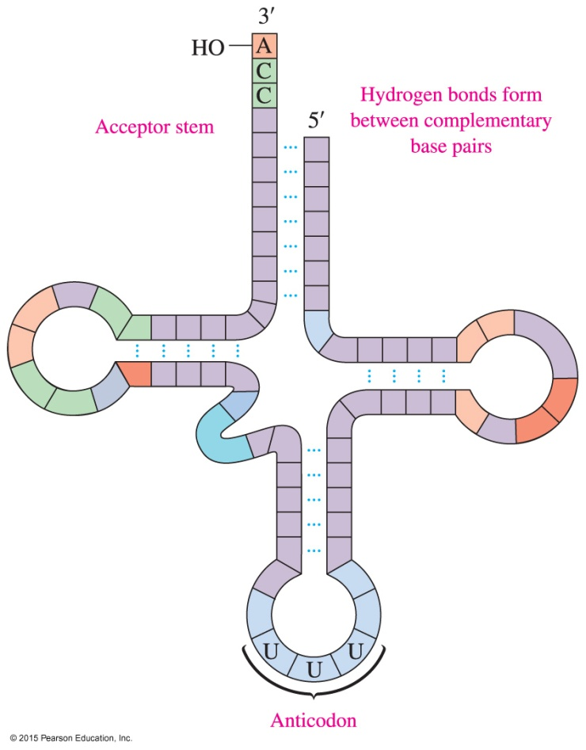
tRNA
tRNA structures
are similar, consisting of 70 to 90 nucleotides
have a 3′-end with the nucleotide sequence ACC, which is known as the acceptor stem
contain an anticodon, which is a series of three bases that complements three bases on mRNA

Slide 6
Protein Synthesis
Protein synthesis involves
transcription: in the nucleus, genetic information for the synthesis of a protein is copied from a gene in DNA to make mRNA
translation: tRNA molecules convert the information in the mRNA into amino acids, which are placed in the proper sequence to synthesize a protein

Slide 7
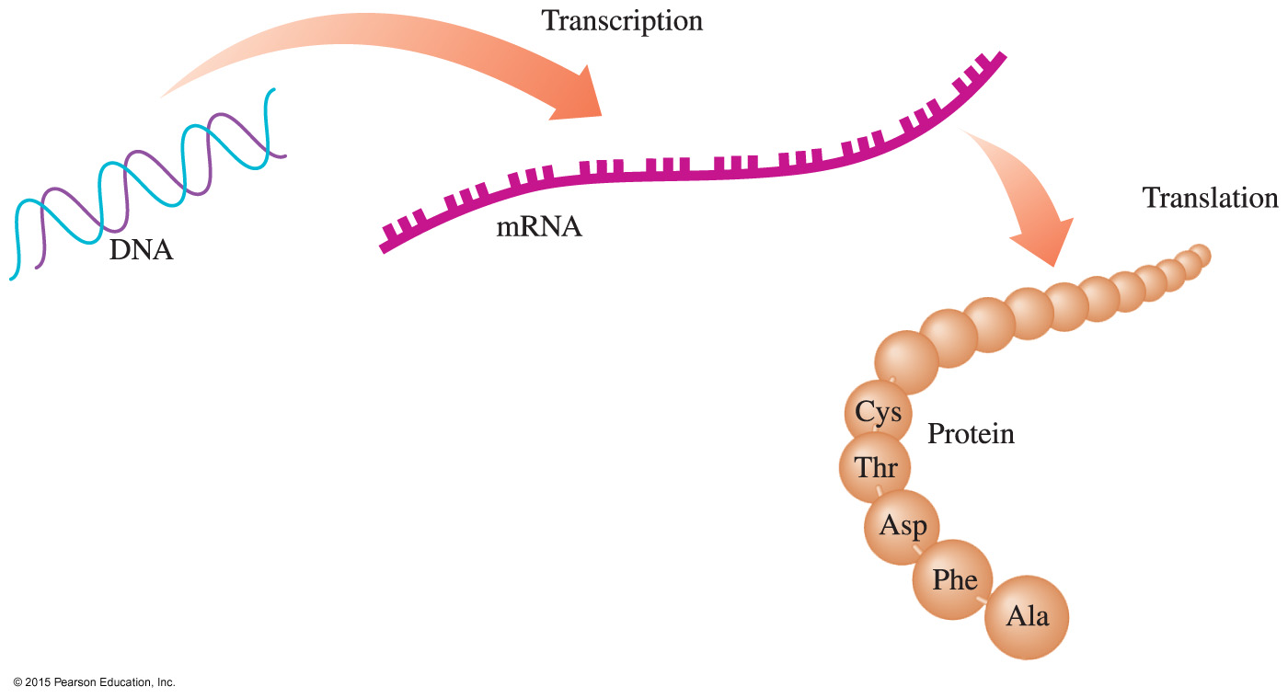
Protein Synthesis
The genetic information in DNA is replicated in cell division and used to produce mRNAs that code for the amino acids needed for protein synthesis.

Slide 8
Protein Synthesis: Transcription
Transcription begins when a section of DNA containing the gene unwinds and an RNA polymerase enzyme uses one of the strands as a template to synthesize mRNA.
mRNA is synthesized using complementary base pairing, with uracil (U) pairing with adenine in DNA.
The newly formed mRNA moves out of the nucleus to ribosomes in the cytoplasm.

Slide 9
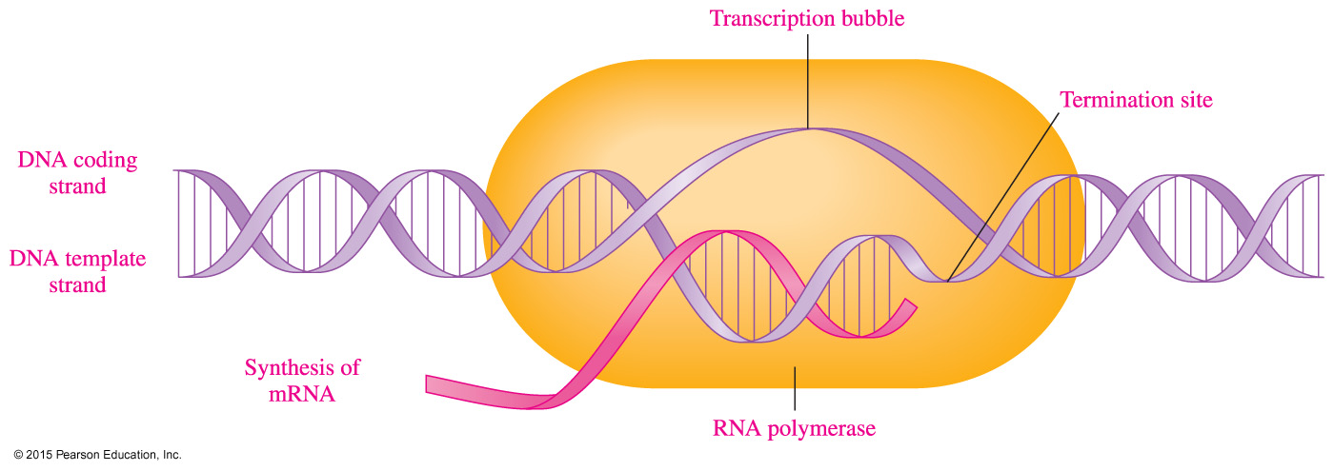
RNA Polymerase
During transcription,
RNA polymerase moves along the DNA template to synthesize the corresponding mRNA
the mRNA is released at the termination point

Slide 10
Study Check
What is the sequence of bases in mRNA produced from a section of the template strand of DNA that has the sequence of bases — C — T — A — A — G — G —?
A. — G — A — T — T — C — C —
B. — G — A — U — U — C — C —
C. — C — T — A — A — G — G —

Slide 11
Solution
What is the sequence of bases in mRNA produced from a section of the template strand of DNA that has the sequence of bases — C — T — A — A — G — G —?
— C — T — A — A — G — G —
B. — G — A — U — U — C — C —

Slide 12
Genetic Code
The genetic code consists of a series of three nucleotides (triplets) in mRNA called codons that specify the amino acids and their sequence in the protein.

Slide 13
Genetic Code
Codons have been determined for all 20 amino acids needed to build a protein.
At the beginning of mRNA, the codon AUG signals the start of protein synthesis.
A total of 64 codons are possible from the triplet combinations of A, G, C, and U.
A codon stop signal of UGA, UAA, and UAG in mRNA signals for the termination of protein synthesis.
Core Chemistry Skill Writing the Amino Acid for an mRNA Codon

Slide 14
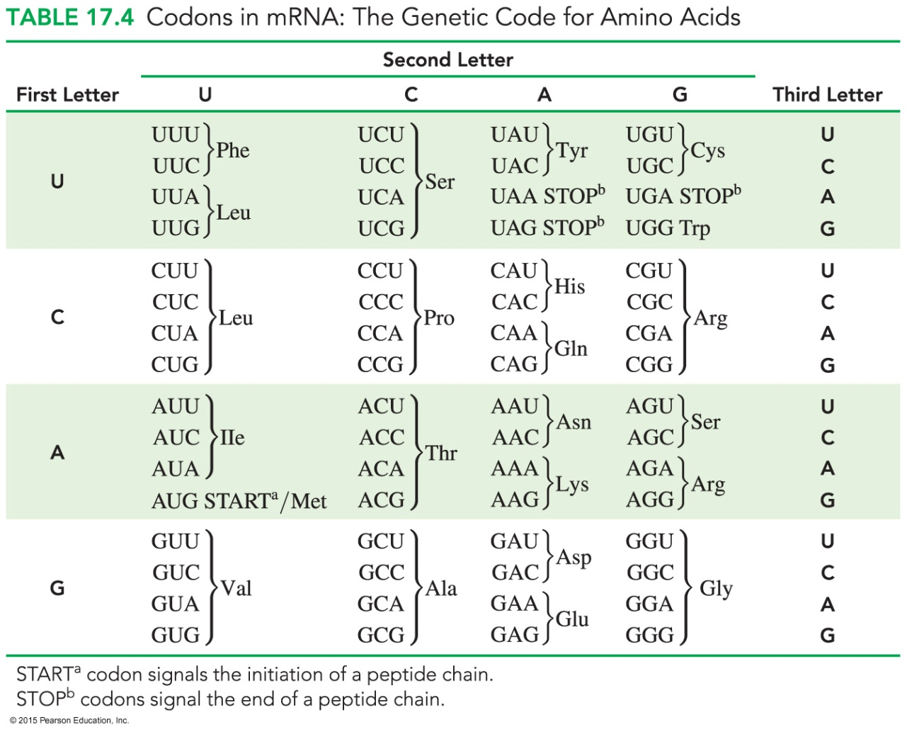
Codons in mRNA: The Genetic Code for Amino Acids
All other three-base codons designate a specific amino acid:

Slide 15
Codons and Amino Acids
Determine the amino acids from the following
codons in a section of mRNA.
— CCU — AGC — GGA — CUU —
According to the genetic code, the amino acids for these
codons are
CCU = proline AGC = serine
GGA = glycine CUU = leucine
This mRNA section codes for an amino acid sequence of
— CCU — AGC — GGA — CUU —
— Pro — Ser — Gly — Leu —

Slide 16
Study Check
Write the order of amino acids coded for by a section of mRNA
with the base sequence
— GCC — GUA — GAC —
GGC = glycine GAC = aspartic acid
CUC = leucine GUA = valine
GCC = alanine CGC = arginine

Slide 17
Solution
GGC = glycine GAC = aspartic acid
CUC = leucine GUA = valine
GCC = alanine CGC = arginine
— GCC — GUA — GAC —
Ala — Val — Asp

