Slide 1
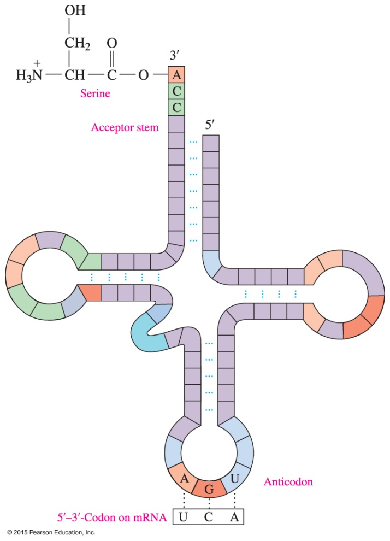
17.5 Protein Synthesis
In the translation process, tRNA molecules, amino acids, and enzymes convert the codons on mRNA to build a protein.
An activated tRNA with anticodon AGU bonds to serine at the acceptor stem.
Learning Goal Describe the process of protein synthesis from mRNA.

Slide 2
Activation of tRNA
Each tRNA contains
an anticodon, which is a triplet of bases that complements a codon in mRNA
an acceptor stem, which forms an ester bond with a specific amino acid
Activation of tRNA occurs when aminoacyl–tRNA synthetase forms an ester bond between the carboxylate group of its amino acid and the hydroxyl group on the acceptor stem.

Slide 3
Initiation and Chain Elongation
Protein synthesis begins when mRNA binds to a ribosome.
The first codon in mRNA is a start codon, AUG, which forms hydrogen bonds to methionine−tRNA.
Another tRNA hydrogen bonds to the next codon, placing a second amino acid adjacent to methionine.
A peptide bond forms between the C-terminal of methionine and the N-terminal of the second amino acid.

Slide 4
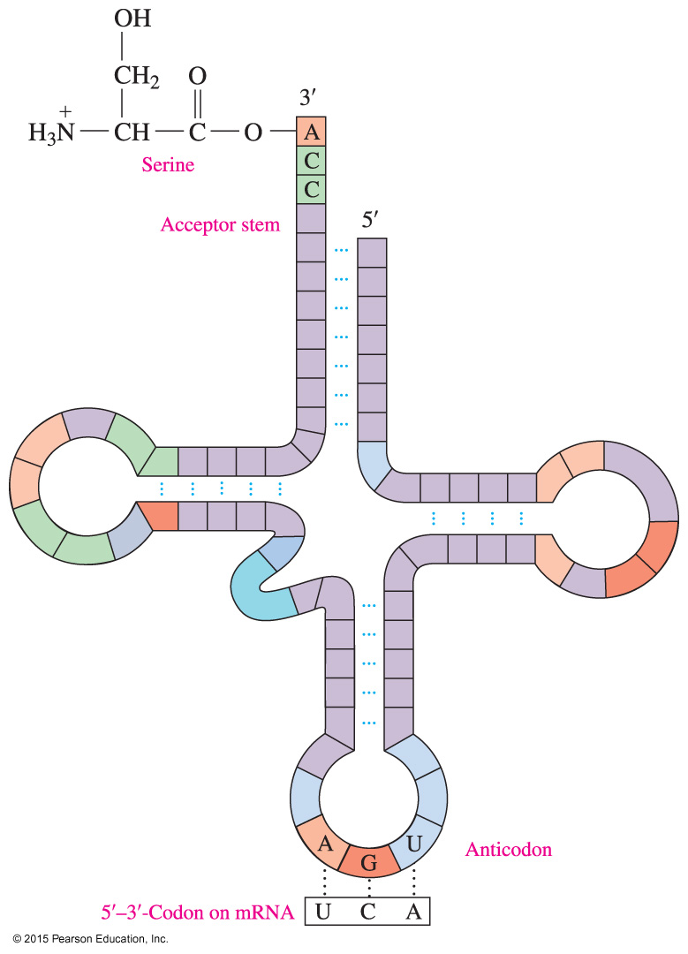
Initiation and Chain Elongation
An activated tRNA with anticodon AGU bonds to serine at the acceptor stem.

Slide 5
Translocation and Chain Elongation
The initial tRNA detaches from the ribosome, which shifts to the next available codon, a process called translocation.
During chain elongation, the ribosome moves along the mRNA from codon to codon, so that the tRNAs can attach new amino acids to the growing protein chain.

Slide 6
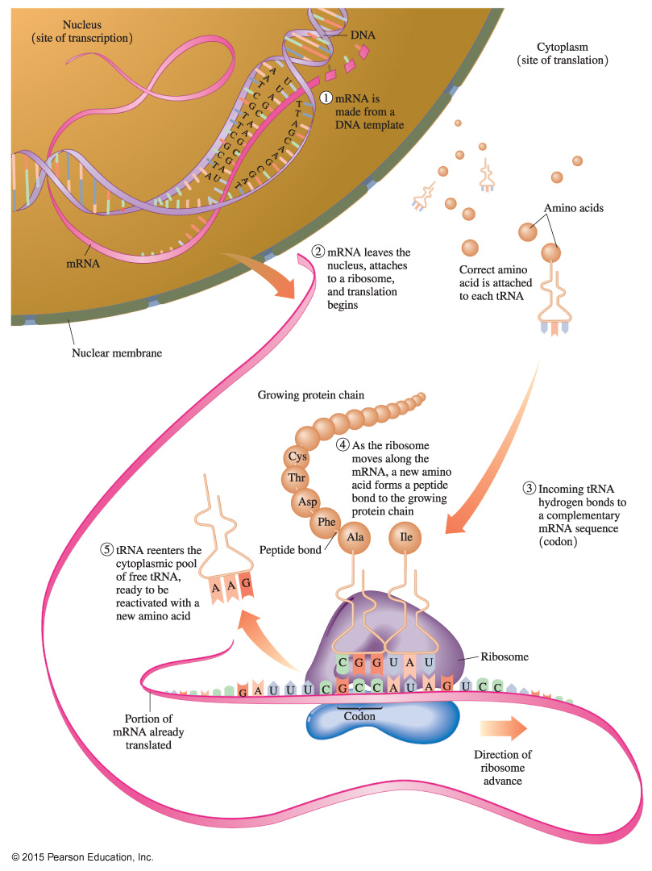
Protein Synthesis: Translation
In the translation process, the mRNA synthesized by transcription attaches to a ribosome, and tRNAs pick up their amino acids, bind to the appropriate codon, and place them in a growing protein chain.

Slide 7
Chain Termination
In the termination step,
all the amino acids are linked
the ribosome reaches a “stop” codon: UGA, UAA, or UAG
there is no tRNA with an anticodon for the “stop” codons
the polypeptide detaches from the ribosome
the initial amino acid, methionine, is usually removed from the beginning of the protein chain

Slide 8
Termination
Once the polypeptide is released,
the R groups of the amino acids in the new polypeptide can form hydrogen bonds to give the secondary structures of α helices, β-pleated sheets, or triple helices
chains form cross-links such as salt bridges and disulfide bonds to produce tertiary and quaternary structures, making it a biologically active protein

Slide 9
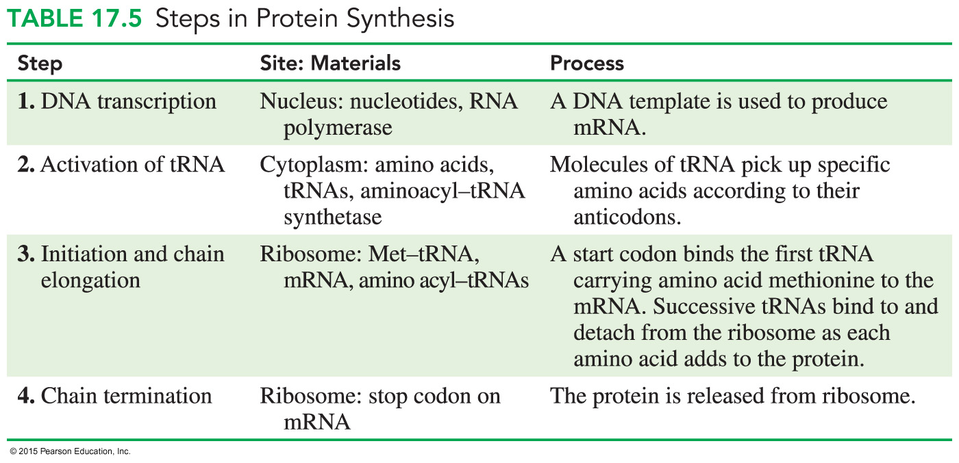
Steps in Protein Synthesis

Slide 10
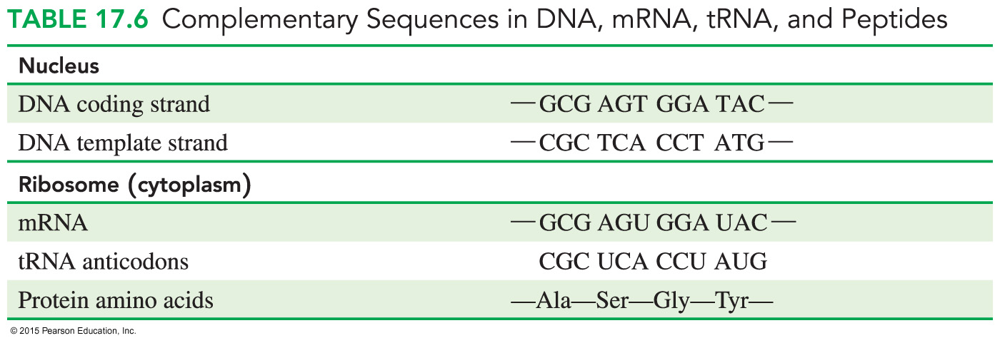
Complementary Sequences in DNA, mRNA, tRNA, and Peptides

Slide 11
Study Check
Match each of the following terms to a definition or concept:
activation initiation
translocation termination
A. Ribosomes move along mRNA, adding amino acids to a growing peptide chain.
B. A completed peptide chain is released.
C. A tRNA attaches to its specific amino acid.
D. A tRNA binds to the AUG codon of the mRNA on the ribosome.

Slide 12
Solution
Match each of the following terms to a definition or concept:
activation initiation
translocation termination
A. Ribosomes move along mRNA, adding amino acids to a growing peptide chain. translocation
B. A completed peptide chain is released. termination
C. A tRNA attaches to its specific amino acid. activation
D. A tRNA binds to the AUG codon of the mRNA on the ribosome. initiation

Slide 13
Study Check
The following section of DNA is used to build mRNA for a protein:
— GAA — CCC — TTT —
A. What is the corresponding mRNA sequence?
B. What are the anticodons on the tRNAs?
C. What is the amino acid order in the peptide?

Slide 14
Solution
The following section of DNA is used to build mRNA for a protein:
— GAA — CCC — TTT —
A. What is the corresponding mRNA sequence?
— CUU — GGG — AAA —
B. What are the anticodons for the tRNAs?
GAA for CUU; CCC for GGG; UUU for AAA
C. What is the amino acid order in the peptide?
— CUU — GGG — AAA —
Leu — Gly — Lys

Slide 15
Study Check
Place the following statements in order of their occurrence in
protein synthesis:
A. mRNA attaches to a ribosome.
B. The ribosome moves along mRNA to add amino acids to
the growing peptide chain.
C. A completed polypeptide is released.
D. A tRNA brings an amino acid to its codon on mRNA.
E. DNA produces mRNA.

Slide 16
Solution
Place the following statements in order of their occurrence in
protein synthesis:
E. DNA produces mRNA.
A. mRNA attaches to a ribosome.
D. A tRNA brings an amino acid to its codon on mRNA.
B. The ribosome moves along mRNA to add amino acids to
the growing peptide chain.
C. A completed polypeptide is released.

