Slide 1
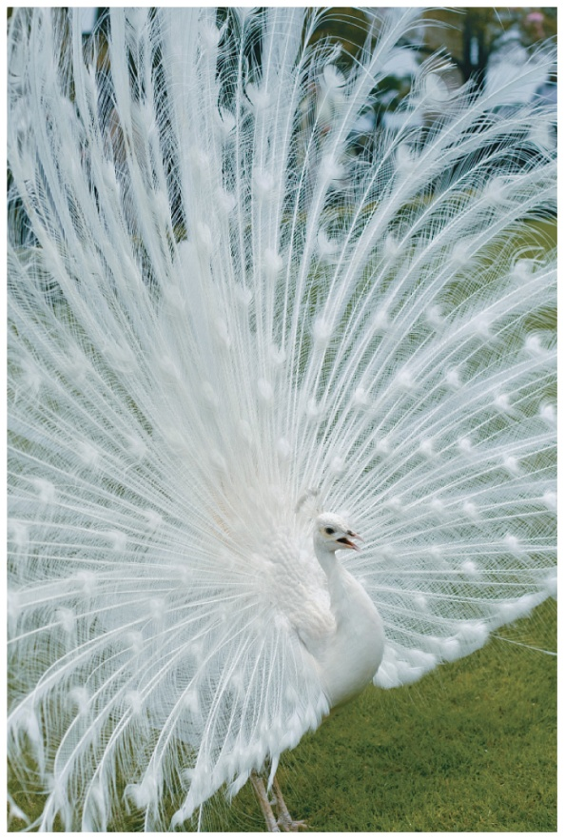
17.6 Genetic Mutations
If the enzyme that converts tyrosine to melanin is defective, no melanin is produced and a genetic disease known as albinism results.
A peacock with albinism does not produce the melanin needed to make the bright colors of its feathers.
Learning Goal Describe some ways in which DNA is altered to cause mutations.

Slide 2
Mutations
A mutation, or change in the nucleotide sequence of DNA, may
alter the sequence of amino acids
affect the structure and function of a protein in a cell
Mutations may result from
X-rays
overexposure to sun (ultraviolet, or UV, light)
chemicals called mutagens
some viruses

Slide 3
Mutations
If a mutation occurs in a somatic cell, a cell other than a reproductive cell, the altered DNA will be limited to that cell and its daughter cells.
If the mutation causes uncontrolled growth, cancer could result.
If a mutation occurs in a germ cell (egg or sperm), then all the DNA produced in a new individual will contain the same genetic change.

Slide 4
Types of Mutations
A substitution or point mutation is the replacement of one base in the template strand of DNA with another.
If a substitution or point mutation changes the nucleotide, a different amino acid may be inserted into the polypeptide.
If this produces no change in the amino acid sequence, it is called a silent mutation.
A frameshift mutation is the insertion or deletion of a single nucleotide into the sequence resulting in a change to all subsequent codons, leading to a new amino acid sequence.

Slide 5
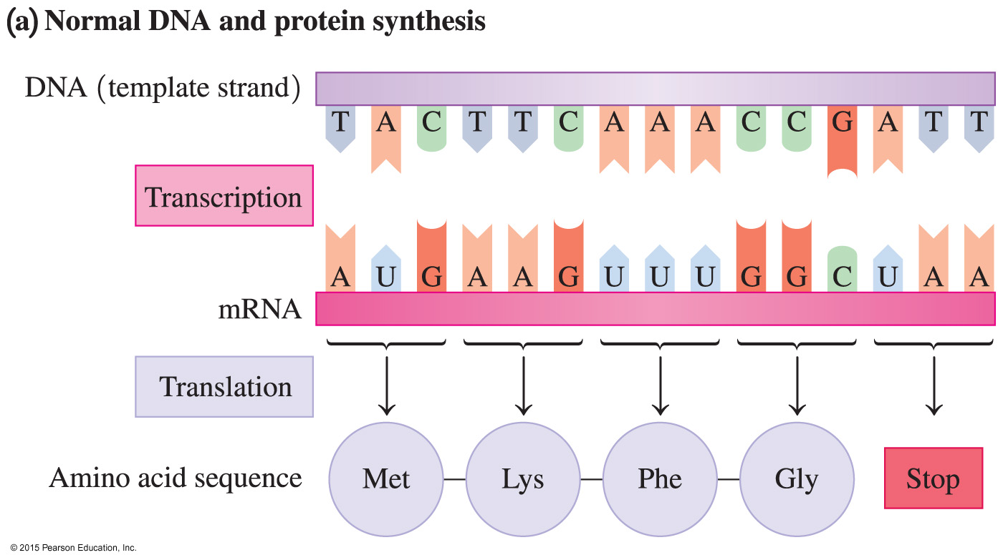
Normal DNA and Protein Synthesis
The normal DNA sequence produces an mRNA that provides instructions for the correct series of amino acids in a protein.

Slide 6
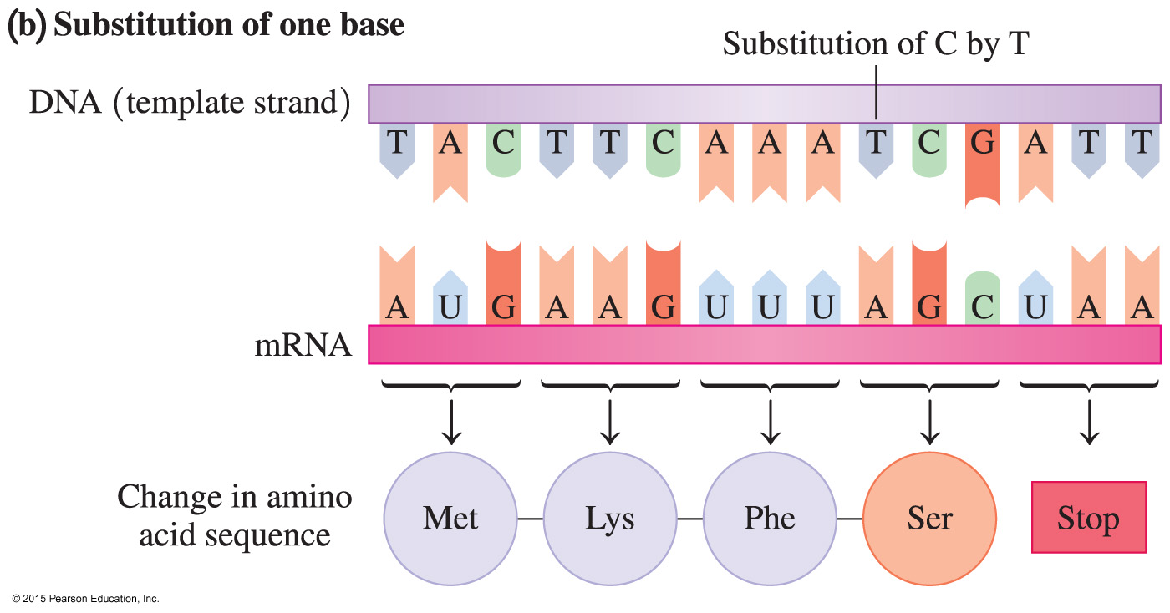
Mutation: Substitution
Substitution of a base in DNA changes a codon in the mRNA, leading to the placement of an incorrect amino acid in the polypeptide.

Slide 7
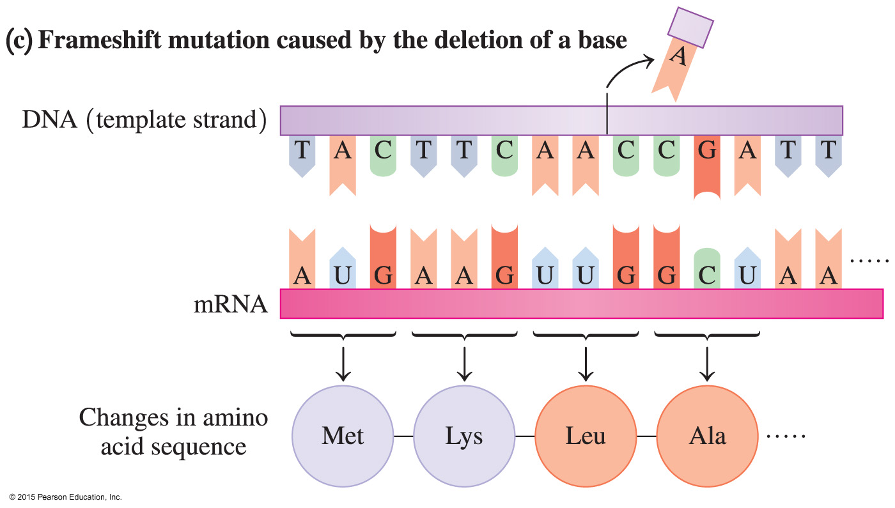
Frameshift Mutation
The deletion of a base causes a frameshift mutation, which changes the mRNA codons that follow the mutation and produces a different amino acid sequence.

Slide 8
Effect of Mutations
When a mutation causes a change in the amino acid sequence, the structure of the resulting protein may be severely altered, causing loss of its biological activity.
When this condition is hereditary, it is called a genetic disease.

Slide 9
Genetic Diseases
A genetic disease is the result of a defective enzyme caused by a mutation in its genetic code. For example,
phenylketonuria (PKU) results when DNA cannot direct the synthesis of the enzyme phenylalanine hydroxylase, required for the conversion of phenylalanine to tyrosine
albinism results when the enzyme that converts tyrosine to melanin is defective

Slide 10
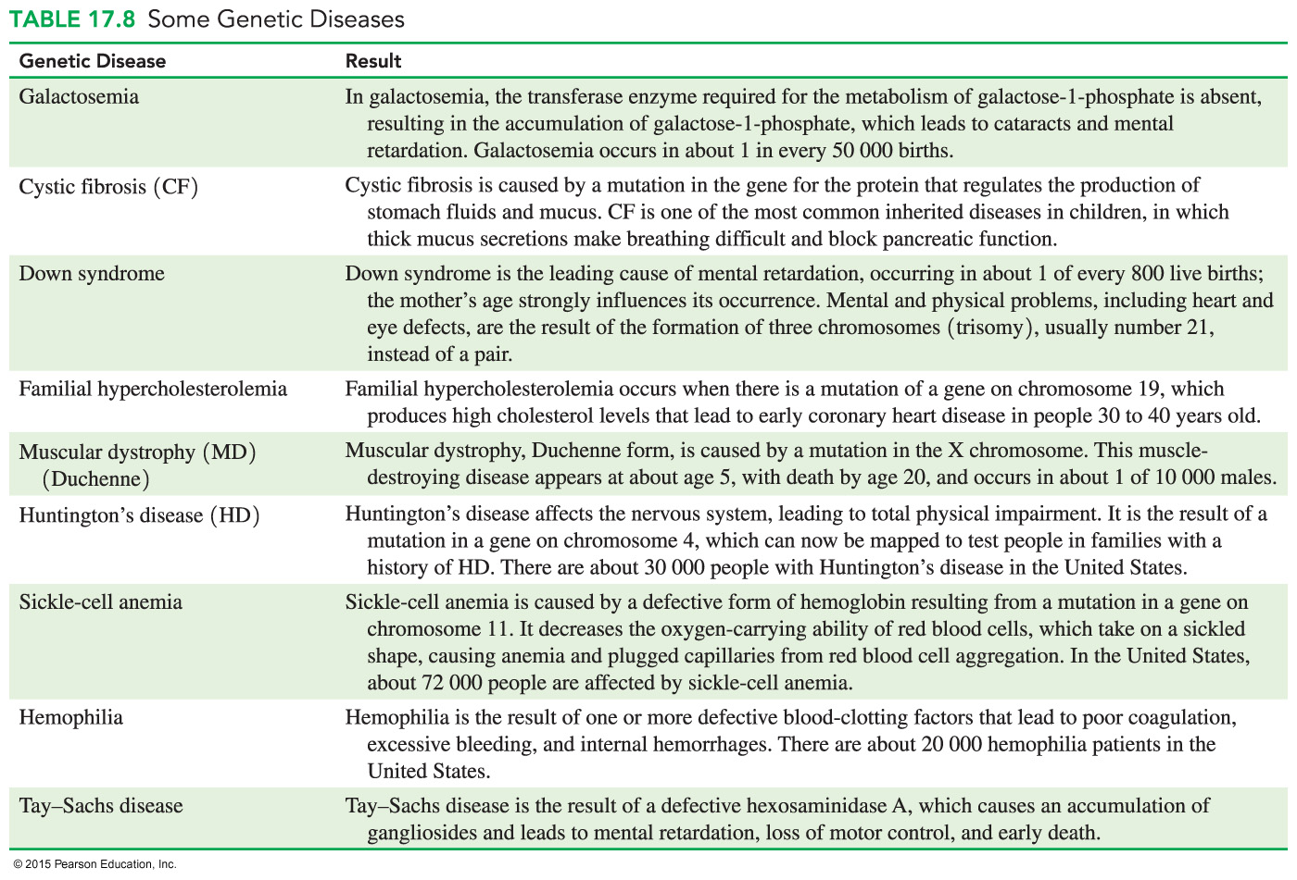
Genetic Diseases

Slide 11
Study Check
Identify each type of mutation as a substitution or frameshift.
A. Cytosine (C) enters the DNA sequence.
B. One adenosine is removed from the DNA sequence.
C. A base sequence of TGA in DNA changes to TAA.

Slide 12
Solution
Identify each type of mutation as a substitution or frameshift.
A. Cytosine (C) enters the DNA sequence. frameshift
B. One adenosine is removed from the DNA sequence.
frameshift
C. A base sequence of TGA in DNA changes to TAA.
substitution

