Slide 1
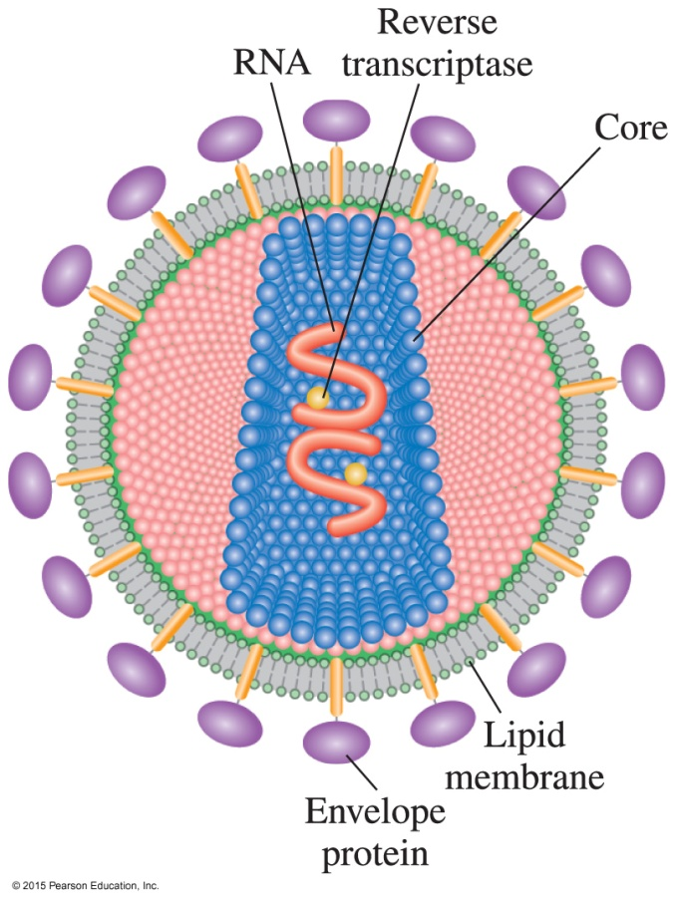
17.7 Viruses
HIV causes AIDS, which destroys the immune system in the body. HIV is a retrovirus that infects and destroys T4 lymphocyte cells, which are involved in the immune response.
Learning Goal Describe the methods by which a virus infects a cell.

Slide 2
Viruses
Viruses
are small particles of 3 to 200 genes that require a host cell to replicate
contain a nucleic acid—DNA or RNA, but not both—inside a protein coat
do not have the necessary material, such as nucleotides and enzymes, to make proteins and grow
replicate by invading a host cell and taking over the machinery and materials necessary for protein synthesis and growth

Slide 3
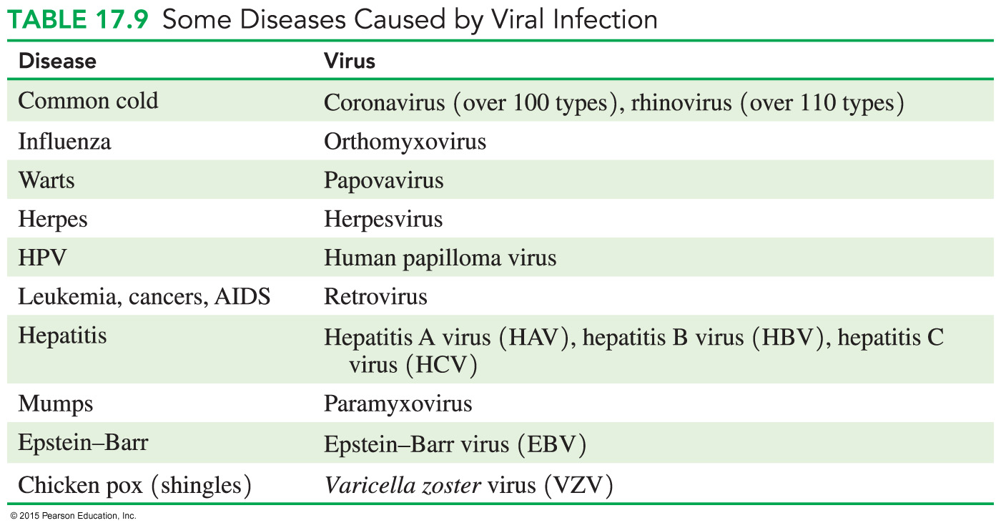
Some Diseases Caused by Viruses

Slide 4
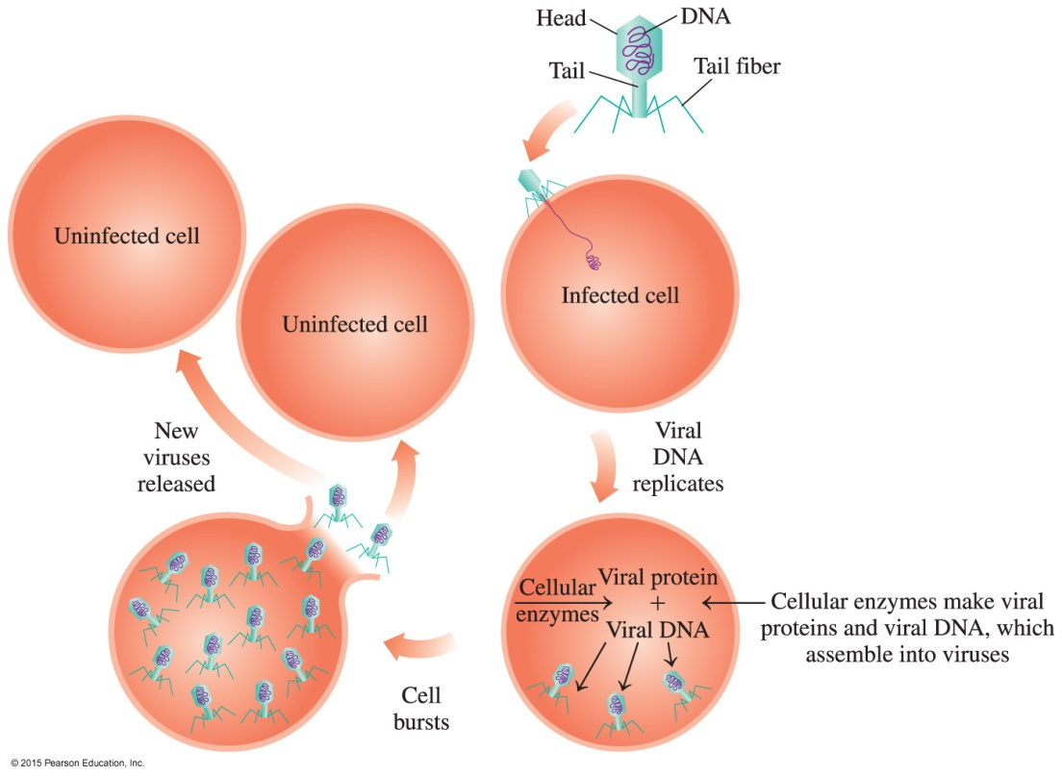
Viruses
A virus
attaches to the host cell and injects its viral DNA
uses the host cell’s amino acids to synthesize viral protein
uses the host cell’s contents to make viral RNA
When the cell bursts, the new viruses are released to infect other cells.

Slide 5
Viral Infection
A viral infection begins when
a virus enzyme makes a hole in the host cell wall
the viral nucleic acids enter and mix with the materials in the host cell
the host cell begins to replicate the viral DNA (if the virus contains DNA)
viral DNA produces viral RNA, and a protease processes proteins to produce a protein coat to form a viral particle that leaves the cell
the cell synthesizes so many virus particles that it releases new viruses to infect more cells

Slide 6
Reverse Transcription
In reverse transcription,
a retrovirus, which contains viral RNA but no viral DNA, enters a cell
the viral RNA uses reverse transcriptase to produce a viral DNA strand
the viral DNA strand forms a complementary DNA strand
the new DNA uses the nucleotides and enzymes in the host cell to synthesize new virus particles

Slide 7
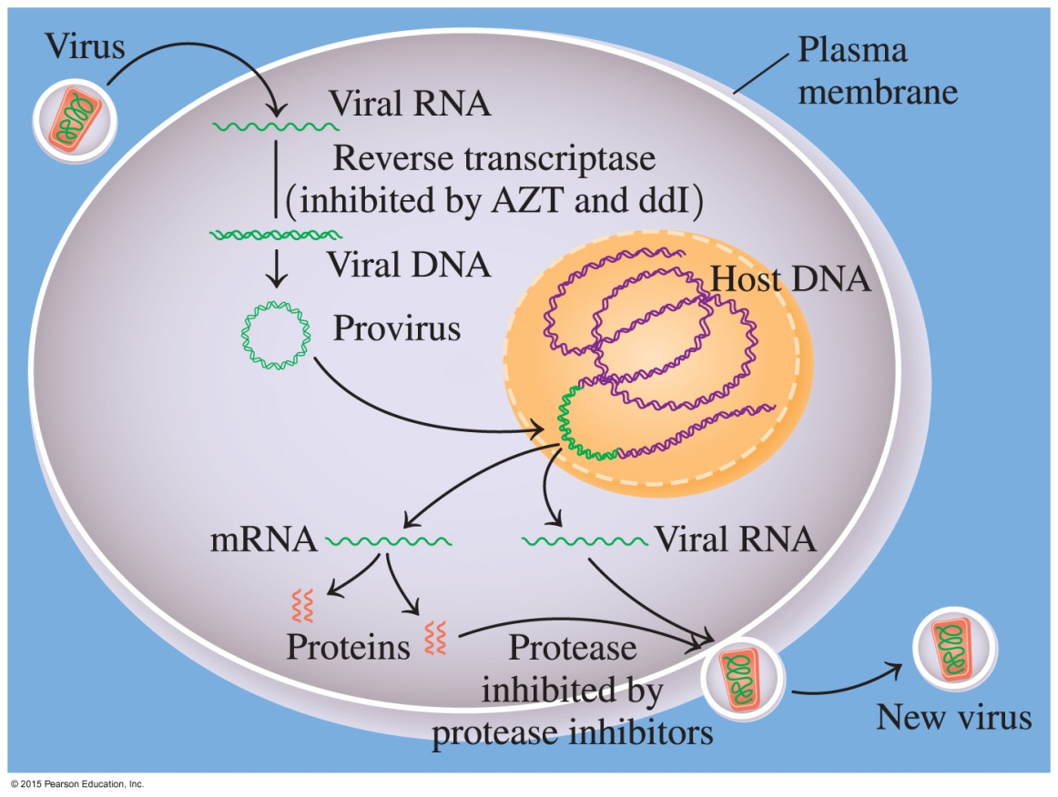
Reverse Transcription
After a retrovirus injects its viral RNA into a cell, it forms a DNA strand by reverse transcription.
The DNA forms a double-stranded DNA called a provirus, which joins the host cell’s DNA.
When the cell replicates, the provirus produces the viral RNA needed to produce more virus particles.

Slide 8
HIV and AIDS
The HIV-1 virus
is a retrovirus that infects T4 lymphocyte cells
decreases the T4 level and the immune system fails to destroy harmful organisms
causes pneumonia and skin cancer associated with AIDS

Slide 9
AIDS Treatment
Treatment for AIDS is based on attacking HIV-1 at different points in its life cycle, such as prevention of reverse transcription of the viral DNA and protein synthesis.
For example, AZT, similar to thymidine, mimics the structures of the nucleosides used for DNA synthesis, which inhibit the reverse transcriptase enzyme.
Lexiva is a protease inhibitor that prevents protein synthesis used by viruses to make more copies.

Slide 10
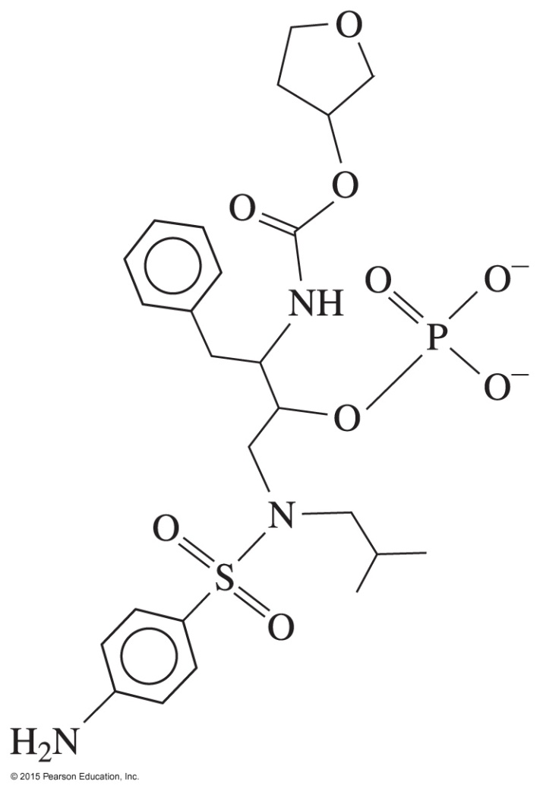
AIDS Treatment
Azidothymidine (AZT) Lexiva

Slide 11
Study Check
Match the following terms with the descriptions below:
virus retrovirus
protease inhibitor reverse transcription
A. a virus containing RNA
B. a small particle requiring a host cell to replicate
C. a substance that prevents the synthesis of viral proteins
D. using viral RNA to synthesize viral DNA

Slide 12
Solution
Match the following terms with the descriptions below:
virus retrovirus
protease inhibitor reverse transcription
A. a virus containing RNA retrovirus
B. a small particle requiring a host cell to replicate
virus
C. a substance that prevents the synthesis of viral proteins
protease inhibitor
D. using viral RNA to synthesize viral DNA
reverse transcription

Slide 13
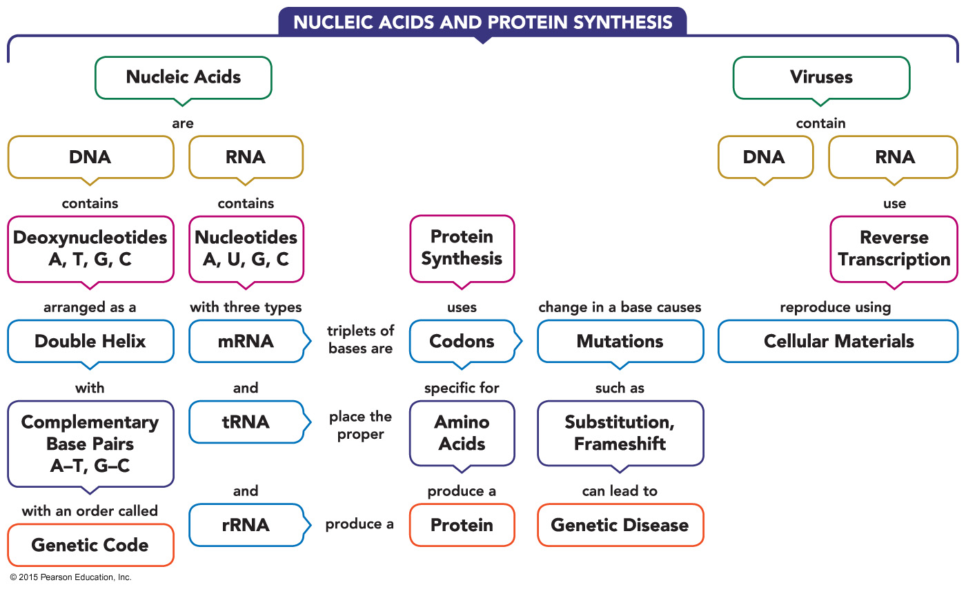
Nucleic Acids and Protein Synthesis—Concept Map

