Slide 1
Aphra Behn Oroonoko, The Royal Slave
By Shivani, Kiely, Manpreet, Richard, Andres and Jonathon

Slide 2
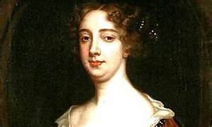
Aphra Behn 1640? – 1689
One of the first English professional female writers
Wrote plays, poetry, short stories, and novels
Little information is known about her early life
She may have been raised Catholic and educated in a convent abroad
1664 traveled to the new sugar colony of Surinam
1665 was a spy during the trade war for King Charles II
1670 published her first plays
1682 arrested for the “abusive reflections” on the king’s illegitimate son, the Whig duke of Monmouth
Part of the social world of the playhouse and the court

Slide 3
Cultural Criticism
challenged with expressing themselves in a patriarchal system that generally refused to grant merit to women's views.
modern feminism was nonexistent used other subversive and creative methods.
Educated was not advocated believed it went against traditional female virtues of innocence and morality.
Women who went against were in risk of being exiled from their communities, and targeted to be involved in witch hunts.
Were allowed religious material, and expressed themselves through private letters and autobiographies.
Women were not allowed to go against their husbands political views, played small roles within their family and local community.

Slide 4
Historical Criticism
First to consider herself a writer by profession
Strongly supported by Feminist critics- “avocation of freedom for women”
Boldly attempted to overcome the barriers of seventeenth-century prejudices and rigid gender roles
Woolfe- “All women together, ought to let flowers fall upon the grave of Aphra Behn….for it was she who earned them the right to speak their minds.
“Behn’s writing unveils the homosocial roles of male rivalry in stimulating heterosexual desire for women and explores the ways in which cross dressing and masquerade complicate and destabilize gender relations.
Critics- Alexander Pope- “Imitation of Horace”- “The stage how loosely does Astraea tread who fairly puts all characters to bed”

Slide 5
Rise of Women
Women become much more prominent in theater and writing during the Restoration
Women can be actresses for the first time and many find their way to a career in theater
Although acting is not considered to be of higher class, many women are able to make their way into elite circles due to their association with men of the upper class who come to watch their plays
Women writers are beginning to appear during this time
Aphra Behn is the first woman writer to make a living as a professional writer
Though she is best known for pioneering the format of the novel, she first made her living from writing plays, primarily comedies
Wrote freely on the topic of women’s sexuality, as shown through The Disappointment
She is one of the most prolific dramatists of her time, second only to John Dryden

Slide 6
The Disappointment
A poem by Aphra Behn published in 1680.
The Disappointment: Aphra Behn’s Obsession with Desire, Shame and Honor
Virtue= virginity
Lysander's failure, Behn is concerned with Cloris's disappointment
Women are not sexually explicit at that time
Feminist view point

Slide 7
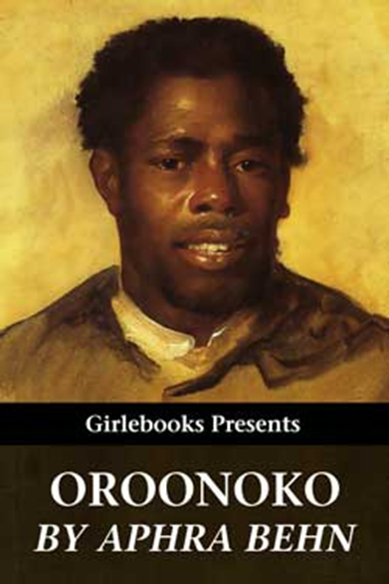

Slide 8
Oroonoko, or The Royal Slave
Published in 1688
A heroic love story
First philosophical novel in English
Female narrator
“Oroonoko cannot be classified as fact or fiction, realism or romance. In the still unshaped field of prose narrative – where a ‘history’ could mean any story, true or false – Behn combined the attractions of three older forms” – memoir, travel narrative, and a biography (Norton Anthology).

Slide 9
Freytag’s Pyramid of Oroonoko & Imoinda’s Love
Cesar kills his wife by decapitation.
Oroonoko reunites with Imionda. They resume their marriage and Clemene becomes pregnant.
Oroonoko and Imoinda and consummates their marriage. Once discovered, Imoinda is sold off into slavery.
Cesar mutilates himself by cutting out his intestines.
The King sends the royal veil to Imionda.
Oroonoko meets and marries Imoinda.
Cesar is punished by death – his genitals and arms were cut off, then his body quartered.

Slide 11
Slavery
In the eighteenth and nineteenth centuries Oroonoko was considered an anti-slavery novel
two members of disadvantaged groups: the hero of the story, the black male slave, and the white mistress who is his narrator.
Moor- Loosely used for any dark-skinned person.
oppression in Oroonoko is race and not gender
Behn writes of the horrors of slavery, she never suggests that it should be outlawed as an institution.
Oroonoko suffers as a slave; he never regrets taking slaves himself.
How can Oroonoko be both beautiful and yet black? The narrator's complex negotiation with racist stereo-types.

Slide 12
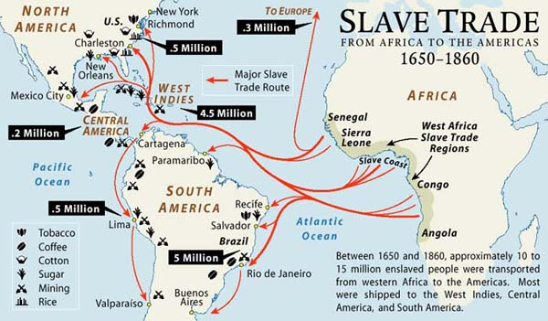

Slide 13
Multi-Cultural Background
During time of colonialism and slave trade
Oroonoko takes place in the sugar colony of Surinam as well as parts of Africa
Europeans are interacting with Native American Indians as well as African slaves
The politics and dealings between Europeans and Native American Indians and slaves are exposed in Oroonoko as seen through the tenuous peace between the colonists and the Native Americans as well as the treatment of the slaves by the colonists
Trade with China, Peru, and Brazil is mentioned in passing in Oroonoko

Slide 14
Multi-Cultural Background
Oroonoko is unique as a piece of literature during Aphra Behn’s time as the protagonist of the story is an African royal slave
Most stories written by other writers during this time would emphasize a white European protagonist but Behn is drawn to more exotic landscapes and most of the primary characters in Oroonoko are of a different ethnicity
Not only is the protagonist an African slave, he demonstrates better morals, principles, learning, and combat strength than most, if not all, of the white European characters in the novel
Differences in culture are explored in the Behn’s Oroonoko
European customs are seen as novel and amusing to some of the Native American Indians
Oroonoko himself discusses matters of philosophy and faith with some of the European characters

Slide 15
Social Classes in the Novel
Social classes are intertwined with gender roles throughout the novel, as well as this time period in history
The black male protagonist can only speak through the white female narrator.
Oroonoko is the story of the royal slave from the point of view of the middle-class colonial mistress
Struggle between races:
Oroonoko is portrayed more positively than most of the colonists
the narrator insists that she has a certain amount of authority in the colonial society of Surinam, which would seem to imply participation in the racist-colonialist ideology

Slide 16
Behn’s Use of Pronouns
Abuse of the slaves: the narrator refers to the colonists as "they“
Peaceful coexistence with the Indians : uses "we"
“But before I give you the story of this gallant slave, it is fit I tell you the manner of bringing them to these new colonies; those they make use of there, not being natives of the place: for those we live within perfect amity, without daring to command them...”

Slide 17
Behn’s Use of Pronouns
Refers to "the Christians" as "they"
implying that she does not belong in this category either
When there is a threat to the colony, the narrator becomes part of the colonists.

Slide 18
Social Classes in the Novel
Overall contradiction between the narrator's assumed social position and her actual powerlessness as a character within the framework of the plot
Oroonoko is actually the story of a hero’s journey, with touches of romance and tragedy, but the narrator's failure to save him, as well as her struggle against the social apparatus, is a distinct section of the novel. This struggle is ultimately due to the constraints of race and gender.

Slide 19
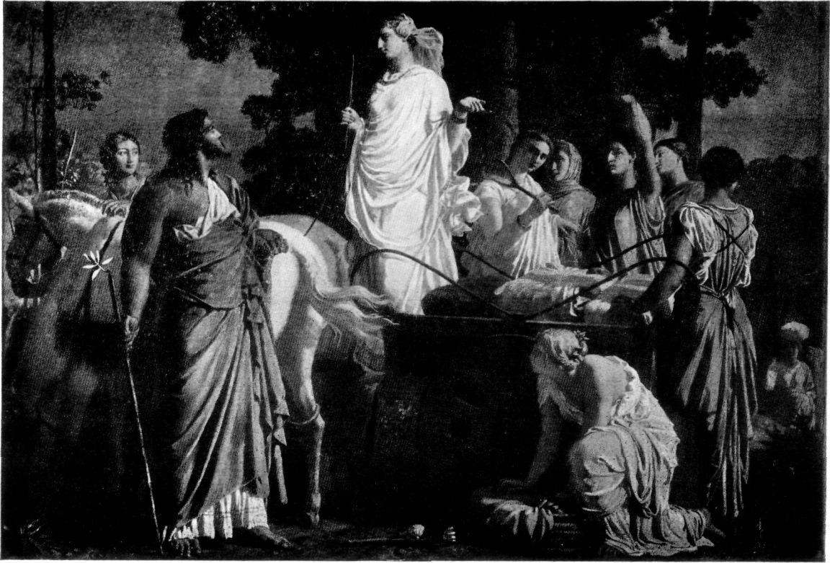
Classical Epic
The Iliad The Odyssey

Slide 20
Heroic Character
The “values of the civilization”
Brave
Noble
Leader

Slide 21
“He came into the room and addressed himself… with the best grace in the world. He was pretty tall, but of a shape the most exact that can be fancied. The most famous statuary could not form the figure of a man more admirably turned from head to foot.” (taken from page 2187)

Slide 22
“The royal youth appeared in spite of the slave, and people could not help treating him after a different manner, without designing it. As soon as they approached him, they venerated and esteemed him; his eyes insensibly commanded respect, and his behavior insinuated into every soul.”
(taken from page 2205)

Slide 23
Hero’s Journey
A vast setting covering many nations, the world or the universe

Slide 24
Other Characteristics
Opens by stating the theme or cause of the epic
Contains details of heroic deeds and events significant to a culture or nation

Slide 25
Code Of Virtue
Virtue- moral excellence; goodness; righteousness. conformity of one’s life and conduct to moral and ethical principles. chastity; virginity (Dictionary.com)
Imoinda
Oroonoko
White men

Slide 26
Imoinda
“This old dead hero had one only daughter….to describe her truly…in charming in her person as he, and of delicate virtues” (Behn 2188)
Virginity- Oroonoko took it
The king tried to take it
“Tis not to be imagined the satisfaction of these two young lovers; nor the vows she made him that she remained a spotless maid till that night, and that what she did with his grandfather had robbed him of no part of her virgin honor, the gods in mercy and justice having reserved that for her plighted lord, to whom of right it belonged”(Behn 2196)
She was down for whatever

Slide 27
Oroonoko
Honorable/Ethical/Noble
“The company laughed at his civility to a slave, and Caesar only applauded the nobleness of his passion and nature, since that slave might be noble or, what was better, have true notions of honor and virtue in her.”(Behn 2207)
He feels that killing himself and Imoinda is more ethical than being a slave
“And why,” said he, “my dear friends and fellow sufferers, should we be slaves to an unknown people? Have they vanquished us nobly in fight? Have they won us in honorable battle?”(Behn 2217)
He’s a badass warrior: Killed a tiger that no one else could kill

Slide 28
White Men
Aphra Behn stresses the lack of virtue from white men
“Such ill morals are only practiced in Christian countries, where they prefer the bare name of religion, and, without virtue or morality, think that’s sufficient.” (Behn 2188)
“Do you not hear every day how they upbraid each other with infamy of life, below the wildest savages; and shall we render obedience to such a degenerate race, who have no one human virtue left to distinguish ‘em from the vilest creatures?” (Behn 2217)

